Slide 1
Chapter 1
Introduction to Statistics and Data Analysis

Slide 2
Use of Statistics and Probability
Gathering of information or scientific data for meaningful use
Collection of scientific information vs Inferential statistics
To make scientific judgments in the face of uncertainty and variation
Copyright © 2010 Pearson Addison-Wesley. All rights reserved.
1 - <number>

Slide 3
Who uses Statistics and Probability
Automotive
Finance
Agriculture
Medicine
Health Care
Transportation
Etc..
Copyright © 2010 Pearson Addison-Wesley. All rights reserved.
1 - <number>

Slide 4
Section 1.1
Overview: Statistical Inference, Samples, Populations, and the Role of Probability

Slide 5
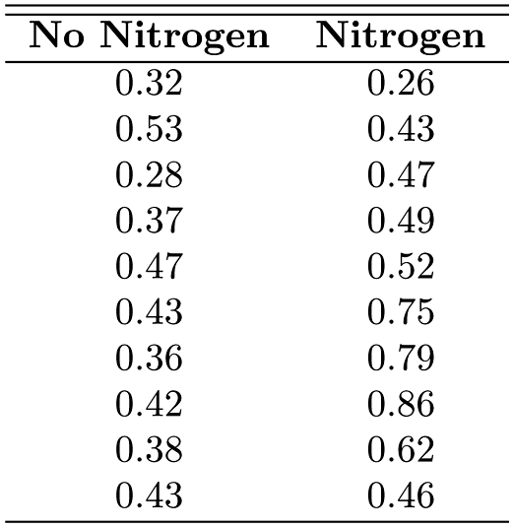
Table 1.1 Data Set for Example1.2
Copyright © 2010 Pearson Addison-Wesley. All rights reserved.
1 - <number>

Slide 6
Figure 1.1 A dot plot of stem weight data
O- with Nitrogen
X- With Nitrogen
Copyright © 2010 Pearson Addison-Wesley. All rights reserved.
1 - <number>

Slide 7
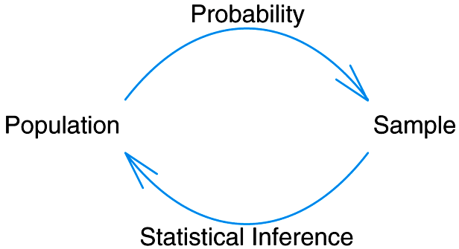
Figure 1.2 Fundamental relationship between probability and inferential statistics
Copyright © 2010 Pearson Addison-Wesley. All rights reserved.
1 - <number>

Slide 8
Section 1.2
Sampling Procedures; Collection of Data

Slide 9
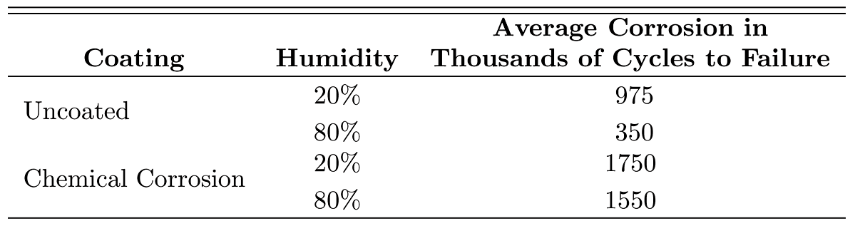
Table 1.2 Data Example 1.3
Copyright © 2010 Pearson Addison-Wesley. All rights reserved.
1 - <number>

Slide 10
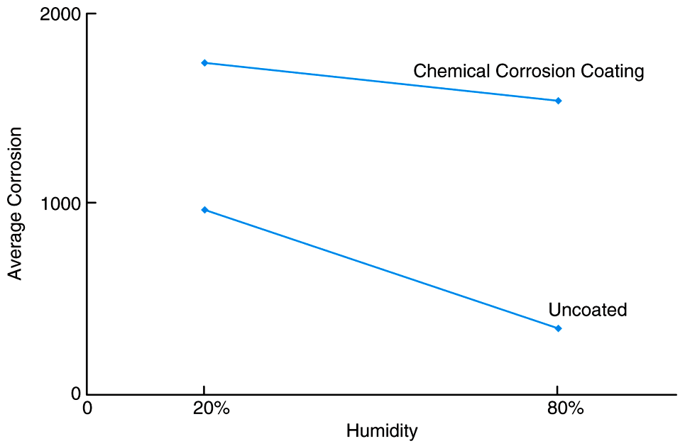
Figure 1.3 Corrosion results for Example 1.3
Copyright © 2010 Pearson Addison-Wesley. All rights reserved.
1 - <number>

Slide 11
Section 1.3
Measures of Location: The Sample Mean and Median

Slide 12
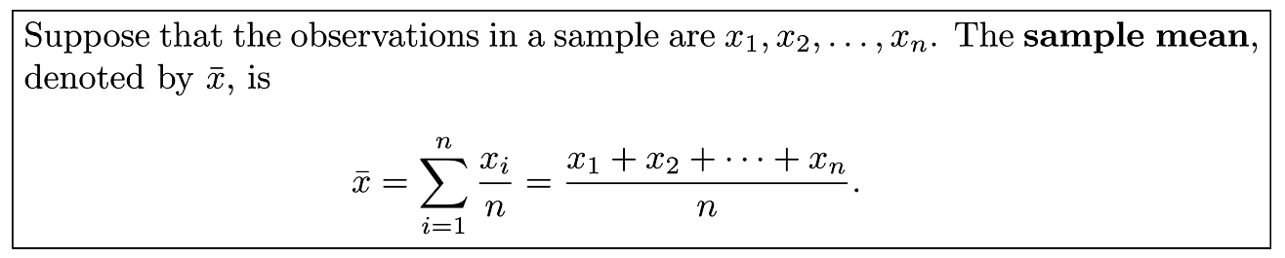
Definition 1.1
Copyright © 2010 Pearson Addison-Wesley. All rights reserved.
1 - <number>

Slide 13
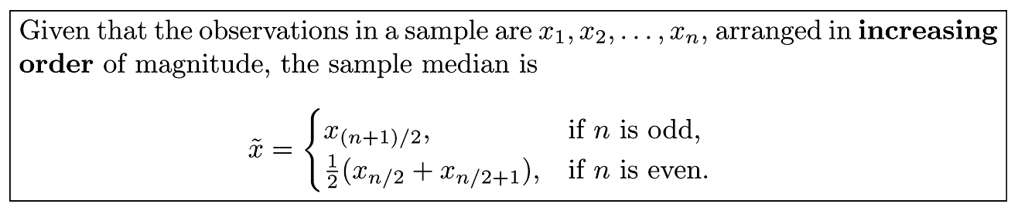
Definition 1.2
Copyright © 2010 Pearson Addison-Wesley. All rights reserved.
1 - <number>

Slide 14
Figure 1.4 Sample mean as a centroid of the with-nitrogen stem weight
Copyright © 2010 Pearson Addison-Wesley. All rights reserved.
1 - <number>

Slide 15
Section 1.4
Measures of Variability

Slide 16
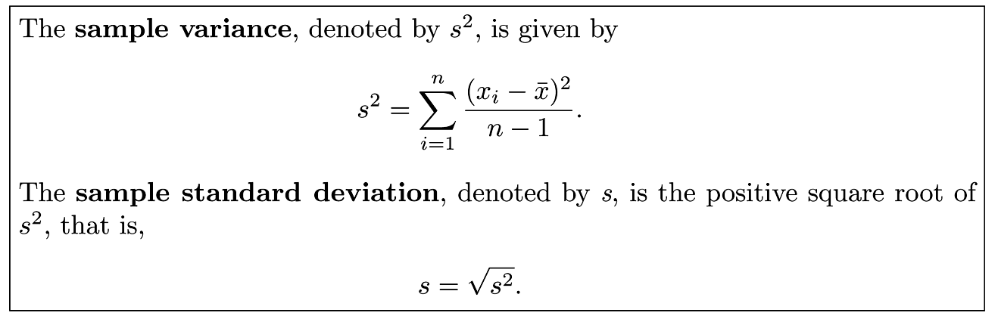
Definition 1.3
- Standard deviation is referred as variation in daily usage
Copyright © 2010 Pearson Addison-Wesley. All rights reserved.
1 - <number>

Slide 17
Section 1.5
Discrete and Continuous Data

Slide 18
Section 1.6
Statistical Modeling, Scientific, Inspection, and Graphical Diagnostics

Slide 19
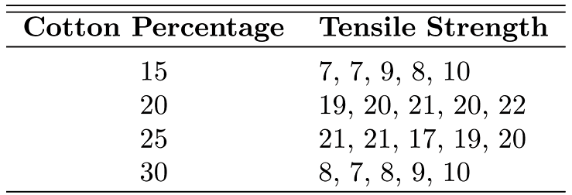
Table 1.3 Tensile strength
Copyright © 2010 Pearson Addison-Wesley. All rights reserved.
1 - <number>

Slide 20
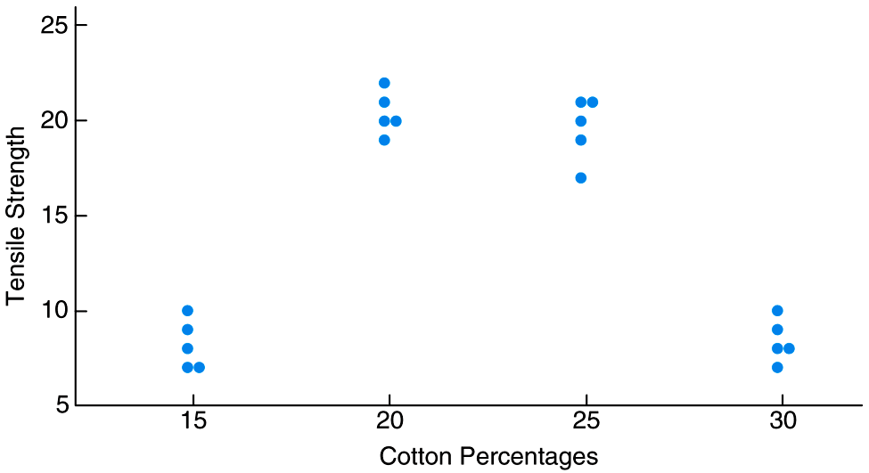
Figure 1.5 Scatter plot of tensile strength and cotton percentages
Copyright © 2010 Pearson Addison-Wesley. All rights reserved.
1 - <number>

Slide 21
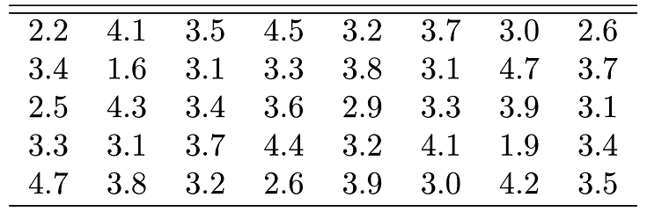
Table 1.4 Car Battery Life
Copyright © 2010 Pearson Addison-Wesley. All rights reserved.
1 - <number>

Slide 22
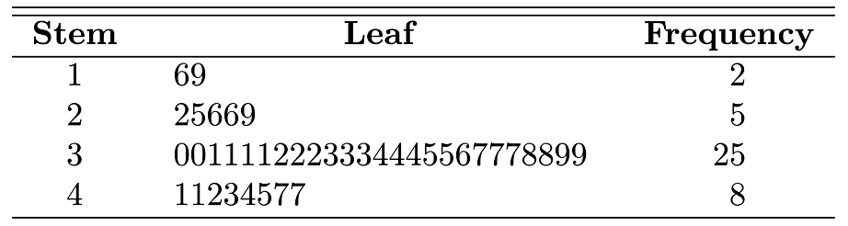
Table 1.5 Stem-and-Leaf Plot of Battery Life
Copyright © 2010 Pearson Addison-Wesley. All rights reserved.
1 - <number>

Slide 23
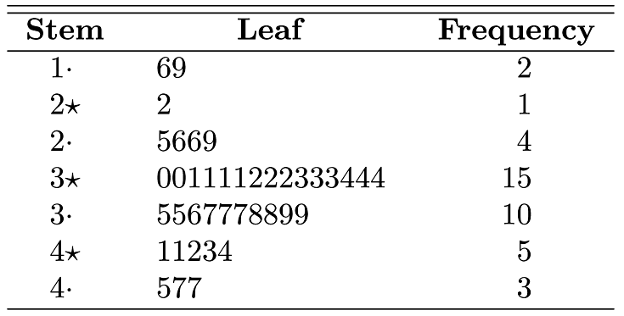
Table 1.6 Double-Stem-and-Leaf Plot of Battery Life
Copyright © 2010 Pearson Addison-Wesley. All rights reserved.
1 - <number>

Slide 24
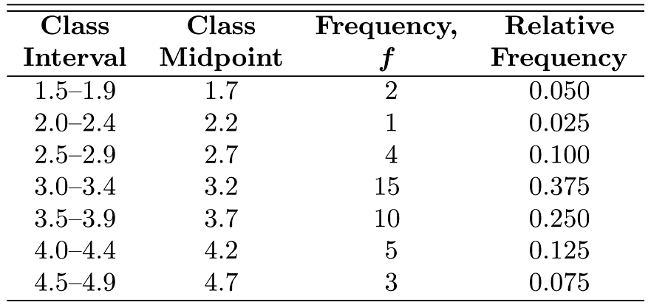
Table 1.7 Relative Frequency Distribution of Battery Life
Copyright © 2010 Pearson Addison-Wesley. All rights reserved.
1 - <number>

Slide 25
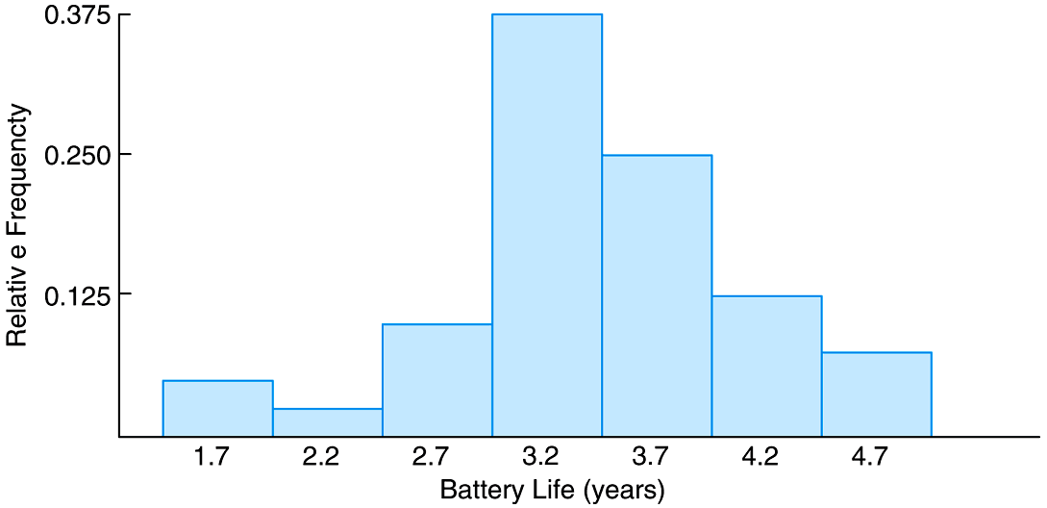
Figure 1.6 Relative frequency histogram
Copyright © 2010 Pearson Addison-Wesley. All rights reserved.
1 - <number>

Slide 26
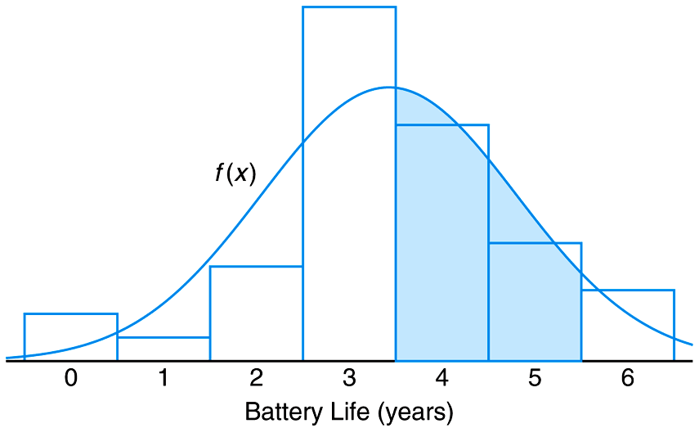
Figure 1.7 Estimating frequency distribution
Copyright © 2010 Pearson Addison-Wesley. All rights reserved.
1 - <number>

Slide 27
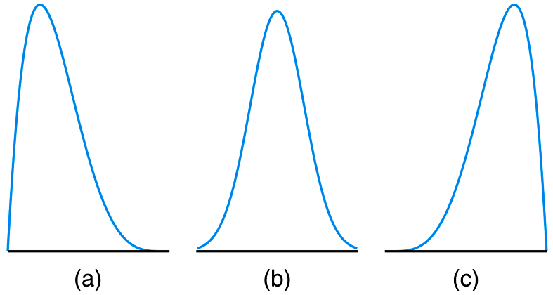
Figure 1.8 Skewness of data
Copyright © 2010 Pearson Addison-Wesley. All rights reserved.
1 - <number>

Slide 28
Box and Whiskers Plot
Graphically illustrating groups of data through their quartiles
Box plots also have extended lines (aka Whiskers) indicating variability outside the upper and lower quartiles
Outliers are shown as individual points
Copyright © 2010 Pearson Addison-Wesley. All rights reserved.
1 - <number>

Slide 29
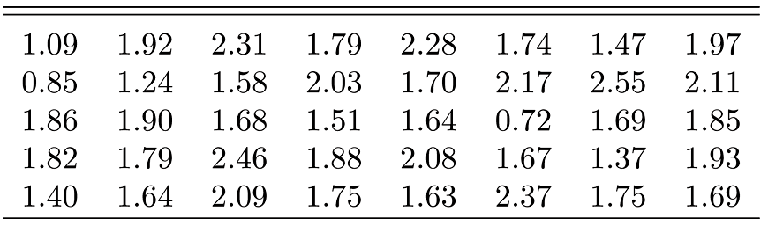
Table 1.8 Nicotine Data for Example 1.5
Copyright © 2010 Pearson Addison-Wesley. All rights reserved.
1 - <number>

Slide 30
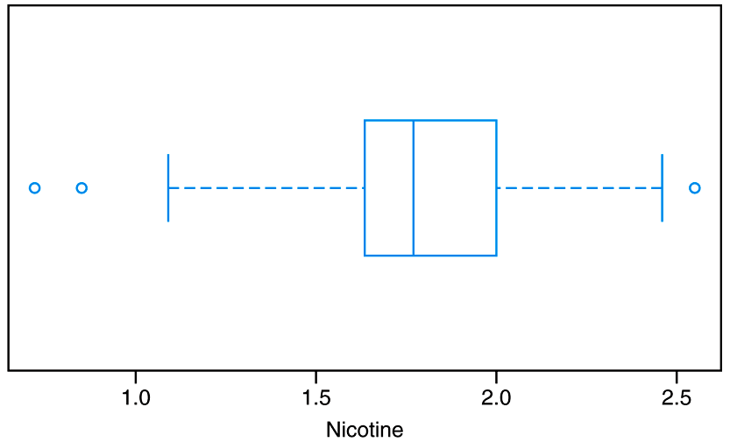
Figure 1.9 Box-and-whisker plot for Example 1.5
Outlier
2nd Quartile/Median
3rd Quartile
Extreme Outlier
1st Quartile
Outlier
Whisker Extends to smallest data point within 1.5 inter quartile ranges from 1st Quartile
Whisker Extends to largest data point within 1.5 inter quartile ranges from 3rd Quartile
Copyright © 2010 Pearson Addison-Wesley. All rights reserved.
1 - <number>

Slide 31
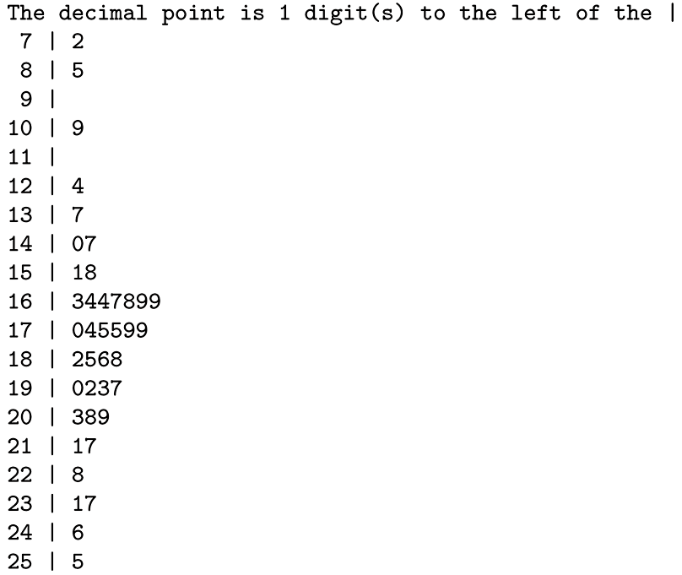
Figure 1.10 Stem-and-Leaf plot for the nicotine data
Copyright © 2010 Pearson Addison-Wesley. All rights reserved.
1 - <number>

Slide 32
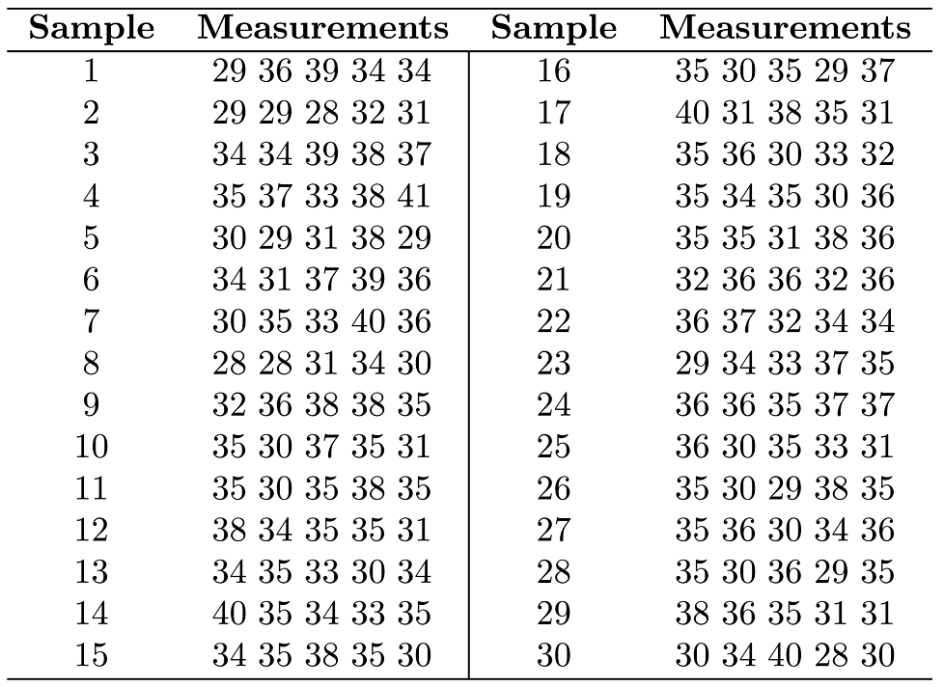
Table 1.9 Data for Example 1.6
Copyright © 2010 Pearson Addison-Wesley. All rights reserved.
1 - <number>

Slide 33
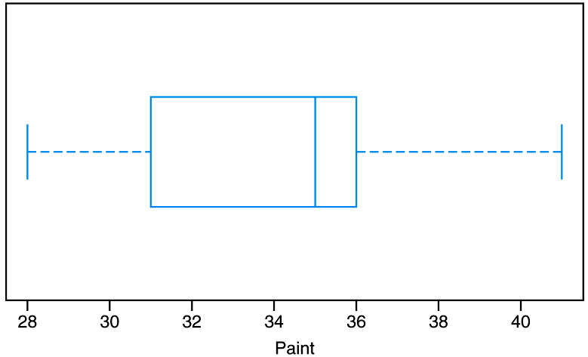
Figure 1.11 Box-and-whisker plot for thickness of paint can “ears”
Copyright © 2010 Pearson Addison-Wesley. All rights reserved.
1 - <number>

Slide 34
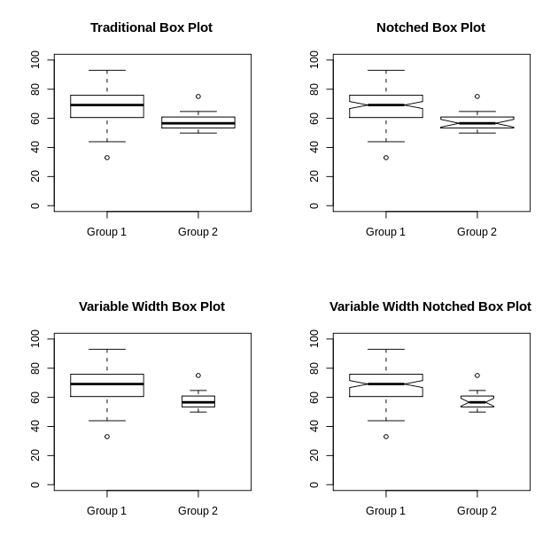
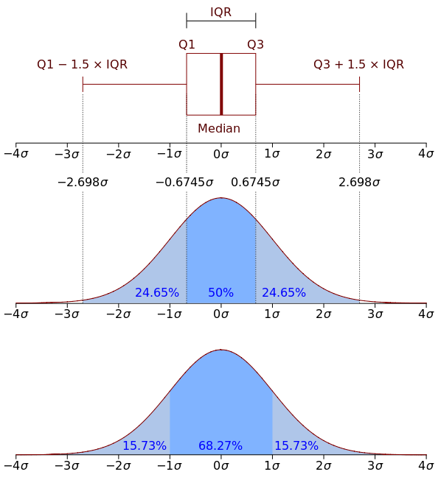
Box Plot Contd,,
Source: http://en.wikipedia.org/wiki/Box_plot
Copyright © 2010 Pearson Addison-Wesley. All rights reserved.
1 - <number>

Slide 35
Section 1.7
General Types of Statistical Studies: Designed Experiment, Observational Study, and Retrospective Study

