Slide 1
Wilcoxon Ranked Test and Mann-Whitney Test
Source: Business Statistics, 4e, by Ken Black. © 2003 John Wiley & Sons.

Slide 2
Wilcoxon Matched-Pairs Signed Rank Test
A nonparametric alternative to the t test for related samples
Before and After studies
Studies in which measures are taken on the same person or object under different conditions
Studies or twins or other relatives
Notes:
47

Slide 3
Wilcoxon Matched-Pairs Signed Rank Test
Differences of the scores of the two matched samples
Differences are ranked, ignoring the sign
Ranks are given the sign of the difference
Positive ranks are summed
Negative ranks are summed
T is the smaller sum of ranks

Slide 4
Wilcoxon Matched-Pairs Signed Rank Test: Sample Size Consideration
n is the number of matched pairs
If n > 15, T is approximately normally distributed, and a Z test is used.
If n ≤ 15, a special “small sample” procedure is followed.
The paired data are randomly selected.
The underlying distributions are symmetrical.

Slide 5
Wilcoxon Matched-Pairs Signed Rank Test: Small Sample Example
H₀: M_{d} = 0
H_{a}: M_{d} ≠ 0
n = 6
α =0.05
If T_{observed} ≤ 1, reject H_{0.}
Family
Pair
Pittsburgh
Oakland
1
1,950
1,760
2
1,840
1,870
3
2,015
1,810
4
1,580
1,660
5
1,790
1,340
6
1,925
1,765

Slide 6
Wilcoxon Matched-Pairs Signed Rank Test: Small Sample Example
Family
Pair
Pittsburgh
Oakland
d
Rank
1
1,950
1,760
190
+4
2
1,840
1,870
-30
-1
3
2,015
1,810
205
+5
4
1,580
1,660
-80
-2
5
1,790
1,340
450
+6
6
1,925
1,765
160
+3
T = minimum(T₊, T₋)
T₊ = 4 + 5 + 6 + 3= 18
T₋ = 1 + 2 = 3
T = 3
T = 3 > T_{crit} = 1, do not reject H₀
_{Tcal > Tcritcial} . Do not reject H₀

Slide 7
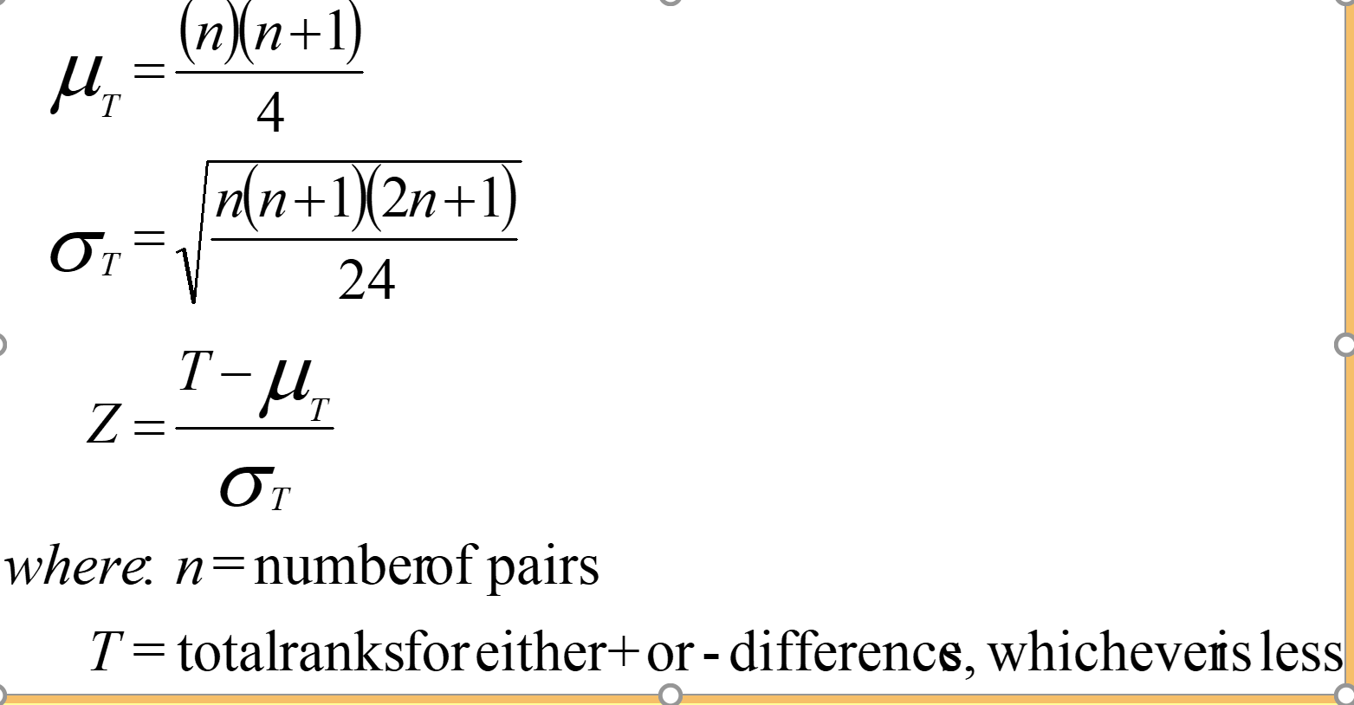
Wilcoxon Matched-Pairs Signed Rank Test: Large Sample Formulas
Notes:
52

Slide 8
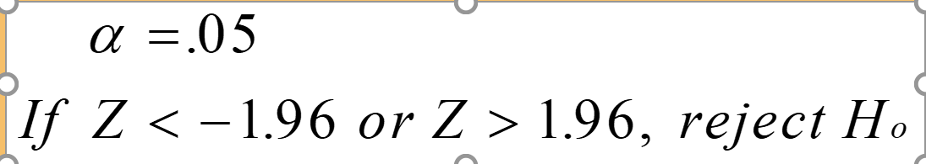
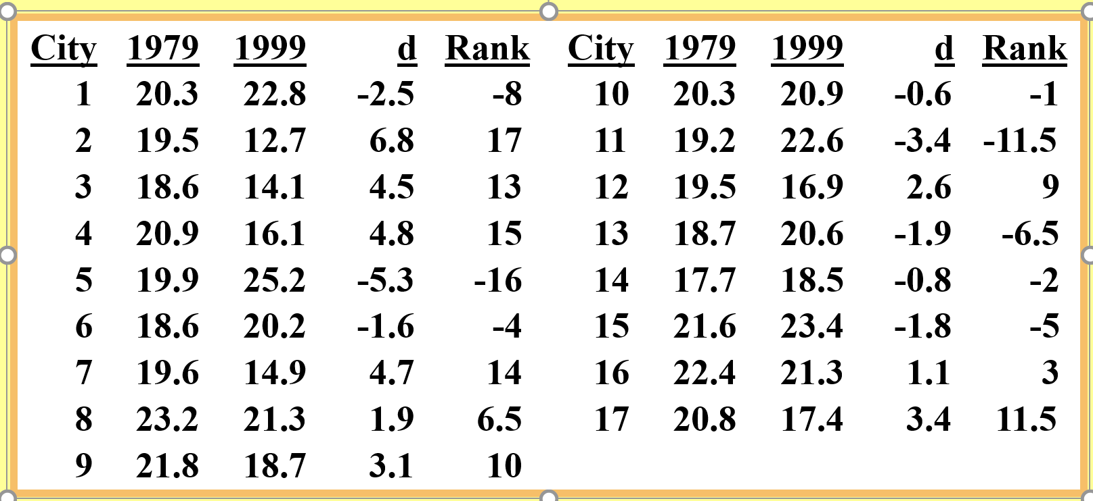
Airline Cost Data for 17 Cities, 1997 and 1999
H₀: M_{d} = 0
H_{a}: M_{d} ≠ 0
Notes:
53

Slide 9
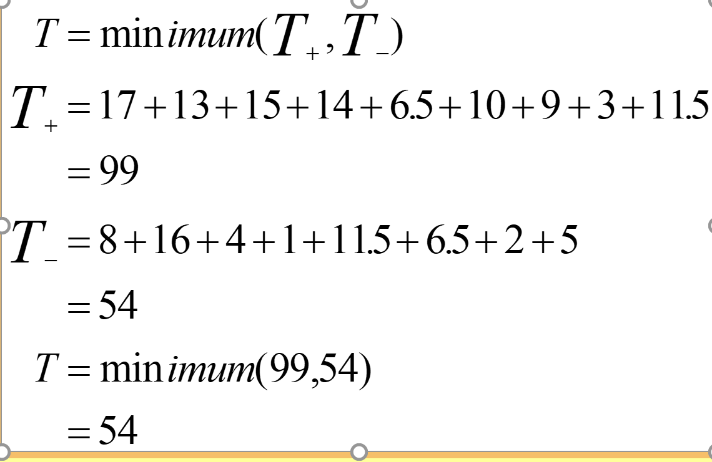
Airline Cost: T Calculation
Notes:
54

Slide 10
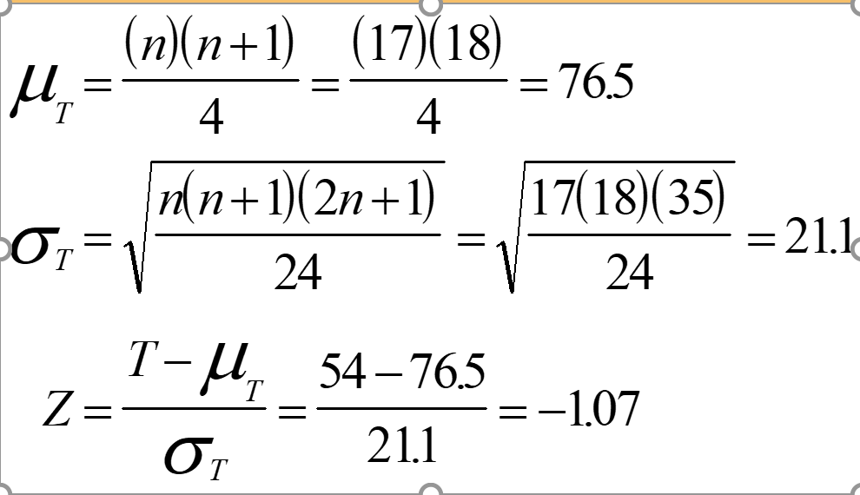
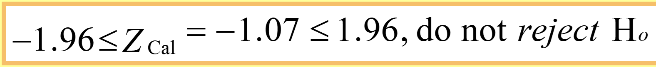
Airline Cost: Conclusion
Notes:
55

Slide 11
Mann-Whitney U Test
Nonparametric counterpart of the t test for independent samples
Does not require normally distributed populations
May be applied to ordinal data
Assumptions
Independent Samples
At Least Ordinal Data
Notes:
37

Slide 12
Mann-Whitney U Test: Sample Size Consideration
Size of sample one: n₁
Size of sample two: n₂
If both n₁ and n₂ are ≤ 10, the small sample procedure is appropriate.
If either n₁ or n₂ is greater than 10, the large sample procedure is appropriate.

Slide 13
Mann-Whitney U Test: Small Sample Example
Health
Educational
H₀: The health service population is identical to the educational service population on employee compensation
H_{a}: The health service population is not identical to the educational service population on employee compensation
Service
Service
20.10
26.19
19.80
23.88
22.36
25.50
18.75
21.64
21.90
24.85
22.96
25.30
20.75
24.12
23.45

Slide 14
Mann-Whitney U Test: Small Sample Example
α = .05
If the final p-value < .05, reject H₀.
W₁ = 1 + 2 + 3 + 4 + 6 + 7 + 8
= 31
W₂ = 5 + 9 + 10 + 11 + 12 + 13 + 14 + 15
= 89
Compensation
Rank
Group
18.75
1
H
19.80
2
H
20.10
3
H
20.75
4
H
21.64
5
E
21.90
6
H
22.36
7
H
22.96
8
H
23.45
9
E
23.88
10
E
24.12
11
E
24.85
12
E
25.30
13
E
25.50
14
E
26.19
15
E

Slide 15
Mann-Whitney U Test: Small Sample Example
Since U₂ < U₁, U = 3.
Ucritical from tables for (n1=8
And n2=8 at 0.05 )
Ucritical=10
Ucal < U critical . Reject Ho

Slide 16
Mann-Whitney U Test: Formulas for Large Sample Case
Notes:
42

Slide 17
Incomes of PBS and Non-PBS Viewers
PBS
Non-PBS
24,500
41,000
39,400
32,500
H_{o}: The incomes for PBS viewers and non-PBS viewers are identical
H_{a}: The incomes for PBS viewers and non-PBS viewers are not identical
36,800
33,000
44,300
21,000
57,960
40,500
32,000
32,400
61,000
16,000
34,000
21,500
43,500
39,500
55,000
27,600
n₁ = 14
39,000
43,500
62,500
51,900
n₂ = 13
61,400
27,800
53,000
Notes:
43

Slide 18
Ranks of Income from Combined Groups of PBS and Non-PBS Viewers
Income
Rank
Group
Income
Rank
Group
16,000
1
Non-PBS
39,500
15
Non-PBS
21,000
2
Non-PBS
40,500
16
Non-PBS
21,500
3
Non-PBS
41,000
17
Non-PBS
24,500
4
PBS
43,000
18
PBS
27,600
5
Non-PBS
43,500
19.5
PBS
27,800
6
Non-PBS
43,500
19.5
Non-PBS
32,000
7
PBS
51,900
21
Non-PBS
32,400
8
Non-PBS
53,000
22
PBS
32,500
9
Non-PBS
55,000
23
PBS
33,000
10
Non-PBS
57,960
24
PBS
34,000
11
PBS
61,000
25
PBS
36,800
12
PBS
61,400
26
PBS
39,000
13
PBS
62,500
27
PBS
39,400
14
PBS
Notes:
44

Slide 19
PBS and Non-PBS Viewers: Calculation of U
Notes:
45

Slide 20
PBS and Non-PBS Viewers: Conclusion
Notes:
46

