Slide 1

RETAIL BANKING TRANSACTION
ANALYSIS
Presented By – Mahesh
(2025 -2026)
In
Computer Science & Data Science

Slide 2
Meet Team
Mahesh Nasarla
Background : B.Tech
Experience: Fresher
LinkedIn:
https://www.linkedin.com/in/mahesh-nasarla-549935359
Manishankar Eadamala
Background: B.Tech
Experience: Fresher
LinkedIn:
https://www.linkedin.com/in/manishankar-edamala-59660a290
Karthik Koneni
Background:B.Tech
Experience:Fresher
LinkedIn:
https://www.linkedin.com/in/karthikkoneni

Slide 3
TABLE OF CONTENTS
Introduction
Why This Project
Dataset Information
Database & Tables Overview
Table Structure Explanation
ER Diagram / Relationships
Problem Statement
SQL Queries
Query Results / Outputs
Insights (Business Understanding)
Conclusion (Include Insights Summary, Recommendations, and Challenges Faced)

Slide 4
PROJECT OVERVIEW
The project Uses Retail Banking SQL Business Analytics is a MySQL-based data analytics project designed to analyze customer, account, transaction, loan, and card-related data of a retail bank.
The analysis covers five major business areas:
Customer Profile & Segmentation
Account Usage & Branch Activity
Transaction Patterns
Loan Performance & Repayment Behaviour
Card Usage & Product Engagement
Key Insight :
The project follows a structured process of database creation from the ER diagram, data import and verification, SQL-based analysis, business-question formulation, findings, insights, and recommendations

Slide 5
INTRODUCTION
Retail Banking generates large volume of transaction data every day .
Retail Bank Transaction Analysis focuses on analyzing customer banking transactions to understand spending,patterns,transactions behaviour and financial trends.
This project mainly uses SQL and data analytics techniques to examine deposits,withdrawls,transfers,transaction volumes and customer activity.
It helps identify high- value customers, unusual transactions,popular transactions.
Customer profiles and segmentation
Account usage and balances
Banking transactions
Branch performance
Loan portfolio and repayment behavior
Card usage and Customer banking-product adoption

Slide 6
WHY THIS PROJECT?
BUSINESS PROBLEM
Banks generate large volumes of customers,accounts,transactions,loan and card data.
This challenge is converting this raw data into useful business information.
BANK NEED TO UNDERSTAND
Customers
Who are the major customer segments?
Products
Which accounts , cards and loans are being used?
Transactions
How are customers moving money through the banking system?
Loans
Are customers repaying loans on time?
Branches
How does activity differ across brances?

Slide 7
PROJECT OBJECTIVES
Key Objectives
1.Customer Analytics
Analyze customer demographics and segmentation
2.Account Analytics
Understand account distribution and balances
3.Transaction Analytics
Identify transaction patterns
4.Branch Analytics
Evaluate branch performance
5.Loan Analytics
Analyze loan performance and repayment behavior
6.Card Analytics
Examine card usage
Identify customers with multiple banking products
Generate actionable business insights using SQL

Slide 8
DATASET & DATABASE OVERVIEW
Database : retail_banking analysis
Dataset Overview
The Dataset contains:
500 Customers – Bank customers their demography, financial and bank details.
700 Bank Accounts - Stores information about customer bank accounts
50 Branches - Stores information about different bank branches.
300 Loans – Stores information about loans taken by customers
600 Cards – Information about banking cards
5000 Transactions – Banking activities performed by customers
Database Overview :
These are main tables :
Customers
Accounts
Branches
Loans
Loan Payments
Cards
Transactions

Slide 9
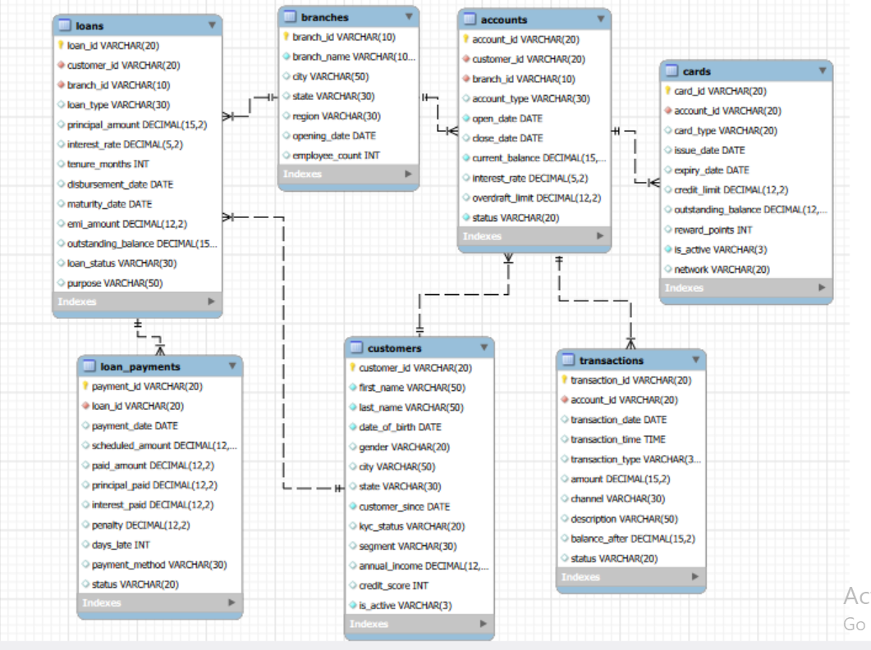
ER DIAGRAM & Database Structure
Key Relationships
Customers → Accounts
Branches → Accounts
Branches → Loans
Customers → Loans
Loans → Loan Payments
Accounts → Cards
Accounts → Transactions
Key Insight :
The ER model integrates customer, account, transaction, card, loan, branch, and repayment data relationships, enabling comprehensive analysis of customer behaviour and banking product engagement

Slide 10
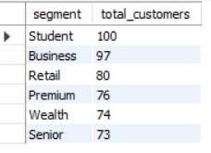

SQL QUERIES :
1. Customer Segment Analysis
Question : Which customer segment has the highest number of customers?
SQL Query :
SELECT segment, COUNT(customer_id) AS total_customers FROM customers GROUP BY segment
ORDER BY total_customers DESC;
Result
Student is the largest customer segment with 100 customers.
Business Insight
Students are the largest customer group. The bank can target them with digital banking, low-fee accounts, debit cards, and future loan products.
2. Branch Performance Analysis
Question : Which branch has the highest number of bank accounts?
SQL Query :
SELECT b.branch_id, b.branch_name, COUNT(a.account_id) AS total_accounts FROM branches b JOIN accounts a b.branch_id=a.branch_id
GROUP BY b.branch_id, b.branch_name ORDER BY total_accounts DESC LIMIT 1;
Result
Pittsburgh Branch has the highest number of accounts with 28 accounts.
Business Insight
The bank can study successful practices at this branch and apply them to other branches.

Slide 11
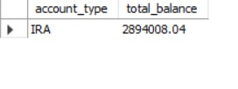

3. Account Performance Analysis
Question
Which account type has the highest total balance?
SQL Query : SELECT account_type, ROUND(SUM(current_balance), 2) AS total_balance FROM accounts GROUP BY account_type
ORDER BY total_balance DESC LIMIT 1;
Result
IRA accounts hold the highest total balance of 2,894,008.04.
Business Insight
IRA accounts are a major source of deposits and show the importance of retirement and long-term investment products.
4. Card Usage Analysis
Question
Which card type has the highest number of cards?
SQL Query
SELECT card_type, COUNT(card_id) AS total_cards
FROM cards
GROUP BY card_type
ORDER BY total_cards DESC
LIMIT 1;
Result
Debit cards are the most popular, with 374 cards.
Business Insight
The bank has an opportunity to cross-sell credit cards to eligible customers.

Slide 12

5. Transaction Analysis
Question : Which transaction channel is used most frequently?
SQL Query :
SELECT channel, COUNT(transaction_id) AS total_transactions
FROM transactions
GROUP BY channel
ORDER BY total_transactions DESC
LIMIT 1;
Result : Online banking is the most frequently used channel, with 1,470 transactions.
Business Insight
Customers strongly prefer digital banking, so the bank should continue investing in online platforms, mobile banking, security, and digital customer experience.
6. Loan Repayment & Risk Analysis
Question : How many loans have experienced at least one repayment delay?
SQL Query : SELECT COUNT(DISTINCT loan_id) AS delayed_loans FROM loan_payments
WHERE days_late > 0;
Result : 241 loans have experienced at least one delayed payment.
Business Insight
Delayed loans can become future defaults. The bank should use early-warning systems, reminders, auto-debit, and targeted collection strategies.

Slide 13
SQL ANALYTICS FRAMEWORK
How SQL Was Used : This is pipeline how the SQL Techniques has been implemented
1. SELECT
Retrieve required data
↓
2. WHERE
Filter relevant records
↓
3. JOINS
Combine banking tables
↓
4. GROUP BY
Create business-level summaries
↓
5. AGGREGATE
COUNT() • SUM() • AVG() • MAX()
↓
6. ORDER BY / LIMIT
Identify top-performing or highest-value records

Slide 14
Overall key Insights
1. Customers
Customer data helps the bank understand customer segments, demographics, income, credit scores, and activity status.
Customer information can be used to identify high-value and potentially inactive customer groups.
2. Accounts
Account data helps analyze account types, balances, interest rates, and account status.
Linking accounts with customers, branches, cards, and transactions enables complete account-level behaviour analysis.
3. Branches
Branch data allows the bank to compare customer and account activity across different branches and regions.
Branch-level analysis can help identify high-performing and low-performing branches

Slide 15
Overall Key Insights
4. Transactions
Transaction data helps identify popular transaction types, channels, amounts, and activity patterns over time.
Linking transactions to accounts helps analyze how transaction activity affects account balances.
5. Loans
Loan data helps evaluate loan types, purposes, outstanding balances, interest rates, and loan statuses.
Combining loans with customer and branch data supports analysis of loan performance across customers and branches.
6. Loan Payments
Payment data helps identify repayment delays, penalties, payment amounts, and payment methods.
Comparing scheduled and actual payments helps the bank understand customer repayment behaviour.
7. Cards
Card data helps analyze card types, networks, active/inactive cards, credit limits, and outstanding balances.
Reward points and card-account relationships help measure customer card engagement and broader product usage.

Slide 16
Bussiness Recommendation
Understand customers better – Use customer data to offer suitable products.
Increase product usage – Encourage customers to use more banking products like cards, loans, and
accounts.
Monitor transactions – Track transaction activity to identify important changes and patterns.
Improve loan repayment – Monitor late payments and penalties to reduce loan repayment problems.
Improve customer service – Use data insights to provide better services and make better business decisions.
The Overall recommendation bank should use customer and transaction data to improve services, increase product usage, and better understand customer needs. It should also monitor loan repayments and financial activity to reduce risks and make better business decisions.

Slide 17
Conclusion
This project helped the bank understand its customers, accounts, branches, transactions, loans, and cards using SQL analysis.
Customers: The bank can better understand customer segments, income, credit scores, and activity.
Accounts: Account balances, account types, and usage can be compared to understand customer banking needs.
Branches: Branch activity and account balances can be compared to identify strong and weak-performing branches.
Loans: Loan amounts, outstanding balances, repayment delays, and penalties can be monitored to improve loan performance.
Overall: The analysis helps the bank understand customer behaviour, reduce financial risks, improve services, and make better business decisions.

Slide 18

THANK YOU

