Slide 1

PROJECT ON
SWIFTCART ONLINE RETAIL
ANALYSIS
Exploratory Data Analysis & Visualization
Presented by — Mahesh Nasarla
Computer Science & Data Science
2026
Notes:
Hello, I'm Mahesh. This presentation is about my SwiftCart Online Retail Analysis project. I used Python to explore the cleaned retail dataset, understand customer and product patterns, and turn the results into practical business recommendations.

Slide 2
TABLE OF CONTENTS
➢ Introduction and project overview
➢ Why this project? — business problem
➢ Project objectives
➢ Dataset overview
➢ Data preparation and cleaning
➢ Descriptive analysis
➢ Customer analysis
➢ Product analysis
➢ Sales analysis
➢ Order analysis
➢ Group-based analysis
➢ Pivot table analysis
➢ Crosstab and relationship analysis
➢ Visualization report
➢ Business insights and recommendations
➢ Conclusion
Notes:
I'll start with the business problem and the dataset, then explain how I prepared it. After that, I'll walk through each Sprint 2 analysis area, show the key charts and outputs, and finish with recommendations.

Slide 3
INTRODUCTION
SwiftCart is an online retail business that sells products to customers across different cities and states in India. The business generates data related to customers, products, orders, sales, order status, shopping channels, and delivery locations.
The main purpose of this project is to understand how the business is performing by analyzing this data. I started by exploring and cleaning the dataset using Python, then performed Exploratory Data Analysis (EDA) to identify useful patterns and trends.
The analysis focuses on customer purchasing behavior, product performance, sales trends, order patterns, channel performance, and regional demand. By studying these areas, the project aims to turn raw data into useful business insights that can support better decisions.

Slide 4
PROJECT OVERVIEW
This project focuses on analyzing SwiftCart's online retail data to understand how the business is performing and where improvements can be made.
The dataset contains 31,047 records and 21 columns, covering customer details, products, orders, sales amounts, shopping channels, and delivery locations.
I used Python and its data analysis libraries, including Pandas, NumPy, Matplotlib, and Seaborn, to explore and prepare the data, perform EDA, analyze different business areas, and create visualizations.
The project covers five major areas:
Customer Analysis: Understanding customer demographics and purchasing patterns.
Product Analysis: Identifying popular categories, size preferences, and product performance.
Sales Analysis: Comparing recorded sales amounts and monthly trends.
Order Analysis: Examining order quantities, status, returns, cancellations, and refunds.
Channel & Geographic Analysis: Comparing shopping platforms, cities, and states.
The final goal is to understand the patterns hidden in the data and turn them into practical recommendations that can help SwiftCart improve its sales, product planning, and customer experience.
Notes:
This project looks at SwiftCart from a business point of view. I first understood the data, cleaned the fields that needed attention, and then explored customer, product, sales, order, channel and location patterns. The final step was to explain what those patterns could mean for the business.

Slide 5
WHY THIS PROJECT?
BUSINESS PROBLEM
Online retail businesses generate large amounts of data every day through customer purchases, product sales, orders, and different shopping channels. However, having data alone is not enough.
Businesses need to understand what is happening and where they can improve.
I chose this project to understand how data analysis can help an online retail business make better decisions.
.
QUESTIONS THE ANALYSIS CAN ANSWER
➢ Who appears most often in the customer records?
➢ Which product categories contribute the most recorded amount?
➢ Which channels and regions have the highest activity?
➢ When are recorded sales stronger or weaker?
➢ Which categories show higher return or cancellation rates?
Notes:
The challenge is turning thousands of records into information that a business team can use. Instead of checking individual records, I used summaries and visualizations to answer practical questions about products, sales, customers and order outcomes.

Slide 6
PROJECT OBJECTIVES
1. Customer Analysis
2. Product Analysis
Understand customer demographics, segments and purchase patterns.
Compare categories, sizes, demand and high-frequency SKUs.
3. Sales Analysis
4. Order Analysis
Study recorded amount by channel, category, state and month.
Compare delivered, returned, cancelled and refunded records.
5. Group and Relationship Analysis
6. Visualization and Storytelling
Compare multiple business dimensions using groupby, pivots and crosstabs.
Use charts to explain findings and support business decisions.
Notes:
I divided the work into six main objectives. The analysis covers customer behaviour, products, sales, order outcomes, relationships between business dimensions, and finally visual storytelling so the findings are easy to understand.

Slide 7
DATASET OVERVIEW
31,047
21
5,287
28,394
Records
Columns
Unique SKUs
Unique customer IDs
INFORMATION AVAILABLE
DATASET SNAPSHOT
➢ Customer: gender, age, age group and customer ID
➢ Product: SKU, category and size
➢ Sales: quantity, currency and amount
➢ Order: date, month and status
➢ Location and channel: city, state, postal code and platform
➢ Business domain: E-commerce / online retail
➢ Currency: INR across all 31,047 records
➢ Available dates: 4 January to 6 December 2022
➢ B2B and non-B2B records are both present
Notes:
The cleaned dataset has 31,047 rows and 21 columns. It has 5,287 different SKUs and 28,394 non-missing customer IDs. The data covers 2022 and includes product, customer, sales, order, channel and shipping information. I use the word records because each row should not automatically be treated as a separate unique order.

Slide 8
DATA PREPARATION & CLEANING
1. Inspect
2. Standardize
3. Correct
4. Validate
Checked shape, columns, data types and missing values.
Standardized column names and text labels.
Converted dates, handled invalid ages and checked postal codes.
Checked numeric ranges, duplicates and category values.
FINAL DATA QUALITY CHECKS
MISSING VALUES REMAIN IN
Check | Result
Final dataset size | 31,047 × 21
Exact duplicate rows | 0
Remaining missing cells | 2,084
Age after correction | 18–78 years
Quantity range | 1–20
Amount range | ₹229–₹3,036
➢ order_id: 1,080
➢ customer_id: 41
➢ date: 488
➢ month: 465
➢ ship_postal_code: 10
Potential outliers were reviewed and retained when they were not confirmed data errors.
Notes:
I standardized names and text labels, converted date columns, corrected age values above 100, and checked postal codes. The final dataset has no exact duplicate rows. There are still 2,084 missing cells across five columns, so I kept those gaps visible rather than inventing values. Potential outliers were not removed just because they were statistically unusual.

Slide 9
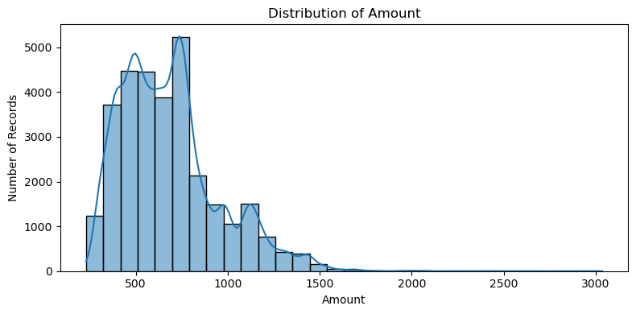
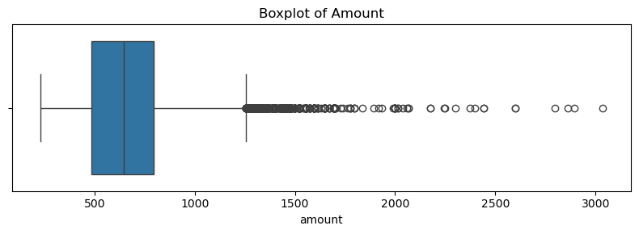
DESCRIPTIVE ANALYSIS
Variable | Average | Median | Range
Age | 39.39 years | 37 years | 18–78
Quantity | 1.01 units | 1 unit | 1–20
Amount | ₹682.07 | ₹646 | ₹229–₹3,036
Transaction Amount: The average transaction amount is ₹682, while the typical transaction value (median) is ₹646.
Purchase Quantity: Customers usually purchase one item per record, with an average quantity of 1.01.
Customer Age: The average customer age is 39 years, with customers ranging from 18 to 78 years.
Transaction Distribution: Most transaction amounts are in the lower-to-middle range, while a few high-value transactions increase the overall average.
The middle 50% of amounts fall between ₹486 and ₹794.
Transaction amounts are right-skewed. Most records fall within a moderate spending range, while a small number of high-value transactions increase the average.
Notes:
The average amount is about 682 rupees, while the median is 646. Since the mean is higher than the median and the skewness is positive, some higher-value records are pulling the average upward. Most quantities are one unit, even though a small number of records contain more items.

Slide 10
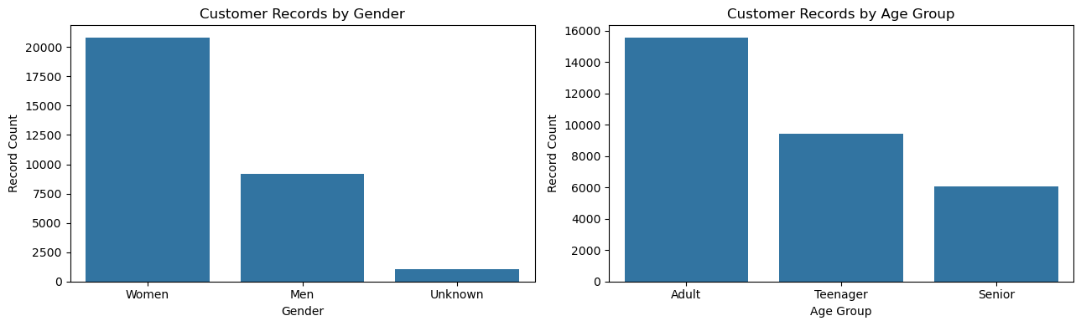
CUSTOMER ANALYSIS
Group | Records | Share
Women | 20,813 | 67.04%
Men | 9,159 | 29.50%
Unknown | 1,075 | 3.46%
Adults | 15,560 | 50.12%
Teenagers | 9,407 | 30.30%
Seniors | 6,080 | 19.58%
PURCHASE PATTERNS
➢ Women contribute ₹13.08M in total recorded amount.
➢ Men have the highest average recorded amount: ₹800.75.
➢ Adult customers contribute the highest total amount: ₹10.62M.
WHERE RECORDS COME FROM
➢ Top states: Maharashtra and Karnataka.
➢ Top cities: Bengaluru and Hyderabad.
➢ B2B accounts for only 0.6% of records.
Overall Interpretation
The customer analysis shows that women and adults make up the largest groups in the dataset. Men have a higher average recorded amount per record, even though women contribute more records. Maharashtra and Karnataka lead in geographic activity, while Bengaluru and Hyderabad are the top cities.
Notes:
Women make up about two-thirds of the records and contribute the highest total recorded amount. Men have a higher average amount per record, while average amounts across age groups are very close. Maharashtra and Karnataka lead by record count, and Bengaluru and Hyderabad are the top cities in the dataset.

Slide 11
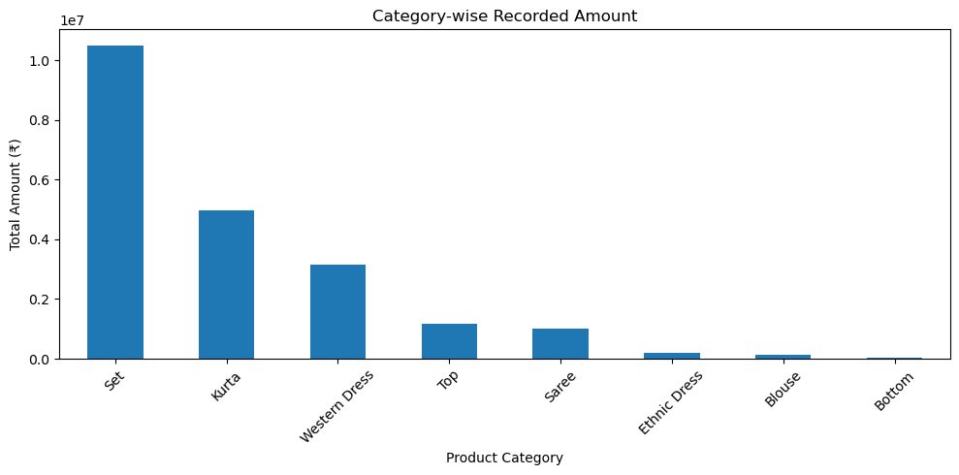
PRODUCT ANALYSIS
Category | Records | Recorded amount
Set | 12,391 | ₹10.51M
Kurta | 10,446 | ₹4.96M
Western Dress | 4,066 | ₹3.15M
Top | 2,193 | ₹1.19M
Saree | 1,380 | ₹1.01M
Bottom | 78 | ₹0.03M
SIZE AND SKU PATTERNS
WHAT THIS SUGGESTS
➢ M and L are the most frequent sizes overall.
➢ Sets and Kurtas have broad size ranges.
➢ Sarees are recorded as Free size.
➢ Sets and Kurtas lead in record count and recorded amount.
➢ JNE3797-KR-L is the most frequent SKU (273 records).
Overall Interpretation
The product analysis shows that Sets and Kurtas contribute the most to recorded amounts, while M, L, and XL are the most frequently recorded sizes. Bottom has low recorded activity and a higher return rate, while Western Dress also has a noticeable return and refund rate.
Notes:
Sets are the strongest category in both record count and recorded amount. Kurtas are second, and Western Dresses are third. M and L are common sizes, especially in Sets and Kurtas. The most frequent SKU in the dataset is JNE3797-KR-L, with 273 records.

Slide 12
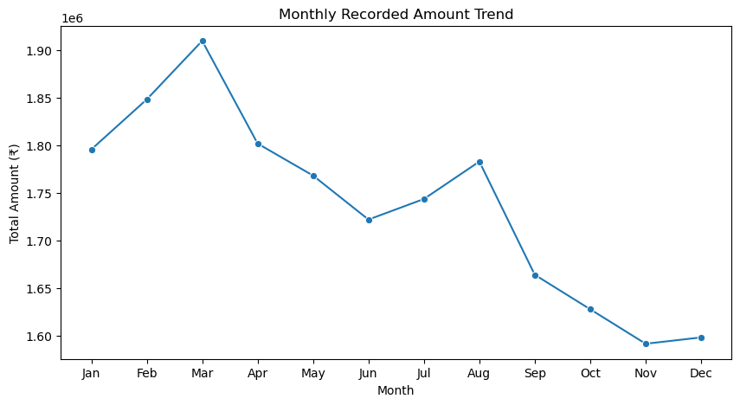
SALES ANALYSIS
Channel | Recorded amount
Amazon | ₹7.52M
Myntra | ₹4.94M
Flipkart | ₹4.57M
Ajio | ₹1.33M
Nalli | ₹1.02M
Meesho | ₹0.93M
Amazon leads by a clear margin. March is the strongest month (₹1.91M), while November is the weakest (₹1.59M).
Monthly Sales Performance: March recorded the highest sales amount (₹19.09 lakh), while November recorded the lowest (₹15.92 lakh), showing that sales vary across months.
Sales Distribution: Transaction amounts range from ₹229 to ₹3,036. Most transactions fall within a moderate spending range, while a few high-value transactions increase the average.
Overall Interpretation
The sales analysis shows that SwiftCart recorded approximately ₹2.12 crore across the dataset. March was the strongest month, while November was the weakest. Most recorded amounts are concentrated in a moderate range, with a few higher-value transactions increasing the average.
Notes:
The dataset contains about 21.18 million rupees in recorded amounts. Amazon contributes the largest share among the channels, followed by Myntra and Flipkart. Looking at months, March is the strongest and November is the weakest. These are recorded amounts from the dataset, not verified profit.

Slide 13
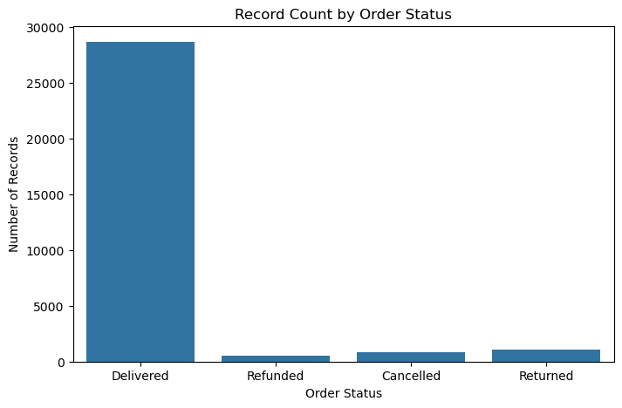
ORDER ANALYSIS
Status | Records | Share
Delivered | 28,641 | 92.25%
Returned | 1,045 | 3.37%
Cancelled | 844 | 2.72%
Refunded | 517 | 1.67%
Order Status: 92.25% of records are delivered, while 3.37% are returned, 2.72% cancelled, and 1.67% refunded.
Quantity Analysis: A total of 31,418 items are recorded, with an average of 1.01 items per record. Most records contain one item.
Order ID Analysis: The dataset contains 27,555 unique order IDs, with 1,080 missing order IDs. One order ID appears in a maximum of 12 records.
Order Performance: Most records result in successful deliveries, but returns, cancellations, and refunds still create opportunities to improve the customer experience.
Overall Interpretation
The order analysis shows that most SwiftCart records are delivered successfully and customers generally purchase one item per record. However, returns, cancellations, and refunds represent areas where the business can improve the overall shopping and order experience.
Notes:
More than 92 percent of records are marked delivered. Bottom stands out with the highest return and cancellation percentages. Western Dress has the highest refund percentage and also a high return percentage. These categories are good places to start when investigating order problems.

Slide 14
GROUP-BASED ANALYSIS
Grouped by | Leading group | Records | Recorded amount
Category | Set | 12,391 | ₹10.51M
Gender | Women | 20,813 | ₹13.08M
Age group | Adult | 15,560 | ₹10.62M
Channel | Amazon | 11,016 | ₹7.52M
State | Maharashtra | 4,519 | ₹2.99M
Status | Delivered | 28,641 | ₹19.71M
Category-wise: Sets lead with ₹1.05 crore, followed by Kurtas at ₹49.59 lakh.
Gender-wise: Women contribute the highest recorded amount (₹1.31 crore), while men have a higher average amount (₹800.75).
Channel-wise: Amazon leads with ₹75.20 lakh in recorded amount, followed by Myntra and Flipkart.
State-wise: Maharashtra leads with ₹29.90 lakh, followed by Karnataka (₹26.46 lakh).
Status-wise: Delivered records contribute the highest recorded amount at ₹1.97 crore.
Age Group-wise: Adults contribute the highest recorded amount (₹1.06 crore), mainly due to their larger number of records.
Overall Interpretation
The group-based analysis shows that recorded amounts differ across product categories, customer groups, channels, states, and order statuses. Sets and Kurtas lead among product categories, Amazon leads among channels, and Maharashtra leads among states. These comparisons help identify the areas that contribute most to SwiftCart's recorded sales value and the areas that may need more attention.
16
Notes:
Group-based analysis allowed me to compare the same measures across different categories, customer groups, channels, states and statuses. For example, the largest group by record count is women, while Sets lead by category and Amazon leads by channel.

Slide 15
PIVOT TABLE ANALYSIS
Month | Amount | Quantity
Jan | ₹1.80M | 2,680
Feb | ₹1.85M | 2,743
Mar | ₹1.91M | 2,845
Apr | ₹1.80M | 2,681
May | ₹1.77M | 2,614
Jun | ₹1.72M | 2,600
Jul | ₹1.74M | 2,553
Aug | ₹1.78M | 2,601
Sep | ₹1.66M | 2,500
Oct | ₹1.63M | 2,403
Nov | ₹1.59M | 2,374
Dec | ₹1.60M | 2,357
OTHER PIVOT COMPARISONS
Category-wise: Sets lead with ₹1.05 crore, followed by Kurtas at ₹49.59 lakh.
Customer-wise: Adult women contribute the highest recorded amount (₹65.30 lakh).
Monthly Sales: March has the highest recorded amount (₹19.09 lakh), while November has the lowest (₹15.92 lakh).
Order Status: December has the highest returns (124), while November has the highest cancellations (80) and refunds (68).
State-wise: Maharashtra leads with ₹29.90 lakh, followed by Karnataka at ₹26.46 lakh.
Channel-wise: Amazon has the highest number of records across all order statuses, including delivered, returned, cancelled, and refunded.
Overall Interpretation:
The pivot table analysis provides a combined view of SwiftCart's product, customer, monthly, geographic, and channel performance. It highlights the major contributors to recorded sales value and helps identify months and channels where order-related issues deserve attention.
Notes:
The monthly pivot table compares both amount and quantity. March is the highest month for both measures, while November is the lowest by recorded amount. I also used pivots to compare customer groups, channels and order statuses together.

Slide 16
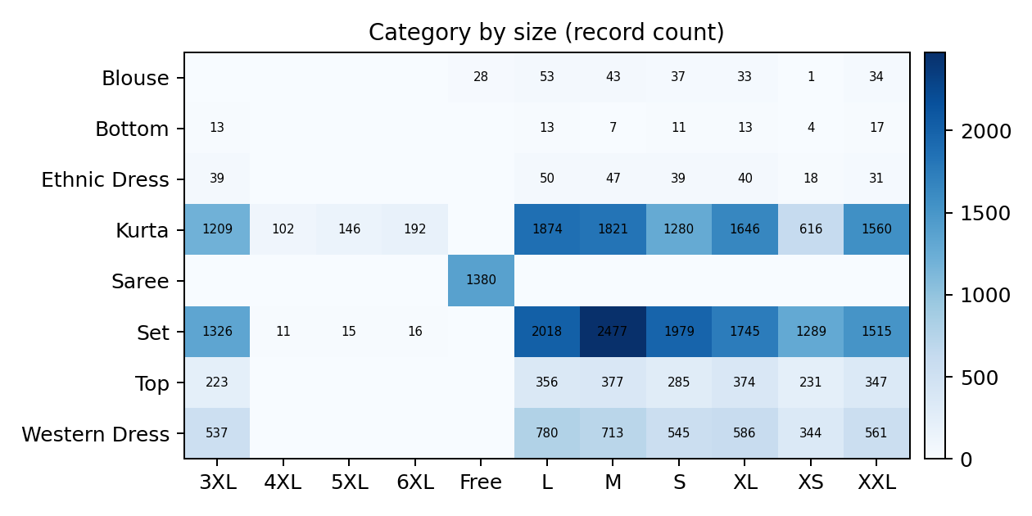
CROSSTAB ANALYSIS
CATEGORY × SIZE
Category vs Size: M and L are frequently recorded sizes for Sets and Kurtas, while Sarees are available only in Free Size.
Gender vs B2B: Women have the highest record count in both B2B and non-B2B groups.
Order Status vs B2B: Delivered records dominate both B2B (177) and non-B2B (28,464) groups.
Channel vs Gender: Women contribute the highest record count across all shopping channels, especially Amazon (7,341).
State vs Channel: Amazon has the highest record count in several states, including Delhi (633) and Andhra Pradesh (474).
Age Group vs Gender: Women contribute the highest recorded amount in every age group, with Adult women leading at ₹65.30 lakh.
Notes:
Crosstabs show percentages or counts across two categorical variables. The category-status table highlights Bottom and Western Dress for follow-up. The category-size table shows where sizes are concentrated. The numerical correlation between quantity and amount is only 0.054, which is a very weak positive relationship.

Slide 17
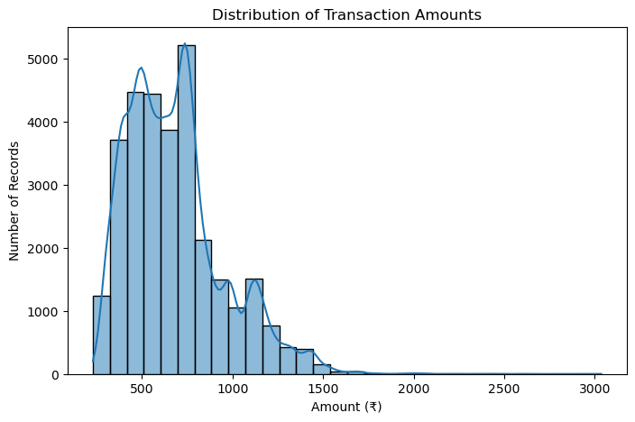
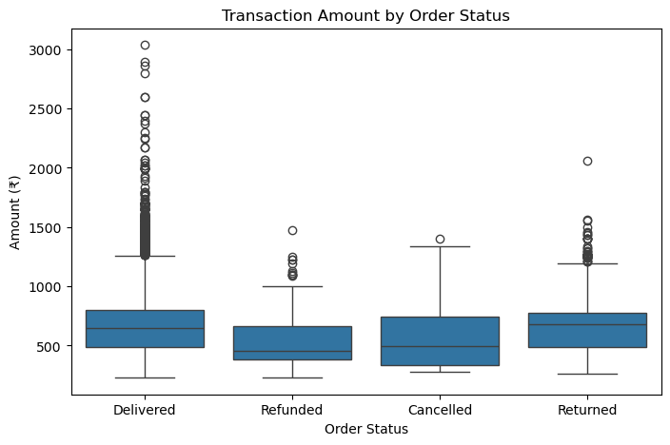
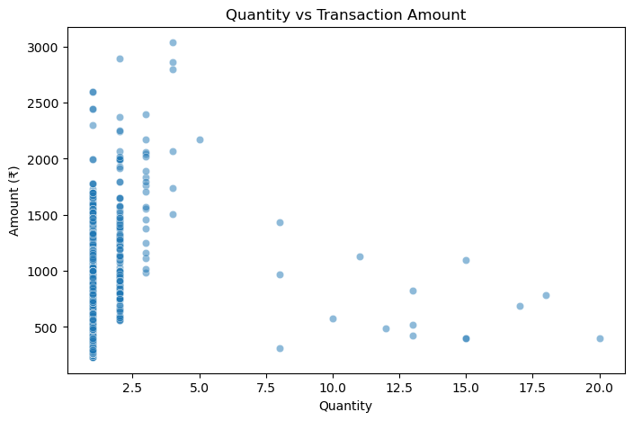
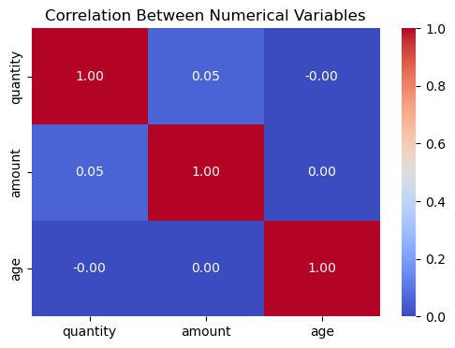
VISUAL STORYTELLING — TRANSACTION PATTERNS
These four charts help explain typical transaction values, order outcomes and the limits of simple numerical relationships.
1. Transaction amount distribution
2. Transaction amount by order status
Observation: Most records fall around ₹300–₹1,200; only a small number reach much higher amounts.
Interpretation: The distribution is right-skewed, so a few high-value records pull the average above the median.
Business decision: Test add-on or bundle offers around common spending levels, and study what drives high-value baskets.
Observation: Median amounts are about ₹650 for Delivered, ₹680 Returned, ₹499 Cancelled and ₹459 Refunded.
Interpretation: Returned records have a typical amount close to delivered records; cancelled and refunded medians are lower.
Business decision: Review return reasons and higher-value returned transactions before changing return policies.
3. Quantity vs transaction amount
4. Correlation between numerical variables
Observation: Most records show 1–4 items, but amounts vary widely; the correlation is only 0.054.
Interpretation: Quantity by itself does not explain how much a customer spends.
Business decision: Design offers around product price and category combinations, not just the number of items.
Observation: Quantity and amount correlate at about 0.05; age has almost zero correlation with both.
Interpretation: These variables show little linear relationship in this dataset.
Business decision: Do not estimate spending from age or quantity alone; also consider category, SKU, channel and purchase history.
Notes:
The charts were selected based on the question being asked. The histogram shows the shape of transaction amounts, the box plot compares amounts by status, the scatter plot checks the relationship between quantity and amount, and the heatmap summarizes numerical correlations.

Slide 18
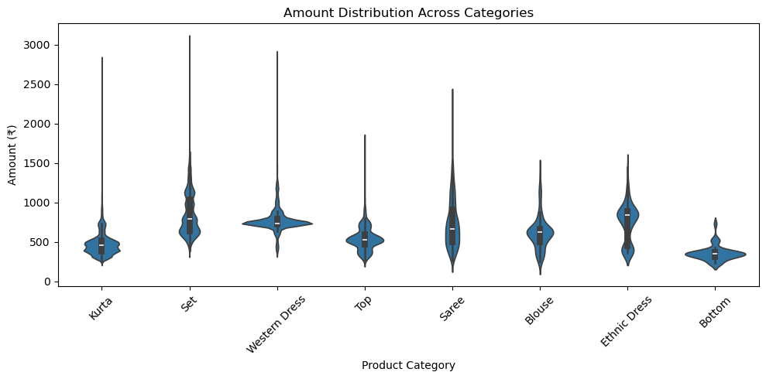
VISUAL STORYTELLING — PRODUCT, TIME & ORDER PATTERNS
The next four charts show where recorded sales value is concentrated and which areas are worth investigating.
5. Category-wise recorded amount
6. Monthly recorded amount trend
Observation: Sets contribute ₹10.51M, Kurtas ₹4.96M and Western Dresses ₹3.15M; Bottom is lowest at ₹27.8K.
Interpretation: Recorded value is concentrated in Sets and Kurtas.
Business decision: Prioritise replenishment for strong categories; test promotions for Bottom before increasing its stock.
Observation: March is highest at ₹1.91M; November is lowest at ₹1.59M. Amounts fall from August to November.
Interpretation: Recorded sales value weakened toward the later months of the year.
Business decision: Review the products and campaigns behind March, then test targeted offers in November.
7. Record count by order status
8. Amount distribution across categories
Observation: There are 28,641 Delivered records, 1,045 Returned, 844 Cancelled and 517 Refunded.
Interpretation: Most records are delivered, but returns, cancellations and refunds still affect a share of activity.
Business decision: Track these outcomes by product and channel, then address the most common reasons for returns and cancellations.
Observation: Amount ranges differ by category; Sets and Western Dresses show broad spreads, while Bottom is concentrated at lower values.
Interpretation: A category total does not show how transaction values vary among individual products.
Business decision: Review SKU-level price and sales mix before changing prices or expanding a category.
Note: Counts refer to dataset records, not unique orders. Amounts are not verified profit. necessarily
Notes:
This slide brings together four more views. The category chart shows where recorded amounts are concentrated. The monthly line chart shows how the amount changes over the year. The count plot makes the difference in order outcomes easy to see, and the violin plot compares amount distributions across categories.

Slide 19
BUSINESS INSIGHTS
Customers
Women and Adults contribute the most records and total recorded amount; men have a higher average amount per record.
Products
Sets and Kurtas lead recorded amount and quantity; Bottom has the highest return and cancellation rates.
Sales
Amazon is the leading channel by recorded amount; March is strongest and November is weakest.
Orders
More than 92% of records are delivered; returns and cancellations are concentrated in a few categories.
Channels
Women appear most often across channels; Amazon leads in overall record count.
Time patterns
Recorded amount declines from August to November; December has the highest number of returns.
Geography
Maharashtra and Karnataka lead in recorded amount; Bengaluru and Hyderabad lead by record count.
Notes:
The main story is that recorded sales are concentrated in a few categories, channels and states. At the same time, most records are delivered, but some categories show higher returns and cancellations. These findings help narrow down where the business should focus first.

Slide 20
BUSINESS RECOMMENDATIONS
Inventory planning
Keep Sets and Kurtas available, especially common sizes such as M and L. Review demand before increasing stock in smaller categories.
Reduce returns
Check product sizing, descriptions and customer feedback for Bottom and Western Dress. Focus on the reasons customers actually report.
Channel strategy
Maintain strong availability on Amazon, Myntra and Flipkart. Review Amazon return and cancellation reasons before increasing spend.
Campaign planning
Use March performance to learn what worked, and test focused campaigns during weaker months such as November.
Regional planning
Prioritize availability in Maharashtra and Karnataka, and test local campaigns in high-activity cities such as Bengaluru and Hyderabad.
Customer engagement
Continue reaching women and adult customers, while testing relevant higher-value product recommendations for men.
Notes:
The recommendations are practical next steps, not claims that the changes have already worked. SwiftCart can test these actions, track results, and then decide where to invest more. For example, it can improve product information for categories with higher returns and focus stock planning on the categories with stronger demand.

Slide 21
CONCLUSION
Through this SwiftCart project, I learned how to turn raw retail data into useful business insights. I cleaned and analyzed 31,047 records using Python, Pandas, NumPy, Matplotlib, and Seaborn.
The analysis helped me understand customer behavior, product performance, sales trends, order patterns, and regional demand. I identified key findings such as the strong performance of Sets and Kurtas, Amazon's leading contribution, and higher returns in certain product categories.
Based on these findings, I suggested practical ways to improve product planning, reduce returns, strengthen sales, and focus on important markets.
Overall, this project improved my data analysis skills and taught me how to use data to support better business decisions.
Notes:
To conclude, the project shows where SwiftCart's recorded activity is strongest and where it may need attention. The next step for the business would be to test the recommendations, measure the results, and keep improving decisions using updated data.

Slide 22

THANK YOU
Presented by — Mahesh Nasarla
Notes:
Thank you for your time. I'm happy to walk through any part of the analysis, the charts, or the business decisions that came from the findings.

