Slide 1
BUILDATHON DEMO
AI Engineering Command Center
One conversational interface for engineering operations — sprint, code, CI/CD, uptime, incidents, and logs, correlated by an agent.
Presented by Mahesh Ramineedi, Technical Lead
Notes:
Open by naming the pain, not the product: engineers lose time every day stitching together Jira, GitHub, CI/CD, monitoring, and logs by hand to answer simple questions like "is this release healthy?". This project is a conversational command center that does that correlation for you. Keep this slide under 20 seconds.

Slide 2
THE PROBLEM
Engineering signal is scattered across six tools
Jira sprint progress and blocked issues
GitHub commits, PRs, review status
CI/CD build and deploy health
Monitoring uptime and active incidents
Logs the error that actually explains what broke
Jira
GitHub
CI/CD
Monitoring
Logs
Answering “is this release healthy?” means opening 5+ tools and manually connecting the dots — every time.
Notes:
Land the pain concretely: to triage one incident, an engineer today has to open five separate tabs and manually connect the dots — a failed build here, an open incident there, a blocked ticket somewhere else — with nothing tying them together. That manual correlation is the actual bottleneck, not any one tool being bad on its own.

Slide 3
THE SOLUTION
One orchestrator agent, six tools, one conversation
Investigates a single tool-use loop (NVIDIA NIM) calls tools across Jira, GitHub, CI/CD, monitoring, incidents, and a log-search RAG pipeline
Correlates connects findings across systems — e.g. a failed build + an open incident + a blocked sprint issue becomes one risk story, not three alerts
Reports returns an executive-ready summary with recommended actions: reprioritize, add resourcing, escalate
Ask it in plain language. It decides which signals matter and pulls them itself.
Notes:
This is the core pitch: one orchestrator agent, not five separate dashboards or five separate bots. It decides which of the six tools to call based on the question, pulls the relevant data itself, and — critically — correlates across sources instead of just listing results. Emphasize the example: failed build + open incident + blocked sprint issue becomes ONE risk story with a recommended action, not three unrelated alerts.

Slide 4
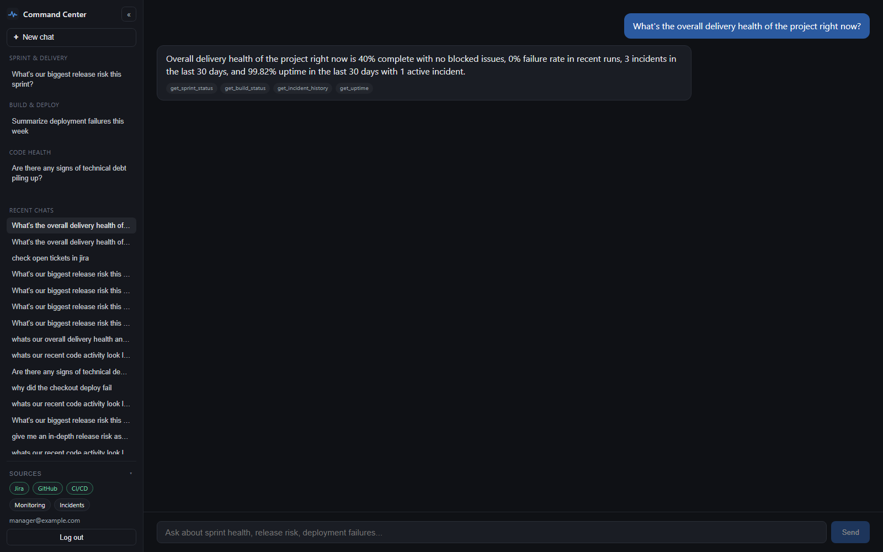
THE PRODUCT
What it looks like in practice
A real question, answered by correlating Jira, GitHub, CI/CD, monitoring, and incidents — with the Sources panel showing which are live vs. mock.
Notes:
This is a real screenshot, not a mockup — captured live against the running app with USE_MOCK_DATA=false, real GitHub/Jira MCP connections, and the manager@example.com demo account. Point out three things: the tool chips under the reply (get_sprint_status, get_build_status, get_incident_history, get_uptime) show exactly which signals the agent pulled for this answer; the reply itself correlates all of them into one paragraph instead of listing four separate stats; and the Sources panel in the sidebar shows Jira/GitHub/CI-CD as live (green) vs. Monitoring/Incidents as mock (gray) — this is the StatusBar component that polls GET /api/integrations/status.

Slide 5
HOW IT WORKS
Architecture
FRONTEND
BACKEND (FASTAPI)
EXTERNAL SERVICES
React Chat UI
ChatWindow + StatusBar
POST /api/chat
rate limit + validation
NVIDIA NIM
chat completions + embeddings
Orchestrator
tool-use loop, max 8 iters
GitHub remote MCP
Atlassian remote MCP
6 TOOLS
Jira
GitHub
CI/CD
Monitoring
Incidents
Log RAG
Postgres + pgvector
conversations, log_chunks
Zero-param tools by design; GitHub/Jira reached via their official remote MCP servers, not raw REST.
Notes:
Walk left to right: React chat UI hits POST /api/chat, which runs the orchestrator's tool-use loop against NVIDIA NIM. The orchestrator dispatches to six tools, each backed by an integration client. GitHub and Jira go through their official remote MCP servers rather than raw REST calls — call this out, it's a deliberate and non-trivial choice. Log search is a RAG pipeline over Postgres/pgvector. If asked 'why not just call the REST APIs directly', explain MCP gives a stable, standardized tool surface instead of each client hand-rolling auth and endpoint quirks per vendor.

Slide 6
WHAT'S NOVEL
Built on real integration constraints, not a toy demo
Real remote MCP GitHub and Jira data comes through their official remote MCP servers — not a REST wrapper
RAG over logs pgvector-backed semantic search over CI/CD + application logs, as a 6th agent tool
Single-tool-call design engineered around a real model constraint (kimi-k2.6 rejects batched tool calls) instead of switching models
Zero-param tools each tool targets one configured repo/project/service — avoids the model hallucinating a plausible but wrong target
Automatic model fallback falls back to a secondary NIM model mid-run if the primary is unavailable, no retry storm
Zero-credential demoable every integration ships realistic mock data by default — the full app runs with no third-party keys
Notes:
This is the 'we actually built and debugged this against real systems' slide — each point came from a real constraint discovered during development, not a design doc. The single-tool-call point is a good story if asked: the default model (kimi-k2.6) hard-rejects batched tool calls with a 400 error, so the orchestrator forces one tool call per turn (parallel_tool_calls=False) rather than switching models. The zero-param tools point: an earlier version let the model pass a target repo/project per call, and a smaller model would hallucinate a plausible-but-wrong one — removing the parameter removed the failure mode entirely.

Slide 7
UNDER THE HOOD
Tech stack
Backend
• FastAPI
• SQLAlchemy (async)
• PostgreSQL + pgvector
Frontend
• React (Vite)
• Single-page chat UI
AI / Agent
• NVIDIA NIM (OpenAI-compatible)
• moonshotai/kimi-k2.6 (default)
• meta/llama-3.1-70b-instruct (fallback)
• nvidia/nv-embedqa-e5-v5
Integrations
• GitHub remote MCP
• Atlassian (Jira) remote MCP
• Mock monitoring/incidents
Notes:
Quick reference slide, don't over-narrate — move fast. Worth flagging if asked: the primary model needs per-account approval on NVIDIA NIM even when catalog-listed, which is why there's an automatic fallback model wired in (meta/llama-3.1-70b-instruct) rather than the app just failing on a fresh account. Also nv-embedqa-e5-v5 was chosen over a catalog-listed alternative that looked fine but 500'd on every real embeddings call.

Slide 8
LIVE DEMO
"Why did the checkout deploy fail?"
1
User asks the question in the chat UI
2
Orchestrator calls search_error_logs(query=…)
3
Query is embedded (NVIDIA NIM) and matched against pgvector log_chunks
4
Top matching log line comes back (e.g. a 500 error spike → rollback)
5
Agent replies citing the specific log line — not a generic guess
→ switching to the live app now
Notes:
Cue to alt-tab into the running app. Ask this exact question (or something close to it) live so the audience sees the tool call happen in real time, not just a canned answer. If the demo environment is offline or credentials aren't handy, narrate the five steps on this slide as a fallback and mention USE_MOCK_DATA lets the whole flow run end-to-end with zero external credentials — that's worth saying even if the live demo works, since it explains why the demo is low-risk to run in front of judges.

Slide 9
WHAT'S NEXT
Roadmap
Real monitoring provider wire in Datadog / Grafana / PagerDuty in place of the always-mock monitoring client
More signal sources the integration pattern is a 2-step add — a client with fetch_summary() plus one tool registration, no orchestrator changes
Production-grade rate limiting swap the in-memory per-IP limiter for a shared store before running multiple workers
Multi-tenant / auth scope conversations and configured targets per team
Notes:
Show this is a foundation, not a finished product, without undercutting what's already working. Monitoring is the one source that's always mock (no universal vendor API exists) — that's the most obvious next real-data integration. The 'more signal sources' point is a good chance to reinforce the extensibility story: adding a new source is a 2-step add (client + tool registration), no orchestrator changes needed.
Q&A PREP — likely questions and grounded answers, by topic:
PRODUCT: Different from just checking dashboards? Dashboards show per-system numbers; this agent correlates across them (failed build + open incident + blocked sprint issue = one risk story with a recommended action).
ARCHITECTURE: Why one orchestrator, not multiple agents? Simpler failure modes, one place to reason about tool choice, no inter-agent coordination needed for a single-user chat loop. Why one tool call per turn? Default model (kimi-k2.6) hard-rejects batched tool_calls with a 400; parallel_tool_calls=False forces one per turn; MAX_TOOL_ITERATIONS=8 covers 5 tools + 1 synthesis turn with margin. Why zero-param tools? An earlier version let the model pick a target repo/project per call and a smaller model hallucinated plausible-but-wrong values — removing the parameter removed the failure mode. Why GitHub/Jira via remote MCP not REST? Standardized tool surface instead of hand-rolling auth/parsing per vendor. What if NIM is down/rate-limited? timeout=20s, max_retries=1, no pooling, clean 502/503/504 instead of a hang; automatic fallback to meta/llama-3.1-70b-instruct mid-run if the primary model fails. Why pgvector? Reuses the same Postgres instance already used for app data, no extra infra.
SECURITY: Prompt injection via tool output (e.g. malicious commit message)? System prompt treats tool output as data, never instructions, verified live against a jailbreak-style prompt. Chat guardrails? 422 on empty/>4000-char messages, per-IP rate limit (20/min default, 429 + Retry-After, in-memory — abuse mitigation not a security boundary). Auth? JWT access token + httponly refresh cookie; refresh-token reuse revokes all sessions for that user (theft-detection pattern). Zero-credential demo? Yes — USE_MOCK_DATA=true by default, every integration falls back to realistic mock data; monitoring/incidents always mock, log search always the mock corpus by design.
NOT PRODUCTION-READY YET (be upfront if asked): in-memory rate limiter (single-process only), monitoring/incidents mock-only, no multi-tenant scoping, no migration tooling (create_all, no Alembic).
DEMO FALLBACK: if live demo breaks, slide 4's screenshot is real (not a mockup), and slide 8 narrates the traced 'why did the checkout deploy fail?' example step by step without needing the live app.

Slide 10
Thank you
Questions?
github.com/mahesh-ramineedi-minfy/ai-engineering-command-center
Notes:
Invite questions. Likely ones to be ready for: why a single orchestrator instead of multiple specialized agents (simpler failure modes, one place to reason about tool choice); how credentials/security are handled (env-var driven, mock-by-default, no secrets in the repo); what happens if NVIDIA NIM is down (bounded timeout + retry, automatic fallback model, then a clean 502/503/504 instead of a hang).

