Slide 1

Apache Mesos
Cloud Computing Assignment
on
Presented By-
Lakshita Nagpal(137130)
Bholaram Seervi(137112)
Mahesh Garhwal(137132)

Slide 2
Overview
What is it?
Features
What is the need?
Why is it beyond Hadoop?
Architecture
Who uses it?

Slide 3
What is Mesos?
A cluster Manager
A distributed systems Kernel
Provides resource isolation/sharing
Cluster Monitoring via Web UI
Tasks isolated via Linux Containers
Written is C++
Master/Slave Based System

Slide 4
Features of Mesos
High Availability: Fault-tolerant replicated master and agents using Zookeeper.
Linear Scalability : Industry proven to easily scale to 10,000s of nodes.
Multi Resource Scheduling: Abstracts CPU, memory, storage, and other compute resources.
Web UIs : Built-in Web UI for viewing cluster state and navigating container sandboxes.
Pluggable Isolation : First class isolation support for CPU, memory, disk, ports, GPU, and modules for custom resource isolation.
APIs : HTTP APIs for developing new distributed applications, for operating the cluster, and for monitoring.

Slide 5

Why do we need Mesos?
Static Partitioning
No Sharing

Slide 6
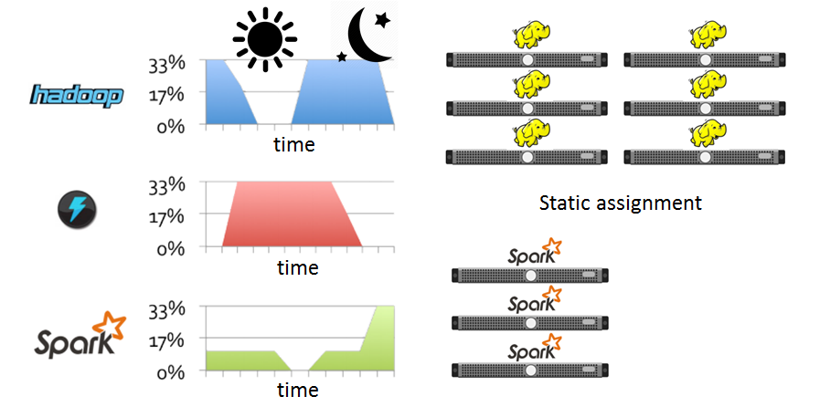
Problem
Required Resources for different frameworks is different
Under Utilization

Slide 7
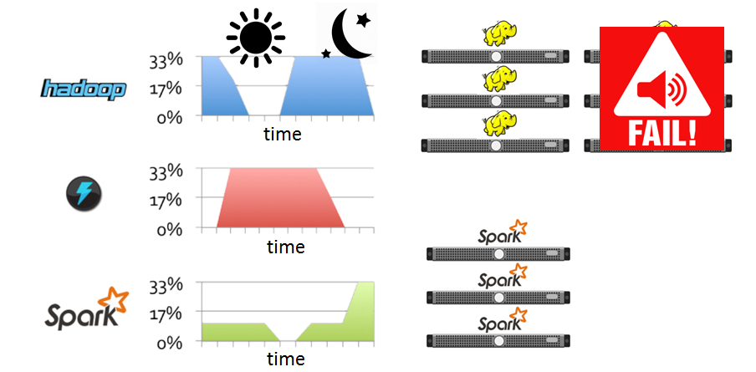
Problem
Required Resources for different frameworks is different
Under Utilization

Slide 8
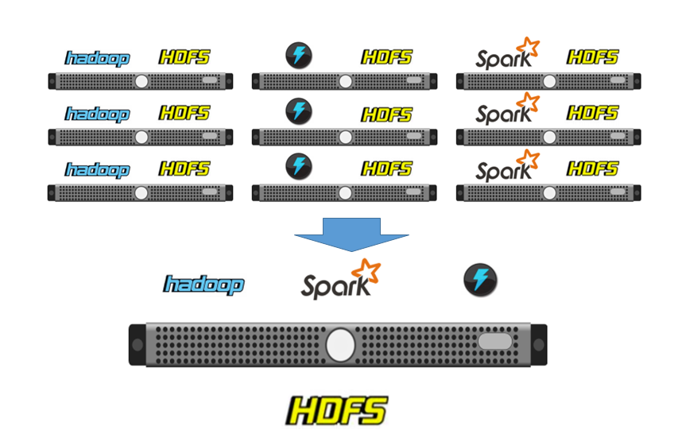
Solution

Slide 9
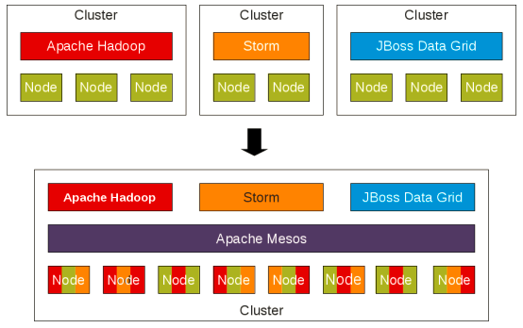
This can be viewed as-
Apache Spark
Apache Spark

Slide 10
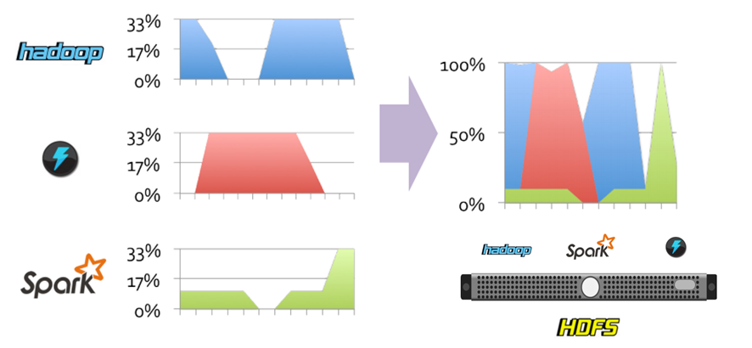
Objective
Dynamic Sharing and Management of Resources
Utilization and Scalibility

Slide 11
Apache Mesos-Beyond Hadoop
What requirements are there beyond Hadoop?
Cluster Sharing and Multi Tenancy
Higher Resource Utilization
Faster Response Times
More out of box functionality
Graphical Cluster Monitoring
Graphical Drag and Drop Cluster Manipulation

Slide 12
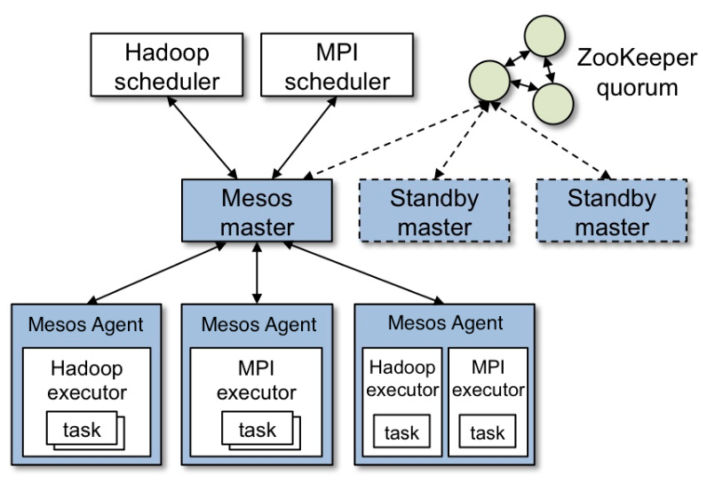
Apache Mesos Architecture

Slide 13
Mesos cluster is made up of 4 components:
Zookeepers: Apache ZooKeeper is a centralised configuration manager, used by distributed applications such as Mesos to coordinate activity across a cluster. Mesos uses ZooKeeper to elect a leading master and for slaves to join the cluster.
Mesos Master: A Mesos master is a Mesos instance in control of the cluster. A cluster will typically have multiple Mesos masters to provide fault-tolerance, with one instance elected the leading master.

Slide 14
Mesos Slaves: A Mesos slave is a Mesos instance which offers resources to the cluster. They are the ‘worker’ instances - tasks are allocated to the slaves by the Mesos master.
Frameworks: Frameworks bridge the gap between the Mesos layer and your applications. They are higher level abstractions which simplify the process of launching tasks on the cluster.

Slide 15
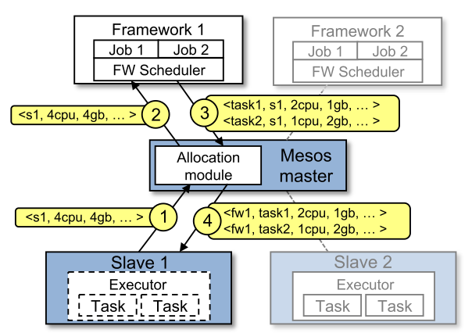
Resource Offer

Slide 19


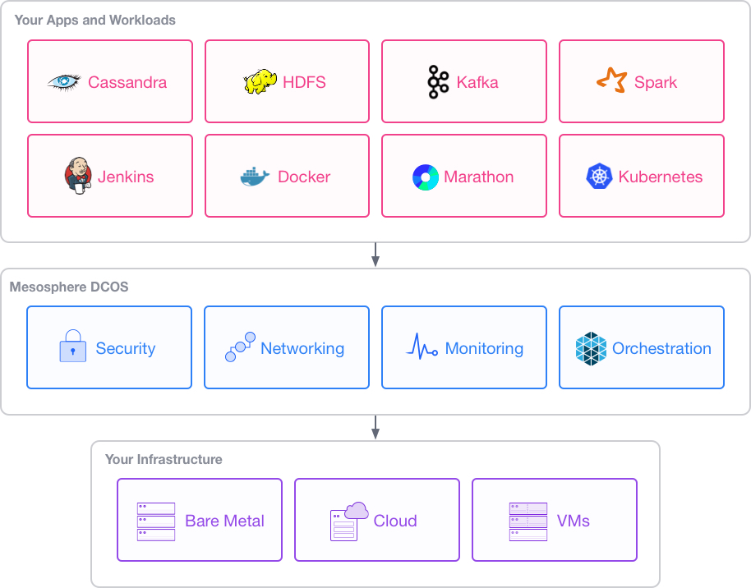
Datacentre OS

Slide 20
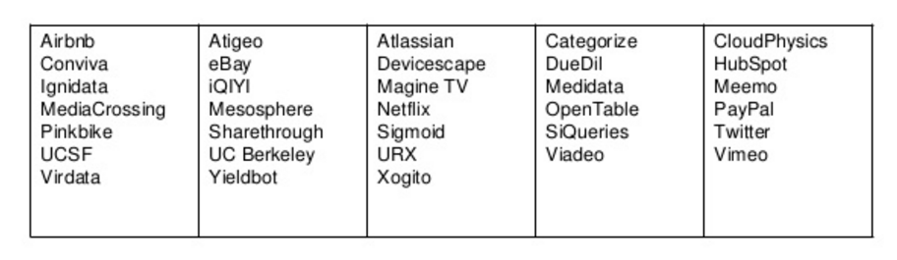
Organizations using Mesos

Slide 21
What is DC/OS?
DC/OS is a distributed operating system based on the Apache Mesos distributed systems kernel. It enables the management of multiple machines as if they were a single computer. It automates resource management, schedules process placement, facilitates inter-process communication, and simplifies the installation and management of distributed services. Its included web interface and available command-line interface (CLI) facilitate remote management and monitoring of the cluster and its services.

Slide 22
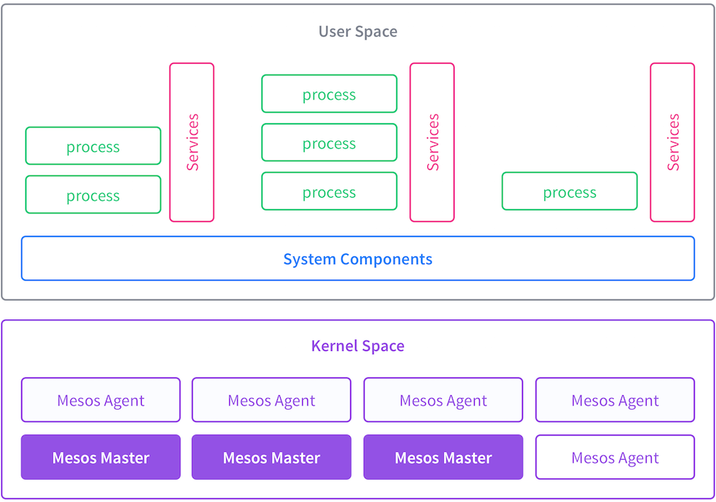
DC/OS Architecture

Slide 23
What is Marathon?
Marathon is a framework for Mesos that is designed to launch long-running applications, and, in Mesosphere, serves as a replacement for a traditional init system. It has many features that simplify running applications in a clustered environment, such as high-availability, node constraints, application health checks, an API for scriptability and service discovery, and an easy to use web user interface. It adds its scaling and self-healing capabilities to the Mesosphere feature set.

Slide 24
What is Chronos?
Chronos is a framework for Mesos that was originally developed by Airbnb as a replacement for cron. As such, it is a fully-featured, distributed, and fault-tolerant scheduler for Mesos, which eases the orchestration of jobs, which are collections of tasks. It includes an API that allows for scripting of scheduling jobs, and a web UI for ease of use.

