Slide 1
Chapter 3: Lexical Analysis
Prof. Steven A. Demurjian
Computer Science & Engineering Department
The University of Connecticut
371 Fairfield Way, Unit 2155
Storrs, CT 06269-3155
steve@engr.uconn.edu
http://www.engr.uconn.edu/~steve
(860) 486 - 4818
Material for course thanks to:
Laurent Michel
Aggelos Kiayias
Robert LeBarre

Slide 2
Lexical Analysis
Basic Concepts & Regular Expressions
  What does a Lexical Analyzer do?
  How does it Work?
  Formalizing Token Definition & Recognition
Regular Expressions and Languages
Reviewing Finite Automata Concepts
  Non-Deterministic and Deterministic FA
  Conversion Process
    Regular Expressions to NFA
    NFA to DFA
Relating NFAs/DFAs /Conversion to Lexical Analysis – Tools Lex/Flex/JFlex/ANTLR
Concluding Remarks /Looking Ahead

Slide 3
Lexical Analyzer in Perspective
token
source program
lexical analyzer
parser
get next token
symbol table
Important Issue:
What are Responsibilities of each Box ?
Focus on Lexical Analyzer and Parser

Slide 4
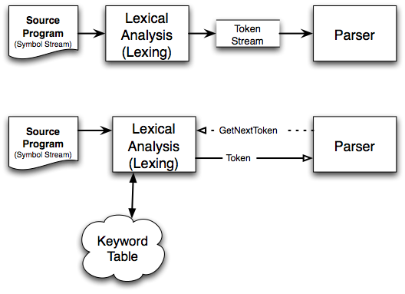
Scanning Perspective
Purpose
  Transform a stream of symbols
  Into a stream of tokens

Slide 5
Lexical Analyzer in Perspective
LEXICAL ANALYZER
  Scan Input
  Remove WS, NL, …
  Identify Tokens
  Create Symbol Table
  Insert Tokens into ST
  Generate Errors
  Send Tokens to Parser
PARSER
  Perform Syntax Analysis
  Actions Dictated by Token Order
  Update Symbol Table Entries
  Create Abstract Rep. of Source
  Generate Errors
  And More…. (We’ll see later)

Slide 6
What Factors Have Influenced the Functional Division of Labor ?
Separation of Lexical Analysis From Parsing Presents a Simpler Conceptual Model
  From a Software Engineering Perspective Division Emphasizes
    High Cohesion and Low Coupling
    Implies Well Specified ⇒ Parallel Implementation
Separation Increases Compiler Efficiency (I/O Techniques to Enhance Lexical Analysis)
Separation Promotes Portability.
  This is critical today, when platforms (OSs and Hardware) are numerous and varied!
  Emergence of Platform Independence - Java

Slide 7
Introducing Basic Terminology
What are Major Terms for Lexical Analysis?
  TOKEN
    A classification for a common set of strings
    Examples Include Identifier, Integer, Float, Assign, LParen, RParen, etc.
  PATTERN
    The rules which characterize the set of strings for a token – integers [0-9]+
    Recall File and OS Wildcards ([A-Z]*.*)
  LEXEME
    Actual sequence of characters that matches pattern and is classified by a token
    Identifiers: x, count, name, etc…
    Integers: 345, 20 -12, etc.

Slide 8
Introducing Basic Terminology
Token
Sample Lexemes
Informal Description of Pattern
const
if
relation
id
num
literal
const
if
<, <=, =, < >, >, >=
pi, count, D2
3.1416, 0, 6.02E23
“core dumped”
const
if
< or <= or = or < > or >= or >
letter followed by letters and digits
any numeric constant
any characters between “ and “ except “
Actual values are critical. Info is :
1. Stored in symbol table
2. Returned to parser
Classifies Pattern

Slide 9
Handling Lexical Errors
Error Handling is very localized, with Respect to Input Source
For example: whil ( x := 0 ) do
generates no lexical errors in PASCAL
In what Situations do Errors Occur?
  Prefix of remaining input doesn’t match any defined token
Possible error recovery actions:
  Deleting or Inserting Input Characters
  Replacing or Transposing Characters
Or, skip over to next separator to “ignore” problem

Slide 10
How Does Lexical Analysis Work ?
Question is related to efficiency
Where is potential performance bottleneck?
Reconsider slide ASU - 3-2
3 Techniques to Address Efficiency :
  Lexical Analyzer Generator
  Hand-Code / High Level Language
  Hand-Code / Assembly Language
In Each Technique …
  Who handles efficiency ?
  How is it handled ?

Slide 11
Efficiency issues
Is efficiency an issue?
3 Lexical Analyzer construction techniques
  How they address efficiency?
    Lexical Analyzer Generator
    Hand-Code / High Level Language (I/O facilitated by the language)
    Hand-Code / Assembly Language (explicitly manage I/O).
In Each Technique …
  Who handles efficiency ?
  How is it handled ?

Slide 12
Basic Scanning technique
Use 1 character of look-ahead
  Obtain char with getc()
Do a case analysis
  Based on lookahead char
  Based on current lexeme
Outcome
  If char can extend lexeme, all is well, go on.
  If char cannot extend lexeme:
    Figure out what the complete lexeme is and return its token
    Put the lookahead back into the symbol stream

Slide 13
Formalization
How to formalize this pseudo-algorithm ?
Idea
  Lexemes are simple
  Tokens are sets of lexemes....
  So: Tokens form a LANGUAGE
Question
  What languages do we know ?
Regular
Context Free
Context Sensitive
Natural

Slide 14
I/O - Key For Successful Lexical Analysis
Character-at-a-time I/O
Block / Buffered I/O
Block/Buffered I/O
  Utilize Block of memory
  Stage data from source to buffer block at a time
  Maintain two blocks - Why (Recall OS)?
    Asynchronous I/O - for 1 block
    While Lexical Analysis on 2nd block
Tradeoffs ?
Block 1
Block 2
When done, issue I/O
ptr...
Still Process token in 2nd block

Slide 15
Algorithm: Buffered I/O with Sentinels
Current token
E
=
M
*
eof
C
*
*
2
eof
eof
lexeme beginning
forward (scans ahead to find pattern match)
forward : = forward + 1 ;
if forward ↑ = eof then begin
if forward at end of first half then begin
reload second half ;
forward : = forward + 1
end
else if forward at end of second half then begin
reload first half ;
move forward to beginning of first half
end
else / * eof within buffer signifying end of input * /
terminate lexical analysis
end
Block I/O
Algorithm performs
I/O’s. We can still
have get & un getchar
Now these work on
real memory buffers !
Block I/O
2nd eof ⇒ no more input !

Slide 16
Formalizing Token Definition
DEFINITIONS:
ALPHABET :
Finite set of symbols {0,1}, or {a,b,c}, or {n,m, … , z}
STRING :
Finite sequence of symbols from an alphabet.
0011 or abbca or AABBC …
A.K.A. word / sentence
If S is a string, then |S| is the length of S, i.e. the number of symbols in the string S.
∈ : Empty String, with | ∈ | = 0

Slide 17
Formalizing Token Definition
EXAMPLES AND OTHER CONCEPTS:
Suppose: S is the string banana
Prefix : ban, banana
Suffix : ana, banana
Substring : nan, ban, ana, banana
Subsequence: bnan, nn
Proper prefix, suffix, or substring cannot be all of S

Slide 18
Language Concepts
A language, L, is simply any set of strings
over a fixed alphabet.
Alphabet
Languages
{0,1} {0,10,100,1000,100000…}
{0,1,00,11,000,111,…}
{a,b,c} {abc,aabbcc,aaabbbccc,…}
{A, … ,Z} {TEE,FORE,BALL,…}
{FOR,WHILE,GOTO,…}
{A,…,Z,a,…,z,0,…9, { All legal PASCAL progs}
+,-,…,<,>,…} { All grammatically correct
English sentences }
Special Languages: ∅ - EMPTY LANGUAGE
∈ - contains ∈ string only

Slide 19
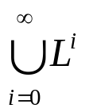

Formal Language Operations
OPERATION
DEFINITION
union of L and M written L ∪ M
L ∪ M = {s | s is in L or s is in M}
concatenation of L and M written LM
LM = {st | s is in L and t is in M}
Kleene closure of L written L*
L*=
L* denotes “zero or more concatenations of “ L
positive closure of L written L⁺
L⁺=
L⁺ denotes “one or more concatenations of “ L

Slide 20
Formal Language Operations
Examples
L = {A, B, C, D } D = {1, 2, 3}
L ∪ D = {A, B, C, D, 1, 2, 3 }
LD = {A1, A2, A3, B1, B2, B3, C1, C2, C3, D1, D2, D3 }
L² = { AA, AB, AC, AD, BA, BB, BC, BD, CA, … DD}
L⁴ = L² L² = ??
L* = { All possible strings of L plus ∈ }
L⁺ = L* - ∈
L (L ∪ D ) = ??
L (L ∪ D )* = ??

Slide 21
Language & Regular Expressions
A Regular Expression is a Set of Rules / Techniques for Constructing Sequences of Symbols (Strings) From an Alphabet.
Let Σ Be an Alphabet, r a Regular Expression Then L(r) is the Language That is Characterized by the Rules of R

Slide 22
Rules for Specifying Regular Expressions:
∈ is a regular expression denoting {∈ }
If a is in Σ, a is a regular expression that denotes {a}
Let r and s be regular expressions with languages L(r) and L(s). Then
(a) (r) | (s) is a regular expression ⇒ L(r) ∪ L(s)
(b) (r)(s) is a regular expression ⇒ L(r) L(s)
(c) (r)* is a regular expression ⇒ (L(r))*
(d) (r) is a regular expression ⇒ L(r)
All are Left-Associative.
precedence

Slide 23
EXAMPLES of Regular Expressions
L = {A, B, C, D } D = {1, 2, 3}
A | B | C | D = L
(A | B | C | D ) (A | B | C | D ) = L²
(A | B | C | D )* = L*
(A | B | C | D ) ((A | B | C | D ) | ( 1 | 2 | 3 )) = L (L ∪ D)

Slide 24
Algebraic Properties of
Regular Expressions
AXIOM
DESCRIPTION
r | s = s | r
| is commutative
r | (s | t) = (r | s) | t
| is associative
(r s) t = r (s t)
concatenation is associative
r ( s | t ) = r s | r t
( s | t ) r = s r | t r
concatenation distributes over |
∈r = r
r∈ = r
∈ Is the identity element for concatenation
r* = ( r | ∈ )*
relation between * and ∈
r** = r*
* is idempotent

Slide 25
Regular Expression Examples
All Strings of Characters That Contain Five Vowels in Order
All Strings that start with “tab” or end with “bat”
All Strings in Which {1,2,3} exist in ascending order
All Strings in Which Digits are in Ascending Numerical Order

Slide 26
Towards Token Definition
Regular Definitions: Associate names with Regular Expressions
For Example : PASCAL IDs
letter → A | B | C | … | Z | a | b | … | z
digit → 0 | 1 | 2 | … | 9
id → letter ( letter | digit )*
Shorthand Notation:
“+” : one or more r* = r⁺ | ∈ & r⁺ = r r*
“?” : zero or one
[range] : set range of characters (replaces “|” )
[A-Z] = A | B | C | … | Z
Using Shorthand : PASCAL IDs
id → [A-Za-z][A-Za-z0-9]*
We’ll Use Both Techniques

Slide 27
Token Recognition
Tokens as Patterns
How can we use concepts developed so far to assist in recognizing tokens of a source language ?
Assume Following Tokens:
if, then, else, relop, id, num
What language construct are they used for ?
Given Tokens, What are Patterns ?
if → if
then → then
else → else
relop → < | <= | > | >= | = | <>
id → letter ( letter | digit )*
num → digit ⁺ (. digit ⁺ ) ? ( E(+ | -) ? digit ⁺ ) ?
What does this represent ? What is Σ ?

Slide 28
What Else Does Lexical Analyzer Do?
Throw Away Tokens
Fact
  Some languages define tokens as useless
  Example: C
    whitespace, tabulations, carriage return, and comments can be discarded without affecting the program’s meaning.
blank → b
tab → ^T
newline → ^M
delim → blank | tab | newline
ws → delim ⁺

Slide 29
Overall
Regular Expression
Token
Attribute-Value
ws
if
then
else
id
num
<
<=
=
< >
>
>=
-
if
then
else
id
num
relop
relop
relop
relop
relop
relop
-
-
-
-
pointer to table entry
pointer to table entry
LT
LE
EQ
NE
GT
GE
Note: Each token has a unique token identifier to define category of lexemes

Slide 30
Constructing Transition Diagrams for Tokens
Transition Diagrams (TD) are used to represent the tokens – these are automatons!
As characters are read, the relevant TDs are used to attempt to match lexeme to a pattern
Each TD has:
  States : Represented by Circles
  Actions : Represented by Arrows between states
  Start State : Beginning of a pattern (Arrowhead)
  Final State(s) : End of pattern (Concentric Circles)
Each TD is Deterministic - No need to choose between 2 different actions !

Slide 31
Example TDs - Automatons
A tool to specify a token
> = :
start
>
=
RTN(GE)
0
6
7
other
*
RTN(G)
8
We’ve accepted “>” and have read other char that must be unread.

Slide 32
Example : All RELOPs
start
<
=
0
1
2
return(relop, LE)
>
3
return(relop, NE)
other
*
=
4
return(relop, LT)
5
return(relop, EQ)
>
=
6
7
return(relop, GE)
other
*
8
return(relop, GT)

Slide 33
Example TDs : id and delim
id :
letter or digit
start
letter
other
*
9
10
11
return(id, lexeme)
delim :
delim
start
delim
other
*
28
29
30

Slide 34
Example TDs : Unsigned #s
digit
digit
digit
start
digit
.
digit
E
+ | -
digit
other
*
12
13
14
15
16
17
18
19
E
digit
digit
digit
start
digit
*
.
digit
other
*
20
21
22
23
24
digit
start
digit
other
*
25
26
27
Questions: Is ordering important for unsigned #s ?
Why are there no TDs for then, else, if ?

Slide 35
QUESTION :
What would the transition diagram (TD) for strings containing each vowel, in their strict lexicographical order, look like ?

Slide 36
Answer
cons → B | C | D | F | … | Z
string → cons* A cons* E cons* I cons* O cons* U cons*
cons
cons
cons
cons
cons
cons
start
A
E
I
O
U
other
accept
Note: The error path is taken if the character is other than a cons or the vowel in the lex order.
error

Slide 37
What Else Does Lexical Analyzer Do?
All Keywords / Reserved words are matched as ids
After the match, the symbol table or a special keyword table is consulted
Keyword table contains string versions of all keywords and associated token values
if
15
then
16
begin
17
...
...
When a match is found, the token is returned, along with its symbolic value, i.e., “then”, 16
If a match is not found, then it is assumed that an id has been discovered

Slide 38
Important Final Notes on Transition Diagrams & Lexical Analyzers
state = 0;
token nexttoken()
{ while(1) {
switch (state) {
case 0: c = nextchar();
/* c is lookahead character */
if (c== blank || c==tab || c== newline) {
state = 0;
lexeme_beginning++;
/* advance beginning of lexeme */
}
else if (c == ‘<‘) state = 1;
else if (c == ‘=‘) state = 5;
else if (c == ‘>’) state = 6;
else state = fail();
break;
… /* cases 1-8 here */
How does this work?
How can it be extended?
What does this do?
Is it a good design?

Slide 39
case 9: c = nextchar();
if (isletter(c)) state = 10;
else state = fail();
break;
case 10; c = nextchar();
if (isletter(c)) state = 10;
else if (isdigit(c)) state = 10;
else state = 11;
break;
case 11; retract(1); install_id();
return ( gettoken() );
… /* cases 12-24 here */
case 25; c = nextchar();
if (isdigit(c)) state = 26;
else state = fail();
break;
case 26; c = nextchar();
if (isdigit(c)) state = 26;
else state = 27;
break;
case 27; retract(1); install_num();
return ( NUM ); } } }
Case numbers correspond to transition diagram states !

Slide 40
When Failures Occur:
int state = 0, start = 0;
Int lexical_value;
/* to “return” second component of token */
Init fail()
{
forward = token_beginning;
switch (start) {
case 0: start = 9; break;
case 9: start = 12; break;
case 12: start = 20; break;
case 20: start = 25; break;
case 25: recover(); break;
default: /* compiler error */
}
return start;
}
What other actions can be taken in this situation ?

Slide 41
Tokens / Patterns / Regular Expressions
Lexical Analysis - searches for matches of lexeme to pattern
Lexical Analyzer returns:<actual lexeme, symbolic identifier of token>
For Example:
Token Symbolic ID
if 1
then 2
else 3
>,>=,<,… 4
:= 5
id 6
int 7
real 8
Set of all regular expressions plus symbolic ids plus analyzer define required functionality.
algs
algs
REs ---→ NFA ---→ DFA (program for simulation)

Slide 42
Automata & Language Theory
Terminology
  FSA
    A recognizer that takes an input string and determines whether it’s a valid string of the language.
  Non-Deterministic FSA (NFA)
    Has several alternative actions for the same input symbol
  Deterministic FSA (DFA)
    Has at most 1 action for any given input symbol
Bottom Line
  expressive power(NFA) == expressive power(DFA)
  Conversion can be automated

Slide 43
Finite Automata & Language Theory
Finite Automata :
A recognizer that takes an input string & determines whether it’s a valid sentence of the language
Non-Deterministic :
Has more than one alternative action for the same input symbol. Can’t utilize algorithm !
Deterministic :
Has at most one action for a given input symbol.
Both types are used to recognize regular expressions.

Slide 44
NFAs & DFAs
Non-Deterministic Finite Automata (NFAs) easily represent regular expression, but are somewhat less precise.
Deterministic Finite Automata (DFAs) require more complexity to represent regular expressions, but offer more precision.
We’ll discuss both plus conversion algorithms, i.e., NFA → DFA and DFA → NFA

Slide 45
Non-Deterministic Finite Automata
An NFA is a mathematical model that consists of :
  S, a set of states
  Σ, the symbols of the input alphabet
  move, a transition function.
    move(state, symbol) → state
    move : S × Σ → S
  A state, s₀ ∈ S, the start state
  F ⊆ S, a set of final or accepting states.

Slide 46
Representing NFAs
Transition Diagrams :
Transition Tables:
Number states (circles), arcs, final states, …
More suitable to representation within a computer
We’ll see examples of both !

Slide 47
Example NFA
S = { 0, 1, 2, 3 }
s₀ = 0
F = { 3 }
Σ = { a, b }
a
start
0
a
1
b
2
b
3
b
What Language is defined ?
What is the Transition Table ?
i n p u t
∈ (null) moves possible
a
b
state
0
{ 0, 1 }
{ 0 }
i
∈
j
1
--
{ 2 }
Switch state but do not use any input symbol
2
--
{ 3 }

Slide 48
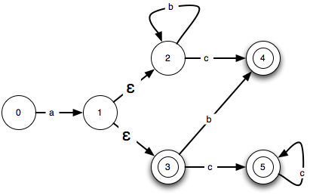
Epsilon-Transitions
Given the regular expression: (a (b*c)) | (a (b |c+)?)
  Find a transition diagram NFA that recognizes it.
Solution ?

Slide 49
How Does An NFA Work ?
a
start
0
a
1
b
2
b
3
b
Given an input string, we trace moves
If no more input & in final state, ACCEPT
EXAMPLE: Input: ababb
-OR-
move(0, a) = 0
move(0, b) = 0
move(0, a) = 1
move(1, b) = 2
move(2, b) = 3
ACCEPT !
move(0, a) = 1
move(1, b) = 2
move(2, a) = ? (undefined)
REJECT !

Slide 50
Handling Undefined Transitions
We can handle undefined transitions by defining one more state, a “death” state, and transitioning all previously undefined transition to this death state.
a
start
0
a
1
b
2
b
3
b
a
a
a, b
4
Σ

Slide 51
Worse still...
Not all path result in acceptance!
a
start
0
a
1
b
2
b
3
b
aabb is accepted along path :
0 → 0 → 1 → 2 → 3
BUT… it is not accepted along the valid path:
0 → 0 → 0 → 0 → 0

Slide 52
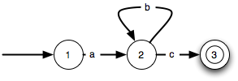
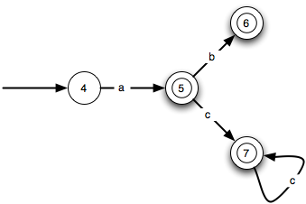
NFA Construction
Automatic construction example
a(b*c)
a(b|c+)?
Build a Disjunction

Slide 53
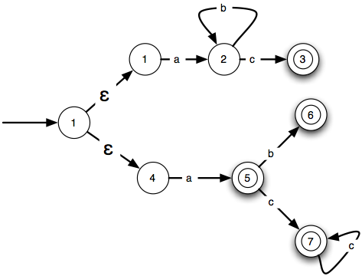
Resulting NFA

Slide 54
NFA- Regular Expressions & Compilation
Problems with NFAs for Regular Expressions:
1. Valid input might not be accepted
2. NFA may behave differently on the same input
Relationship of NFAs to Compilation:
1. Regular expression “recognized” by NFA
2. Regular expression is “pattern” for a “token”
3. Tokens are building blocks for lexical analysis
4. Lexical analyzer can be described by a collection of NFAs. Each NFA is for a language token.

Slide 55
Second NFA Example
Given the regular expression : (a (b*c)) | (a (b | c⁺)?)
Find a transition diagram NFA that recognizes it.

Slide 56
Second NFA Example - Solution
Given the regular expression : (a (b*c)) | (a (b | c⁺)?)
Find a transition diagram NFA that recognizes it.
b
c
2
4
∈
start
a
b
0
1
∈
c
3
c
5
String abbc can be accepted.

Slide 57
Alternative Solution Strategy
b
a
c
a (b*c)
1
2
3
6
a (b | c+)?
4
a
5
b
c
c
Now that you have the individual diagrams, “or” them as follows:
7

Slide 58
Using Null Transitions to “OR” NFAs
b
a
c
1
2
3
∈
0
6
∈
4
a
5
b
c
c
7

Slide 59
Working with NFAs
a
start
0
a
1
b
2
b
3
b
• Given an input string, we trace moves
• If no more input & in final state, ACCEPT
EXAMPLE: Input: ababb
-OR-
move(0, a) = 0
move(0, b) = 0
move(0, a) = 1
move(1, b) = 2
move(2, b) = 3
ACCEPT !
move(0, a) = 1
move(1, b) = 2
move(2, a) = ? (undefined)
REJECT !

Slide 60
The NFA “Problem”
Two problems
  Valid input may not be accepted
  Non-deterministic behavior from run to run...
Solution?

Slide 61
The DFA Save The Day
A DFA is an NFA with a few restrictions
  No epsilon transitions
  For every state s, there is only one transition (s,x) from s for any symbol x in Σ
Corollaries
  Easy to implement a DFA with an algorithm!
  Deterministic behavior

Slide 62
NFA vs. DFA
NFA
  smaller number of states Qnfa
  In order to simulate it requires a |Qnfa| computation for each input symbol.
DFA
  larger number of states Qdfa
  In order to simulate it requires a constant computation for each input symbol.
caveat - generic NFA=>DFA construction: Qdfa ~ 2^{Qnfa}
but: DFA’s are perfectly optimizable! (i.e., you can find smallest possible Qdfa )

Slide 63
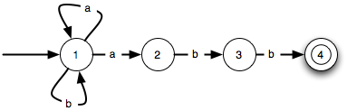
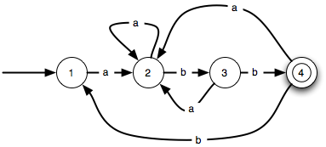
One catch...
NFA-DFA comparison
b

Slide 64
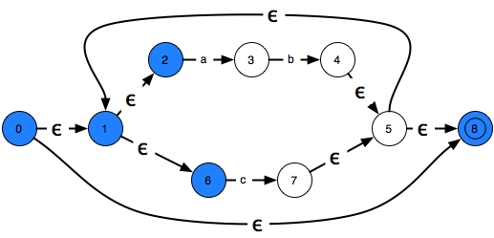
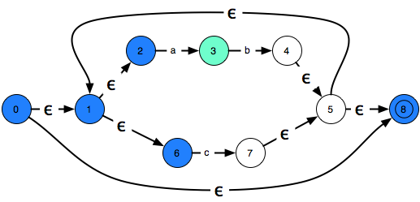
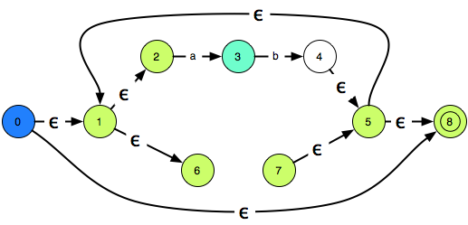
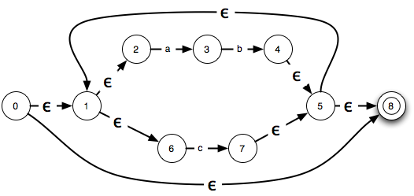



NFA to DFA Conversion – Main Idea
Look at the state reachable without consuming any input, and Aggregate them in macro states

Slide 65
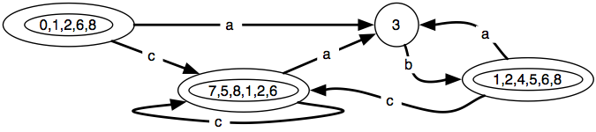
Final Result
A state is final
  IFF one of the NFA state was final

Slide 66
Deterministic Finite Automata
A DFA is an NFA with the following restrictions:
  ∈ moves are not allowed
  For every state s ∈S, there is one and only one path from s for every input symbol a ∈ Σ.
Since transition tables don’t have any alternative options, DFAs are easily simulated via an algorithm.
s ← s₀
c ← nextchar;
while c ≠ eof do
s ← move(s,c);
c ← nextchar;
end;
if s is in F then return “yes”
else return “no”

Slide 67
Example - DFA
b
a
start
0
a
1
b
2
b
3
a
b
a
What Language is Accepted?
Recall the original NFA:
a
start
0
a
1
b
2
b
3
b

Slide 68
Regular Expression to NFA Construction
We now focus on transforming a Reg. Expr. to an NFA
This construction allows us to take:
  Regular Expressions (which describe tokens)
  To an NFA (to characterize language)
  To a DFA (which can be computerized)
The construction process is componentwise
  Builds NFA from components of the regular expression in a special order with particular techniques.
NOTE: Construction is syntax-directed translation, i.e., syntax of regular expression is determining factor for NFA construction and structure.

Slide 69
Motivation: Construct NFA For:
:
a :
b:
ab:
∈ | ab :
a*
(∈ | ab )* :

Slide 70
Motivation: Construct NFA For:
∈
:
a :
b:
ab:
∈ | ab :
a*
(∈ | ab )* :
start
i
f
start
0
a
1
start
A
b
B
start
0
a
1
∈
A
b
B

Slide 71
Construction Algorithm : R.E. → NFA
Construction Process :
1st : Identify subexpressions of the regular expression
∈
Σ symbols
r | s
rs
r*
2nd : Characterize “pieces” of NFA for each subexpression

Slide 72
Piecing Together NFAs
1. For ∈ in the regular expression, construct NFA
start
i
∈
f
L(∈)
2. For a ∈ Σ in the regular expression, construct NFA
start
i
a
f
L(a)

Slide 73
Piecing Together NFAs – continued(1)
3.(a) If s, t are regular expressions, N(s), N(t) their NFAs s|t has NFA:
N(s)
∈
start
i
∈
f
L(s) ∪ L(t)
∈
N(t)
∈
where i and f are new start / final states, and ∈-moves are introduced from i to the old start states of N(s) and N(t) as well as from all of their final states to f.

Slide 74
Piecing Together NFAs – continued(2)
3.(b) If s, t are regular expressions, N(s), N(t) their NFAs st (concatenation) has NFA:
start
i
N(s)
N(t)
f
L(s) L(t)
overlap
Alternative:
start
i
∈
N(s)
∈
N(t)
∈
f
where i is the start state of N(s) (or new under the alternative) and f is the final state of N(t) (or new). Overlap maps final states of N(s) to start state of N(t).

Slide 75
Piecing Together NFAs – continued(3)
3.(c) If s is a regular expressions, N(s) its NFA, s* (Kleene star) has NFA:
∈
start
i
∈
N(s)
∈
f
∈
where : i is new start state and f is new final state
∈-move i to f (to accept null string)
∈-moves i to old start, old final(s) to f
∈-move old final to old start (WHY?)

Slide 76
Properties of Construction
Let r be a regular expression, with NFA N(r), then
N(r) has at most 2*(#symbols + #operators) of r
N(r) has exactly one start and one accepting state
Each state of N(r) has at most one outgoing edge a∈Σ and at most two outgoing ∈’s
BE CAREFUL to assign unique names to all states !

Slide 77
Detailed Example
See example 3.16 in textbook for (a | b)*abb
2nd Example - (ab*c) | (a(b|c*))
Parse Tree for this regular expression:
r₁₃
r₅
|
r₁₂
r₃
r₄
r₁₁
r₁₀
(
)
a
a
r₉
r₁
r₂
r₇
|
r₈
r₀
c
*
r₆
b
*
b
c
What is the NFA? Let’s construct it !

Slide 78
Detailed Example – Construction(1)
r₀:
b
∈
r₃:
a
r₁:
∈
b
∈
∈
r₂:
c
∈
r₄ : r₁ r₂
∈
b
∈
c
∈
∈
a
∈
b
∈
c
r₅ : r₃ r₄
∈

Slide 79
Detailed Example – Construction(2)
∈
r₇:
b
r₈:
∈
c
∈
r₁₁:
a
∈
b
r₆:
c
∈
∈
∈
r₉ : r₇ | r₈
∈
c
∈
∈
r₁₀ : r₉
b
∈
∈
∈
r₁₂ : r₁₁ r₁₀
a
∈
c
∈
∈

Slide 80
Detailed Example – Final Step
r₁₃ : r₅ | r₁₂
∈
a
∈
b
∈
c
2
3
4
5
6
7
∈
∈
∈
17
1
b
10
11
∈
∈
∈
∈
∈
a
∈
c
∈
8
9
12
13
14
15
16
∈

Slide 81
Final Notes : R.E. to NFA Construction
NFA may be simulated by algorithm, when NFA is constructed using Previous techniques (see algorithm 3.4 and figure 3.31)
Algorithm run time is proportional to |N| * |x| where |N| is the number of states and |x| is the length of input
Alternatively, we can construct DFA from NFA and use the resulting Dtran to recognize input:
space
time
NFA
O(|r|)
O(|r|*|x|)
DFA
O(2^{|r|})
O(|x|)
where |r| is the length of the regular expression.

Slide 82
Conversion : NFA → DFA Algorithm
Algorithm Constructs a Transition Table for DFA from NFA
Each state in DFA corresponds to a SET of states of the NFA
Why does this occur ?
  ∈ moves
  non-determinism
  Both require us to characterize multiple situations that occur for accepting the same string.
  (Recall : Same input can have multiple paths in NFA)
Key Issue : Reconciling AMBIGUITY !

Slide 83
Converting NFA to DFA – 1st Look
∈
2
a
3
b
4
∈
∈
0
∈
1
5
∈
8
∈
∈
6
c
7
∈
From State 0, Where can we move without consuming any input ?
This forms a new state: 0,1,2,6,8 What transitions are defined for this new state ?

Slide 84
The Resulting DFA
a
0, 1, 2, 6, 8
a
3
a
c
b
1, 2, 5, 6, 7, 8
c
1, 2, 4, 5, 6, 8
c
Which States are FINAL States ?
a
A
How do we handle alphabet symbols not defined for A, B, C, D ?
B
a
a
c
b
D
c
C
c

Slide 85
Algorithm Concepts
NFA N = ( S, Σ, s₀, F, MOVE )
∈-Closure(S) : s ∈S
: set of states in S that are reachable
from s via ∈-moves of N that originate
from s.
∈-Closure of T : T ⊆ S
: NFA states reachable from all t ∈ T
on ∈-moves only.
move(T,a) : T ⊆ S, a∈Σ
: Set of states to which there is a
transition on input a from some t ∈ T
No input is consumed
These 3 operations are utilized by algorithms / techniques to facilitate the conversion process.

Slide 86
Illustrating Conversion – An Example
Start with NFA: (a | b)*abb
∈
a
2
3
∈
∈
start
∈
∈
a
b
0
1
6
7
8
9
∈
∈
b
b
4
5
10
∈
First we calculate: ∈-closure(0) (i.e., state 0)
∈-closure(0) = {0, 1, 2, 4, 7} (all states reachable from 0
on ∈-moves)
Let A={0, 1, 2, 4, 7} be a state of new DFA, D.

Slide 87
Conversion Example – continued (1)
2nd , we calculate : a : ∈-closure(move(A,a)) and
b : ∈-closure(move(A,b))
a : ∈-closure(move(A,a)) = ∈-closure(move({0,1,2,4,7},a))}
adds {3,8} ( since move(2,a)=3 and move(7,a)=8)
From this we have : ∈-closure({3,8}) = {1,2,3,4,6,7,8}
(since 3→6 →1 →4, 6 →7, and 1 →2 all by ∈-moves)
Let B={1,2,3,4,6,7,8} be a new state. Define Dtran[A,a] = B.
b : ∈-closure(move(A,b)) = ∈-closure(move({0,1,2,4,7},b))
adds {5} ( since move(4,b)=5)
From this we have : ∈-closure({5}) = {1,2,4,5,6,7}
(since 5→6 →1 →4, 6 →7, and 1 →2 all by ∈-moves)
Let C={1,2,4,5,6,7} be a new state. Define Dtran[A,b] = C.

Slide 88
Conversion Example – continued (2)
3rd , we calculate for state B on {a,b}
a : ∈-closure(move(B,a)) = ∈-closure(move({1,2,3,4,6,7,8},a))}
= {1,2,3,4,6,7,8} = B
Define Dtran[B,a] = B.
b : ∈-closure(move(B,b)) = ∈-closure(move({1,2,3,4,6,7,8},b))}
= {1,2,4,5,6,7,9} = D
Define Dtran[B,b] = D.
4th , we calculate for state C on {a,b}
a : ∈-closure(move(C,a)) = ∈-closure(move({1,2,4,5,6,7},a))}
= {1,2,3,4,6,7,8} = B
Define Dtran[C,a] = B.
b : ∈-closure(move(C,b)) = ∈-closure(move({1,2,4,5,6,7},b))}
= {1,2,4,5,6,7} = C
Define Dtran[C,b] = C.

Slide 89
Conversion Example – continued (3)
5th , we calculate for state D on {a,b}
a : ∈-closure(move(D,a)) = ∈-closure(move({1,2,4,5,6,7,9},a))}
= {1,2,3,4,6,7,8} = B
Define Dtran[D,a] = B.
b : ∈-closure(move(D,b)) = ∈-closure(move({1,2,4,5,6,7,9},b))}
= {1,2,4,5,6,7,10} = E
Define Dtran[D,b] = E.
Finally, we calculate for state E on {a,b}
a : ∈-closure(move(E,a)) = ∈-closure(move({1,2,4,5,6,7,10},a))}
= {1,2,3,4,6,7,8} = B
Define Dtran[E,a] = B.
b : ∈-closure(move(E,b)) = ∈-closure(move({1,2,4,5,6,7,10},b))}
= {1,2,4,5,6,7} = C
Define Dtran[E,b] = C.

Slide 90
Conversion Example – continued (4)
This gives the transition table for the DFA of:
Input Symbol
State
a
b
A B C
B B D
C B C
D B E
E B C
b
b
C
b
start
A
a
B
b
D
b
E
a
a
a

Slide 91
Algorithm For Subset Construction
initially, ∈-closure(s₀) is only (unmarked) state in Dstates;
while there is unmarked state T in Dstates do begin
mark T;
for each input symbol a do begin
U := ∈-closure(move(T,a));
if U is not in Dstates then
add U as an unmarked state to Dstates;
Dtran[T,a] := U
end
end

Slide 92
Algorithm For Subset Construction – (2)
push all states in T onto stack;
initialize ∈-closure(T) to T;
while stack is not empty do begin
pop t, the top element, off the stack;
for each state u with edge from t to u labeled ∈ do
if u is not in ∈-closure(T) do begin
add u to ∈-closure(T) ;
push u onto stack
end
end

Slide 93
Summary
We can
  Specify tokens with R.E.
  Use DFA to scan an input and recognize token
  Transform an NFA into a DFA automatically
What we are missing
  A way to transform an R.E. into an NFA
Then, we will have a complete solution
  Build a big R.E.
  Turn the R.E. into an NFA
  Turn the NFA into a DFA
  Scan with the obtained DFA

Slide 94
Pulling Together Concepts
Designing Lexical Analyzer Generator
  Reg. Expr. → NFA construction
  NFA → DFA conversion
  DFA simulation for lexical analyzer
Recall Lex Structure
  Pattern Action
  Pattern Action
  … …
  Each pattern recognizes lexemes
  Each pattern described by regular expression
(a | b)*abb
∈
e.g.
∈
(abc)*ab
∈
etc.
Recognizer!

Slide 95
Lex Specification → Lexical Analyzer
Let P₁, P₂, … , P_{n} be Lex patterns
  (regular expressions for valid tokens in prog. lang.)
Construct N(P₁), N(P₂), … N(P_{n})
What’s true about list of Lex patterns ?
Construct NFA:
N(P₁)
Lex applies conversion algorithm to construct DFA that is equivalent!
∈
∈
N(P₂)
∈
N(P_{n})

Slide 96
Pictorially
Lex Specification
Lex Compiler
Transition Table
(a) Lex Compiler
lexeme
input buffer
FA
Simulator
Transition Table
(b) Schematic lexical analyzer

Slide 97
Example
Let : a
abb
a*b*
3 patterns
NFA’s :
start
a
1
2
start
a
b
b
3
4
5
6
a
b
start
7
8
b

Slide 98
Example – continued(1)
Combined NFA :
∈
a
1
2
start
∈
a
b
b
0
3
4
5
6
a
b
∈
7
8
b
Construct DFA : (It has 6 states)
{0,1,3,7}, {2,4,7}, {5,8}, {6,8}, {7}, {8}
Can you do this conversion ???

Slide 99
Example – continued(2)
Dtran for this example:
Input Symbol
STATE
a
b
Pattern
{0,1,3,7}
{2,4,7}
{8}
none
{2,4,7}
{7}
{5,8}
a
{8}
-
{8}
a*b⁺
{7}
{7}
{8}
none
{5,8}
-
{6,8}
a*b⁺
{6,8}
-
{8}
abb

Slide 100
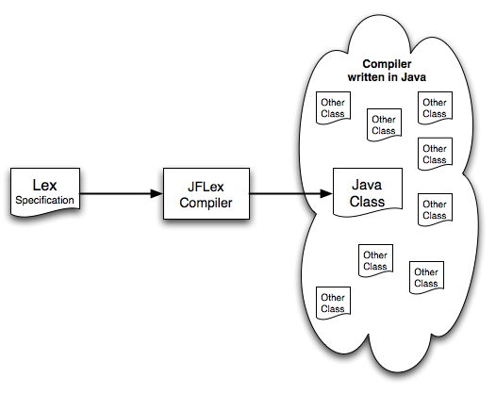
Morale?
All of this can be automated with a tool!
  LEX The first lexical analyzer tool for C
  FLEX A newer/faster implementation C / C++ friendly
  JFLEX A lexer for Java. Based on same principles.
  JavaCC
  ANTLR

Slide 101
Other Issues - § 3.9 – Not Discussed
More advanced algorithm construction – regular expression to DFA directly
Minimizing the number of DFA states

Slide 102
Concluding Remarks
Focused on Lexical Analysis Process, Including
  - Regular Expressions
  Finite Automaton
  Conversion
  Lex
  Interplay among all these various aspects of lexical analysis
Looking Ahead:
The next step in the compilation process is Parsing:
  Top-down vs. Bottom-up
  - Relationship to Language Theory

