Slide 1

Heart Failure prediction
Date: 31 October 2023
Name: Mahesh Jadhav
Email ID:MJ35806N@pace.edu
Class Name: Practical Data Science
Program Name: Data Science

Slide 2
Agenda:
Problem Statement
Data Section
Exploratory Data Analysis
EDA Summary
Data Scaling
Feature Engineering
Modeling
Findings
Recommendation
Appendix

Slide 3
Problem Statement:
Cardiovascular diseases (CVDs) are the number 1 cause of death globally, taking an estimated 17.9 million lives each year, which accounts for 31% of all deaths worldwide. Heart failure is a common event caused by CVDs. People with cardiovascular disease or who are at high cardiovascular risk (due to the presence of one or more risk factors such as hypertension, diabetes, hyperlipidaemia or already established disease) need early detection and management wherein a machine learning model can be of great help.

Slide 4
Data Section:
Age : age of the patient [years]
Sex : sex of the patient [M: Male, F: Female]
ChestPainType : chest pain type [TA: Typical Angina, ATA: Atypical Angina, NAP: Non-Anginal Pain, ASY: Asymptomatic]
RestingBP : resting blood pressure [mm Hg]
Cholesterol : serum cholesterol [mm/dl]
FastingBS : fasting blood sugar [1: if FastingBS > 120 mg/dl, 0: otherwise]
RestingECG : resting electrocardiogram results [Normal: Normal, ST: having ST-T wave abnormality (T wave inversions and/or ST elevation or depression of > 0.05 mV), LVH: showing probable or definite left ventricular hypertrophy by Estes' criteria]
MaxHR : maximum heart rate achieved [Numeric value between 60 and 202]
ExerciseAngina : exercise-induced angina [Y: Yes, N: No]
Oldpeak : oldpeak = ST [Numeric value measured in depression]
ST_Slope : the slope of the peak exercise ST segment [Up: upsloping, Flat: flat, Down: downsloping]
HeartDisease : output class [1: heart disease, 0: Normal]

Slide 5
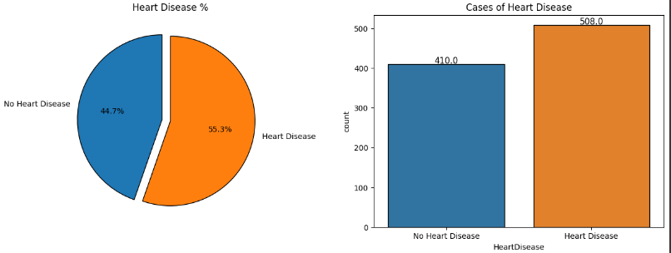
Distribution:
Dataset is balanced

Slide 6
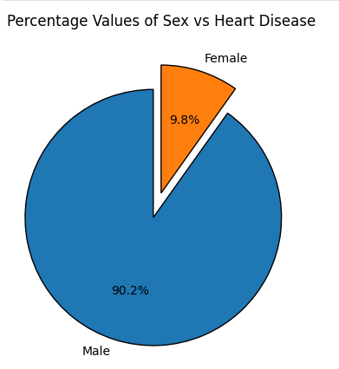
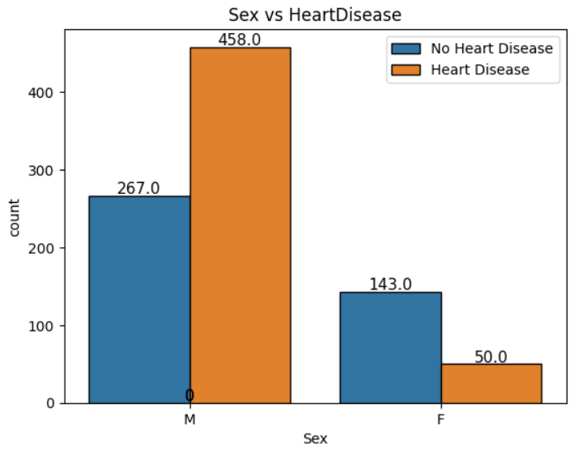
Exploratory Data Analysis

Slide 7
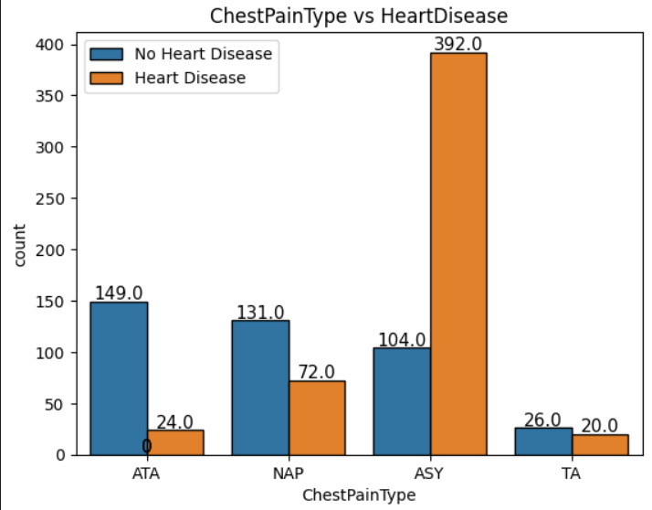
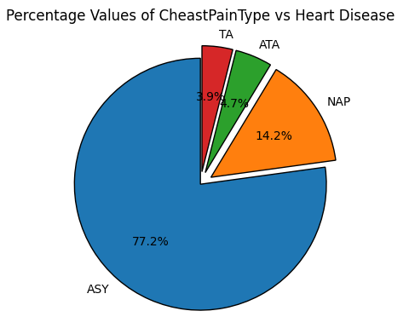
Chest Pain Type:

Slide 8
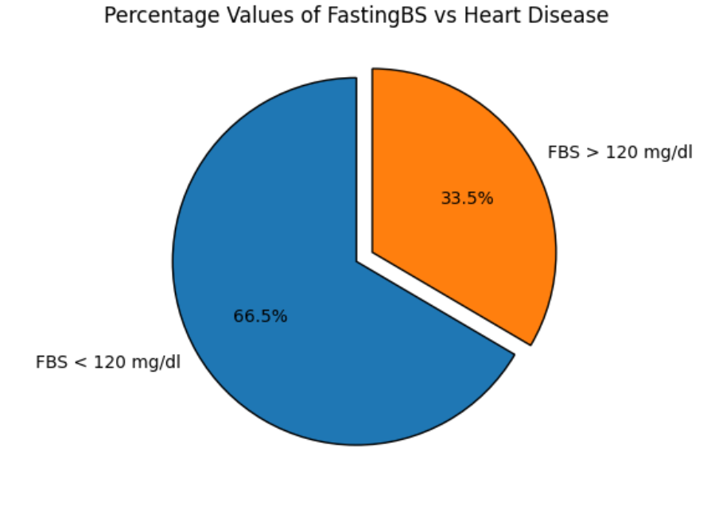
Fasting Blood Sugar
Fasting Blood Sugar level < 120 mg/dl displays high chances of heart diseases.

Slide 9
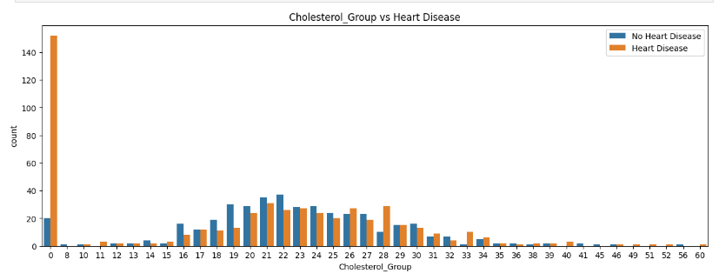
Cholesterol

Slide 10
Summary:
Among the male population, there is a higher prevalence of heart disease patients compared to those without heart disease. Conversely, in the female population, heart disease patients are less common than those without heart disease.
The presence of ASY type chest pain strongly indicates a higher likelihood of being diagnosed with heart disease.
Fasting Blood Sugar levels are a complex factor. Heart disease patients diagnosed with abnormal Fasting Blood Sugar levels and those with normal levels show a significant difference.
In the case of ST Slope values, a flat slope is associated with a significantly higher likelihood of being diagnosed with heart disease, and a downward slope also indicates this, though in fewer cases.
Cholesterol levels between 160 (16x10) - 340 (34x10) are highly susceptible to heart diseases.

Slide 11
Methods, Findings, and Recommendations

Slide 12
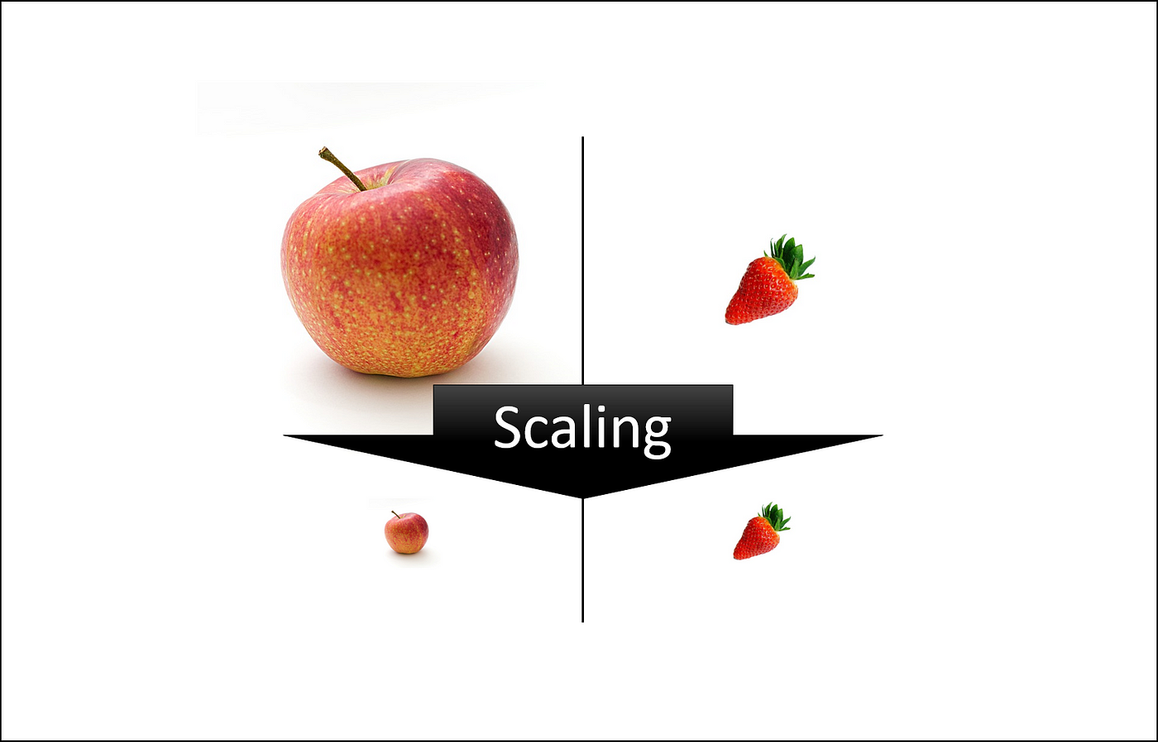
Data Scaling:
Everyone is speaking the same language
For Example,Basket filled with apples and strawberries
It is quite challenging If We Wish to categorize them as they have different size range and scale.
In same way, Heart Diseases data has Different Patient’s information and their symptoms on different scales.
Age, RestingBP, Cholesterol and MaxHR features are scaled down
Technical Details of Data Scaling

Slide 13
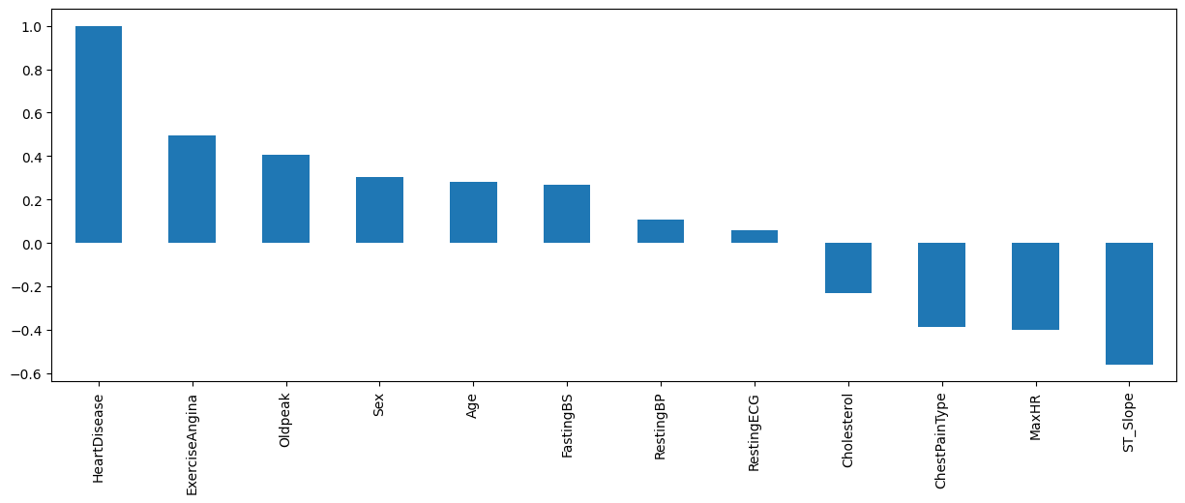
Feature Engineering: (Focus on Important Features)
Figure Shows the How much Importance of each feature( Patient’s every details) is to predict
Heart Disease.
For Example, If Someone is recruiting for Software engineering position. Only people will get hired those who have relevant skills.
Technical Details of Feature Engineering

Slide 14

Modeling(Selection,Training, Evaluation):
Model Training Process (Baking a Cookie)
Step 1: Ingredients Gathering (Data Collection)
├─ Gather all ingredients for baking a Cookie
├─ Collect people’s data like age, Chestpaintype for the model
Step 2: Recipe Creation (Model Selection)
├─ Choose a Cookie recipe (e.g., chocolate chips, Peanut Butter)
├─ Select a model type (e.g.,Random Forest(selected), KNN)
Step 3: Preparing the Cookie Batter (Training the Model)
├─ Mix and blend the ingredients for Cookie batter
├─ Train the model by feeding it the collected data
Step 4: Baking the Cookie (Model Evaluation)
├─ Bake the Cookie in the oven
├─ Evaluate the model's performance on new, unseen data
Step 5: Adjusting the Recipe (Model Improvement)
├─ Tweak the Cookie recipe for better taste
├─ Refine the model parameters or techniques for improved performance
Step 6: Serving the Cookie (Using the Model)
├─ Serve the baked Cookie to guests
├─ Use the refined model to make predictions or decisions based on new data

Slide 15
Findings:
For Training: Provided 734 People’s Information
For Testing : Provided 181 People’s Information
Out of 181 People,
In case of No Heart disease, 75 correctly predicted and 13 incorrectly predicted
In case of Heart disease, 81 correctly predicted and 15 incorrectly predicted
Recommendation:
Hospital needs to provide more data in order to train the model well.
Be extra cautious while collecting most important information(features that we found more related to Heart disease in Feature Engineering Process).

Slide 16
Appendix:
Review the GitHub for programming details?
What is Data Scaling?
What is Feature Engineering and Feature Selection?
What is Random Forest?

