Slide 1
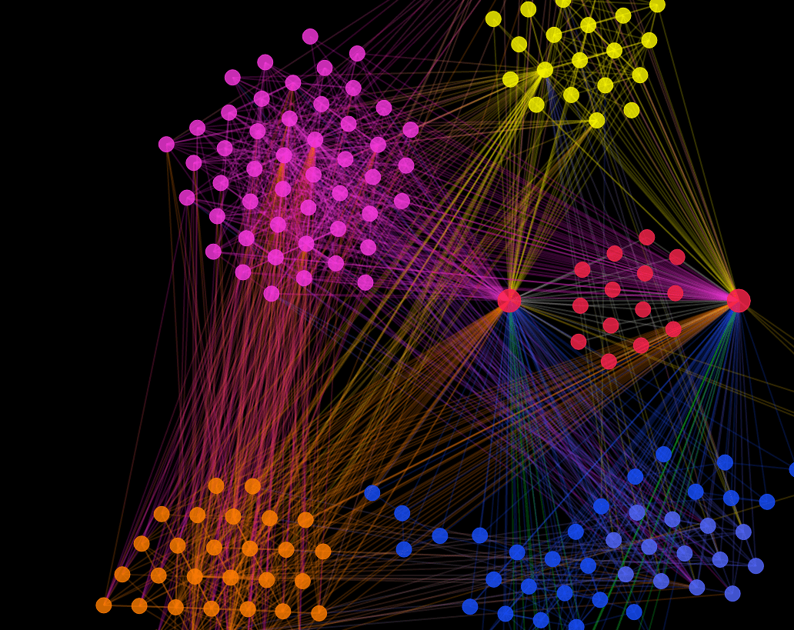
K- Means Clustering
Team Members:
Mahesh Jadhav
Mugdha Shinde
Chaitanya Dave

Slide 2
Table of Content:
Introduction
Problem Statement
K – means Algorithm
Implementation of Algorithm from Scratch
Exploratory Data Analysis
Conclusion

Slide 3
Introduction
The k-means algorithm is a popular clustering technique used in unsupervised machine learning. In this project, we aim to develop the k-means algorithm from scratch using R language.
Algorithm from scratch using R language. We will start by understanding the theory and working of the algorithm, and then proceed to implement it step-by-step. Once the algorithm is developed, we will test its effectiveness by comparing the results with existing libraries using the USArrests dataset.
Through this project, we will gain a deeper understanding of the k-means algorithm and its practical applications in real-world scenarios.

Slide 4
Problem Statement
The problem we aim to address is the need for a reliable and efficient clustering algorithm to analyze the USArrests dataset.
The objective of this project is to develop the k-means algorithm from scratch using R language and evaluate its effectiveness against existing libraries.

Slide 5
What is K means clustering?
K-means clustering is a popular unsupervised machine learning algorithm used to group similar data points into clusters. It works by iteratively assigning data points to clusters based on their distance from the cluster center (or mean), until the optimal number of clusters is reached.
The algorithm is commonly used in a variety of applications, such as image segmentation, customer segmentation, and anomaly detection.

Slide 6
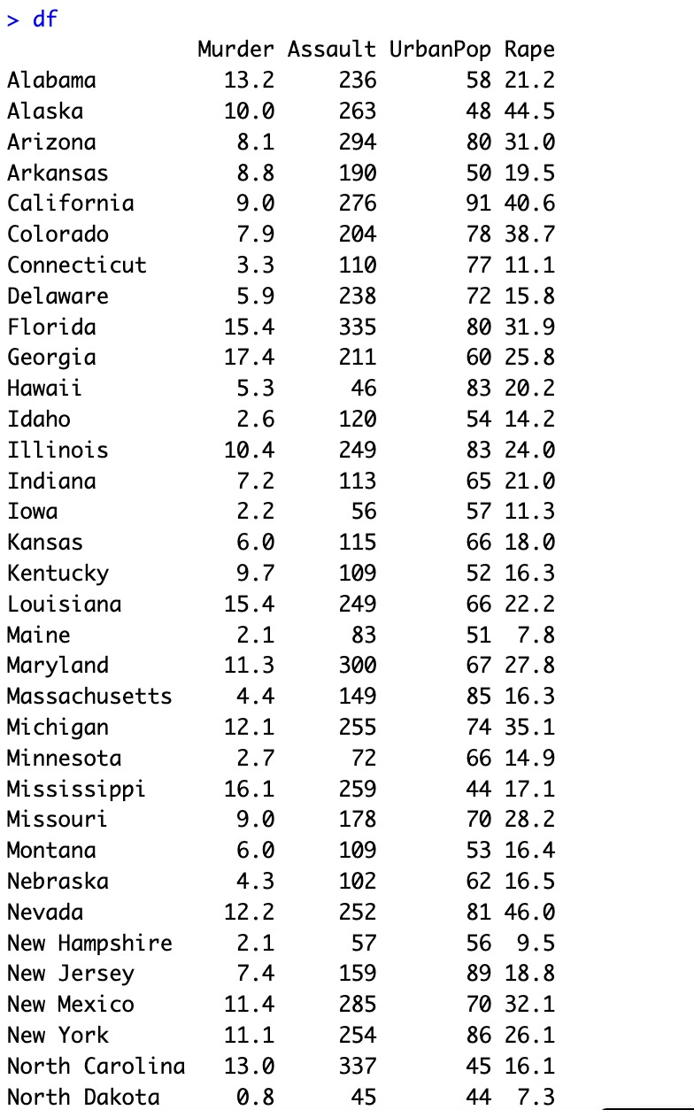
Dataset used
The USArrest dataset in R is a built-in dataset that contains statistics on arrests made in the United States in 1973 for murder, rape, and assault. The dataset includes data for all 50 states as well as the District of Columbia. The variables in the dataset are the number of arrests per 100,000 residents for each crime category, as well as the percentage of the population living in urban areas.
This dataset is commonly used for exploratory data analysis and machine learning algorithms, particularly for clustering and classification tasks. Its simplicity and relevance to real-world scenarios make it a useful starting point for learning about data analysis and machine learning in R.

Slide 7
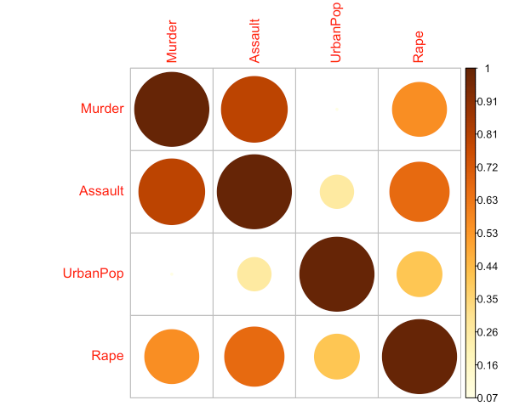
Exploratory Data Analysis

Slide 8
Steps to Implement K - Means Clustering?
1. Import and preprocess dataset as necessary
2. Determine the range of k values to be tested
3. For each value of k:
a. Run MacQueen's algorithm to obtain initial centroids
b. Run k-means algorithm with given k value and initial centroid
c. Calculate average silhouette score for all data points
4. Choose k value with highest average silhouette score
5. Run k-means algorithm again with chosen k value and initial centroids obtained using MacQueen's algorithm
6. Visualize the clusters and interpret the results

Slide 9
Silhouette Score
s(i) = (b(i) - a(i)) / max(a(i), b(i))
where:
• a(i) the average distance between i and all other points in the same cluster.
• b(i) is the smallest average distance between i and all points in a different cluster.
• max(a(i), b(i)) is the maximum of a(i) and b(i)

Slide 10
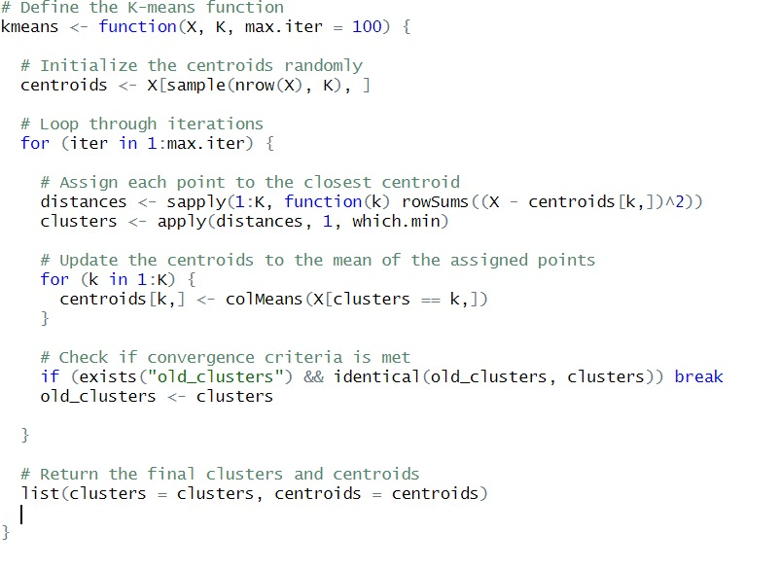
Implementation of K - Means Clustering in R?
This code defines a function called "kmeans" that implements the K-means clustering algorithm in R. The function takes a matrix or data frame of data points to be clustered, the number of clusters to be formed, and the maximum number of iterations to be performed before stopping the algorithm.
The function initializes the centroids randomly and iteratively assigns each data point to the closest centroid and updates the centroid positions until convergence.
Finally, the function returns a list with two elements: the cluster assignment of each data point and the final positions of the centroids.
This code provides a simple and customizable implementation of the K-means clustering algorithm in R.

Slide 11
Inbuilt K Means Function in R
To perform K-means clustering using the "kmeans()" function in R, we need to provide the following parameters:
"x": A numeric matrix or data frame containing the dataset to be clustered.
"centers": The number of clusters to be formed.
"nstart": The number of times the algorithm should be run with different initial cluster centers.
"algorithm": The algorithm used to compute the clusters. It can be "Hartigan-Wong" or "Lloyd".
"iter.max": The maximum number of iterations to be run.
"tol": The convergence tolerance value.
"trace": If TRUE, it prints the convergence information during the algorithm.
Once the "kmeans()" function is executed, it returns an object of class "kmeans". This object contains information such as cluster centers, cluster assignments, within-cluster sum of squares, and iteration details.
To determine the optimal number of clusters, we can use the elbow method or silhouette analysis. The "fviz_nbclust()" function from the "factoextra" package can be used to create a plot of the within-cluster sum of squares for different numbers of clusters, allowing us to identify the elbow point where the plot starts to level off.
Overall, the inbuilt "kmeans()" function in R makes it easy to perform K-means clustering on a dataset, and the elbow method and silhouette analysis can be used to determine the optimal number of clusters.

Slide 12
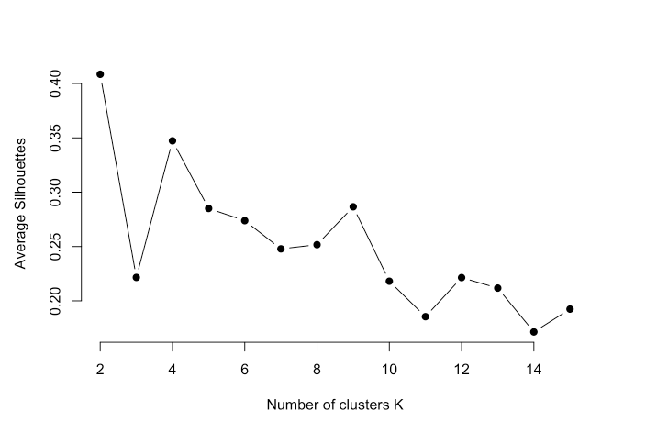
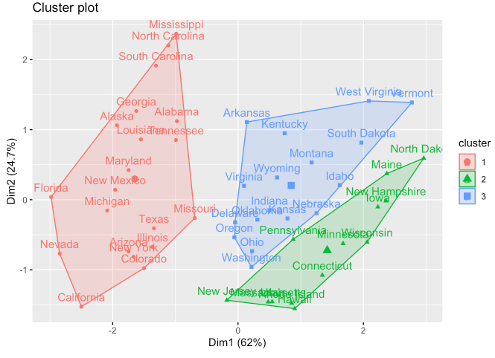
K Means Clustering Result

Slide 13
Conclusion
We successfully developed a k-means clustering algorithm from scratch in R language for the USArrest dataset, using optimization techniques to improve its modularity, flexibility, and computational efficiency.
Our implementation produced results that were comparable to existing R implementations, and we also created a visualization tool to aid in interpreting the clustering structure of the data.
This project provided valuable insights into the k-means algorithm and its practical applications, making it a useful resource for researchers and practitioners analyzing crime statistics data.

Slide 14
Thank You!

