Slide 1
Sarcasm Detection
Maheswara Reddy
51518487

Slide 2
Problem Statement
To predict whether the given statement is sarcastic or not.
The following example shows this.
I love being ignored. (Sarcastic)
I love being pampered. (Non Sarcastic)
Inputs/Dataset to be used:
Input is taken from “https://nlp.cs.princeton.edu/SARC/” version 2.0
Output:
Presentations and Report.
Codes, Environment Setup
Final metrics values.

Slide 3
Proposed Solution

Slide 4
Abstract
To predict whether the given statement is sarcastic or not
Sarcasm, as linguist Robert Gibbs noted, includes “words used to express something other than and especially the opposite of the literal meaning of a sentence.”
However, it’s not always easy to figure out if a writer is being sarcastic.
Sarcasm thrives in ambiguous situations – and that’s the main issue.
Sarcasm transforms the polarity of an apparently positive or negative utterance into its opposite.
Automatic detection of sarcasm is still in its infancy. One reason for the lack of computational models has been the absence of accurately-labeled naturally occurring utterances that can be used to train machine learning systems.
While speaking, people often use heavy tonal stress and certain gestural clues like rolling of the eyes, hand movement, etc. to reveal sarcastic. In the textual data, these tonal and gestural clues are missing, making sarcasm detection very difficult for an average human.

Slide 5
Data
Data set is taken from “https://nlp.cs.princeton.edu/SARC/” version 2.0
The dataset is divided into four categories.
Main Balanced: This is the primary dataset which contains a balanced distribution of both sarcastic and non-sarcastic comments.
Main imbalanced: To emulate real-world scenarios where the sarcastic comments are typically fewer than non-sarcastic ones, this can be used an imbalanced version of the Main dataset.
Pol Balanced: This is the subset of man which contains politics related comments with balanced distribution of sarcastic and non-sarcastic comments.
Pol imbalanced: This is the subset of man which contains politics related comments with unbalanced distribution of sarcastic and non-sarcastic comments.
For more information read readme file in the above link.

Slide 6
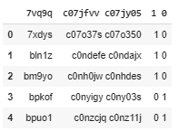
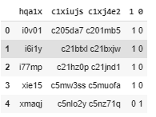
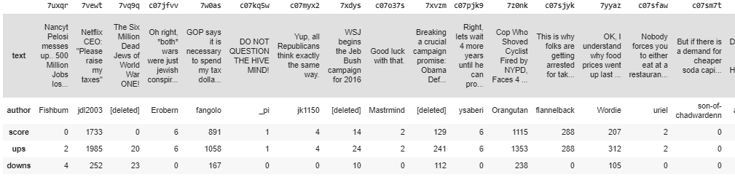
Data Pre-Processing
Train Data Test Data
Json Data

Slide 7
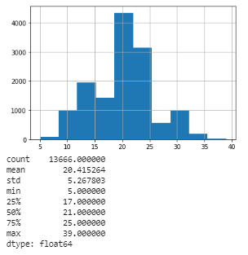
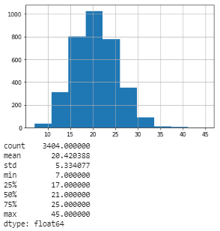
Data Pre-Processing
Read the Train and Test data from csv files
ID’s data is separated with space and Result data is also separated with space. Then concatenated these columns.
Read the JSON file and Transposed the date to get the ID’s in a column.
Merged the JSON data with CSV files and removed unnecessary columns.
Converted the data to lower
Removed punctuation from the text
Removed Stop Words from the data
Lemmatization have been done on Train and Test data
Counted individual words and created a dictionary word with count
Vocabulary is converted to int for Train and Test Data
Still some of the punctuation are left out in data, Assigned 0 to those punctuations.
Train and Test data after processing, data distribution is specified in pictures next to the text.
Transformed the data to Tensors before exposing to model
Split-ted train data with 80:20. 20 percent of data is used for validation to tune the hyper parameters.

Slide 8
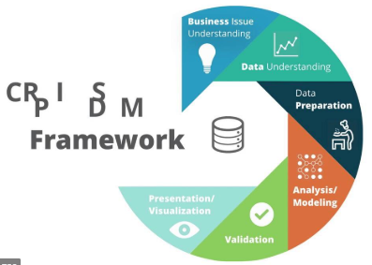
Modelling

Slide 9
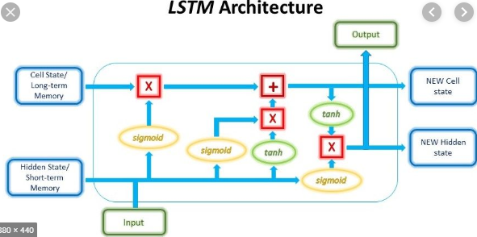
Modelling
I used RNN LSTM deep learning technic to classify sarcastic comments.
Total Vocab size is used. For im-balanced data size is increased to fit all the words.
400 Embedding dimensions, 512 hidden dimensions and 10 layers were considered to build LSTM network.
Output size was considered as 1

Slide 10
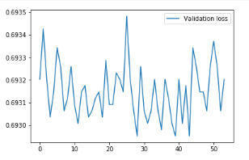
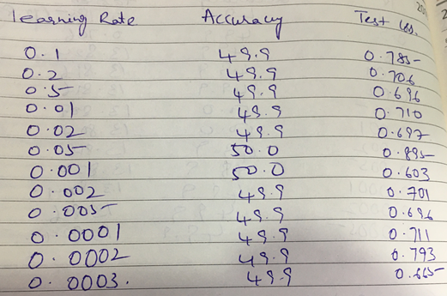
Performance Measures
Different learning rates were considered and almost for all the learning rates I got a accuracy of 50%.
These I tried for 4 epochs.
But even I tried for 100 epochs with learning rate of 0.01, I got the same accuracy and even validation loss was not changing it was around 0.69, even the training loss was around 0.69.
The above slides procedure have been used for im-balanced data also.

Slide 11
Tools and Framework Used
Python, Pandas, NumPy and Pytorch
Tried BERT

Slide 12
Setup
Project has been executed in Google Colab. So upload all the required input files in google drive. Then execute the below commands
from google.colab import drive
drive.mount('/content/gdrive’)
Imported below libraries
import pandas as pd
import numpy as np
import torch
import json
from string import punctuation
from spacy.lang.en import English
from spacy.lang.en.stop_words import STOP_WORDS
import en_core_web_sm
from collections import Counter
import pandas as pd
import matplotlib.pyplot as plt
import torch
from torch.utils.data import DataLoader, TensorDataset
import torch.nn as nn

Slide 13
Source Code
Placed the code in below GitHub link:
https://github.com/mahesh1982/HCLHackathon_SarcasticCalssification

Slide 14
Metrics
Model Name | Pol
 | Balanced | Imbalanced
 | Accuracy | Accuracy
LSTM | 50.0 | 17.3
BERT | Tried, but Google Colab session was aborting after 1 hour, so unable to proceed further

Slide 15
Problems Faced and Future Implementations
Reading a 2 GB Json File is so tricky.
When I read it in Google Colab, its accommodating full RAM of colab. So I am unable to proceed with that and google colab session is restarted every time.

Slide 16
References
https://nlp.cs.princeton.edu/SARC/
https://arxiv.org/pdf/1704.05579.pdf
https://theconversation.com/why-is-sarcasm-so-difficult-to-detect-in-texts-and-emails-91892
https://www.sciencedirect.com/science/article/pii/S235286481630027X
https://towardsdatascience.com/sentiment-analysis-using-lstm-step-by-step-50d074f09948
https://github.com/mahesh1982/deep-learning-v2-pytorch/blob/master/sentiment-rnn/Sentiment_RNN_Solution.ipynb

Slide 17
About Me
Currently Working as Technical Manager in UTC Aerospace ODC.
Completed PG Diploma in Data Science from IIIT Bangalore in Jun 2019 with 3.3/4 CGPA
Certified as Deep Learning Engineer from Udacity
Certified as Data Scientist in R from Data Camp

Slide 18
Thank You

