Slide 1
CYBER SECURITY PROJECT
GoldenEye, HULK, and LOIC –
DDoS Attack
A Controlled, Isolated-Lab Evaluation of HTTP / TCP Flood Tools
GoldenEye
HULK
LOIC
Prepared for: Skillogic
Prepared by: Mahesh Ade
Project ID: PTID-CSPP-OCT-26-666
GoldenEye • HULK • LOIC | DDoS Attack Simulation
1
Notes:
Welcome. This project is a controlled DDoS simulation in an isolated VirtualBox lab. Three Kali machines run GoldenEye, HULK and LOIC against one Metasploitable 2 target. Everything was done in a closed internal network, nothing touched the internet.

Slide 2
AGENDA
What This Report Covers
01
Introduction & Objective
Why multi-source availability testing matters
02
Lab Setup & Network Configuration
Three isolated sources → one target
03
GoldenEye Simulation
Source 1 (192.168.100.10) — HTTP traffic evidence
04
HULK Simulation
Source 2 (192.168.100.11) — randomized HTTP traffic
05
LOIC Simulation
Source 3 (192.168.100.12) — LOIC traffic evidence
06
Comparative Analysis & Findings
PCAP evidence, findings and mitigation
GoldenEye • HULK • LOIC | DDoS Attack Simulation
2
Notes:
Quick roadmap: introduction and objective, lab setup, then one section per tool (GoldenEye, HULK, LOIC), and finally the comparison, findings and mitigation.

Slide 3
INTRODUCTION
Objective of the Project
This project reviews GoldenEye, HULK and LOIC traffic in an isolated VirtualBox lab. The individual captures identify sources 192.168.100.10, .11 and .12 communicating with target 192.168.100.20. Combined capture evidence is used to examine multi-source traffic patterns; no production-scale impact is claimed.
Project Goals
▸ Configure an isolated 3-source / 1-target lab
▸ Run controlled tool-specific traffic simulations
▸ Capture packets with Wireshark
▸ Compare source IPs, protocols and packet counts
▸ Document limitations and defensive mitigations
GoldenEye • HULK • LOIC | DDoS Attack Simulation
3
Notes:
The goal was to compare the traffic of three tools from three different source IPs (.10, .11, .12) against one target (.20), capture it with Wireshark and document it. I want to be clear that I only claim packet-level evidence, not a proven outage.

Slide 4
PROBLEM STATEMENT
Why This Testing Is Necessary
Unknown Breaking Point
Without controlled testing, teams may not know how a web server responds to traffic from multiple sources. This lab records packet-level observations; it does not establish a server failure threshold.
Evasive Attack Patterns
HULK varies HTTP requests to reduce cache reuse. Whether caching or defenses were bypassed was not independently verified in this lab.
Under-Prepared Response
LOIC can generate TCP/UDP/HTTP traffic. Packet volume alone does not demonstrate that a link or server was saturated.
GoldenEye • HULK • LOIC | DDoS Attack Simulation
4
Notes:
Why test at all: teams often do not know how their web server reacts to multi-source traffic. In this lab I recorded packet-level observations. I did not establish a failure threshold, and I did not verify that caching or defenses were bypassed.

Slide 5
LAB SETUP
Lab Topology & Network Design
ATTACKERS (3 VMs)
TARGET
Kali Linux × 3
Metasploitable 2
GoldenEye: 192.168.100.10
HULK: 192.168.100.11
LOIC: 192.168.100.12
Subnet: 192.168.100.0/24
Apache Web Server (:80)
eth0: 192.168.100.20/24
VirtualBox Internal Network “DDos-Lab”
Isolation Principle: All four lab VMs use the same VirtualBox Internal Network “DDos-Lab” (no NAT/bridged adapter). Keep this topology isolated; captures are evidence from the lab only.
GoldenEye • HULK • LOIC | DDoS Attack Simulation
5
Notes:
Topology: three Kali attackers with IPs .10, .11 and .12, and one Metasploitable 2 target at .20 running Apache on port 80. All four VMs sit on the VirtualBox internal network called DDos-Lab, with no NAT or bridged adapter, so the lab stays isolated.

Slide 6
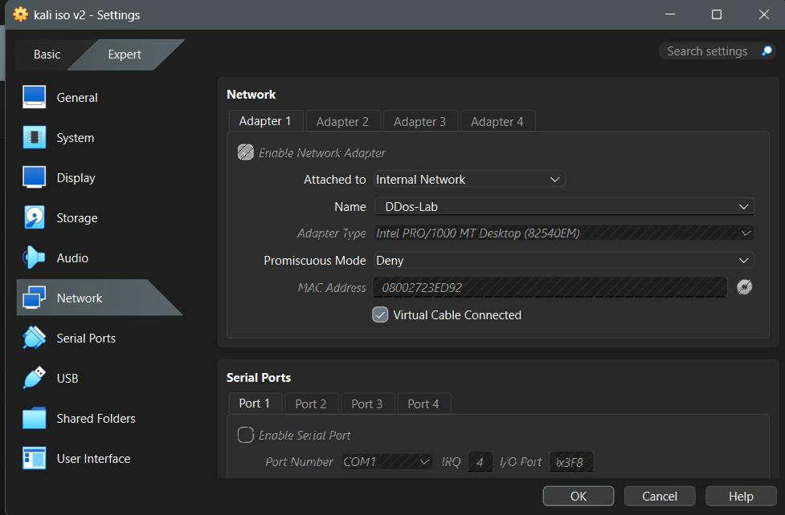
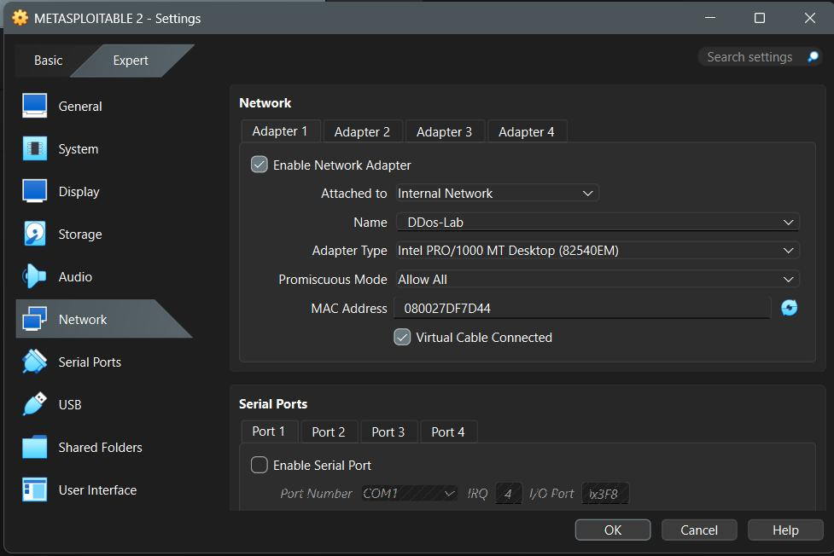
LAB SETUP — STEP 1A | VM Network Adapter Configuration
Kali Attacker Adapter
Metasploitable Target Adapter
Both VMs are attached to the same VirtualBox Internal Network named “DDos-Lab”. Promiscuous Mode is set to Deny on attackers and Allow All on the target to enable full packet visibility during captures.
GoldenEye • HULK • LOIC | DDoS Attack Simulation
6
Notes:
Here are the network adapter settings of one Kali VM and the target. Both use the same internal network. Promiscuous mode is Deny on the attackers and Allow All on the target so the target side can see all packets during captures.

Slide 7
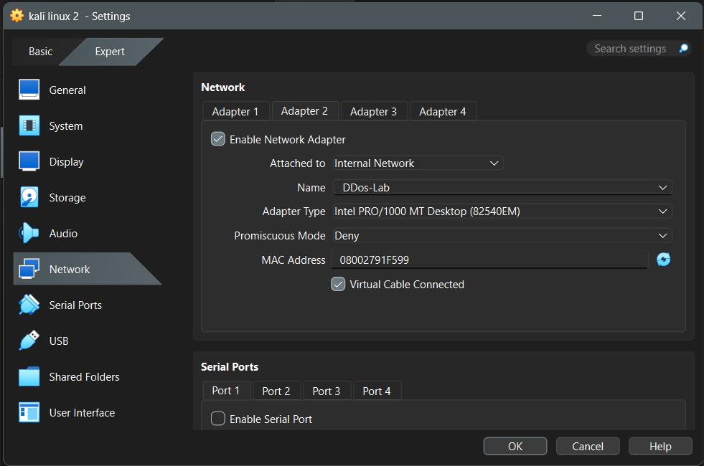
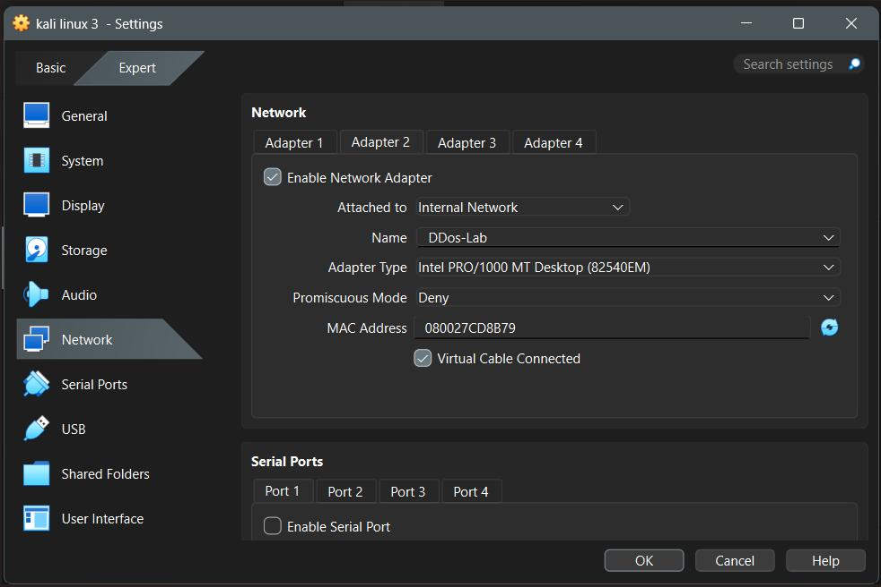
LAB SETUP — STEP 1B | Additional Attacker Adapters
Kali Linux 2 Adapter
Kali Linux 3 Adapter
All three Kali attacker VMs use the same Internal Network “DDos-Lab” with identical adapter type (Intel PRO/1000 MT Desktop). This ensures they can communicate with the target on the same L2 segment.
GoldenEye • HULK • LOIC | DDoS Attack Simulation
7
Notes:
The other two Kali VMs use the same internal network and the same adapter type, Intel PRO/1000 MT Desktop, so all three are on the same layer-2 segment as the target.

Slide 8
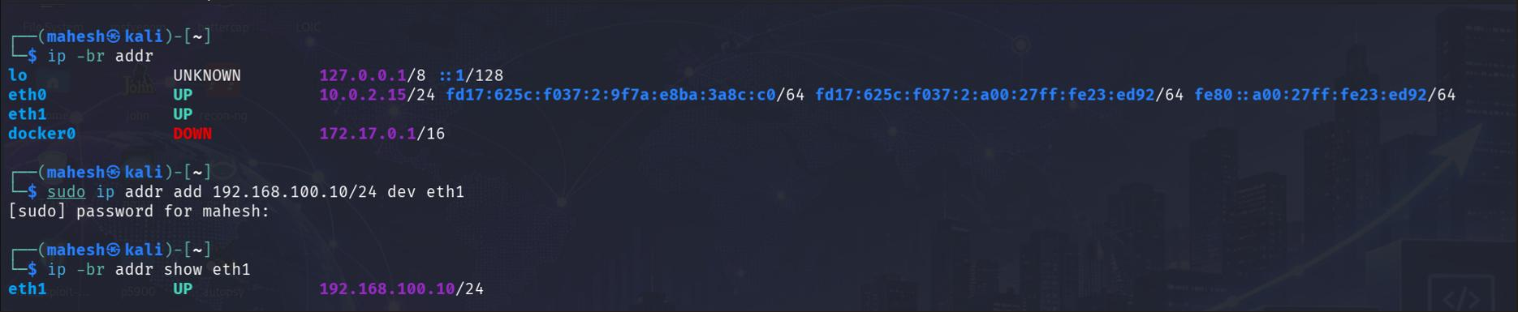
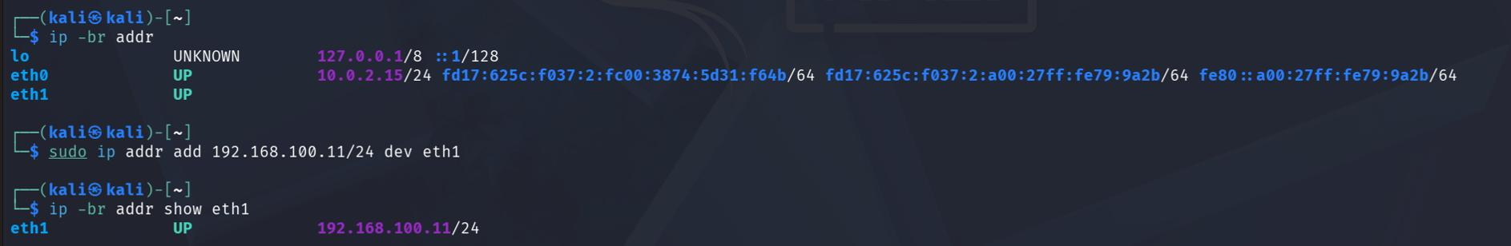
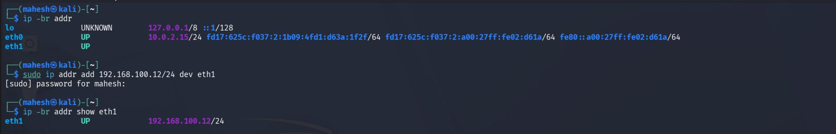
LAB SETUP — STEP 2A | Attacker IP Configuration
Kali 1 → 192.168.100.10
Kali 2 → 192.168.100.11
Kali 3 → 192.168.100.12
GoldenEye • HULK • LOIC | DDoS Attack Simulation
8
Notes:
IP configuration of the three attackers: .10, .11 and .12 on the 192.168.100.0/24 subnet, set with the ip addr command.

Slide 9
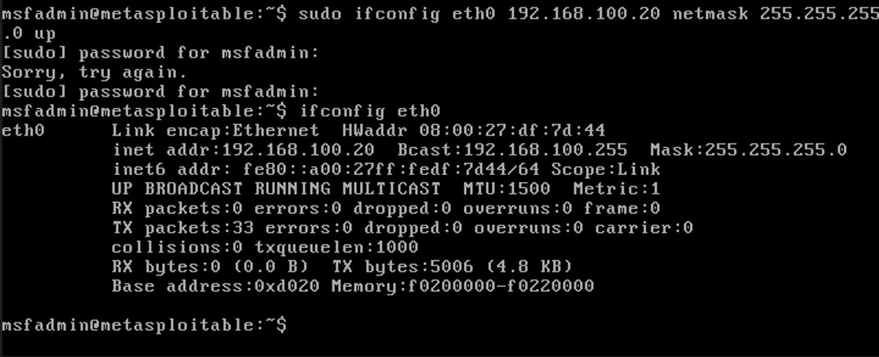
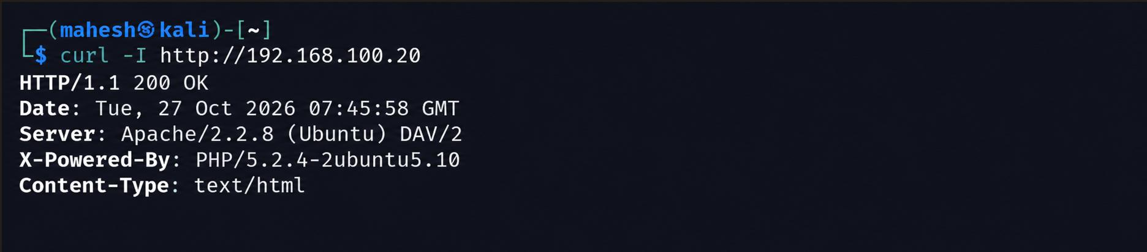
LAB SETUP — STEP 2B | Target IP & Connectivity Check
Target IP Configuration (192.168.100.20)
curl -I Response Headers (HTTP 200 OK)
GoldenEye • HULK • LOIC | DDoS Attack Simulation
9
Notes:
Target is set to 192.168.100.20. The curl -I request returns HTTP 200 OK from Apache 2.2.8, which confirms connectivity before any attack traffic.

Slide 10
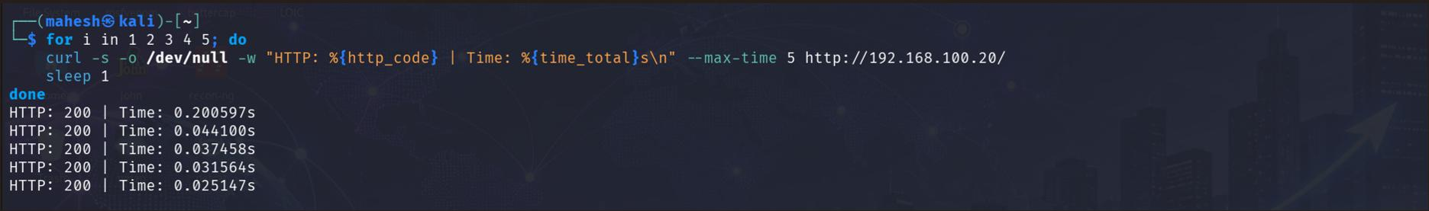
LAB SETUP — STEP 3 | Baseline Response Times
Five sequential HTTP requests confirm stable baseline before any attack traffic.
What this baseline shows
• All five requests returned HTTP 200 OK
• Response times remained low and consistent
• This establishes a clean reference point before launching GoldenEye, HULK or LOIC
• Any later increase in latency or appearance of errors can be attributed to the simulated traffic
GoldenEye • HULK • LOIC | DDoS Attack Simulation
10
Notes:
Baseline: five sequential HTTP requests, all 200 OK with consistently low response times. This is the reference point; any later change in latency or errors could be compared against it.

Slide 11
01
GoldenEye
HTTP Layer-7 Flood — Deployment, Execution & Traffic Analysis
GoldenEye • HULK • LOIC | DDoS Attack Simulation
11
Notes:
Section 1: GoldenEye, an HTTP layer-7 flood tool.

Slide 12
GOLDENEYE — BUSINESS CASE
Introduction, Problem & Solution Overview
1. Introduction
GoldenEye is an open-source tool used to simulate HTTP-based Denial of Service (DoS) and Distributed Denial of Service (DDoS) attacks. It is primarily used by penetration testers and cybersecurity professionals to evaluate the robustness of web applications and servers against DoS threats. GoldenEye plays a key role in identifying performance bottlenecks and preparing defensive mechanisms for real-world DDoS scenarios.
2. Problem Statement
Organizations often struggle to identify how well their infrastructure can withstand DoS or DDoS attacks. Without proper testing, applications may be vulnerable to performance degradation or outages. Security teams need tools like GoldenEye to simulate such attacks and gauge preparedness.
3. Solution Overview
GoldenEye floods target HTTP servers with seemingly legitimate traffic, testing the target’s ability to maintain availability under high load. This helps in stress-testing and assessing scalability and resilience of infrastructure.
GoldenEye • HULK • LOIC | DDoS Attack Simulation
12
Notes:
GoldenEye is an open-source HTTP DoS tool used by testers to check how a web server behaves under heavy request load. This slide is the background; the actual lab results follow in the execution slide.

Slide 13
GOLDENEYE — BUSINESS CASE
Key Features, Benefits & Project Outcome
4. Key Features and Benefits
▸ Simulates realistic HTTP-based DoS/DDoS attacks.
▸ Customizable request headers and concurrency options.
▸ Helps evaluate the effectiveness of rate limiting, firewalls, and load balancers.
▸ Useful for training incident response teams in a controlled environment.
5. Outcome of the Project
In this lab, GoldenEye generated HTTP traffic from 192.168.100.10 towards the Apache target (9,614 IPv4 packets captured, 711 strikes recorded). No service outage was verified; the capture serves as a baseline for tuning rate limiting, WAF rules and load balancing.
GoldenEye • HULK • LOIC | DDoS Attack Simulation
13
Notes:
Main features: customizable headers and concurrency, useful for testing rate limiting, firewalls and load balancers. In our lab it gave 9,614 packets and 711 strikes, with no verified outage, so it is a baseline for tuning, not proof of impact.

Slide 14
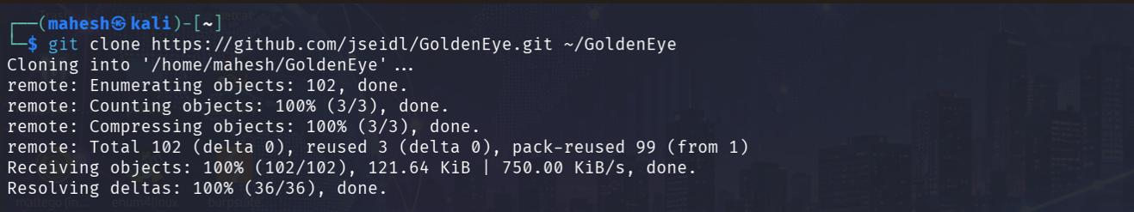
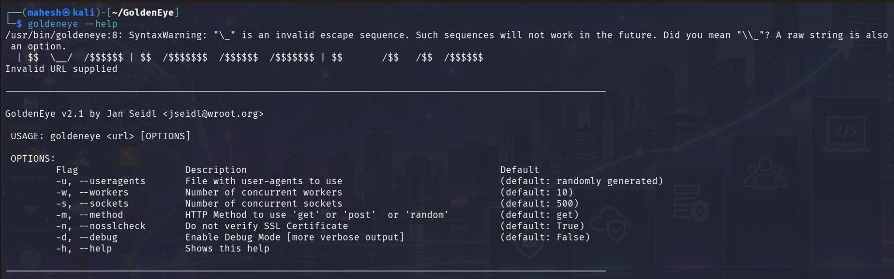
GOLDENEYE — DEPLOYMENT | Cloning & Reviewing the Tool
Git clone of GoldenEye repository
GoldenEye help / options
GoldenEye • HULK • LOIC | DDoS Attack Simulation
14
Notes:
Deployment: I cloned the GoldenEye repository from GitHub and checked the help output to see the options like workers, sockets and HTTP method.

Slide 15
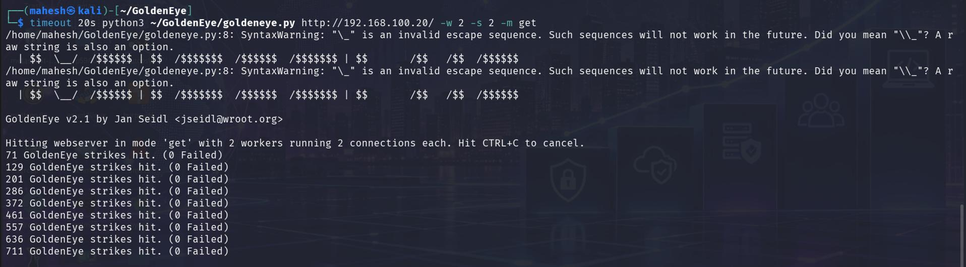
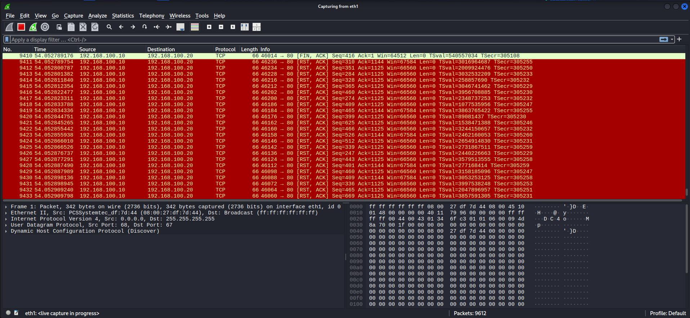
GOLDENEYE — EXECUTION | Attack Execution & Traffic Analysis
9,614
5,337
4,272
IPv4 PACKETS
SRC → TGT
TGT → SRC
Execution Output
GoldenEye launched from 192.168.100.10 with 2 workers and 2 sockets. 711 successful strikes recorded. No failed requests observed during the short run.
Wireshark Capture
Heavy TCP RST packets from source .10 to target .20 on port 80. Multiple retransmissions visible. Confirms Layer-7 flood traffic reached the target.
GoldenEye • HULK • LOIC | DDoS Attack Simulation
15
Notes:
Execution: GoldenEye ran from 192.168.100.10 with 2 workers and 2 sockets, 711 successful strikes, no failed requests in the short run. Wireshark shows 9,614 IPv4 packets, 5,337 from source to target and 4,272 back, with many TCP RST packets on port 80.

Slide 16
02
HULK
HTTP Unbearable Load King — Randomized Request Flood
GoldenEye • HULK • LOIC | DDoS Attack Simulation
16
Notes:
Section 2: HULK, the HTTP Unbearable Load King.

Slide 17
HULK — BUSINESS CASE
Introduction, Problem & Solution Overview
1. Introduction
HULK (HTTP Unbearable Load King) is a DoS tool designed to generate unique and randomized HTTP requests to evade caching and simulate high-volume traffic. It is used to test how web servers respond to unpredictable and excessive load, often highlighting weaknesses in traffic handling and session management.
2. Problem Statement
Web applications might have poor scalability or suffer from untested session handling logic under load. Standard DoS tests often get blocked by caching and firewalls. HULK generates unique requests intended to get past such protections, which helps test WAF and caching behaviour.
3. Solution Overview
HULK sends randomized HTTP GET requests that mimic legitimate behaviour but overload server processing. It aids in evaluating WAF and IDS configurations and their effectiveness against dynamic threats.
GoldenEye • HULK • LOIC | DDoS Attack Simulation
17
Notes:
HULK sends unique, randomized HTTP GET requests so that caching does not simply absorb the load. It is used to test web servers, WAFs and IDS rules against unpredictable traffic.

Slide 18
HULK — BUSINESS CASE
Key Features, Benefits & Project Outcome
4. Key Features and Benefits
▸ Randomizes requests to reduce cache reuse.
▸ Simulates real-world user load without IP spoofing.
▸ Tests robustness of web servers and reverse proxies.
▸ Exposes weaknesses in dynamic content delivery.
5. Outcome of the Project
In this lab, HULK sent randomized HTTP GET traffic from 192.168.100.11 (20,799 IPv4 packets captured). Cache bypass, worker exhaustion and outage were not verified; the result is packet-level evidence only.
GoldenEye • HULK • LOIC | DDoS Attack Simulation
18
Notes:
Key point: HULK randomizes requests to reduce cache reuse. In this lab it produced 20,799 packets from .11, but cache bypass, worker exhaustion and outage were not verified.

Slide 19
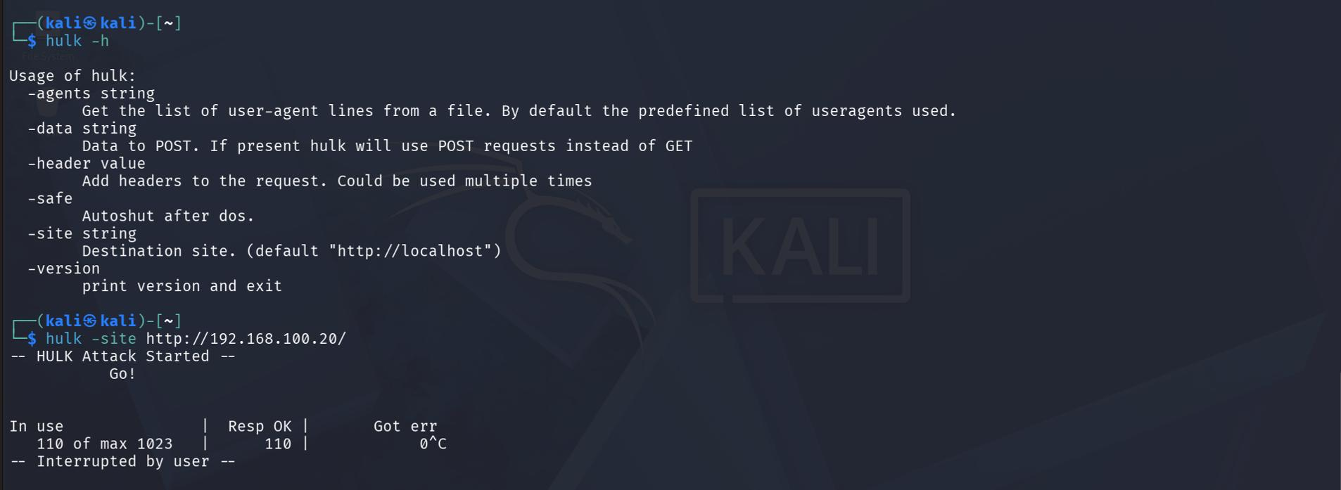
HULK — DEPLOYMENT | Cloning & Building the Tool
Go install of HULK
HULK help & live attack
GoldenEye • HULK • LOIC | DDoS Attack Simulation
19
Notes:
Deployment: HULK is a Go tool, installed with go install and run with the site parameter pointing at the target. The screenshot shows it started and then interrupted by me after a short run.

Slide 20
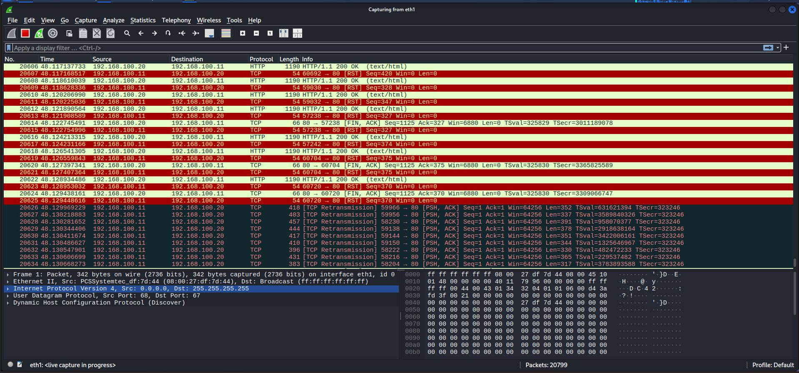
HULK — EXECUTION | Attack Execution & Traffic Analysis
20,799
15,422
N/V
IPv4 PACKETS
SRC → TGT
OUTAGE NOT VERIFIED
Wireshark capture — HULK traffic (source 192.168.100.11)
GoldenEye • HULK • LOIC | DDoS Attack Simulation
20
Notes:
Execution: 20,799 IPv4 packets, 15,422 from .11 to the target. The third box says outage not verified, meaning I have no evidence of a service failure in this capture.

Slide 21
03
LOIC
Low Orbit Ion Cannon — Volumetric TCP/UDP/HTTP Flood
GoldenEye • HULK • LOIC | DDoS Attack Simulation
21
Notes:
Section 3: LOIC, the Low Orbit Ion Cannon, a volumetric TCP, UDP and HTTP flood tool.

Slide 22
LOIC — BUSINESS CASE
Introduction, Problem & Solution Overview
1. Introduction
LOIC (Low Orbit Ion Cannon) is a widely known network stress testing tool capable of launching TCP, UDP, or HTTP requests to flood a targeted server. While often linked to hacktivist movements, it is also used for educational and research purposes in cybersecurity labs.
2. Problem Statement
Many organizations are unaware of their exposure to simple volumetric DDoS attacks. LOIC shows how easily a simple volumetric flood can be generated, helping teams plan mitigation controls in advance.
3. Solution Overview
LOIC helps simulate layer 7 or network-layer attacks. With real-time statistics, it shows how effective network defenses (such as rate limiting or geo-blocking) perform under stress.
GoldenEye • HULK • LOIC | DDoS Attack Simulation
22
Notes:
LOIC is a well known stress tool that can generate TCP, UDP or HTTP floods. It is easy to use, which is exactly why it is useful for awareness and for planning basic mitigation.

Slide 23
LOIC — BUSINESS CASE
Key Features, Benefits & Project Outcome
4. Key Features and Benefits
▸ User-friendly interface for launching volumetric attacks.
▸ Supports HTTP, TCP, and UDP flooding.
▸ Customizable packet size, delay, and threads.
▸ Helpful for awareness training and DDoS defense preparation.
5. Outcome of the Project
In this lab, LOIC produced the highest packet volume (112,845 IPv4 packets from 192.168.100.12). Network saturation and firewall gaps were not established; the capture supports planning for geo-IP filtering and traffic shaping.
GoldenEye • HULK • LOIC | DDoS Attack Simulation
23
Notes:
In this lab LOIC created the highest volume of the three, 112,845 packets. Saturation and firewall gaps were not established, so the takeaway is to plan geo-IP filtering and traffic shaping, not that we broke something.

Slide 24
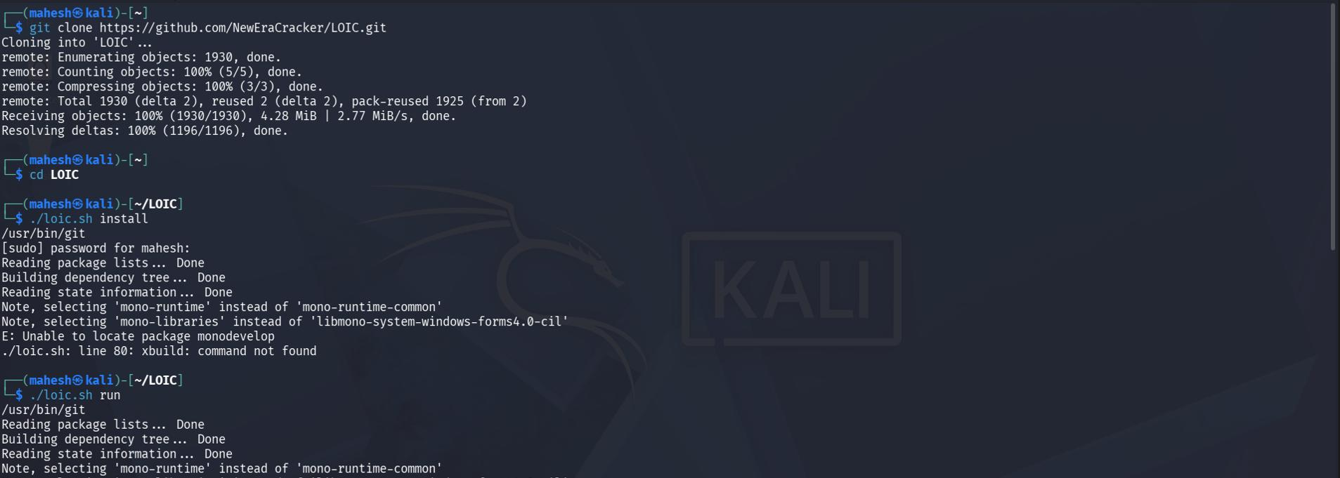
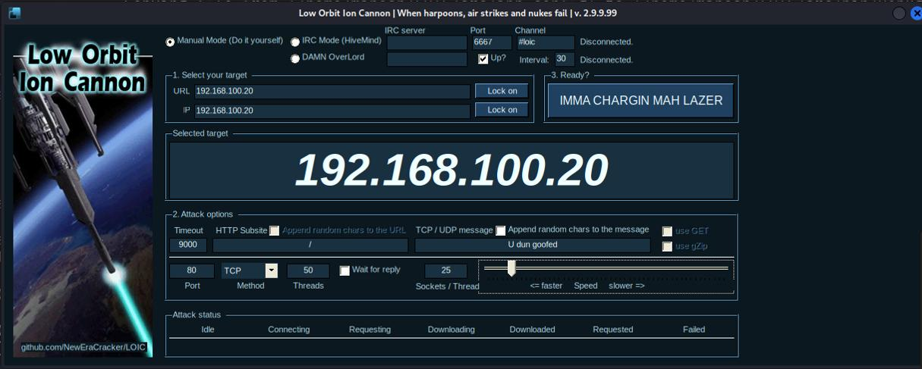
LOIC — DEPLOYMENT | Cloning, Building & Launching
Clone & Install Attempt
LOIC Graphical Interface
LOIC Deployment Notes
• Left: git clone of LOIC repository and attempted install (mono/xbuild dependency issues visible)
• Right: LOIC Graphical Interface locked onto target 192.168.100.20
• The GUI shows Manual Mode with TCP method, 50 threads and adjustable sockets
• Installation warnings are expected in this lab environment; the tool was still launched for traffic generation
GoldenEye • HULK • LOIC | DDoS Attack Simulation
24
Notes:
Deployment: the clone and install showed mono and xbuild dependency warnings, which are expected in this environment, but the GUI still launched. It was set to the target 192.168.100.20 in manual mode, TCP method, 50 threads.

Slide 25
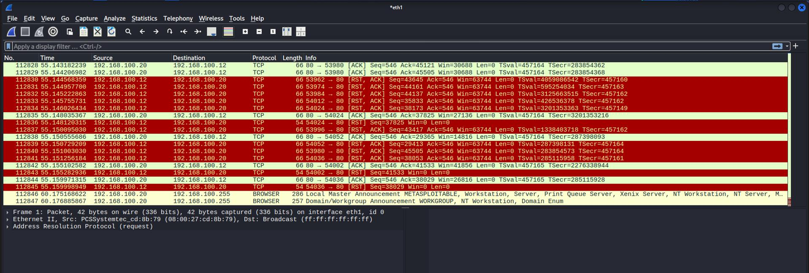
LOIC — EXECUTION | Attack Execution & Traffic Analysis
112,845
97,899
14,946
IPv4 PACKETS
SRC → TGT
TGT → SRC
Wireshark capture — LOIC traffic (source 192.168.100.12)
GoldenEye • HULK • LOIC | DDoS Attack Simulation
25
Notes:
Execution: 112,845 IPv4 packets, 97,899 from source to target and 14,946 back. The Wireshark screenshot shows the TCP flood from 192.168.100.12.

Slide 26
COMPARATIVE ANALYSIS
GoldenEye vs. HULK vs. LOIC
Attribute
GoldenEye
HULK
LOIC
Source IP
192.168.100.10
192.168.100.11
192.168.100.12
Traffic type
HTTP / TCP
HTTP / TCP
TCP / HTTP observed
IPv4 packets parsed
9,614
20,799
112,845
Source → target
5,337
15,422
97,899
GoldenEye • HULK • LOIC | DDoS Attack Simulation
26
Notes:
Side-by-side comparison. Same target, three sources. LOIC has by far the most packets, then HULK, then GoldenEye. The last row, impact proven, is No for all three, because we only have packet evidence.

Slide 27
FINDINGS
Key Findings & Outcomes
GoldenEye
9,614 IPv4 packets parsed; source .10 sent 5,337 packets to target .20. TCP traffic to port 80 dominates the parsed traffic. Service degradation was not independently verified.
HULK
20,799 IPv4 packets parsed; source .11 sent 15,422 packets to target .20. TCP traffic to port 80 dominates the parsed traffic. Worker exhaustion and cache bypass were not established.
LOIC
112,845 IPv4 packets parsed; source .12 sent 97,899 packets to target .20. Highest parsed IPv4 count among the three individual captures. Network saturation and service unavailability were not established.
GoldenEye • HULK • LOIC | DDoS Attack Simulation
27
Notes:
Findings in one line each: GoldenEye 9,614 packets, HULK 20,799 packets, LOIC 112,845 packets, all mainly TCP to port 80. None of the captures proves outage, saturation or cache bypass.

Slide 28
RECOMMENDATIONS
Mitigation & Defense Recommendations
Rate Limiting
WAF Tuning
Cap requests per IP/session to blunt GoldenEye- and HULK-style floods at the edge.
Behavioural and anomaly-based rules to catch randomized, cache-evading request patterns.
Load Balancer Scaling
Geo-IP Filtering & Traffic Shaping
Distribute load and auto-scale backend workers to absorb short bursts.
Block or throttle volumetric sources identified during LOIC-style flooding.
Connection / Session Hardening
Continuous Monitoring
Tune server-side timeouts and session handling to resist exhaustion.
NetFlow + IDS baselines so future floods are detected in real time, not after impact.
GoldenEye • HULK • LOIC | DDoS Attack Simulation
28
Notes:
Mitigations: rate limiting per IP or session, WAF tuning for randomized requests, load balancer scaling, geo-IP filtering and traffic shaping, tighter timeouts and session handling, and continuous monitoring with NetFlow and IDS.

Slide 29
CONCLUSION
Resilience Is Built Before the Attack,
Not During It
The isolated lab captures show distinct HTTP/TCP traffic associated with GoldenEye (.10), HULK (.11) and LOIC (.12), all directed at target .20. The supplied captures provide packet-level evidence of multiple sources, but do not prove service outage, bandwidth saturation or control failure.
Future validation should record baseline versus test latency, HTTP errors, target CPU/RAM, connection counts and throughput.
Thank You
GoldenEye • HULK • LOIC | DDoS Attack Simulation
GoldenEye • HULK • LOIC | DDoS Attack Simulation
29
Notes:
Conclusion: the lab captures give clear packet-level evidence of three distinct sources targeting one server, but they do not prove outage or saturation. For stronger validation, future runs should log baseline versus test latency, HTTP errors, CPU and RAM, connection counts and throughput. Thank you, happy to take questions.

