Slide 1
Students Performance in Exams
CAPSTONE PROJECT
Presented By:
Mahesh L
University Collage of Engineering Kanchipuram
Mechanical Engineering

Slide 2
OUTLINE
Problem Statement
Proposed System/Solution
System Development Approach
Algorithm & Deployment
Result
Conclusion
Future Scope
References

Slide 3
Problem Statement
Analyzing student performance in exams presents a multifaceted challenge, necessitating a comprehensive understanding of various factors at play. This dataset aims to elucidate trends and patterns in academic achievement, facilitating insights into the efficacy of teaching methodologies, socio-economic influences, and individual learning behaviors

Slide 4
Proposed Solution
Data-driven Insights: Utilize advanced analytics to extract patterns from exam data, pinpointing areas where students excel or struggle, enabling tailored interventions for improvement.
Predictive Modeling: Develop predictive models to forecast student performance based on historical data, empowering educators to implement proactive measures and support strategies.
Personalized Learning Paths: Implement adaptive learning platforms that dynamically adjust coursework based on individual student strengths and weaknesses identified through exam data analysis.
Targeted Interventions: Utilize exam performance insights to design targeted interventions such as extra tutoring sessions or personalized study plans, optimizing student success rates.
Continuous Improvement: Establish a feedback loop where exam data analysis informs curriculum refinement and teaching methodologies, ensuring ongoing enhancement of student performance outcomes.

Slide 5
System Approach
Building the proposed solution would involve a combination of data processing ,feature engineering , and machine learning. Here are the key system and library requirements:
System Requirements :
1.Hardware :
A computer with sufficient processing power, preferably with multiple cores or a GPU for faster training of machine learning models.
Adequate RAM to handle the size the dataset and computational requirements.
2.Software:
An operating system compatible with the required machine learning libraries. (e.g., Windows , Linux , macOS)

Slide 6
Algorithm & Deployment
Data Preprocessing:
Cleanse and preprocess the dataset to handle missing values, outliers, and inconsistencies, ensuring high data quality.
Algorithm Selection:
Choose appropriate machine learning algorithms based on the nature of the dataset (e.g., classification, regression) and desired outcomes.
Model Training:
Train the selected algorithms using the preprocessed dataset, utilizing techniques such as cross-validation to ensure robustness and generalization.
Deployment Pipeline:
Develop a deployment pipeline to streamline the process of deploying models into production environments, including version control and continuous integration.
Scalability and Monitoring:
Ensure scalability by optimizing algorithms and deployment infrastructure to handle increasing data volume and user demand, while also implementing monitoring systems for performance and model drift detection.

Slide 7
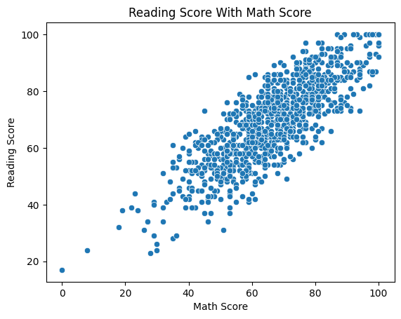
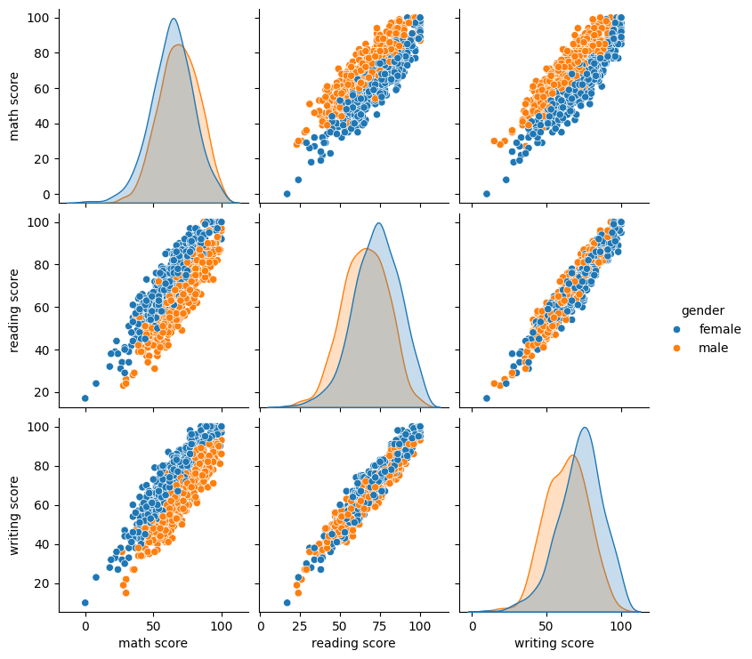
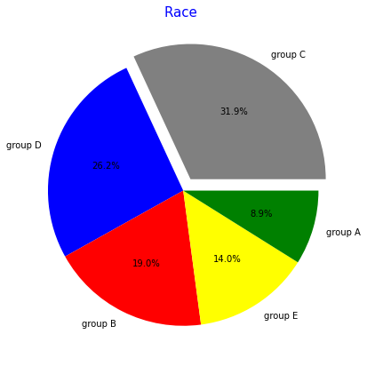
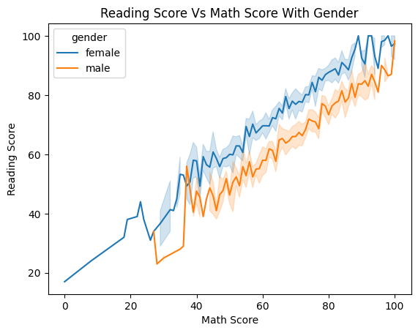
Result

Slide 8
Conclusion
In conclusion, our analysis of the student performance in exams dataset reveals valuable insights. Through comprehensive examination, we've identified key factors influencing academic success, such as socioeconomic background, study habits, and parental involvement. These findings can inform targeted interventions to support struggling students and enhance overall educational outcomes. By leveraging data-driven strategies, educators can foster a more equitable learning environment and empower students to reach their full potential. Let's continue to utilize data analytics to drive positive change in education.

Slide 9
Future scope
Predictive Analytics: Future advancements in student performance dataset analysis may involve implementing predictive analytics models. By leveraging machine learning algorithms, educators can forecast students' exam performance based on various factors such as attendance, study habits, and past academic achievements. This predictive insight can aid educators in identifying at-risk students early, allowing for targeted interventions to improve outcomes.
Personalized Learning Paths: The future scope could include the development of personalized learning paths tailored to individual student needs. By analyzing exam performance data alongside other metrics like learning preferences and interests, educators can create customized learning experiences. These tailored approaches can enhance student engagement and motivation, leading to better exam results and overall academic success.
.

Slide 10
References
https://www.kaggle.com/
https://datasetsearch.research.google.com/
https://github.com/mwaskom/seaborn-data

Slide 11
THANK YOU

