Slide 1
SEMINAR By, Sandra Anna Joshy S1 MSc Computer Science

Slide 2
SHELL Various types of shell linux commands for files and directories creating and viewing files using “cat”

Slide 3
Shell
Provides interface between user and OS.
Command line interpreter.
Shell is not part of system kernel.
But uses the system kernel to execute programs, creates files etc.

Slide 4
USER REQUEST
SHELL
APPLICATION
LINUX KERNEL
HARDWARE

Slide 5
Shell programming
Shell programs or shell scripts are files containing Linux commands, comments, and control statements.
Any command can be executed at the shell prompt can be included in a shell programs.
The shell provides very powerful features for writing shell programs.
Many of the shell programs are used at startup and shutdown time.

Slide 6
Various types of shells
there are different types of shells are available.
The bourne shell
The c shell
The korn shell
The gnu bourn-again shell
Tc shell
Restricted shell
A shell
Z shell

Slide 7
1.The bourne shell
Developed by Stephen Bourne at AT &T Bell Labs.
Stored in the /bin directory.
The executable file name of Bourne sell is ‘sh’.
Limitations
Does not provide history list.
Does not provide Command line editing.
Not friendly for interactive use.
Also lacks built-in arithmetic and logical expression handling.
For the Bourne Shell the :
Command full-path name is : /bin/sh
Non-root user default prompt is :$
Root user default prompt is :#

Slide 8
2.The c shell
Developed by William Joy at the University of California at Berkeley.
The executable file name for this shell is ‘csh’ .
Features
Includes command aliases.
Command history.
For the C shell the :
Command full path name is : /bin/csh
Non-root user default prompt is : %
Root user default prompt is : #

Slide 9
3.The korn shell
Developed by David Korn at AT&T Bell Labs.
Combines the features of both the Bourne and C shells.
Executable file name is ‘ksh’.
Features
Convenient programming features.
For the Korn shell
Command full-path name is :/bin/ksh
Non-root user default prompt is : $
Root user default prompt is : #

Slide 10
4.Bourne again shell(bash)
Developed by Brian Fox and Chet Ramey at Free Software Foundation under their GNU project.
It provides all the interactive features of the C shell and the Korn shell.
Enchancement of Bourne shell.
The executable file name is ‘bash’.
For the GNU Bourne-Again shell the:
Command full-path name is : /bin/bash
Default prompt for a non-root user is : bash-x.xx$(Where x.xx indicates the shell version number .
For eg : bash-3.50$)
Root user default prompt is : bash-x.xx#. (Where x.xx indicates the shell version number . For eg : bash-3.50$)

Slide 11
5.TC Shell or tcsh shell
Tcsh stands for Tom’s C shell .
Enchancement of the C shell.
Can execute the Tcsh shell by typing either csh or tcsh .
It provides all the features of the C shell together with emacs style editing of the command line.

Slide 12
6.Restricted shell
Used to provide limited access on the operating system by the user.
Used for guest users who only need limited rights and permissions.

Slide 13
7.A shell
Developed by Kenneth Almquist.
It emulates Bourne shell.
A shell is suitable for the computers having limited memory.
The executable file name for the A shell is ‘ash’.

Slide 14
8. Z shell
Offers the features of Tcsh and Korn shell.
Provides a large number of utilities and extensive documentation.
The executable file name is ‘zsh’.
Features
Spelling correction
Theming
Sharing command history across multiple terminals

Slide 15
Comparison between various shell
Feature | Bourne | Korn | C | Tcsh | Bash
Background processing | Yes | Yes | Yes | Yes | Yes
Command history | No | Yes | Yes | Yes | Yes
I/O redirection | Yes | Yes | Yes | Yes | Yes
Shell scripts | Yes | Yes | Yes | Yes | Yes
Command alias | No | Yes | Yes | Yes | Yes
File name completion | No | Yes | No | Yes | Yes
Command completion | No | No | No | Yes | Yes
Command line editing | No | Yes | No | Yes | Yes
Job control | No | Yes | Yes | Yes | Yes

Slide 16
Steps to create a shell script
Create a file using a vi editor (or other editor).Name script file with extension .sh .
Start the script with #!/bin/bash (name of the interpreter).
Write some code.
Save the script file as
To execute the script use any of these two steps :
Give execute permission for the file using chmod command : chmodu+x filename.sh or
chmod 755 filename.sh and then run using ./filename.sh
b) Use bash filename.sh

Slide 17
Example of a simple shell script
#!/bin/bash
echo “Our first script”
echo “----------------”
echo “Welcome to BASH Programming”
save this script with name ‘first.sh’ .To execute, use the following commands:
chmod u+x first.sh
./first.sh
output:
Our first script
----------------
Welcome to BASH Programming

Slide 18
commands for files and directories
cd:
To change directory – change the current working directory to a specific dirtectory.
syntax:
cd[options][directory]
cd~ change to your home directory
cd/ change to root directory
cd.. Change to parent directory
cd- change to previous directory where you working earlier
eg : cd /bin
$cd ~
cd ~username
cd dir1/dir2/dir3

Slide 19
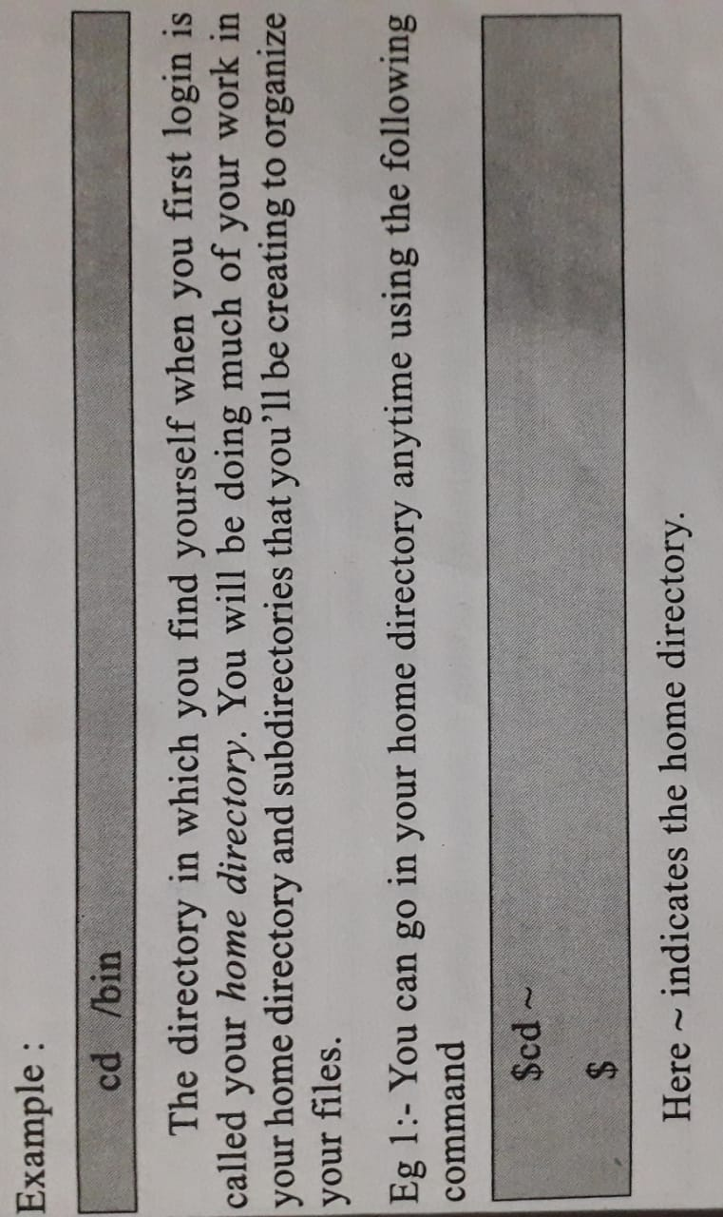
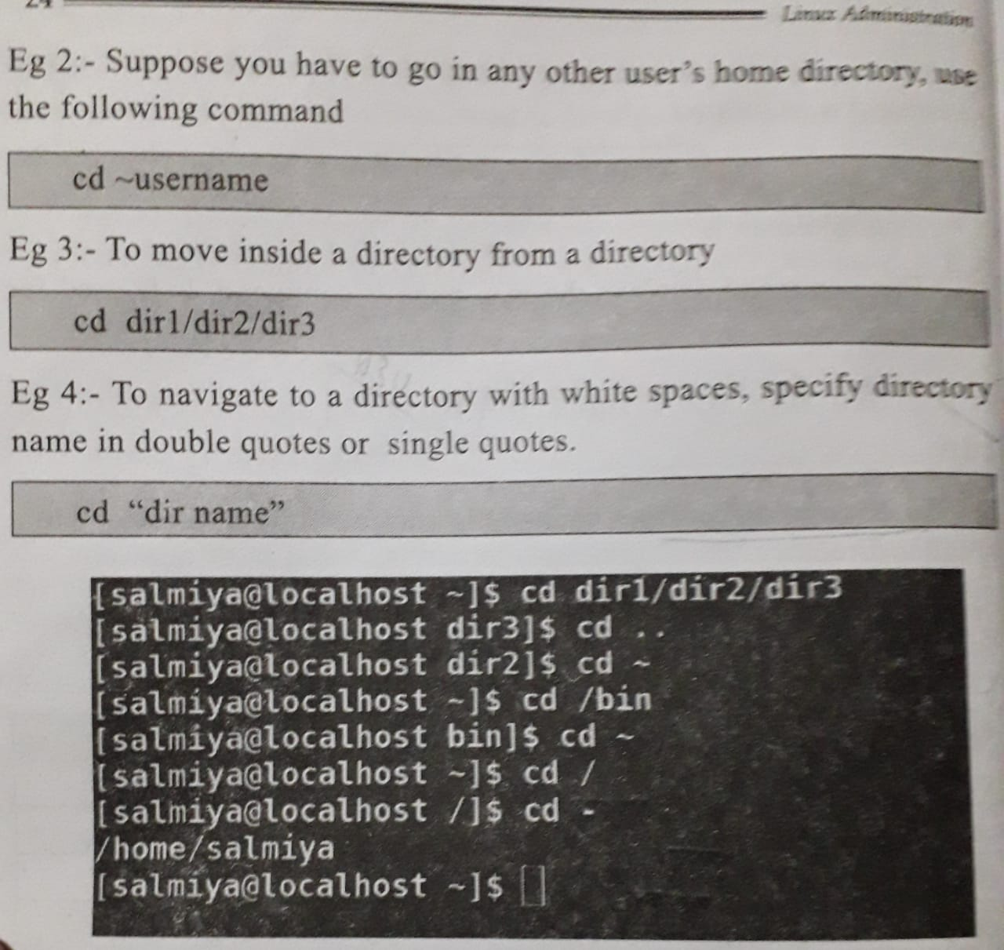
example

Slide 20
ls
used to list the content of the specified directory.
ls [option] [directory]
-a List all files including hidden files starting with ‘.’
-d List directory
-l List with long format
-r List in reverse order
-s Sort by size
-t Sort by time and date
-X Sort by extension name
-R List the file and folder of directory and subdirectory
-C List entries by columns
-i Print inode number of each file

Slide 21
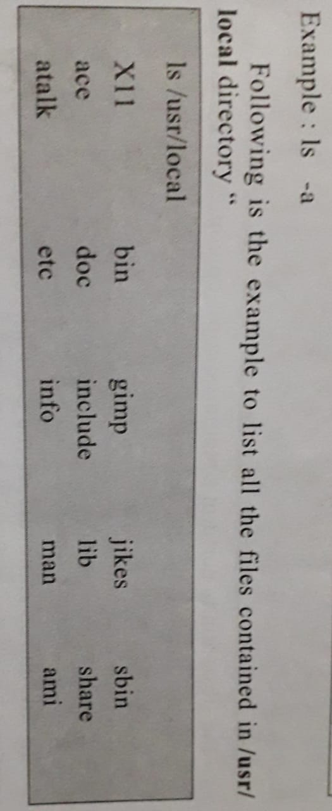
Example:

Slide 22
cp
Used to copy the content of one file into another.
cp [options] <source-file><destination-file>
- if the destination is an existing file ,the file is overwritten : If the destination is an existing directory , the file is copied into that directory.
-a Archieve files
-f Force copy by removing the destination file
-n Do not overwrite an existing file
-R Recursive copy( including hidden file)
-v Print information message
-i Prevent cp from overwriting existing files
-p Preserve all information, including owner, group and permissions.

Slide 23
Example:
cp test.txt sample.txt
cp file1 file2 file3 dir1

Slide 24
rm
Used to remove files or directory.
rm [options] <filename>
-i Prompt before every removal
-I Prompt once before removing more than three files , or when removing recursively
-r,-R Remove directories and their contents recursively
-d Remove empty directories
-f Remove write-protected file , never prompt before removing
-v Explain what is being done(print the name of each file before removing it)
example: rm –i *.txt

Slide 25
mkdir
Used to create a new directory.
Can create multiple directoriesnat once
mkdir [options] <directory-name>
-m Set permission mode
-p Create parent directories as necessary.
-v Print a message for each created directory.

Slide 26
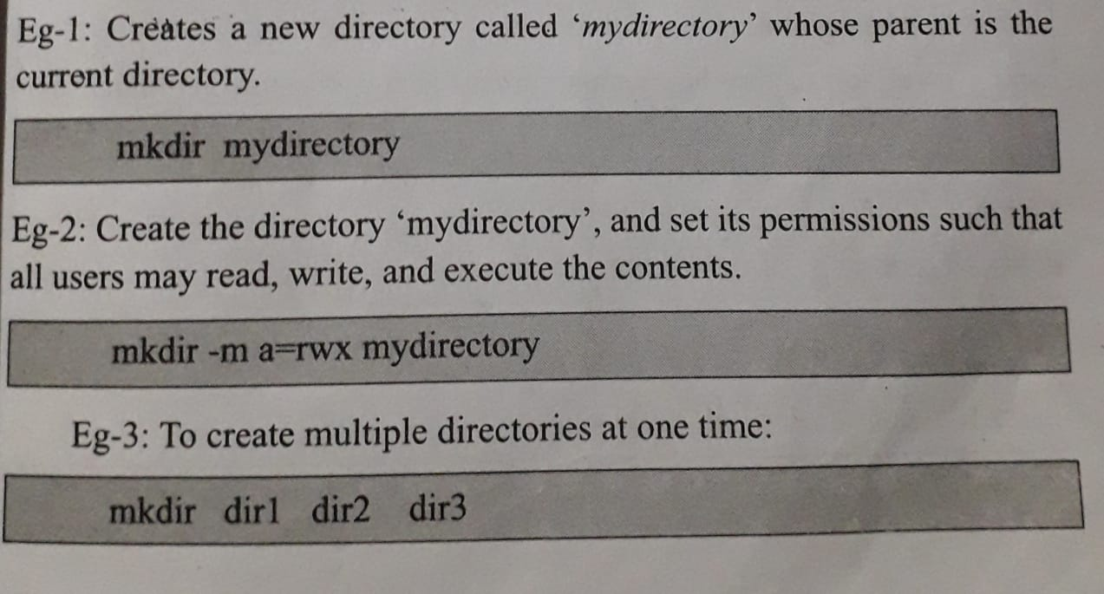
Example:

Slide 27
rmkdir
Used to remove the directory.
The directory should be empty before removing it.
rmkdir [options] <directory-name>
-v Print a message for every directory processed, explain what is being done
-p Each of the directory argument is treated as a pathname of which all components will be removed, if they are already empty , starting from the last component.

Slide 28
Examples:
To delete the directory test :
rmdir test
To delete nested empty directories:
rmdir –p first/second/third
Remove the directories dir1,dir2,dir3,if they are empty:
rmdir dir1 dir2 dir3

Slide 29
pwd
Command displays the present working directory or current directory
pwd [options]
-L Display the content as absolute name
-P Print fully resolved name for the current directory

Slide 30
file
Used to determine the type of a file.
Used to determine how to view or work with a file.
file [options] <filename>
-b To show just the file type
-i To view the mime type of a file rather than the human readable format
-F File and file type are separated by :
-s Used for special files
z To view compressed files without decompressing
example: To see the file type without filename:
file –b sample.txt
file types of multiple files:
file file1 file2

Slide 31
more
Used to display the output page by page
While viewing the file use the following controls:
Enter key : To scroll down line by line.
Space bar or f key : To go to the next page.
b key : To go to back one page.
q key : To quit diplaying
Syntax: more<filename>
-d Prompt the user with the message
-s Squeeze multiple blank lines into one.
-u omits the underlines
-NUM Specify the number of lines per screenful
+NUM Display file beginning from line number NUM

Slide 32
less
Used to read contents of text file one page per time(on screen).
It has faster access.
less<filename>
-F causes less to exit if entire file can be displayed on first screen
-s Squeeze multiple blank lines into one.
-u Omits the underlines.
-n Suppress line number
Example
less sample.txt
man ls|less

Slide 33
Creating and viewing files using cat
Used to display the content of text file and to combine several files to one file .
It is also use to create a file.
Short form of concatenate.
Allows to create single or multiple files ,view content of file, concatenate files and redirect output in terminal or flies.
It displays files content on screen.
Functions related to manipulating text files: creating them, displaying them and combining them.

Slide 34
cat [options] <filename>
- b add line number to non-blank lines
-n add line number to all lines
-s suppress repeated empty output lines
-E display $ at end of each line
To view the content of a file:
cat <filename>
to create a new file,use:
cat>[name-of-new-file]
To copy the contents of one file to another file:
cat [filename-whose-contents-is-to-be-copied]>[destination filename]

Slide 35
To display contents of multiple files:
cat filename1 filename2….
To append the contents of one file to another ,you can use the double greater than ‘>>’ symbol with the cat command.
cat filename1>>filename2
here, the content of filename1 is added at the end of filename2.
To display contents of all txt files,use the following command.
cat * .txt
To display the contents of a file with line number,use the following command.
cat –n filename

Slide 36
Examples:
To create a new file:
cat >sample.txt
To view the content of a file:
cat sample.txt
To copy the contents of one file to another file:
cat sample.txt>samplecopy.txt

Slide 37
Thank you

