Slide 1
Pizza Ordering
System
Group Number-1
Mentor
Manish Rajhans
Group Members:
180620-Amulya Poojari
180616-Shabnam Shaik
180623-Adithya B R
180515-Nikhil Somanth Gadakh
180517-Saurabh Kumar
180621-Sanjay Patel
Notes:
Add instructor notes here.

Slide 2
Objectives
Project Understanding
Approach used
Project Execution
Modules
Learning
Best Practices
Opportunity for improvement
Demo and Code Walkthrough
Q&A
Notes:
Add instructor notes here.

Slide 3
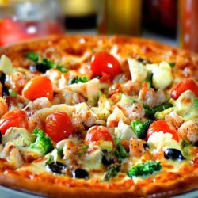
Project Understanding
The project is to develop Pizzeria (Pizza Ordering System).
The application allows customers to place order for Pizza. Employees can process accept or deny orders, and update the status as processing orders continues. The administrator can add and edit ingredients.
Pizzeria(Pizza ordering system) will have following features:
Ordering of products in Custom Pizzas
Notes:
Add instructor notes here.

Slide 4
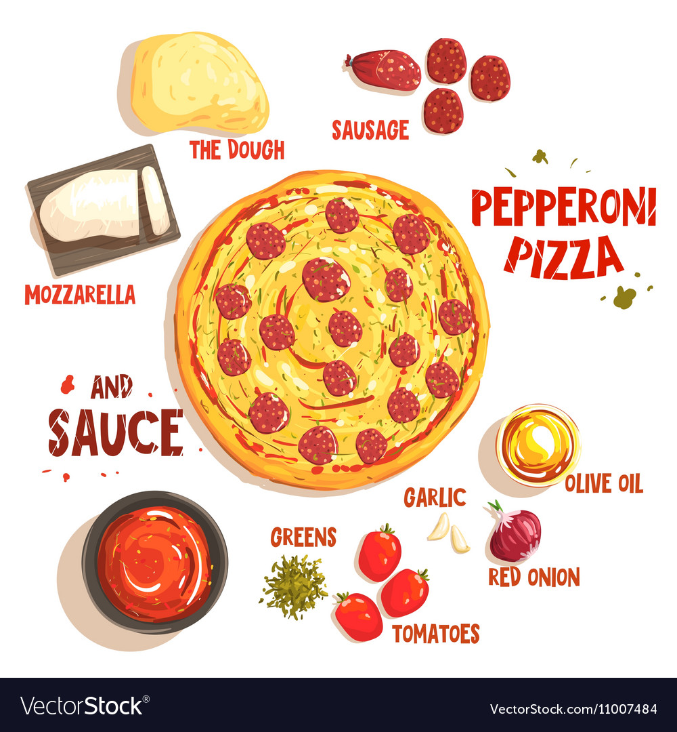
Project Understanding (Continued)
Selection of ingredients for the Pizza
Notes:
Add instructor notes here.

Slide 5
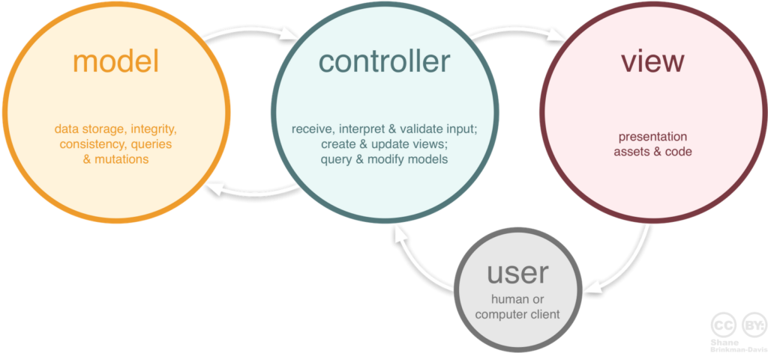
Approach used :
The approach we used in this project is Model View Controller architecture
Model: Model is a part of the application which implements the data-related logic for the application's data domain. It is used to store and retrieve model state in SQL Server database. It also use for business logic separation in the application.
View: View is a component that forms the application's user interface. It is used for all the UI logic of the application.It is used to create web pages for the application.
Controller: Controller is the component which handles user interaction. It works with the model and select view to render the web page. In MVC application, the view only displays information whereas the controller handles and responds to user input and requests.
Here we used Database first entity framework.
Notes:
Add the notes here.
Add instructor notes here.

Slide 6
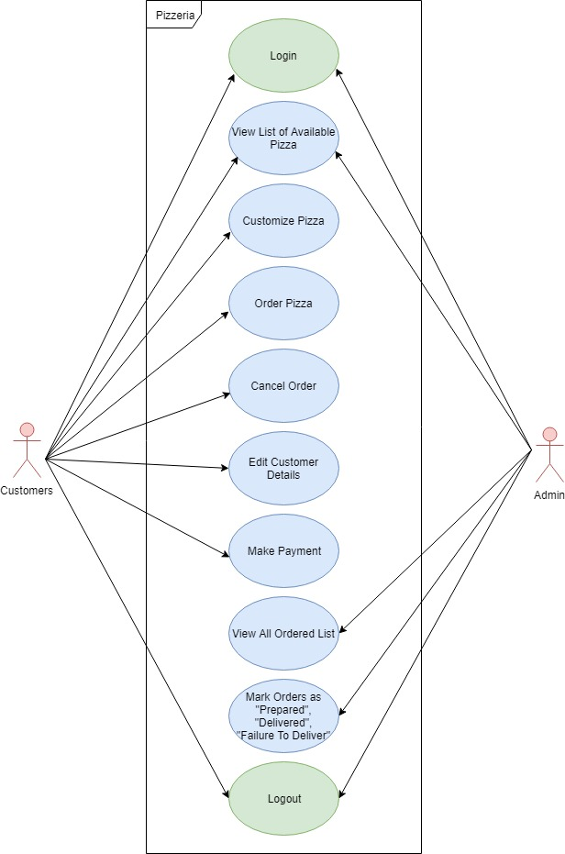
Project Execution
UseCase Diagram :
Notes:
Add the notes here.
Add instructor notes here.

Slide 7
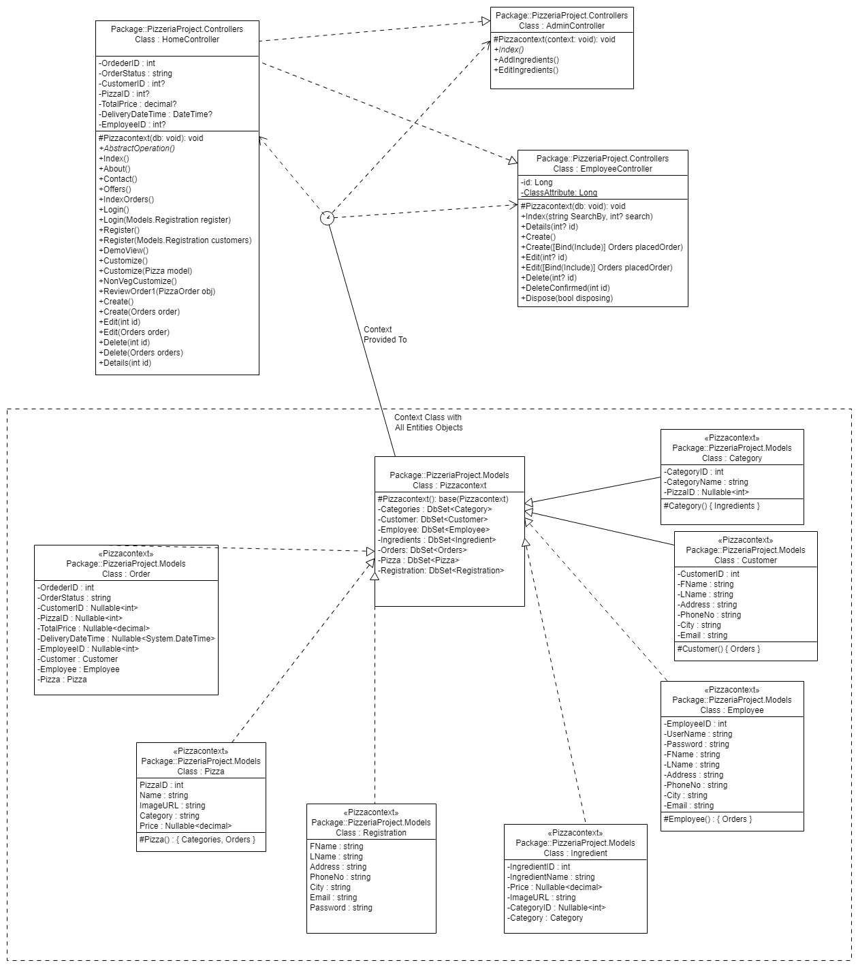
Project Execution
Class Diagram :

Slide 8
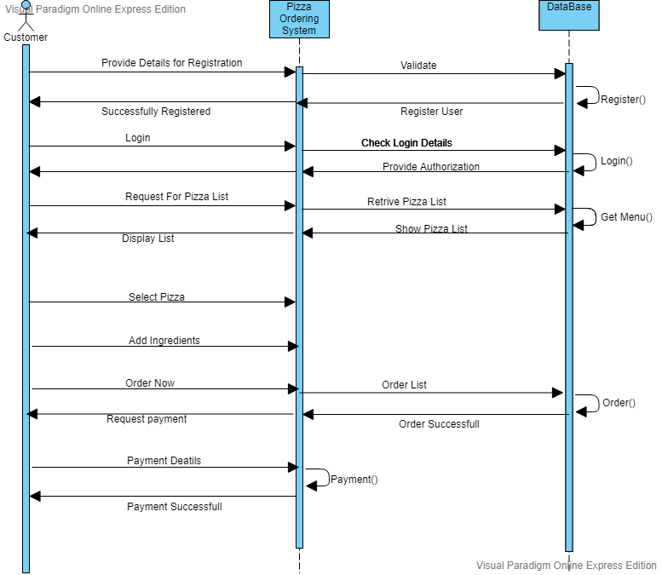
Project Execution
Sequence Diagram :

Slide 9
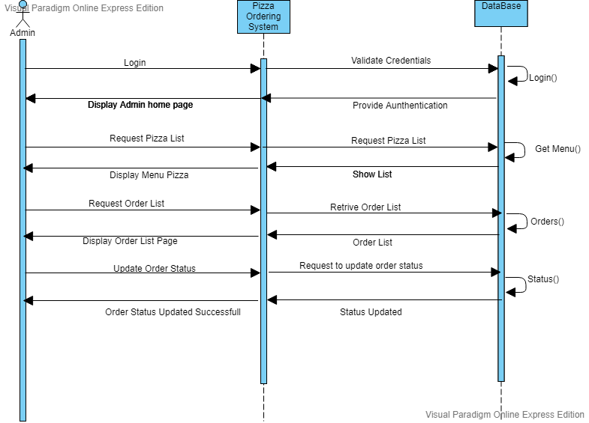
Project Execution
Sequence Diagram(Cont.) :

Slide 10
Modules
This Project consists of 2 modules. They are :
1. Customers
The user must be able to create a new order.
To customize a pizza by, view a list of available ingredients.
Add an ingredient to a custom pizza, to remove an ingredient from a custom pizza.
To add the name and address of the customer.
To confirm the order.
2. Employees
The employee must be able to log in and out.
To view a list of available orders and their custom pizzas.
The employee must be able to mark orders as “prepared” ,“delivered”, “failure to deliver”.
Only users with respective rights (employee) must be able to use all these “Employees” features.
Notes:
Add the notes here.
Add instructor notes here.

Slide 11
Modules Diagrams
Customers:
No
Is Valid
Yes
Home Page
Login
Stop
Database

Slide 12
Module Diagrams(Cont.)
1.Create User:
Create User
Database
Login
2. View Pizza Information:
Database
View List of Pizza available Information
Login

Slide 13
Module Diagrams(Cont.)
3. Add/Remove Ingredients:
Database
Add/Remove
Ingredients
Login
4.Order Pizza:
Database
Order the Pizza
Login

Slide 14
Module Diagrams(Cont.)
5. Edit Details:
Database
Edit the Details
Login

Slide 15
Module Diagrams(Cont.)
Employees:
No
Is Valid
Yes
Home Page
Login
Stop
Database

Slide 16
Module Diagrams(Cont.)
1.View The List of Orders placed:
Database
View the list of orders placed
Login
2. Change the Status:
Changes the Status
Database
Login

Slide 17
Learning
The current application, Pizza Ordering System application is been developed using visual studio 2017 as frontend and SQL Server 2012 as backend.
The Project has been written in C# Programming language using .NET Framework 4.6 and has been successfully deployed on Azure cloud web application.
By Implementing this project, we have gained a good learning experience with MVC, LINQ and Entity Framework and sql server.
We became familiar with front-end technologies like bootstrap, Javascript.
Notes:
Add the notes here.
Add instructor notes here.

Slide 18
Best Practices
Define the Scope and Objectives
Define the Deliverables
Project Planning
Tracking and Reporting Project Progress
Follow Indentation, Naming Convention
Readability, Maintainability of a program
Type mismatch for parameters should be seen carefully
Perform unit testing for each module
Notes:
Add the notes here.
Add instructor notes here.

Slide 19
Opportunity for improvement
While this is technically a complete system, the opportunities for expanding are almost limitless. Here are a few additional features we recommend to be added in the next version.
We can use authentication and authorization filters
Currently, we have implemented this application in MVC, we can extend it to Web API for making it accessible over wide area of Network.
Notes:
Add the notes here.
Add instructor notes here.

Slide 20
Q & A
Notes:
Add the notes here.
Add instructor notes here.

Slide 21
Thank You.!
Notes:
Add the notes here.
Add instructor notes here.

