Slide 1

♪
PROJECT #1
SPOTIFY DATA
ANALYSIS
UNCOVERING INSIGHTS FROM MUSIC STREAMING DATA
BY — MAHESH THAKARE | MARCH 2026

Slide 2
PURPOSE OF ANALYSIS
The primary goal of this project is to leverage Spotify streaming data to uncover key business insights — understanding artist performance, track popularity, audio feature patterns, and platform comparison using PostgreSQL.
📊
🎵
⚡
Performance Analysis
Audio Feature Insights
Query Optimization
Analyze streams, views & engagement across artists and tracks
Discover patterns in danceability, energy, tempo & liveness
Apply indexing to reduce execution time by 30× using EXPLAIN ANALYZE

Slide 3
SCHEMA & DATASET
Single Table: spotify (24 Columns) | Source: Kaggle | Tool: PostgreSQL 17 + pgAdmin 4
artist
tempo
track
duration_min
album
title
album_type
channel
danceability
views
energy
likes
loudness
comments
speechiness
licensed
acousticness
official_video
instrumentalness
stream
liveness
energy_liveness
valence
most_played_on
EDA: Removed 2 rows with duration_min = 0 | Cleaned dataset ready for analysis

Slide 4
QUERIES: EASY LEVEL
1
Retrieve the names of all tracks that have more than 1 billion streams.
2
List all albums along with their respective artists.
3
Get the total number of comments for tracks where licensed = TRUE.
4
Find all tracks that belong to the album type 'single'.

Slide 5
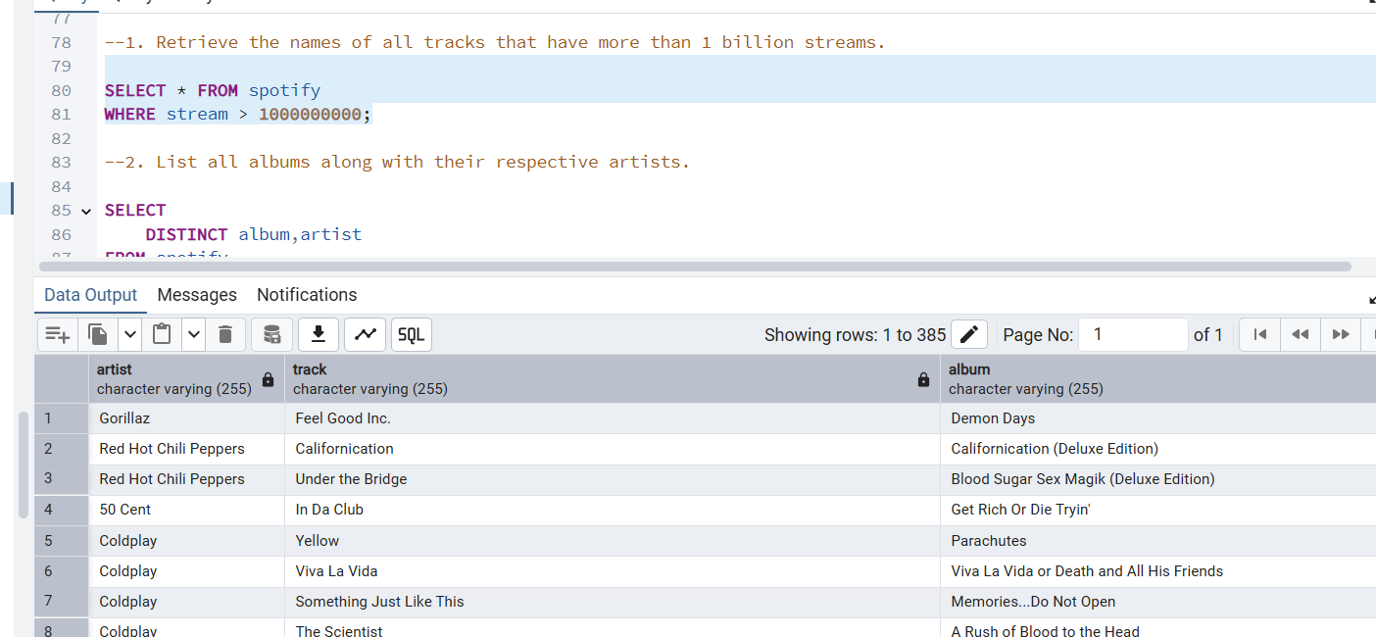
EASY LEVEL
Q1. Retrieve tracks with more than 1 Billion Streams

Slide 6
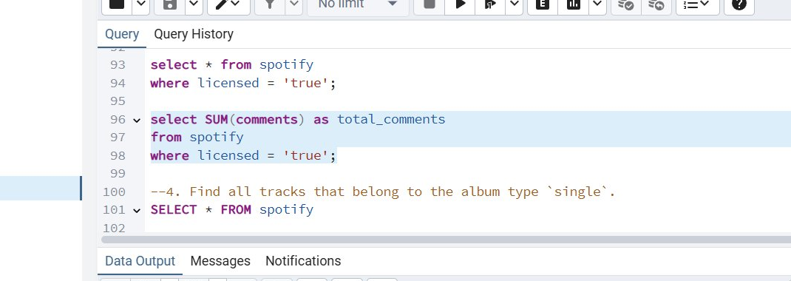
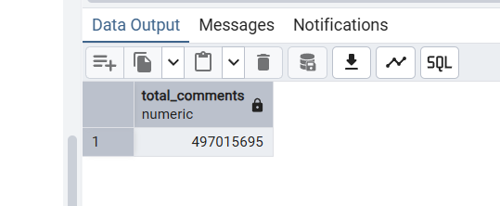
EASY LEVEL
Q3. Total Comments for Licensed Tracks
💡 Concept: SUM() aggregation + WHERE filter on boolean column
SUM(comments) adds up all comment counts for rows where licensed = 'true' → Result: 497,015,695 total comments

Slide 7
EASY LEVEL
Q4. Tracks belonging to album type 'single'
SELECT * FROM spotify WHERE album_type = 'single';
Result:
Returns all single tracks from dataset
(album_type = 'single' filter applied)
Q5. Count total tracks by each artist (Top Results)
SELECT artist, COUNT(track) AS Total_no_Tracks FROM spotify GROUP BY artist ORDER BY Total_no_Tracks DESC;
artist
Total_no_Tracks
Gorillaz
59
Taylor Swift
48
Bad Bunny
46
The Weeknd
45

Slide 8
QUERIES: MEDIUM LEVEL
1
Calculate the average danceability of tracks in each album.
2
Find the top 5 tracks with the highest energy values.
3
List all tracks with their views and likes where official_video = TRUE.
4
Retrieve tracks that have been streamed more on Spotify than YouTube.

Slide 9
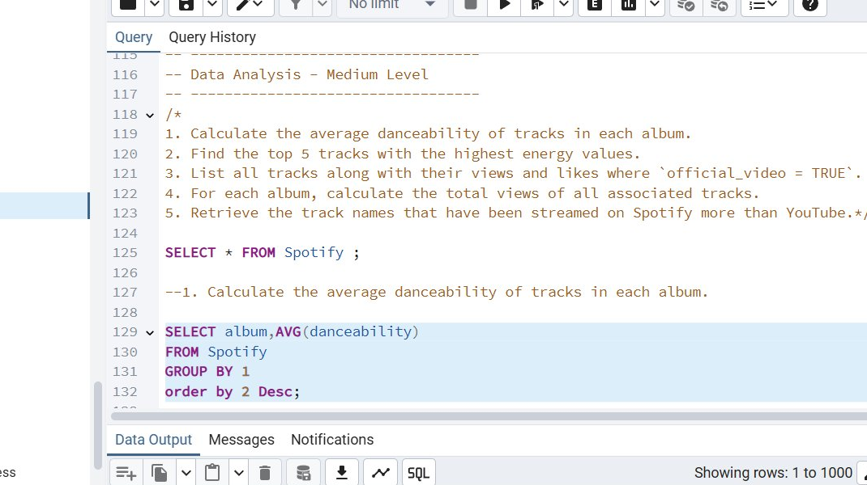
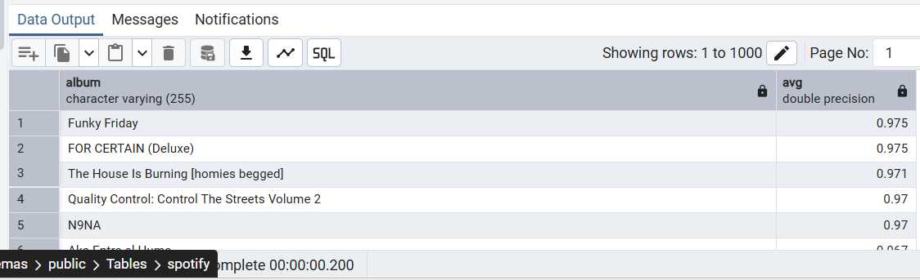
MEDIUM LEVEL
Q1. Average Danceability of Tracks in Each Album

Slide 10
MEDIUM LEVEL
Q2. Top 5 Tracks with Highest Energy Values
SELECT track,
MAX(energy) AS Highest_energy FROM spotify GROUP BY 1 ORDER BY Highest_energy DESC
LIMIT 5;
track
energy
Wonder
1.0
Are You Entertained
1.0
Natural
0.998
Legends Never Die
0.997
Fire
0.995
Q3. Tracks with Views & Likes (Official Video = TRUE)
SELECT track, views, likes FROM Spotify WHERE official_video = 'TRUE';
Result:
Filters only official music video tracks
Shows track name, view count, and like count
Filtered from 20,594 total tracks

Slide 11
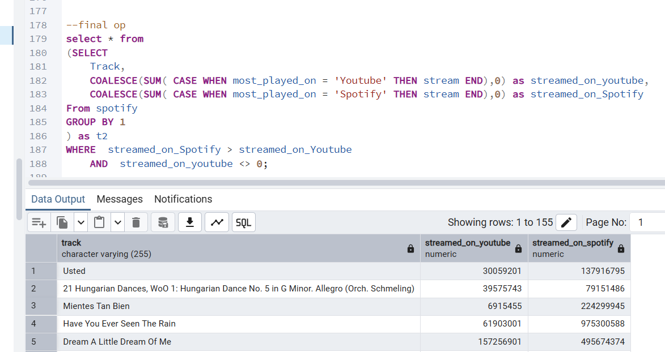
MEDIUM LEVEL
Q4. Tracks Streamed More on Spotify than YouTube

Slide 12
QUERIES: ADVANCED LEVEL
1
Find the top 3 most-viewed tracks for each artist using Window Functions.
2
Find tracks where the liveness score is above the average.
3
Use WITH clause to calculate energy difference (highest − lowest) per album.

Slide 13
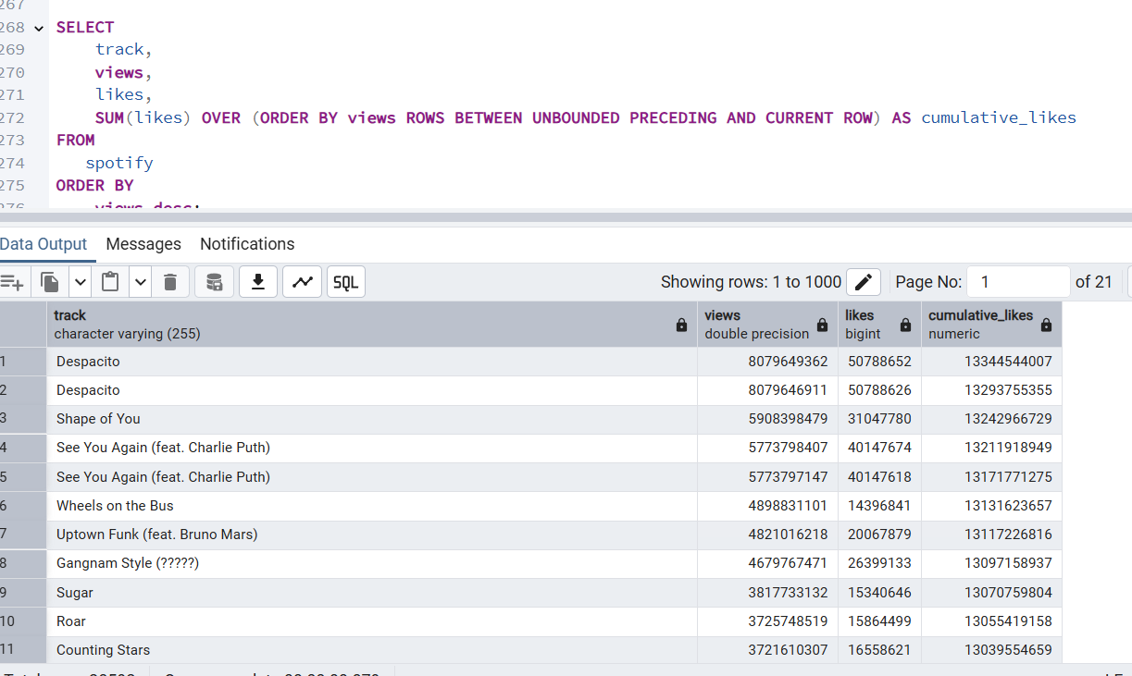
ADVANCED LEVEL
Q1. Calculate the cumulative sum of likes for tracks ordered by the number of views, using window functions

Slide 14
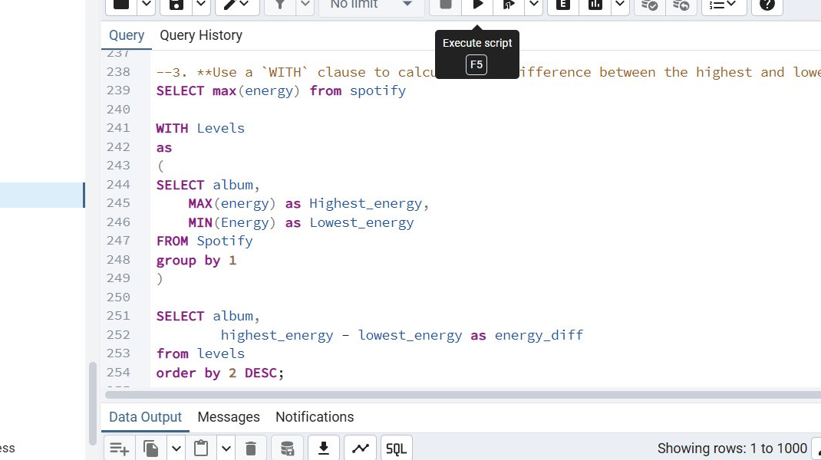
ADVANCED LEVEL
Q2. Tracks where Liveness Score is Above Average
SELECT track, Artist, liveness FROM Spotify WHERE liveness > ( SELECT AVG(liveness) FROM spotify
);
Subquery Pattern:
The inner SELECT AVG(liveness) computes the dataset average first. The outer query then filters only tracks scoring above that threshold — no hardcoded value needed.
Q3. Energy Difference per Album using WITH Clause

Slide 15
QUERY OPTIMIZATION
Using EXPLAIN ANALYZE + Indexing on the artist column to drastically improve PostgreSQL query performance.
BEFORE INDEXING
AFTER INDEXING
Planning Time:
0.076 ms
⚡ 30×
FASTER
Planning Time:
0.096 ms
Execution Time:
4.160 ms
Execution Time:
0.137 ms
Sequential Full Table Scan
Bitmap Index Scan (artist_index)
CREATE INDEX index_artist ON spotify(artist); -- Single line → Massive performance improvement!
⚠️ Over-indexing is harmful — it slows down INSERT, UPDATE, DELETE operations (DML)

Slide 16
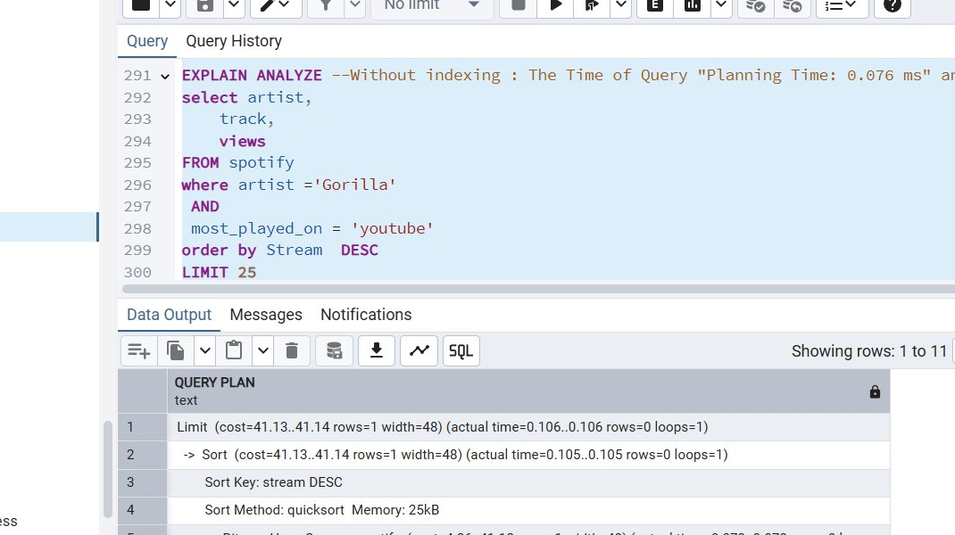
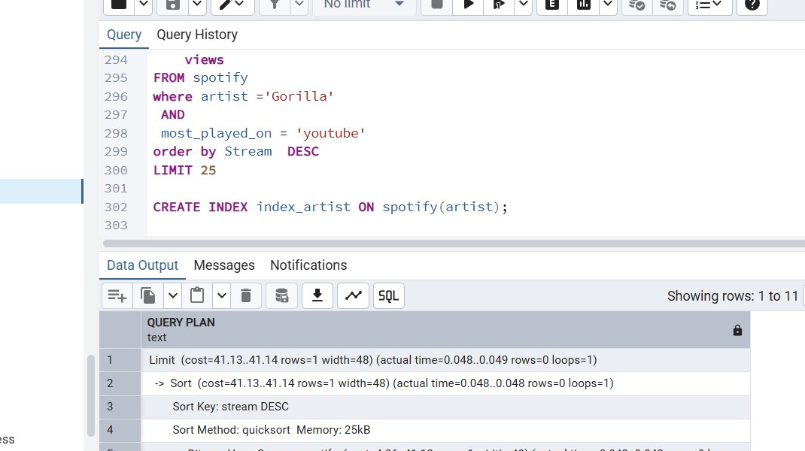
QUERY OPTIMIZATION — EXPLAIN ANALYZE
BEFORE INDEXING | Exec: 4.160 ms
AFTER INDEXING | Exec: 0.137 ms
Execution time: 4.160 ms → 0.137 ms | Performance improved ~30× by adding index on artist column

Slide 17
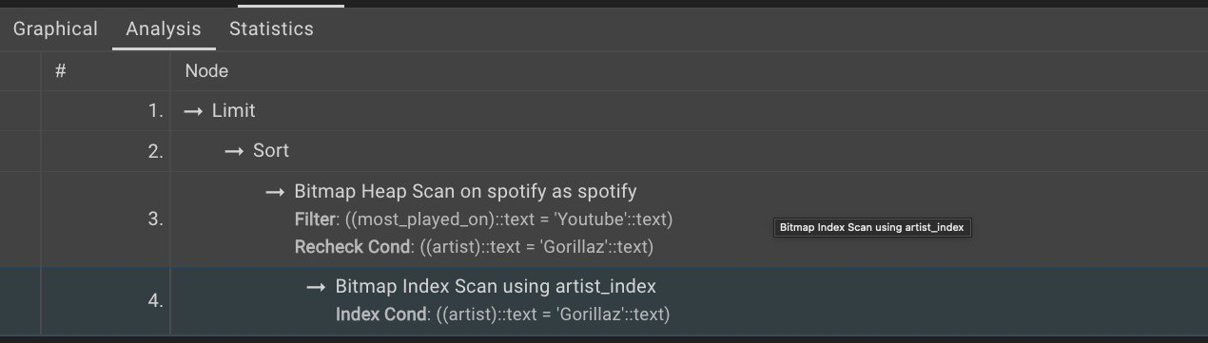
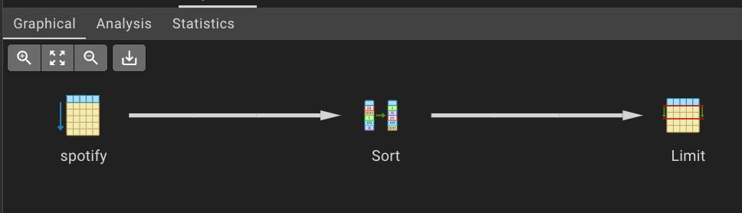
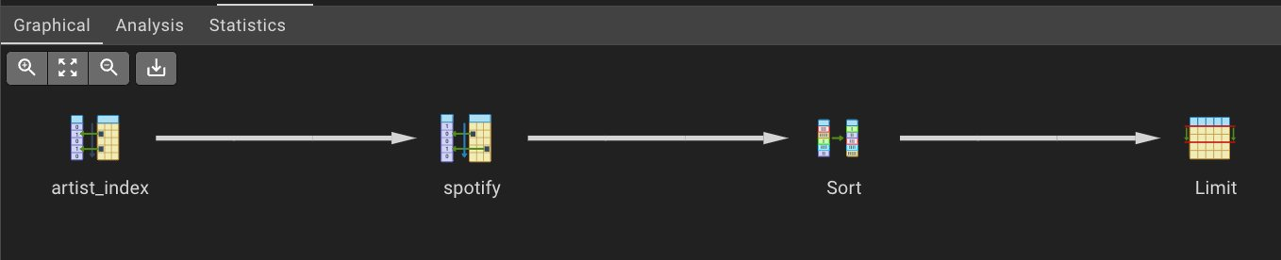
EXECUTION PLAN — GRAPHICAL VIEW
Before Indexing — Sequential Scan (spotify → Sort → Limit)
After Indexing — Bitmap Index Scan (artist_index → spotify → Sort → Limit)
Analysis tab — Bitmap Index Scan using artist_index with filter conditions

Slide 18
KEY INSIGHTS
🎧
Tracks with 1B+ streams are dominated by global artists — Gorillaz, Coldplay, Red Hot Chili Peppers appear frequently in the dataset.
📺
155 tracks are streamed more on Spotify than YouTube, confirming Spotify's dominance for pure audio consumption.
📊
Average danceability peaks at 0.975 — 'Funky Friday' and 'FOR CERTAIN (Deluxe)' top the charts in danceability.
⚡
Query execution time dropped from 4.160 ms to 0.137 ms (~30× faster) simply by creating an index on the artist column.
🏆
Gorillaz leads with 59 tracks in the dataset, followed by Taylor Swift (48) and Bad Bunny (46).

Slide 19
TECHNOLOGY STACK
🗄️
PostgreSQL 17
Primary Database — DDL, DML, Aggregations, Joins, Subqueries, Window Functions, Indexing
🛠️
pgAdmin 4
Query Editor + EXPLAIN ANALYZE for performance profiling and execution plan visualization
📂
Kaggle Dataset
Spotify Dataset by Sanjana Chaudhari — multi-attribute music data (streams, energy, danceability…)
🔍
SQL Concepts Used
CTEs (WITH), DENSE_RANK(), CASE WHEN, COALESCE, Subqueries, NULLIF, Window Functions, CREATE INDEX
Dataset: kaggle.com/datasets/sanjanchaudhari/spotify-dataset | Tool: PostgreSQL 17 + pgAdmin 4

