Slide 1
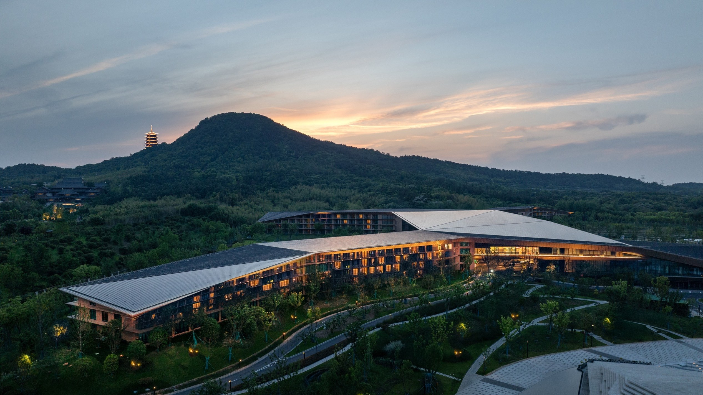
东
麓
禅意营造与在地性表达
南京牛首山东麓酒店设计与实践
ZEN-INSPIRED CREATION AND THE EXPRESSION OF LOCALITY
Design and Practice of the Niushou Mountain Donglu Hotel, Nanjing
Notes:
封面：禅意营造与在地性表达——南京牛首山东麓酒店设计与实践
Cover: Zen-Inspired Creation and the Expression of Locality: Design and Practice of the Niushou Mountain Donglu Hotel, Nanjing

Slide 2
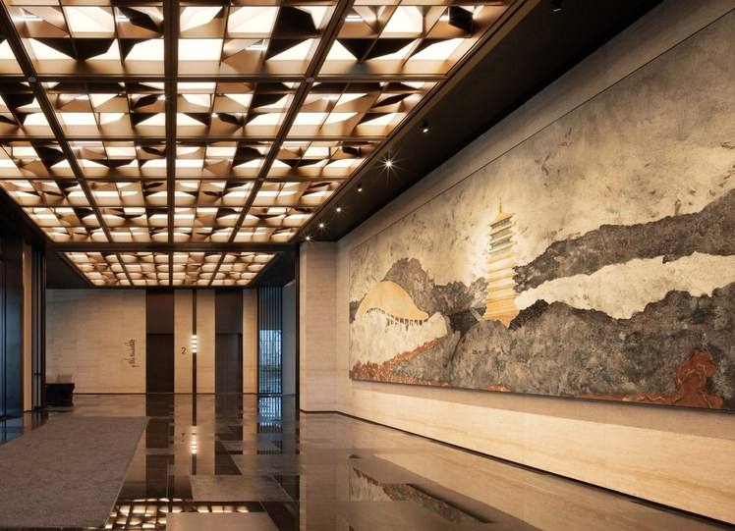
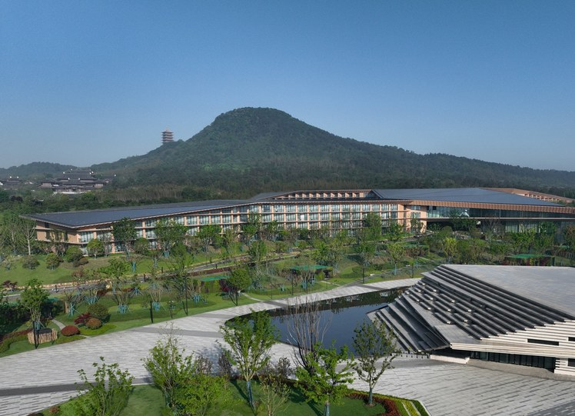
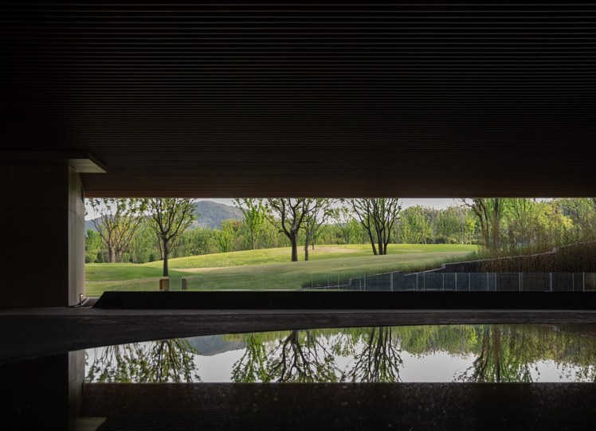
三者有机统一
缘
起
文化转译、地形应答、精神体验，三者有机统一
CULTURE · TERRAIN · SPIRIT
Cultural translation, terrain response, and spiritual experience: the three are organically unified.
文
地
神
CULTURAL TRANSLATION
文化转译
The local Zen Buddhist heritage
TERRAIN RESPONSE
地形应答
Complex mountainous terrain
SPIRITUAL EXPERIENCE
精神体验
High-end resort functions
如何回应复杂山地地形、在地禅佛文脉与高端度假功能的复合需求？
How can a design respond to the combined demands of complex mountainous terrain, the local Zen Buddhist heritage and high-end resort functions?
禅意营造与在地性表达 · 南京牛首山东麓酒店设计与实践
Notes:
文化转译、地形应答、精神体验，三者有机统一——如何回应复杂山地地形、在地禅佛文脉与高端度假功能的复合需求
Cultural translation, terrain response, and spiritual experience: the three are organically unified — How can a design respond to the combined demands of complex mountainous terrain, the local Zen Buddhist heritage and high-end resort functions?

Slide 3
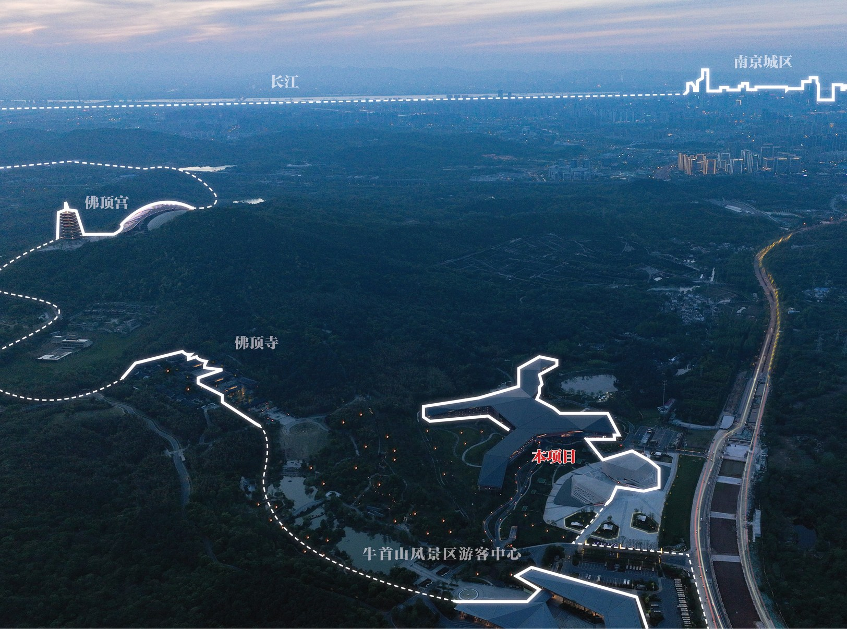
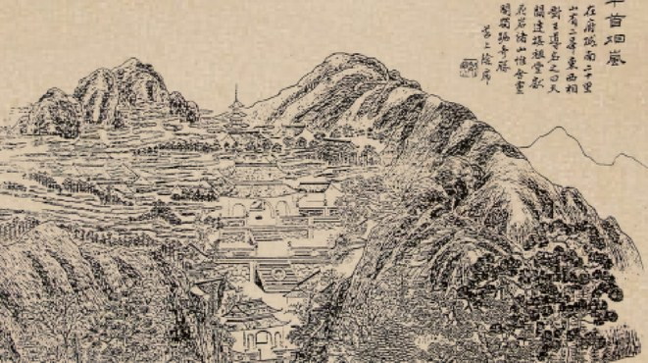
项目位置
PROJECT LOCATION
江苏省南京市江宁区
牛首山风景区
东
麓
Niushou Mountain Scenic Area, Jiangning District, Nanjing, Jiangsu Province
一座牛首山，半部金陵史
佛顶重光，昌明中外；
牛头一脉，融贯古今。
清 · 金陵十八景图 — 牛首烟岚
禅意营造与在地性表达 · 南京牛首山东麓酒店设计与实践
Notes:
项目位置——江苏省南京市江宁区牛首山风景区
Project Location — Niushou Mountain Scenic Area, Jiangning District, Nanjing, Jiangsu Province

Slide 4
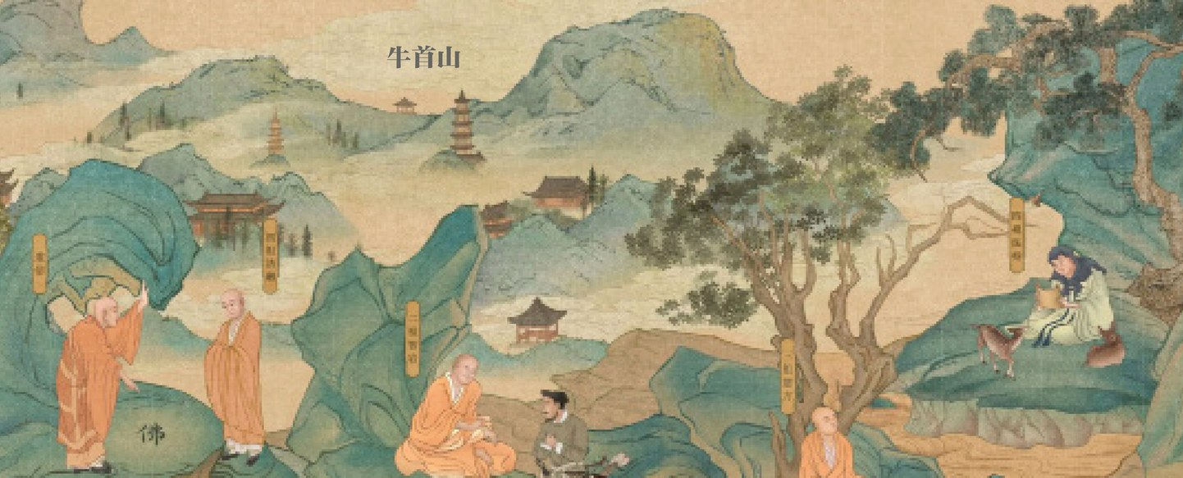
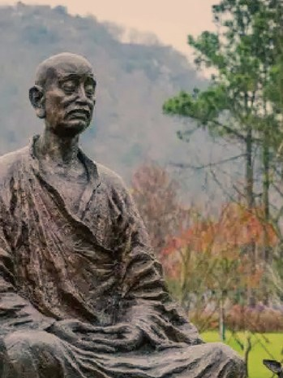
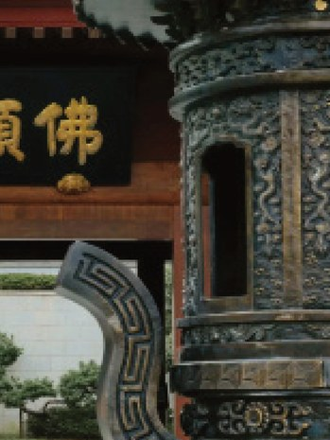
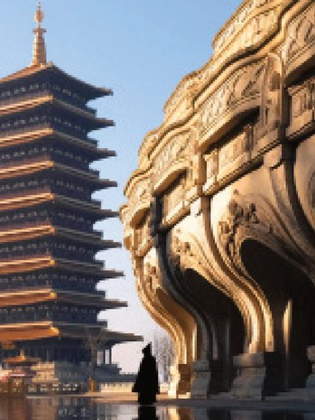

牛头禅宗
NIUTOU ZEN BUDDHISM · CULTURAL ROOTS
牛首山的文化根脉
牛首山为禅意营造的理想之地，与其作为中国禅宗重要流派——牛头禅宗的发源地密切相关。牛头禅由法融禅师于唐代创立，其核心禅语为“空为道本”“无心合道”。
法融牛首定，禅月印千江
法融开宗，双峰证空；佛顶重光，禅灯永续
Niushou Mountain is an ideal place for Zen-inspired creation, a fact closely tied to its role as the birthplace of the Niutou Zen Buddhism, an important school of Chinese Zen Buddhism. The Niutou Zen Buddhism was founded in the Tang dynasty by Zen Master Farong, and its core teachings are “Emptiness is the root of the Way” and “No-mind accords with the Way.”
空为道本 · 无心合道
Emptiness is the root of the Way
No-mind accords with the Way
牛首山法融禅师雕像
Statue of Zen Master Farong
佛顶寺
Foding Temple
佛顶宫
Usnisa Palace
释迦牟尼佛顶骨舍利
Usnisa relic of the Buddha
禅意营造与在地性表达 · 南京牛首山东麓酒店设计与实践
Notes:
牛头禅宗——牛首山的文化根脉。牛首山为禅意营造的理想之地，与其作为中国禅宗重要流派——牛头禅宗的发源地密切相关。牛头禅由法融禅师于唐代创立，其核心禅语为“空为道本”“无心合道”。
Niushou Mountain is an ideal place for Zen-inspired creation, a fact closely tied to its role as the birthplace of the Niutou Zen Buddhism, an important school of Chinese Zen Buddhism. The Niutou Zen Buddhism was founded in the Tang dynasty by Zen Master Farong, and its core teachings are “Emptiness is the root of the Way” and “No-mind accords with the Way.”

Slide 5
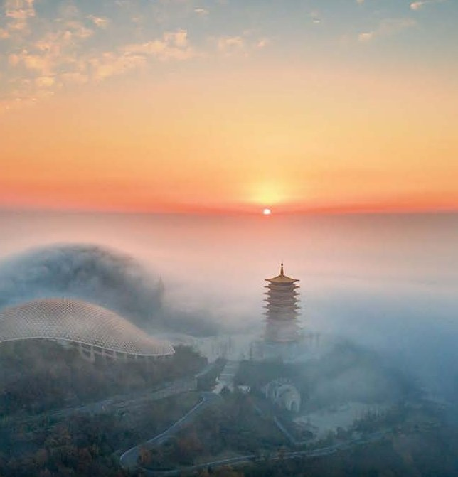
无心合道
禅
宗
NO-MIND ACCORDS WITH THE WAY
法融禅师的禅法要义
心性虚玄，照用自尔，湛然明净，不须巧功；菩提本有，不须觅；烦恼本无，不要除。
—— 法融禅师 Zen Master Farong
“The nature of mind is profound and mysterious; its illumination and function arise of themselves. Clear, bright and pure, it needs no contrived effort. Bodhi is inherently present and need not be sought; afflictions are inherently absent and need not be removed.”
这一思想强调本心的澄明与自足，否定外在的刻意修为，深刻影响了后世禅宗的发展，也对慧能南宗的形成产生了重要作用。
This thought stresses the clarity and self-sufficiency of the original mind and rejects deliberate outward cultivation. It profoundly shaped the later development of Zen Buddhism and played an important role in the formation of Huineng’s Southern School.
禅意营造与在地性表达 · 南京牛首山东麓酒店设计与实践
Notes:
法融主张：“心性虚玄，照用自尔，湛然明净，不须巧功；菩提本有，不须觅；烦恼本无，不要除。”这一思想强调本心的澄明与自足，否定外在的刻意修为，深刻影响了后世禅宗的发展，也对慧能南宗的形成产生了重要作用。
“The nature of mind is profound and mysterious; its illumination and function arise of themselves. Clear, bright and pure, it needs no contrived effort. Bodhi is inherently present and need not be sought; afflictions are inherently absent and need not be removed.” This thought stresses the clarity and self-sufficiency of the original mind and rejects deliberate outward cultivation. It profoundly shaped the later development of Zen Buddhism and played an important role in the formation of Huineng’s Southern School.

Slide 6
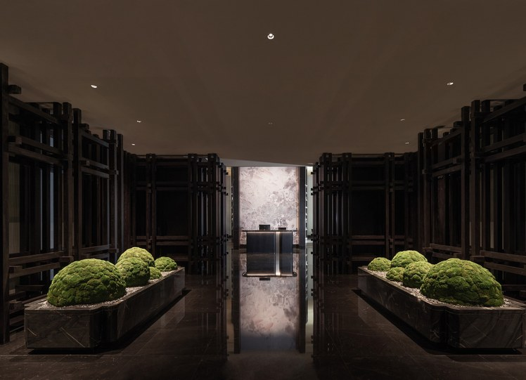
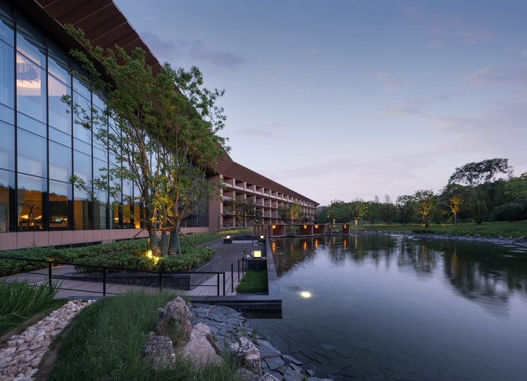
心·空·乐
禅
意
牛头禅宗“心、空、乐”的理念，
构成了牛首山东麓酒店设计的哲学根基。
MIND · EMPTINESS · JOY
心
空
乐
THE MIND
内心的宁静与本真
Inner tranquility and authenticity
EMPTINESS
空灵的境界
摆脱尘世纷扰
Ethereal, free from worldly turmoil
JOY
由此获得的静谧喜悦
The serene delight that follows
“心、空、乐”——东麓酒店设计的哲学根基
The ideal of “Mind, Emptiness and Joy” in the Niutou Zen Buddhism forms the philosophical foundation of the Niushou Mountain Donglu Hotel’s design.
禅意营造与在地性表达 · 南京牛首山东麓酒店设计与实践
Notes:
牛头禅宗“心、空、乐”的理念——心即内心的宁静与本真，空即空灵的境界、摆脱尘世纷扰，乐即由此获得的静谧喜悦——构成了牛首山东麓酒店设计的哲学根基。
The ideal of “Mind, Emptiness and Joy” in the Niutou Zen Buddhism — mind as inner tranquility and authenticity, emptiness as an ethereal state free from worldly turmoil, and joy as the serene delight that follows — forms the philosophical foundation of the Niushou Mountain Donglu Hotel’s design.

Slide 7
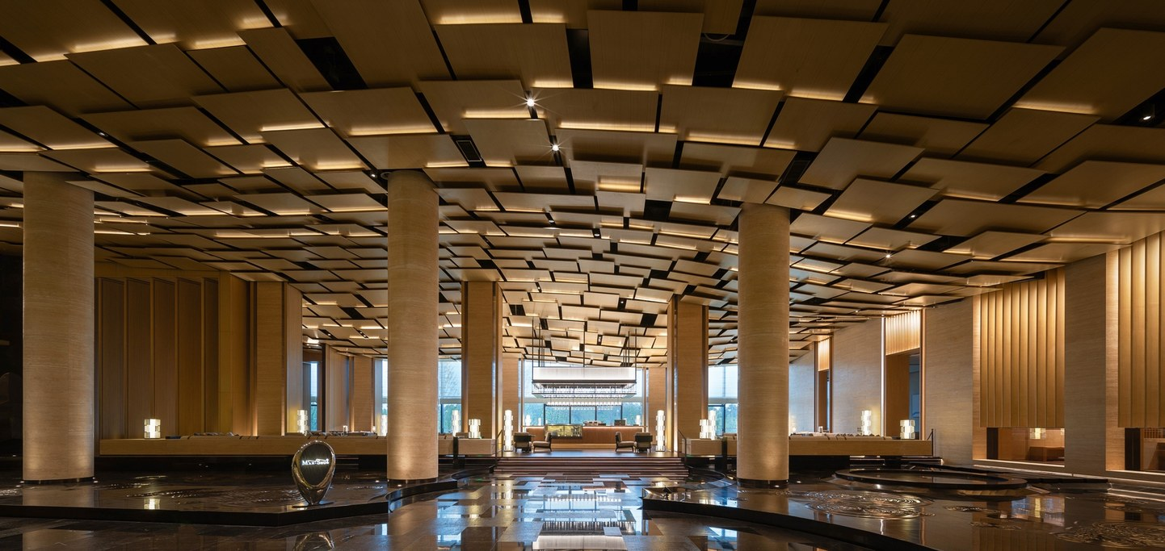
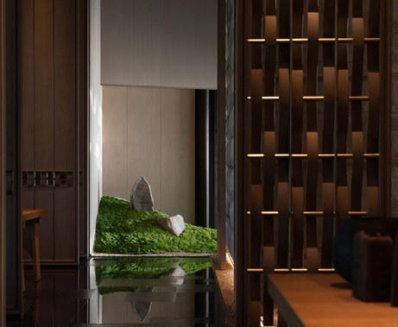
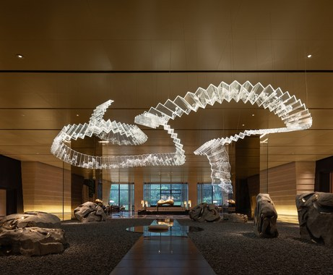
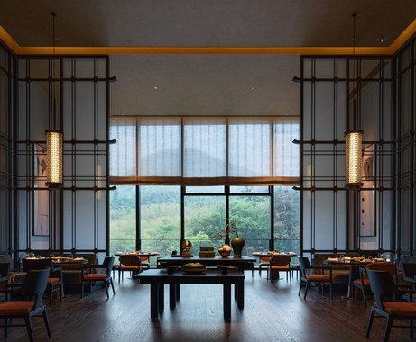
禅思入境
FROM ZEN THOUGHT TO SPACE
从禅宗思想到空间体验
设计师正是将这一禅宗思想转化为具体的空间体验语言，让入住者在日常居停之中感受禅宗文化的独特魅力。
The designers translated this Zen Buddhist thought into a concrete language of spatial experience, allowing guests to feel the distinctive charm of Zen Buddhist culture in the course of an everyday stay.
日常居停，即是修行
An everyday stay as a quiet practice
大堂 · 苔石小景 · 艺术装置 · 窗景山林 Lobby · Moss and stone · Art installation · Framed view
禅意营造与在地性表达 · 南京牛首山东麓酒店设计与实践
Notes:
设计师正是将这一禅宗思想转化为具体的空间体验语言，让入住者在日常居停之中感受禅宗文化的独特魅力。
The designers translated this Zen Buddhist thought into a concrete language of spatial experience, allowing guests to feel the distinctive charm of Zen Buddhist culture in the course of an everyday stay.

Slide 8
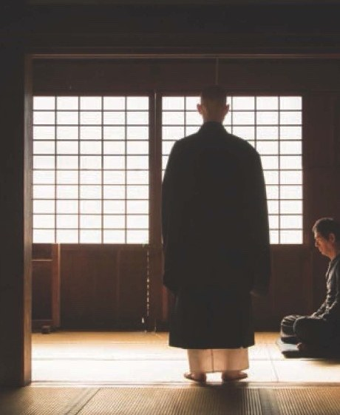
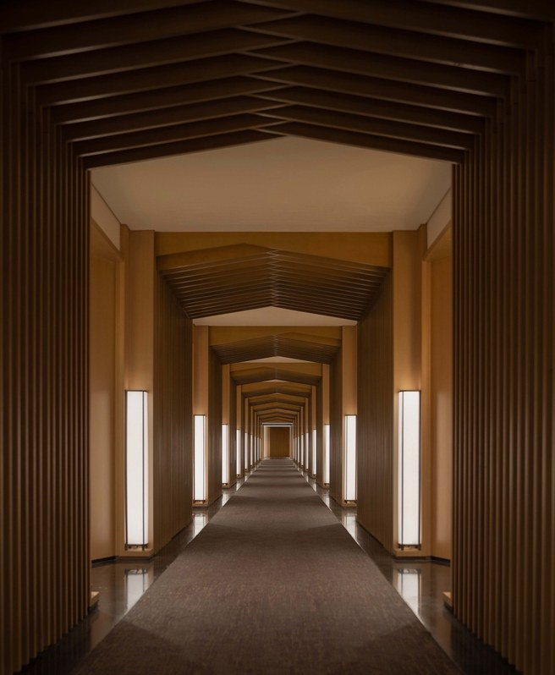
从寺院禅修到酒店禅居
FROM MONASTIC MEDITATION TO ZEN HOTEL LIVING
禅意空间的当代演化
禅意空间正在经历从“寺院”到“酒店”的类型演化。都市人群对减压、疗愈与精神安顿的需求日益增长，催生了“禅意酒店”这一新型文旅业态。
Zen space is undergoing a typological evolution from the “monastery” to the “hotel.” Urban residents’ growing need for stress relief, healing and spiritual settledness has given rise to the “Zen hotel,” a new form of cultural tourism.
→
减压 · 疗愈 · 精神安顿
Stress relief · Healing · Spiritual settledness
寺
MONASTERY
寺院禅修
居
ZEN HOTEL
酒店禅居
禅意营造与在地性表达 · 南京牛首山东麓酒店设计与实践
Notes:
从寺院禅修到酒店禅居——禅意空间的当代演化。禅意空间正在经历从“寺院”到“酒店”的类型演化。都市人群对减压、疗愈与精神安顿的需求日益增长，催生了“禅意酒店”这一新型文旅业态。
Zen space is undergoing a typological evolution from the “monastery” to the “hotel.” Urban residents’ growing need for stress relief, healing and spiritual settledness has given rise to the “Zen hotel,” a new form of cultural tourism.

Slide 9
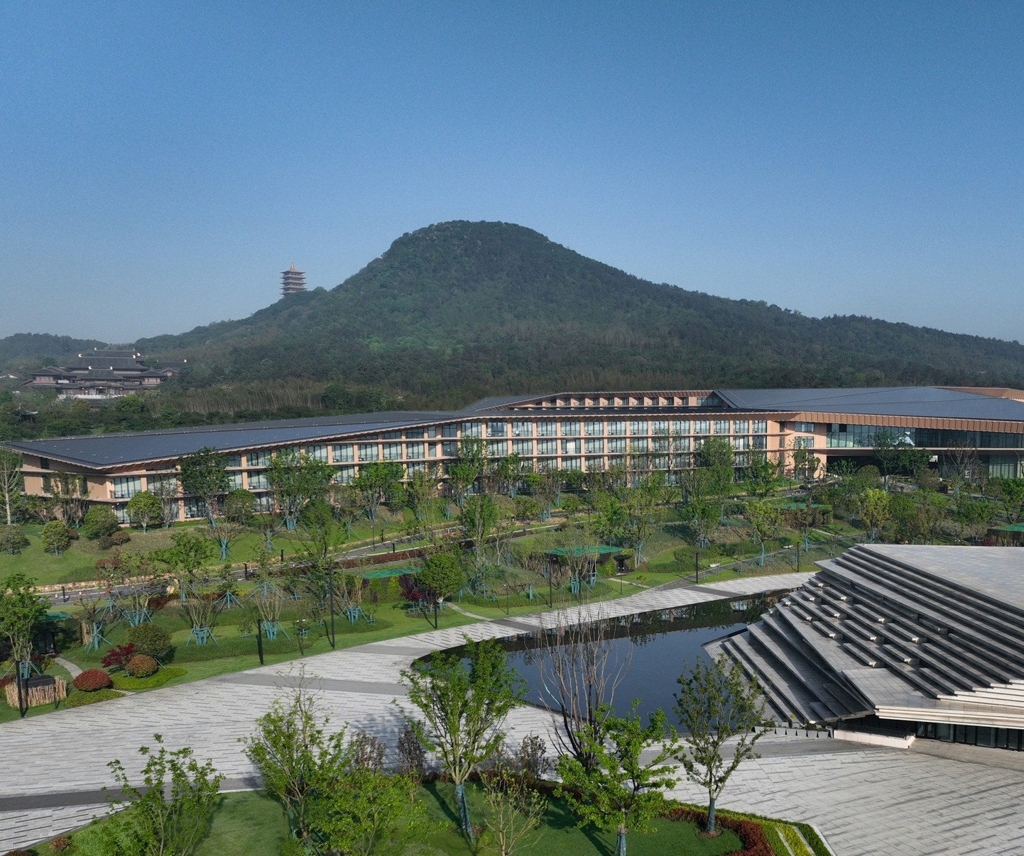
在地共生
在
地
ROOTED COEXISTENCE
山水格局与文化载体的空间应答
不同于“地域性”往往侧重于风格的传承与符号的再现，“在地性”更强调建筑与特定场地的深层联结——这种联结不仅包括可见的自然地形、气候特征，更涵盖不可见的历史文脉、场所精神与集体记忆。
Whereas “regionalism” tends to focus on the inheritance of style and the reproduction of symbols, “locality” emphasizes a deeper bond between architecture and a specific site — a bond that includes not only the visible natural terrain and climate but also the invisible historical context, spirit of place and collective memory.
禅意营造与在地性表达 · 南京牛首山东麓酒店设计与实践
Notes:
在地共生——山水格局与文化载体的空间应答。不同于“地域性”往往侧重于风格的传承与符号的再现，“在地性”更强调建筑与特定场地的深层联结——这种联结不仅包括可见的自然地形、气候特征，更涵盖不可见的历史文脉、场所精神与集体记忆。
Whereas “regionalism” tends to focus on the inheritance of style and the reproduction of symbols, “locality” emphasizes a deeper bond between architecture and a specific site — a bond that includes not only the visible natural terrain and climate but also the invisible historical context, spirit of place and collective memory.

Slide 10
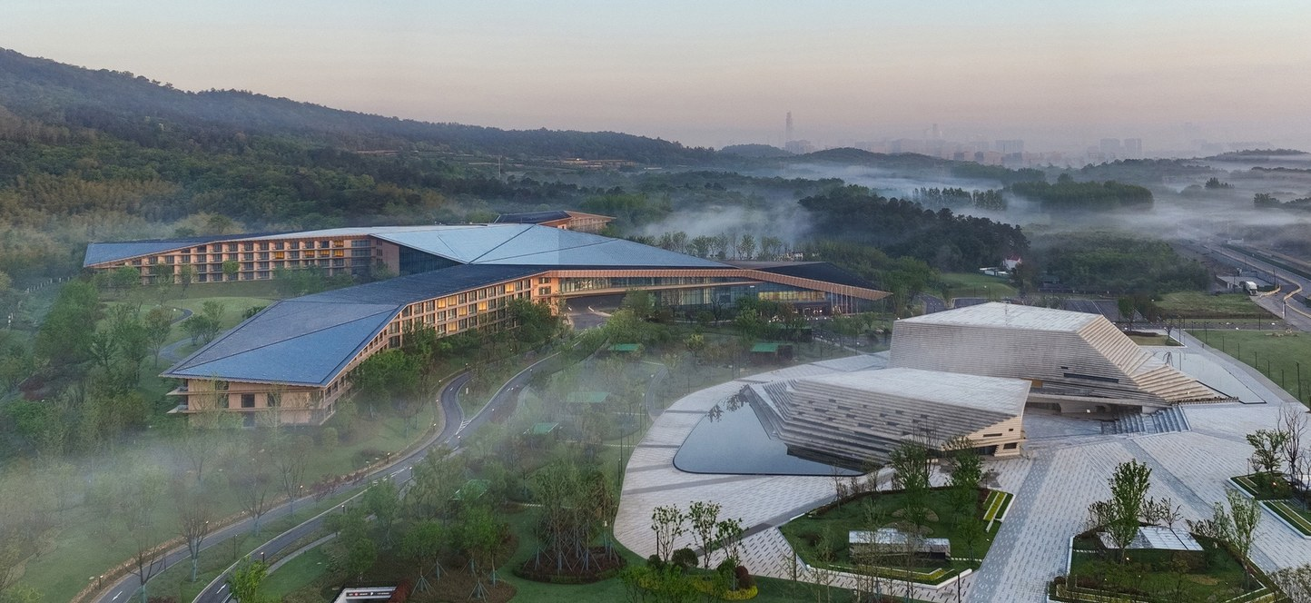
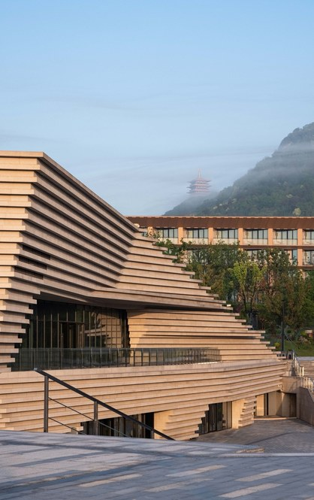
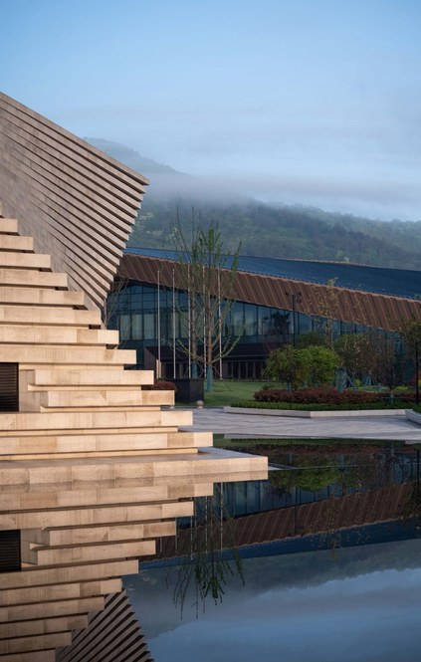
从场地中生长
GROWING OUT OF THE SITE
晨雾中的东麓酒店与演艺文创中心 The hotel and the Performing Arts & Cultural Center in morning mist
层叠的石材立面，远借佛顶塔 Layered stone façade
在地性设计不是将某种预制好的形式强加于场地，而是让建筑从场地中“生长”出来，成为场地逻辑的自然延伸。
Design rooted in locality does not impose a predetermined form on a site; it lets the building “grow” out of the site and become a natural extension of the site’s own logic.
禅意营造与在地性表达 · 南京牛首山东麓酒店设计与实践
Notes:
在地性设计不是将某种预制好的形式强加于场地，而是让建筑从场地中“生长”出来，成为场地逻辑的自然延伸。
Design rooted in locality does not impose a predetermined form on a site; it lets the building “grow” out of the site and become a natural extension of the site’s own logic.

Slide 11
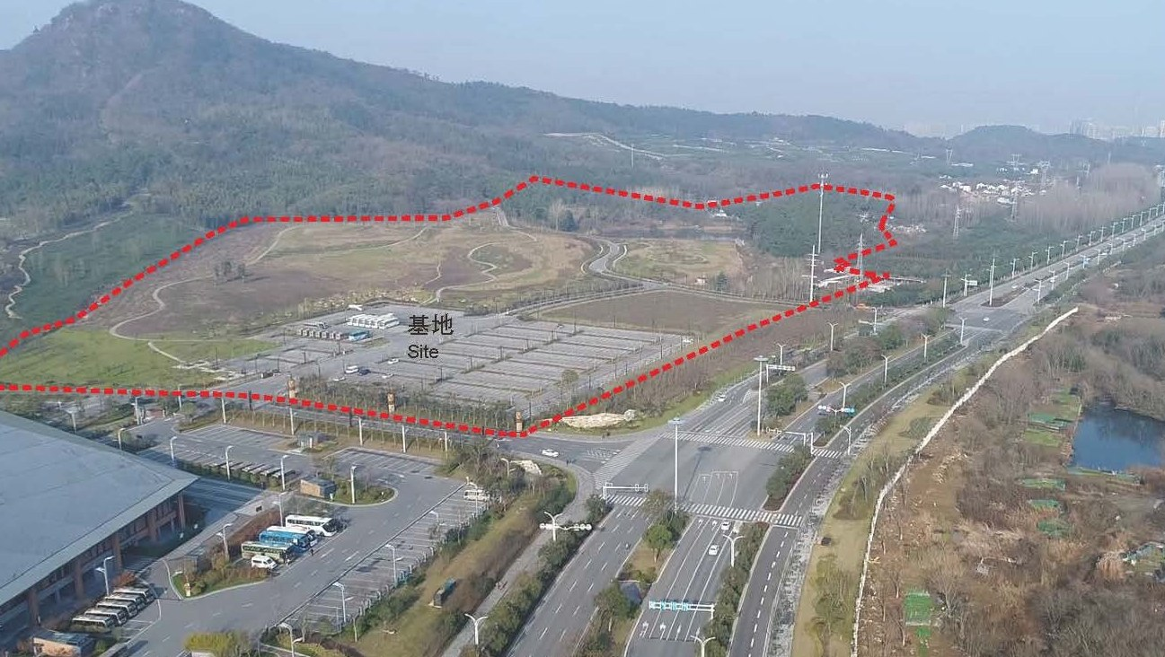
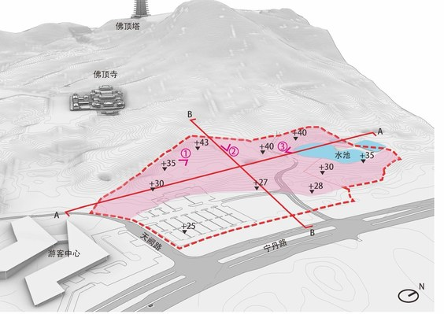
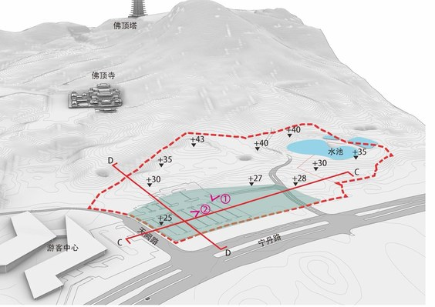
山水格局
THE LANDSCAPE SETTING
牛首山东麓的场地特征
牛首山位于南京市江宁区，地处江南丘陵地带，山体呈南北走向，东麓地势北高南低、高差显著，形成了一道层层叠落的山地地形序列。场地背倚牛首山主峰，面向开阔的东部平原，宁丹路从东侧穿越，构成了城市与山林之间的过渡界面。
Niushou Mountain lies in Jiangning District, Nanjing, within the hilly region south of the Yangtze River. The mountain runs north to south, and its eastern foothills fall from north to south with a marked difference in elevation, forming a sequence of terraced mountain terrain. The site backs onto the main peak of Niushou Mountain and faces the open plain to the east. Ningdan Road runs along its eastern side, forming the transitional interface between the city and the mountain forest.
禅意营造与在地性表达 · 南京牛首山东麓酒店设计与实践
Notes:
山水格局——牛首山东麓的场地特征。牛首山位于南京市江宁区，地处江南丘陵地带，山体呈南北走向，东麓地势北高南低、高差显著，形成了一道层层叠落的山地地形序列。场地背倚牛首山主峰，面向开阔的东部平原，宁丹路从东侧穿越，构成了城市与山林之间的过渡界面。
Niushou Mountain lies in Jiangning District, Nanjing, within the hilly region south of the Yangtze River. The mountain runs north to south, and its eastern foothills fall from north to south with a marked difference in elevation, forming a sequence of terraced mountain terrain. The site backs onto the main peak of Niushou Mountain and faces the open plain to the east. Ningdan Road runs along its eastern side, forming the transitional interface between the city and the mountain forest.

Slide 12
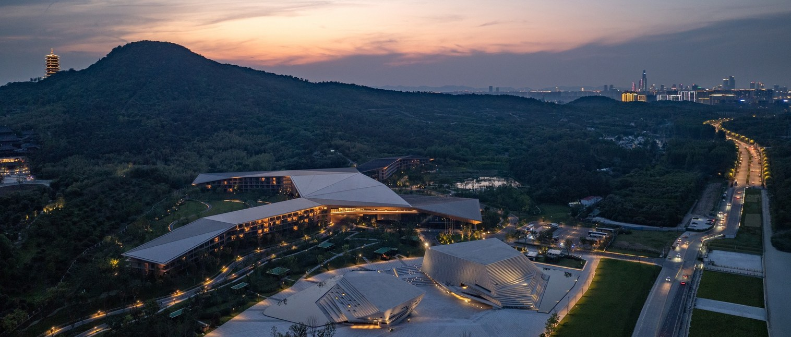
场地“边缘性”
THE LIMINALITY OF THE SITE
城市 → 山林
From city to mountain forest
世俗 → 圣地
From the secular to the sacred
神圣 → 日常
From the “sacred” to the “everyday”
它既是城市向山林的过渡，也是世俗向圣地的过渡。北侧毗邻佛顶宫、佛顶寺等核心宗教建筑群，这些文化地标以庄严宏大的姿态占据着山体制高点，传达着佛教圣地的神圣性。而场地所在的东麓，恰恰需要完成从“神圣”到“日常”的空间转换——它不再要求建筑的庄严与彰显，而是要求建筑的谦卑与融入。
The site is both a transition from city to mountain forest and a transition from the secular to the sacred. To the north lie core religious complexes such as the Usnisa Palace and Foding Temple; these cultural landmarks occupy the mountain’s commanding heights with solemn grandeur, conveying the sanctity of a Buddhist holy site. The eastern foothills where the site sits must accomplish the spatial shift from the “sacred” to the “everyday” — no longer asking architecture to be solemn and conspicuous, but to be humble and to blend in.
禅意营造与在地性表达 · 南京牛首山东麓酒店设计与实践
Notes:
场地“边缘性”——它既是城市向山林的过渡，也是世俗向圣地的过渡。北侧毗邻佛顶宫、佛顶寺等核心宗教建筑群，这些文化地标以庄严宏大的姿态占据着山体制高点，传达着佛教圣地的神圣性。而场地所在的东麓，恰恰需要完成从“神圣”到“日常”的空间转换——它不再要求建筑的庄严与彰显，而是要求建筑的谦卑与融入。
The site is both a transition from city to mountain forest and a transition from the secular to the sacred. To the north lie core religious complexes such as the Usnisa Palace and Foding Temple; these cultural landmarks occupy the mountain’s commanding heights with solemn grandeur, conveying the sanctity of a Buddhist holy site. The eastern foothills where the site sits must accomplish the spatial shift from the “sacred” to the “everyday” — no longer asking architecture to be solemn and conspicuous, but to be humble and to blend in.

Slide 13
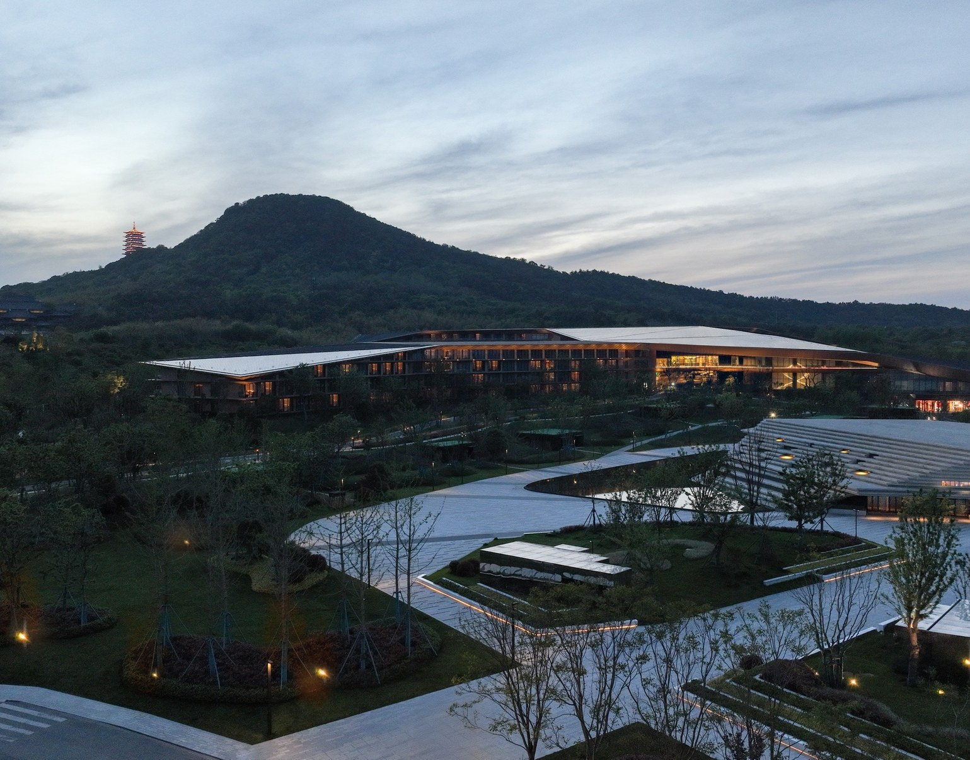
文化锚点
对
话
CULTURAL ANCHORS
佛顶宫、佛顶寺
与酒店的格局对话
东麓酒店的建筑不应与佛顶宫争夺视觉主导权，不应以标志性造型喧宾夺主，而应成为山势的一部分、景观的一部分，以低调内敛的姿态完成从“礼佛”到“休憩”的过渡。
The Donglu hotel should not compete with the Usnisa Palace for visual dominance, nor upstage it with an iconic form. Instead it should become part of the mountain and part of the landscape, completing the transition from “worship” to “repose” with a modest, restrained presence.
禅意营造与在地性表达 · 南京牛首山东麓酒店设计与实践
Notes:
文化锚点——佛顶宫、佛顶寺与酒店的格局对话。东麓酒店的建筑不应与佛顶宫争夺视觉主导权，不应以标志性造型喧宾夺主，而应成为山势的一部分、景观的一部分，以低调内敛的姿态完成从“礼佛”到“休憩”的过渡。
The Donglu hotel should not compete with the Usnisa Palace for visual dominance, nor upstage it with an iconic form. Instead it should become part of the mountain and part of the landscape, completing the transition from “worship” to “repose” with a modest, restrained presence.

Slide 14
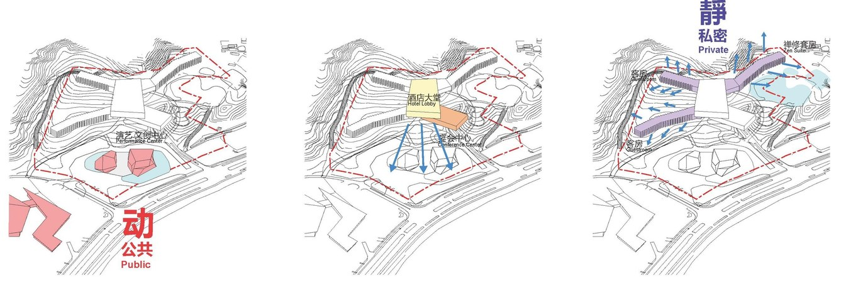
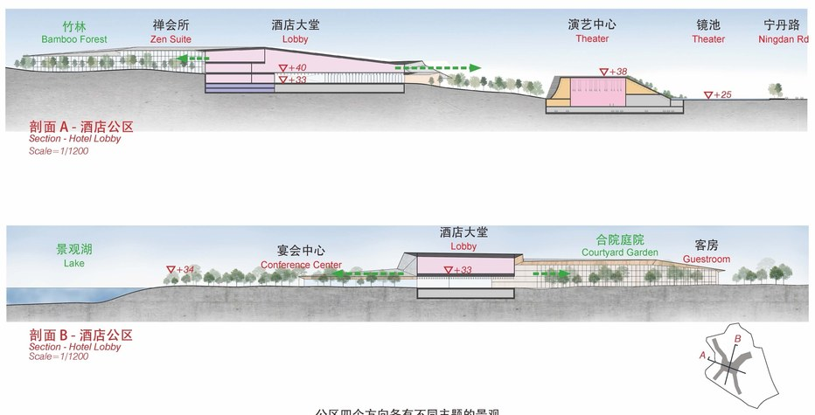
依山就势
山
势
FOLLOWING THE MOUNTAIN’S CONTOURS
依山而建 · 动静分明
建筑群充分利用北高南低的原始地形，分成三个层次依山铺陈，形体随山脉起伏变化，由动态的公共领域逐渐过渡到静态的私密空间。建筑高度被严格控制，轮廓线顺应山体走势，避免了人工构筑物对自然天际线的破坏。
体量分析：动 · 公共 → 静 · 私密 Massing: from public to private
The complex makes full use of the original terrain, which is high in the north and low in the south. It is laid out on the slope in three tiers, its forms rising and falling with the mountain, moving gradually from dynamic public realms to quiet private spaces. Building heights are strictly controlled and the silhouette follows the line of the mountain, so that the built structures do not disrupt the natural skyline.
剖面：建筑随地形层层叠落 Sections: the building steps down with the terrain
禅意营造与在地性表达 · 南京牛首山东麓酒店设计与实践
Notes:
依山就势——建筑群充分利用北高南低的原始地形，分成三个层次依山铺陈，形体随山脉起伏变化，由动态的公共领域逐渐过渡到静态的私密空间。建筑高度被严格控制，轮廓线顺应山体走势，避免了人工构筑物对自然天际线的破坏。
The complex makes full use of the original terrain, which is high in the north and low in the south. It is laid out on the slope in three tiers, its forms rising and falling with the mountain, moving gradually from dynamic public realms to quiet private spaces. Building heights are strictly controlled and the silhouette follows the line of the mountain, so that the built structures do not disrupt the natural skyline.

Slide 15
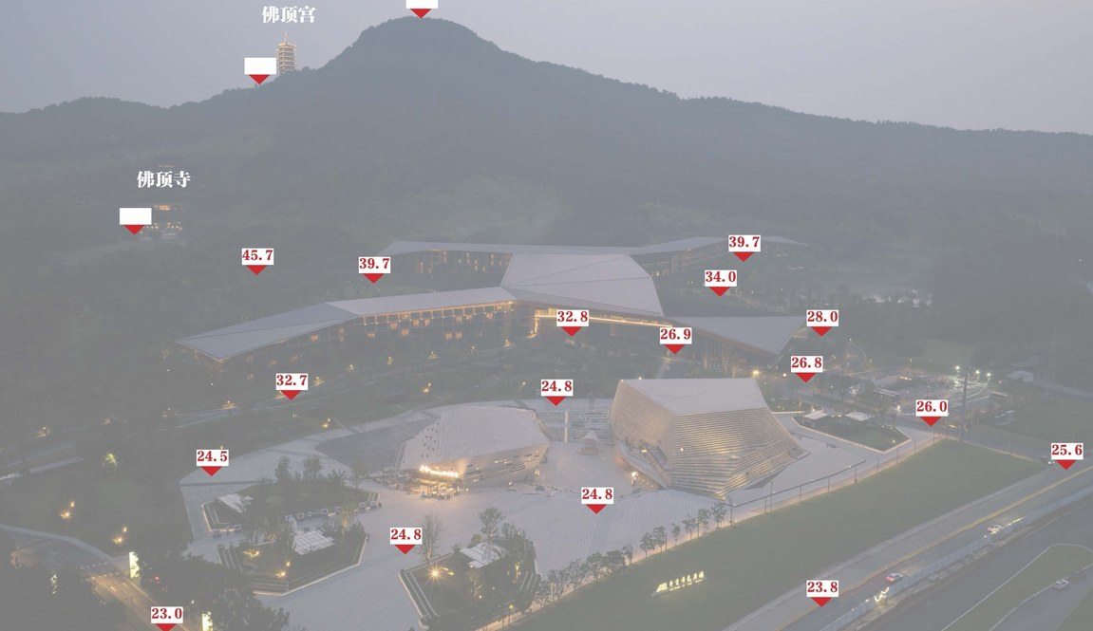
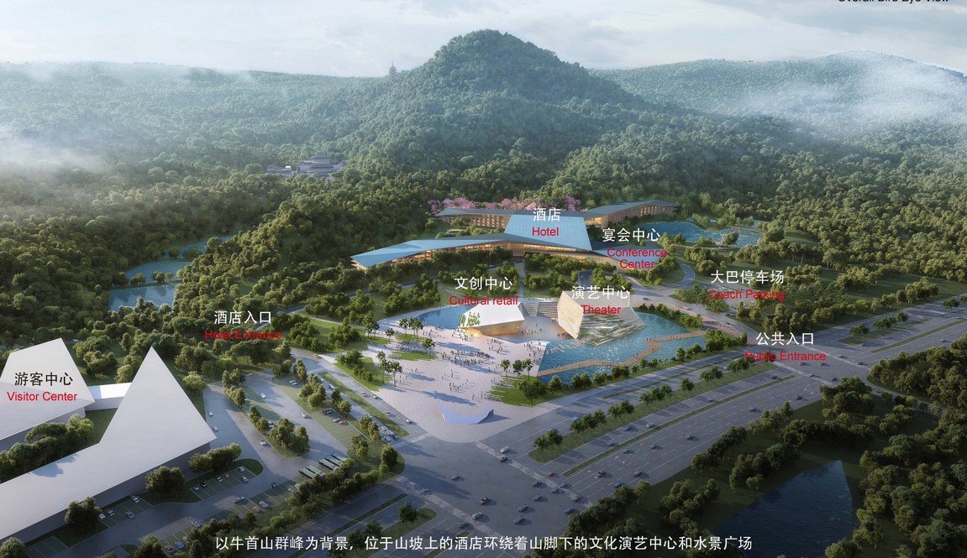
地形即动力
高差 → 空间的层次
坡度 → 视线的高度
TERRAIN AS THE DRIVING FORCE
场地标高：自 +23.0 至 +50.5 层层抬升 Site levels rising from +23.0 to +50.5
以牛首山群峰为背景的总体布局 Master plan set against the peaks of Niushou Mountain
建筑不强行改变地形，而是让地形成为空间组织的主动力——高差被转化为空间的层次，坡度被转化为视线的高度。
The architecture does not forcibly reshape the land; instead the terrain becomes the driving force of spatial organization — differences in elevation are turned into spatial layers, and slopes into elevated lines of sight.
禅意营造与在地性表达 · 南京牛首山东麓酒店设计与实践
Notes:
建筑不强行改变地形，而是让地形成为空间组织的主动力——高差被转化为空间的层次，坡度被转化为视线的高度。
The architecture does not forcibly reshape the land; instead the terrain becomes the driving force of spatial organization — differences in elevation are turned into spatial layers, and slopes into elevated lines of sight.

Slide 16
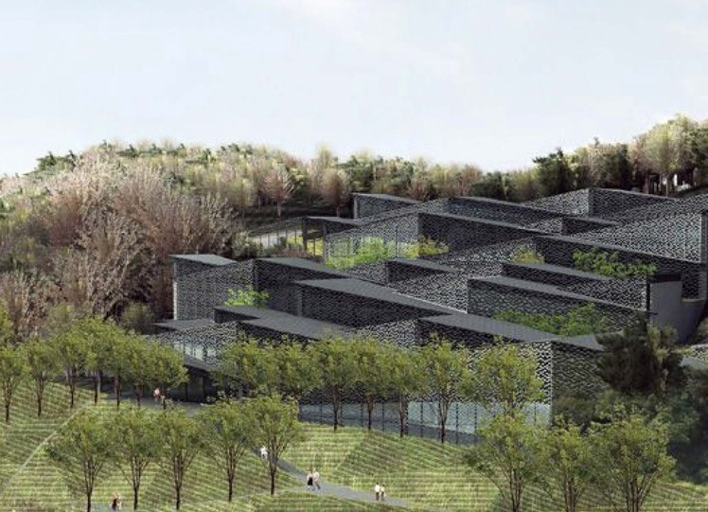
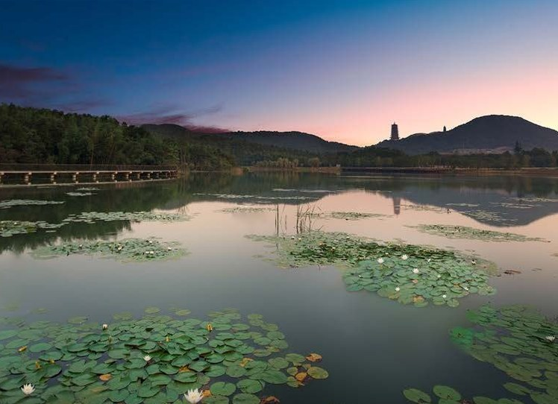
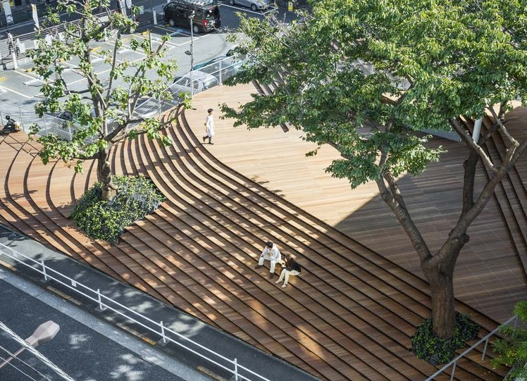
营造智慧的当代转译
营
造
“顺应”而非“对抗”，
追求建筑与山水的“和合”。
TRADITIONAL BUILDING WISDOM, TRANSLATED
顺
和
叠
ACCOMMODATE
顺应自然地形
而非对抗
Rather than confront the terrain
HARMONY
建筑与山水的
“和合”关系
Between architecture and landscape
TIERS
随山形错落
借高差筑屋
Staggered tiers that exploit elevation
从皖南徽派村落随山形错落布置，到川东吊脚楼利用高差架空筑屋
From the Huizhou villages of southern Anhui, staggered along the hillsides, to the stilt houses of eastern Sichuan, raised on posts to exploit differences in elevation.
禅意营造与在地性表达 · 南京牛首山东麓酒店设计与实践
Notes:
中国传统营造智慧的当代转译——建筑对自然地形的“顺应”而非“对抗”；追求建筑与山水的“和合”关系；皖南徽派村落随山形错落布置，到川东吊脚楼利用高差架空筑屋。
A Contemporary Translation of Traditional Chinese Building Wisdom — Architecture that “accommodates” rather than “confronts” natural terrain; the pursuit of “harmony” between architecture and landscape; from the Huizhou villages of southern Anhui, arranged in staggered tiers along the hillsides, to the stilt houses of eastern Sichuan, raised on posts to exploit differences in elevation.

Slide 17
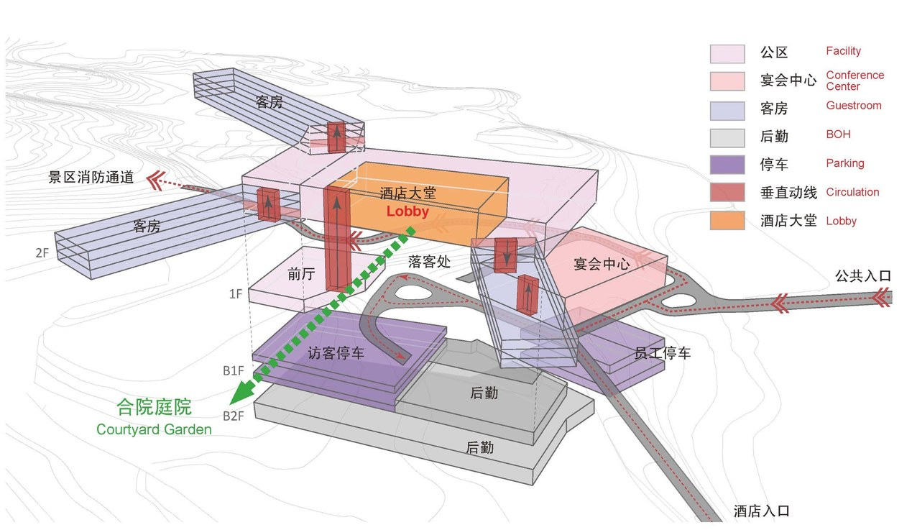
空间组织结构
THE DONGLU HOTEL’S SPATIAL STRUCTURE
建筑利用自然高差形成空间层次的递进：入口广场与公共活动区设于较低标高处，承接城市界面的到达与集散；宴会厅、会议中心等公共功能布置于中部过渡标高；客房区则设于较高处，顺应山势向三个方向延展，获取最佳景观视野。每一组功能都坐落在与其空间属性相匹配的地形标高上。
The building uses the natural differences in elevation to create a progression of spatial layers. The entrance plaza and public activity areas sit at the lower levels, receiving arrivals and dispersal from the urban interface. Public functions such as the banquet hall and conference center occupy the intermediate levels, while the guest-room zones sit higher up, extending in three directions along the slope to capture the best views. Each group of functions sits at an elevation suited to its spatial character.
酒店空间关系图 Axonometric diagram of the hotel
禅意营造与在地性表达 · 南京牛首山东麓酒店设计与实践
Notes:
东麓酒店的空间组织的结构——建筑利用自然高差形成空间层次的递进：入口广场与公共活动区设于较低标高处，承接城市界面的到达与集散；宴会厅、会议中心等公共功能布置于中部过渡标高；客房区则设于较高处，顺应山势向三个方向延展，获取最佳景观视野。每一组功能都坐落在与其空间属性相匹配的地形标高上。
The building uses the natural differences in elevation to create a progression of spatial layers. The entrance plaza and public activity areas sit at the lower levels, receiving arrivals and dispersal from the urban interface. Public functions such as the banquet hall and conference center occupy the intermediate levels, while the guest-room zones sit higher up, extending in three directions along the slope to capture the best views. Each group of functions sits at an elevation suited to its spatial character.

Slide 18
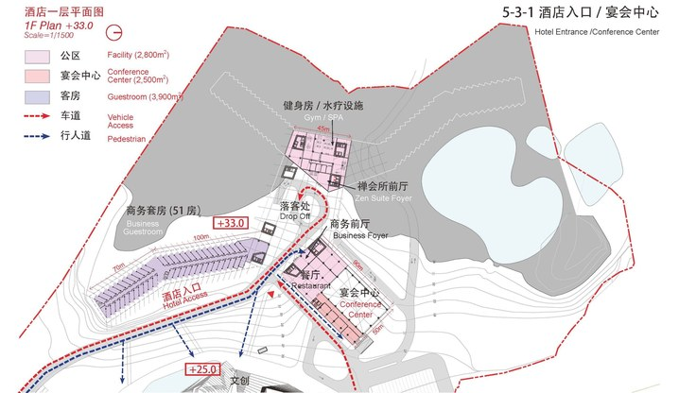
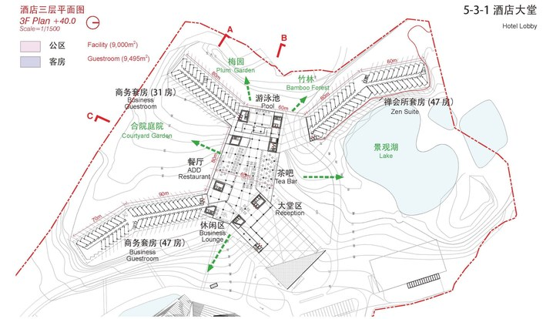
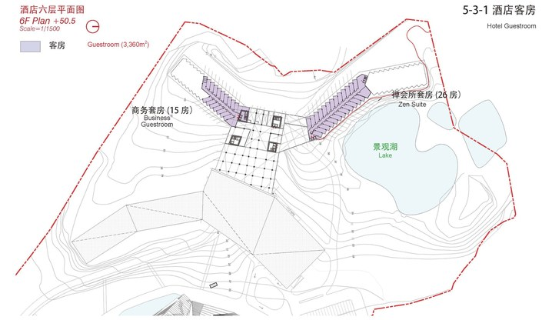
标高与功能
层
次
低处到达集散，中部公共过渡，
高处客房延展。
ELEVATION AND FUNCTION
低
中
高
1F · +33.0
酒店入口 · 宴会中心
Hotel entrance and conference center
3F · +40.0
酒店大堂 · 公共区
Hotel lobby and public facilities
6F · +50.5
客房向三个方向延展
Guest rooms extending in three directions
每一组功能都坐落在与其空间属性相匹配的地形标高上
Each group of functions sits at an elevation suited to its spatial character.
禅意营造与在地性表达 · 南京牛首山东麓酒店设计与实践
Notes:
每一组功能都坐落在与其空间属性相匹配的地形标高上。
Each group of functions sits at an elevation suited to its spatial character.

Slide 19
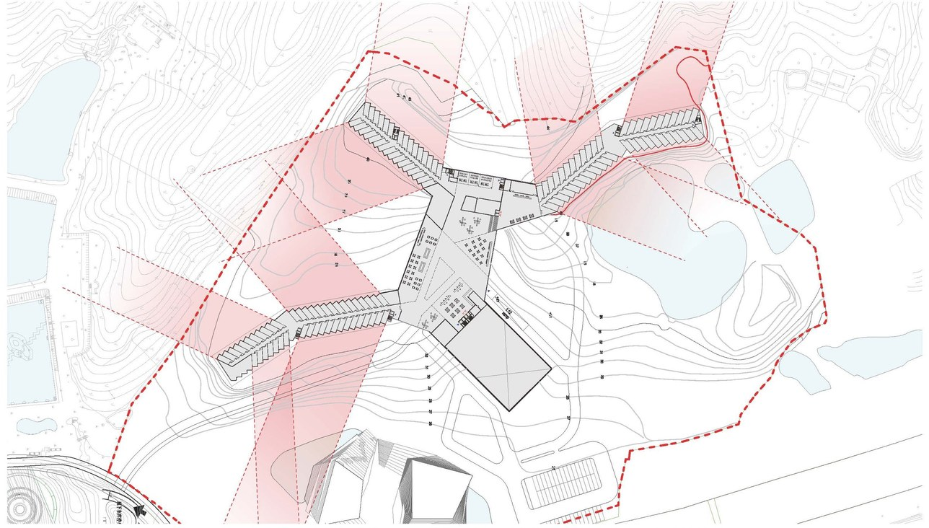
视线关系的精密控制
PRECISE CONTROL OF SIGHTLINES
客房分成长条形体块向不同方向伸展，既避免了彼此之间的视线交叉，又将山林、寺院、城景三大景观资源分别导入不同朝向的客房。景观资源的精细化配置，使“依山就势”从宏观策略落实为具体的空间品质。
The guest rooms are divided into long, slender blocks extending in different directions. This prevents rooms from overlooking one another and channels the three main scenic resources — mountain forest, temple and cityscape — into rooms with different orientations. Through this careful allocation of views, “following the mountain’s contours” moves from a broad strategy to concrete spatial quality.
酒店客房视线分析 Sightline analysis: views and privacy for every room
禅意营造与在地性表达 · 南京牛首山东麓酒店设计与实践
Notes:
视线关系的精密控制——客房分成长条形体块向不同方向伸展，既避免了彼此之间的视线交叉，又将山林、寺院、城景三大景观资源分别导入不同朝向的客房。景观资源的精细化配置，使“依山就势”从宏观策略落实为具体的空间品质。
The guest rooms are divided into long, slender blocks extending in different directions. This prevents rooms from overlooking one another and channels the three main scenic resources — mountain forest, temple and cityscape — into rooms with different orientations. Through this careful allocation of views, “following the mountain’s contours” moves from a broad strategy to concrete spatial quality.

Slide 20
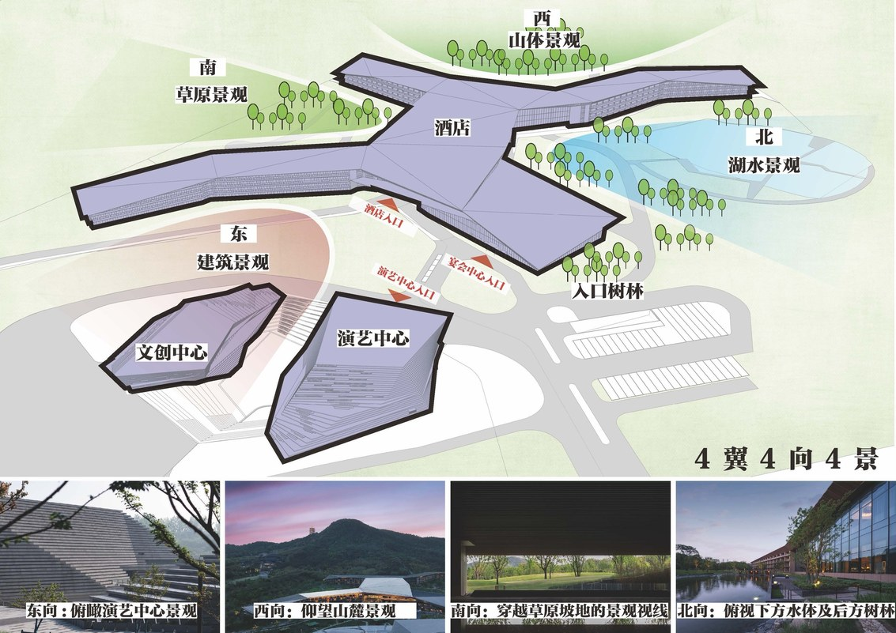
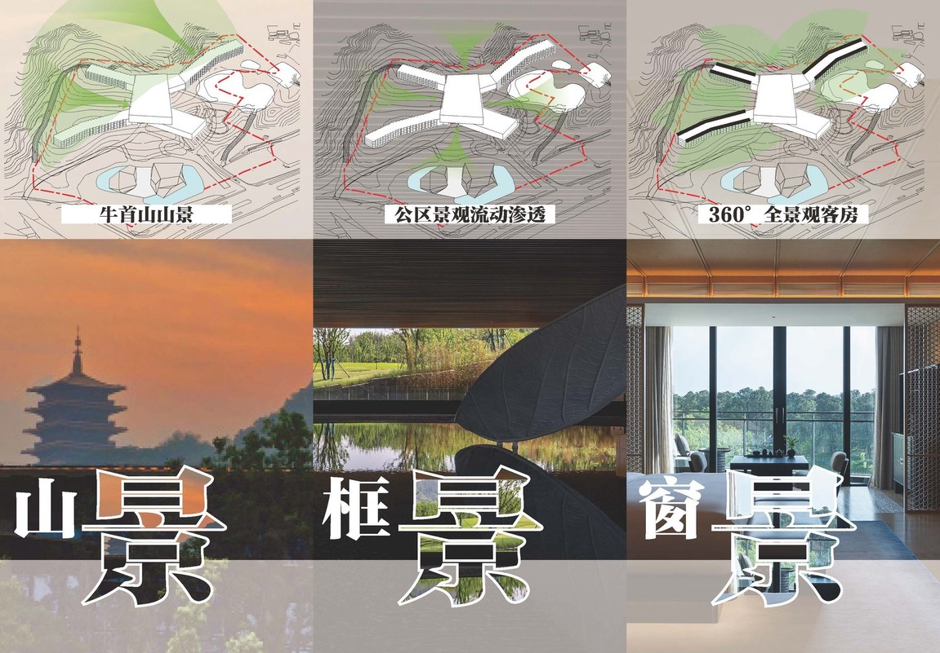
四翼 · 四向 · 四景
FOUR WINGS · FOUR ORIENTATIONS · FOUR VIEWS
景观资源的精细化配置，使“依山就势”从宏观策略落实为具体的空间品质
Through this careful allocation of views, “following the mountain’s contours” moves from a broad strategy to concrete spatial quality.
禅意营造与在地性表达 · 南京牛首山东麓酒店设计与实践
Notes:
景观资源的精细化配置，使“依山就势”从宏观策略落实为具体的空间品质。
Through this careful allocation of views, “following the mountain’s contours” moves from a broad strategy to concrete spatial quality.

Slide 21
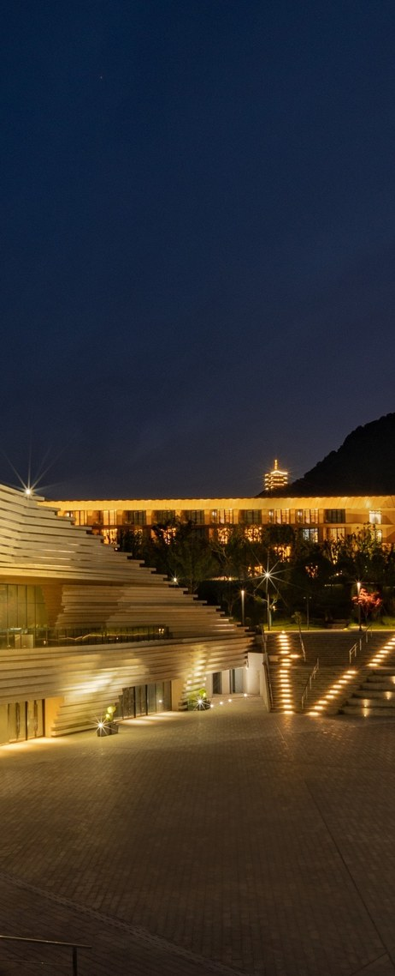
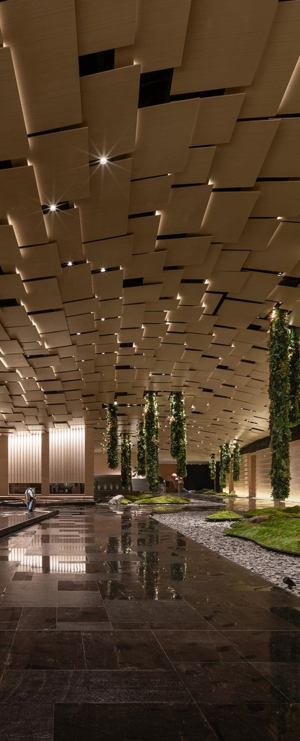
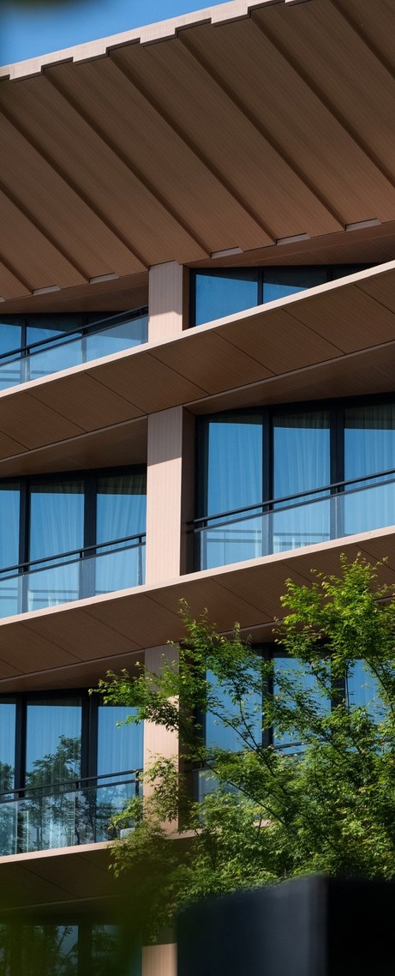
禅意营造
叙
事
ZEN-INSPIRED CREATION
空间叙事与设计策略
SPATIAL NARRATIVE AND DESIGN STRATEGY
“礼佛—参禅—休憩”的叙事主线对应“山门—佛殿—禅堂”的空间序列。空间的递进的同时伴随心理状态的递进。
The narrative thread of “worship – meditation – repose” corresponds to the spatial sequence of “mountain gate – Buddha hall – meditation hall”. The progression of space is accompanied by a progression of state of mind.
空间递进，心境亦递进
As space unfolds, so does the state of mind
礼佛 山门
WORSHIP · MOUNTAIN GATE
参禅 佛殿
MEDITATION · BUDDHA HALL
休憩 禅堂
REPOSE · MEDITATION HALL
禅意营造与在地性表达 · 南京牛首山东麓酒店设计与实践
Notes:
禅意营造：空间叙事与设计策略——“礼佛—参禅—休憩”的叙事主线对应“山门—佛殿—禅堂”的空间序列。空间的递进的同时伴随心理状态的递进。
The narrative thread of “worship – meditation – repose” corresponds to the spatial sequence of “mountain gate – Buddha hall – meditation hall”. The progression of space is accompanied by a progression of state of mind.

Slide 22
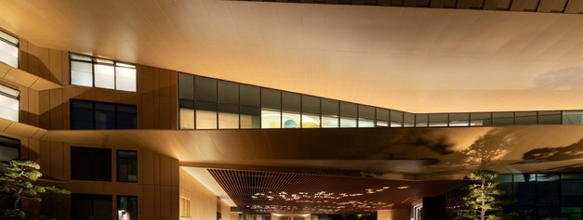
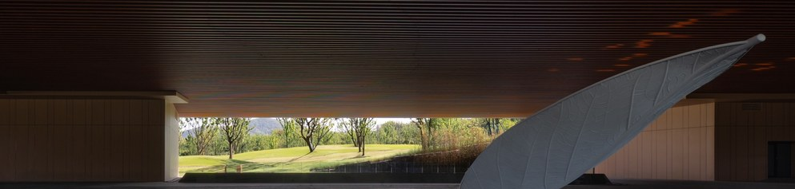
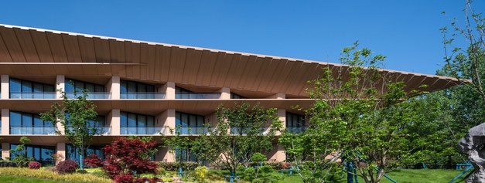
三重境界
礼佛 — 参禅 — 休憩
山门 — 佛殿 — 禅堂
THREE STAGES OF THE JOURNEY
第一重 · 礼佛 WORSHIP
第二重 · 参禅 MEDITATION
第三重 · 休憩 REPOSE
从城市界面进入酒店区域，入口广场以开放的姿态迎接访客。
空间逐渐收束，庭院水景、枯山水意境、首层架空引入的山林绿意次第展开，建筑的边界在此被有意模糊，实现了“人在室内，如在林中”的空间体验。这正是禅宗“内外一如”思想的建筑表达。
空间归于静谧。客房栋分散布置于高区，各自朝向不同的景观面，确保了私密性与专属感。
Entering the hotel grounds from the urban interface, the entrance plaza welcomes visitors with an open gesture.
The space returns to stillness. The guest-room buildings are dispersed across the upper zone, each facing a different view, ensuring privacy and a sense of exclusivity.
The space gradually narrows, as courtyard water features, the mood of a dry landscape garden and the greenery of the mountain forest drawn in through the raised ground floor unfold one after another; here the boundaries of the building are deliberately blurred, creating the spatial experience of “being indoors as if in the forest.” This is the architectural expression of the Zen Buddhist idea of “inside and outside as one”.
禅意营造与在地性表达 · 南京牛首山东麓酒店设计与实践
Notes:
第一重 · 礼佛：从城市界面进入酒店区域，入口广场以开放的姿态迎接访客。 Entering the hotel grounds from the urban interface, the entrance plaza welcomes visitors with an open gesture.
第二重 · 参禅：空间逐渐收束，庭院水景、枯山水意境、首层架空引入的山林绿意次第展开，建筑的边界在此被有意模糊，实现了“人在室内，如在林中”的空间体验。这正是禅宗“内外一如”思想的建筑表达。 The space gradually narrows, as courtyard water features, the mood of a dry landscape garden and the greenery of the mountain forest drawn in through the raised ground floor unfold one after another; here the boundaries of the building are deliberately blurred, creating the spatial experience of “being indoors as if in the forest.” This is the architectural expression of the Zen Buddhist idea of “inside and outside as one”.
第三重 · 休憩：空间归于静谧。客房栋分散布置于高区，各自朝向不同的景观面，确保了私密性与专属感。 The space returns to stillness. The guest-room buildings are dispersed across the upper zone, each facing a different view, ensuring privacy and a sense of exclusivity.

Slide 23
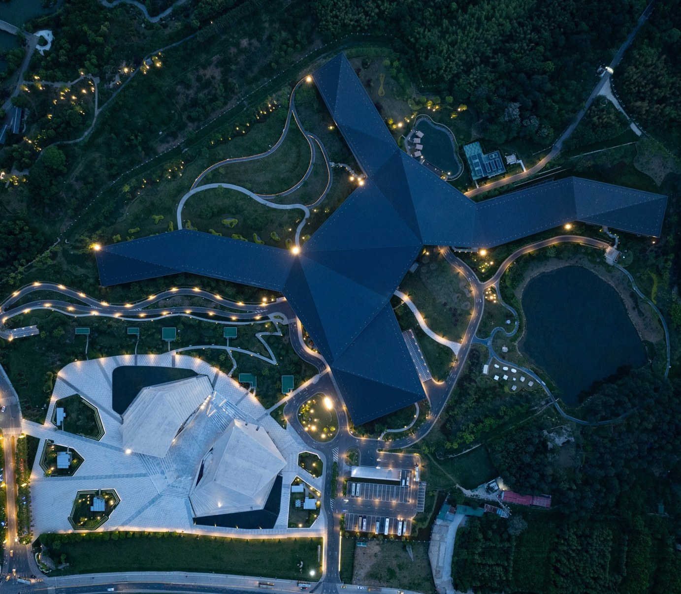
负建筑
消
隐
NEGATIVE ARCHITECTURE
形态的消隐
THE DISSOLUTION OF FORM
“负建筑”的概念，其核心主张是建筑不应以张扬的形态与环境对抗，而应通过材料的消隐、体量的分解、边界的模糊，使建筑“消失”于环境之中。这一思想与东方“无为”“隐逸”的哲学传统一脉相通。
The concept of “negative architecture”: its central claim is that architecture should not confront its environment with an assertive form, but should “disappear” into it through receding materials, broken-down volumes and blurred boundaries. This thought shares the same lineage as the Eastern philosophical traditions of “non-action” (wuwei) and “reclusion.”
禅意营造与在地性表达 · 南京牛首山东麓酒店设计与实践
Notes:
负建筑：形态的消隐——“负建筑”的概念，其核心主张是建筑不应以张扬的形态与环境对抗，而应通过材料的消隐、体量的分解、边界的模糊，使建筑“消失”于环境之中。这一思想与东方“无为”“隐逸”的哲学传统一脉相通。
The concept of “negative architecture”: its central claim is that architecture should not confront its environment with an assertive form, but should “disappear” into it through receding materials, broken-down volumes and blurred boundaries. This thought shares the same lineage as the Eastern philosophical traditions of “non-action” (wuwei) and “reclusion.”

Slide 24
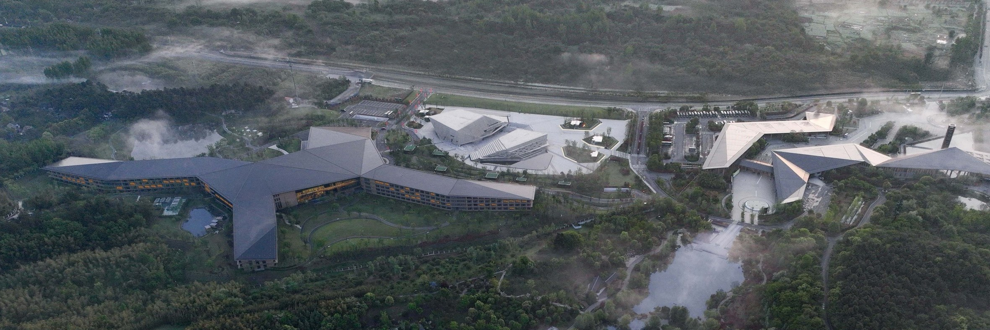
山脊线的延续
建筑整体造型秉持低调内敛，连续起伏、流畅舒展的金属屋面呼应着山体轮廓，使建筑的天际线成为山脊线的延续而非打断。
CONTINUING THE RIDGELINE
与游客中心相统一的建筑屋面
The overall form of the building remains modest and restrained; the continuously undulating, flowing metal roofs echo the mountain’s outline, so that the building’s skyline continues the ridgeline rather than interrupting it.
禅意营造与在地性表达 · 南京牛首山东麓酒店设计与实践
Notes:
建筑整体造型秉持低调内敛，连续起伏、流畅舒展的金属屋面呼应着山体轮廓，使建筑的天际线成为山脊线的延续而非打断。
The overall form of the building remains modest and restrained; the continuously undulating, flowing metal roofs echo the mountain’s outline, so that the building’s skyline continues the ridgeline rather than interrupting it.

Slide 25

“生长”的建筑
ARCHITECTURE THAT “GROWS”
从佛顶宫俯瞰，酒店如同一片从山坡上“生长”出来的聚落，而非被“放置”上去的人工物。
Seen from the Usnisa Palace above, the hotel looks like a settlement that has “grown” out of the hillside rather than an artificial object “placed” upon it.
是“生长”，而非“放置”
Grown from the hillside, not placed upon it
禅意营造与在地性表达 · 南京牛首山东麓酒店设计与实践
Notes:
“生长”的建筑——从佛顶宫俯瞰，酒店如同一片从山坡上“生长”出来的聚落，而非被“放置”上去的人工物。
Seen from the Usnisa Palace above, the hotel looks like a settlement that has “grown” out of the hillside rather than an artificial object “placed” upon it.

Slide 26




木色入山林
材
质
温润质朴的木质饰面材料呼应着山林生态，让建筑在色彩与质感上与自然融为一体。
TIMBER AMONG THE TREES
Warm, unpretentious timber finishes echo the mountain-forest ecology, letting the building merge with nature in color and texture.
禅意营造与在地性表达 · 南京牛首山东麓酒店设计与实践
Notes:
温润质朴的木质饰面材料呼应着山林生态，让建筑在色彩与质感上与自然融为一体。
Warm, unpretentious timber finishes echo the mountain-forest ecology, letting the building merge with nature in color and texture.

Slide 27




以虚为主角
虚
空
树影、风声、光线、远山——
东方美学中最核心的“虚”的要素
THE VOID AS PROTAGONIST
影
风
光
山
SHADOWS
树影
WIND
风声
LIGHT
光线
MOUNTAINS
远山
建筑的物质性被不断消解，空间的“空”成为主导性的体验
The materiality of the building is continually dissolved, and the “emptiness” of space becomes the dominant experience.
禅意营造与在地性表达 · 南京牛首山东麓酒店设计与实践
Notes:
树影、风声、光线、远山——东方美学中最核心的“虚”的要素，在此成为了空间的主角，建筑的物质性被不断消解，空间的“空”成为主导性的体验。
Tree shadows, the sound of the wind, light and distant mountains — the most essential elements of “void” in Eastern aesthetics become the protagonists of the space here; the materiality of the building is continually dissolved, and the “emptiness” of space becomes the dominant experience.

Slide 28

空
“虚”的要素，在此成为了空间的主角
THE ELEMENTS OF “VOID” BECOME THE PROTAGONISTS OF THE SPACE
落客区框景：檐下一线，山林入画
The drop-off: a framed strip of forest beneath the eaves
禅意营造与在地性表达 · 南京牛首山东麓酒店设计与实践
Notes:
“虚”的要素在此成为了空间的主角。
The elements of “void” become the protagonists of the space here.

Slide 29


当代文旅酒店的文化转向
THE CULTURAL TURN OF CONTEMPORARY CULTURAL-TOURISM HOTELS
→
看
TRADITIONAL RESORT HOTEL · LOOKING
感
ZEN HOTEL · SENSING
传统度假酒店的核心价值在于提供优质的景观资源与舒适的服务设施，其空间逻辑围绕“看”展开——看山、看水、看风景。
禅意酒店的核心价值则在于提供一种“安住”的身心状态，其空间逻辑围绕“感”展开——感风、感光、感内心。
The core value of a traditional resort hotel lies in offering fine scenery and comfortable facilities, and its spatial logic revolves around “looking” — looking at mountains, water and scenery.
The core value of a Zen hotel, by contrast, lies in offering a state of body and mind that is “settled and at ease,” and its spatial logic revolves around “sensing” — sensing the wind, the light and one’s inner self.
禅意营造与在地性表达 · 南京牛首山东麓酒店设计与实践
Notes:
当代文旅酒店的文化转向——传统度假酒店的核心价值在于提供优质的景观资源与舒适的服务设施，其空间逻辑围绕“看”展开——看山、看水、看风景。而禅意酒店的核心价值则在于提供一种“安住”的身心状态，其空间逻辑围绕“感”展开——感风、感光、感内心。
The Cultural Turn of Contemporary Cultural-Tourism Hotels — The core value of a traditional resort hotel lies in offering fine scenery and comfortable facilities, and its spatial logic revolves around “looking” — looking at mountains, water and scenery. The core value of a Zen hotel, by contrast, lies in offering a state of body and mind that is “settled and at ease,” and its spatial logic revolves around “sensing” — sensing the wind, the light and one’s inner self.

Slide 30



安住
感
知
空间逻辑围绕“感”展开——
感风、感光、感内心
SETTLED AND AT EASE
风
光
心
SENSING THE WIND
感风
Water, reeds and the evening breeze
SENSING THE LIGHT
感光
Light folded into a landscape screen
SENSING THE SELF
感内心
Stillness, symmetry and moss
从“看山、看水、看风景”，到“感风、感光、感内心”
From looking at scenery to sensing the wind, the light and one’s inner self.
禅意营造与在地性表达 · 南京牛首山东麓酒店设计与实践
Notes:
禅意酒店的空间逻辑围绕“感”展开——感风、感光、感内心。
The spatial logic of a Zen hotel revolves around “sensing” — sensing the wind, the light and one’s inner self.

Slide 31


慢生活 · 静空间 · 内观体验
SLOW LIVING · QUIET SPACES · INTROSPECTIVE EXPERIENCE
禅意酒店正是以建筑空间为载体，将这一需求商品化、服务化、空间化。
Zen hotels use architectural space as the vehicle for turning this demand into a product, a service and a space.
东麓酒店将抄经、禅修、素食、汉服旅拍、非遗体验等文化内容融入旅居服务。
The Donglu hotel weaves cultural offerings — sutra copying, meditation, vegetarian cuisine, Hanfu photo tours and intangible-cultural-heritage experiences — into its hospitality services.
净化与疗愈
Refreshing & Healing — a retreat for body, mind and spirit
禅意营造与在地性表达 · 南京牛首山东麓酒店设计与实践
Notes:
“慢生活”“静空间”“内观体验”——禅意酒店正是以建筑空间为载体，将这一需求商品化、服务化、空间化。东麓酒店将抄经、禅修、素食、汉服旅拍、非遗体验等文化内容融入旅居服务。
Zen hotels use architectural space as the vehicle for turning this demand into a product, a service and a space. The Donglu hotel weaves cultural offerings — sutra copying, meditation, vegetarian cuisine, Hanfu photo tours and intangible-cultural-heritage experiences — into its hospitality services.

Slide 32




文化融入旅居
旅
居
CULTURE WOVEN INTO HOSPITALITY
中餐厅：窗含山林 Chinese restaurant framing the forest
全日餐厅 · 大堂吧 · 书吧 All-day dining · Lobby bar · Library bar
抄经 · 禅修 · 素食 · 汉服旅拍 · 非遗体验
Sutra copying · Meditation · Vegetarian cuisine · Hanfu photo tours · Intangible-cultural-heritage experiences
禅意营造与在地性表达 · 南京牛首山东麓酒店设计与实践
Notes:
东麓酒店将抄经、禅修、素食、汉服旅拍、非遗体验等文化内容融入旅居服务。
The Donglu hotel weaves cultural offerings — sutra copying, meditation, vegetarian cuisine, Hanfu photo tours and intangible-cultural-heritage experiences — into its hospitality services.

Slide 33

结语
东
麓
CONCLUSION
从自然中生长出建筑
Architecture Grown from Nature
隐
空
静
CONCEALMENT
姿态
EMPTINESS
追求
STILLNESS
意境
“依山就势”、“负建筑”、“非对抗”、“过渡性存在”。“隐”的姿态、“空”的追求、“静”的意境，本身就是对禅宗哲学最深切的建筑表达。基于中国传统营造智慧的现代建筑创作拥有更持久生命力。
“Following the mountain’s contours”, “negative architecture”, “non-confrontation” and “transitional presence.” The posture of “concealment,” the pursuit of “emptiness” and the mood of “stillness” are in themselves the most profound architectural expression of Zen Buddhist philosophy. Modern architectural creation grounded in traditional Chinese building wisdom has a more enduring vitality.
禅意营造与在地性表达 · 南京牛首山东麓酒店设计与实践
Notes:
结语：从自然中生长出建筑——“依山就势”、“负建筑”、“非对抗”、“过渡性存在”。“隐”的姿态、“空”的追求、“静”的意境，本身就是对禅宗哲学最深切的建筑表达。基于中国传统营造智慧的现代建筑创作拥有更持久生命力。
“Following the mountain’s contours”, “negative architecture”, “non-confrontation” and “transitional presence.” The posture of “concealment,” the pursuit of “emptiness” and the mood of “stillness” are in themselves the most profound architectural expression of Zen Buddhist philosophy. Modern architectural creation grounded in traditional Chinese building wisdom has a more enduring vitality.

