Slide 1


Slide 2
What Is Angular?
Frontend/Client Side JavaScript framework
Created and maintained by Google
Single Page applications
Dynamic web application

Slide 3
Angular Version History
AngularJS / Angular 1
Angular 2 : Complete rewrite of AngularJS
Angular 4:
Angular 5:
Angular 6:
Angular 7:
Angular 8:

Slide 4
What Angular Is Not?
A Server side framework/technology
JavaScript Library
Design pattern
Platform or language (.Net, Java)
Plugin or extension

Slide 5
FEATURES & BENEFITS
CROSS PLATFORM
SPEED AND PERFORMANCE
PRODUCTIVITY
FULL DEVELOPMENT STORY

Slide 6
Core Features
Components
Data Binding
Directives
Services
Templating
Pipes
Routing
HTTP Module
Observables
Form Module
TypeScript
Build Tools

Slide 7
Setup Angular 8
2 Main ways to Setup
  Angular CLI
  Quickstart Seed
Dependencies
  Node.js & NPM

Slide 8
Create Demo Application
Generate a new project using ng new my-app command
The Angular CLI installs the necessary npm packages, creates the project files
Serve the application - Go to the project directory and launch the server.
cd my-app
ng serve –open
The ng serve command launches the server, watches your files, and rebuilds the app as you make changes to those files.
Using the --open (or just -o) option will automatically open your browser on http://localhost:4200/.

Slide 9
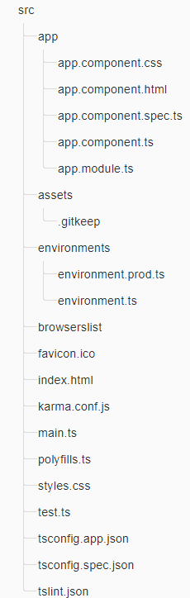
Project file review

Slide 10
File | Purpose
favicon.ico | Its favicon icon for your website or an application.
index.html | It contains html code with head, and body section. It is starting point of your application
main.ts | It is starting point of typescript file in your angular application. It contains library which are imported by your angular project.
polyfill.ts | It is used for browser compatibility.
style.css | It has all the styles and css for your angular 8 project.
test.ts | This file is used to write unit tests.
tsconfig.app.json | It contains the configuration about how your application should compile.
assets/* | In this folder you can put images and anything else to be copied wholesale when you build your application.

Slide 11
File | Purpose
environments/* | In this folder one file for each of your destination environments, each exporting simple configuration variables to use in your application. The files are replaced on-the-fly when you build your app
browserslist | A configuration file to share target browsers between different front-end tools.
app/app.component.{ts,html,css,spec.ts} | Defines the AppComponent along with an HTML template, CSS stylesheet, and a unit test. It is the root component of what will become a tree of nested components as the application evolves.
app/app.module.ts | Defines AppModule, the root module that tells Angular how to assemble the application.
karma.conf.js | Unit test configuration for the Karma test runner, used when running ng test.
tslint.json | Used for building application with consistent code style. We can change the configuration that defines how our application should be build.

Slide 12
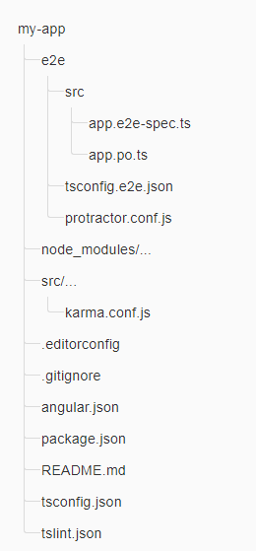
The root folder

Slide 13
File | Purpose
e2e/ | Inside e2e/ live the end-to-end tests
node_modules/ | Node.js creates this folder and puts all third party modules listed in package.jsoninside of it
.editorconfig | It contains the setting of your editor. It has parameter like style, size of character, line length.
.gitignore | We can define all the folders and files which we want to exclude from our repository in our git.
angular.json | Configuration for Angular CLI. In this file you can set several defaults and also configure what files are included when your project is built.
package.json | npm configuration listing the third party packages your project uses.
README.md | Basic documentation for your project.
tsconfig.json | TypeScript compiler configuration for your IDE to pick up and give you helpful tooling.
tslint.json | Used for building application with consistent code style. We can change the configuration that defines how our application should be build.

Slide 14
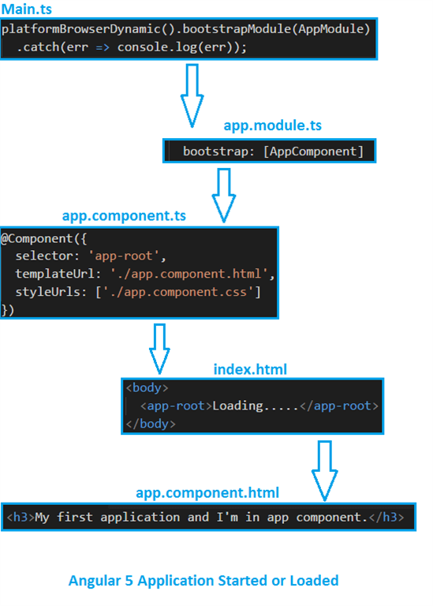

Slide 15

What is TypeScript?
TypeScript is a Superset of JavaScript
TypeScript includes support for modern feature such as modules, classes, interfaces, and arrow functions that are part of ECMAScript 6
TypeScript is JavaScript plus some additional features.
TypesScript is developed by Miscrosoft
TypeScript is a strongly typed, object oriented, compiled language.
TypeScript Complies code into JavaScript

Slide 16
Module
Module in Angular refers to a place where you can group the components, directives, pipes, and services, which are related to the application.
In case you are developing a website, the header, footer, left, center and the right section become part of a module.
To define module, we can use the NgModule. When you create a new project using the Angular –cli command, the ngmodule is created in the app.module.ts file by default and it looks as follows −

Slide 17
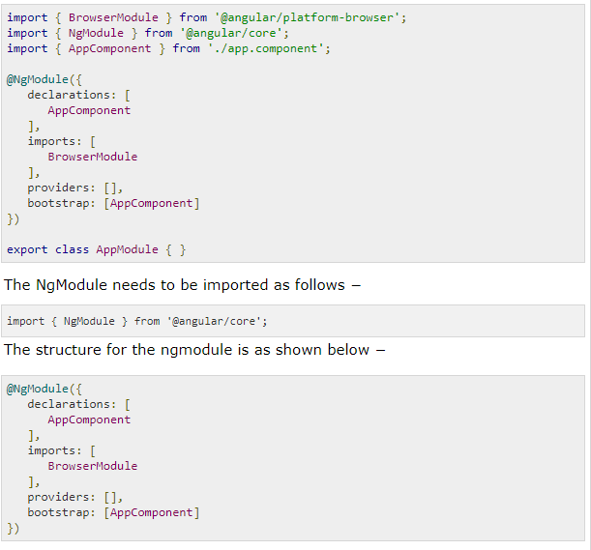

Slide 18
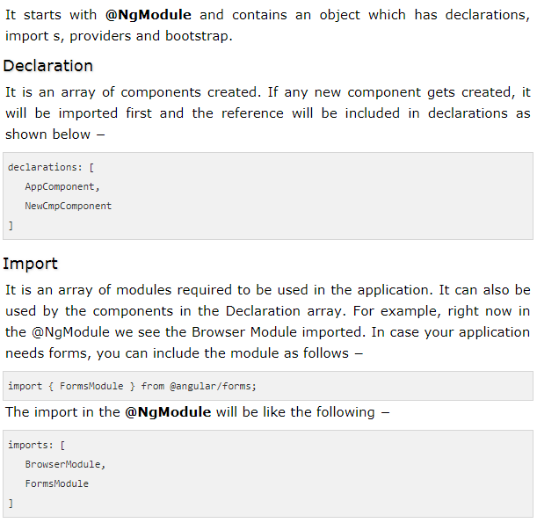
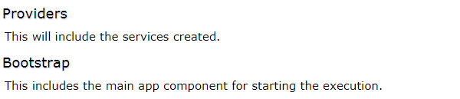

Slide 19
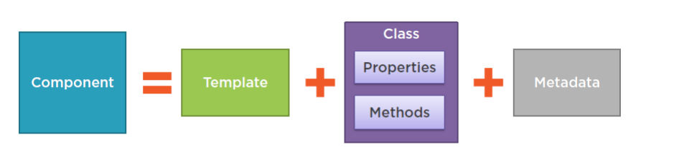
What is Component?
Major part of the development with Angular 8 is done in the components. Components are basically classes that interact with the .html file of the component, which gets displayed on the browser.

Slide 20
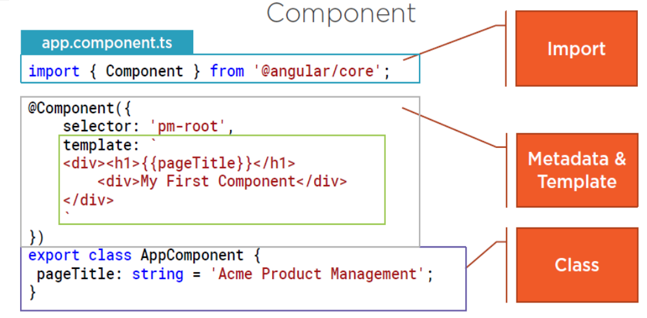

Slide 21
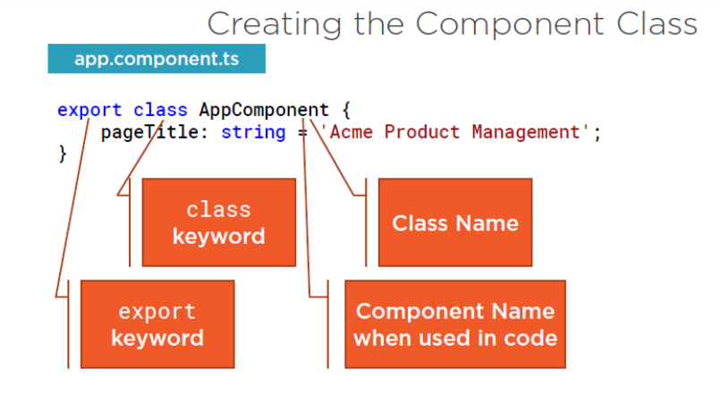

Slide 22
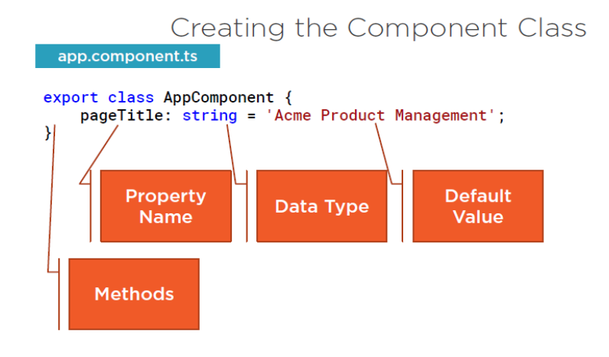

Slide 23
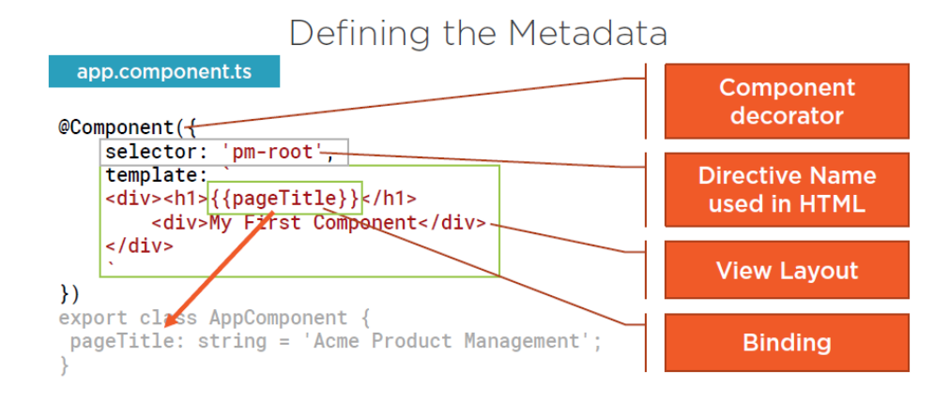

Slide 24
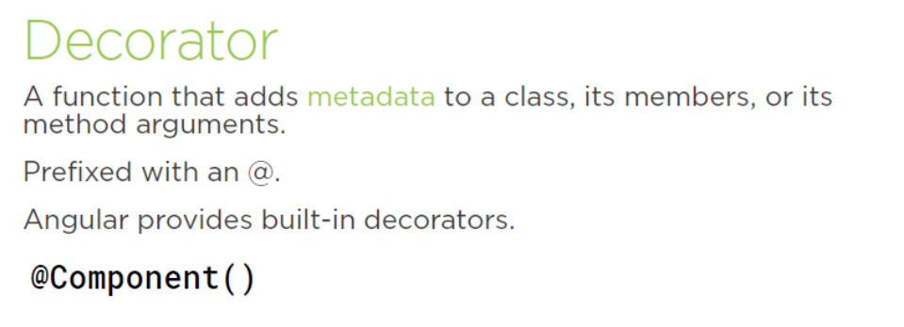

Slide 25
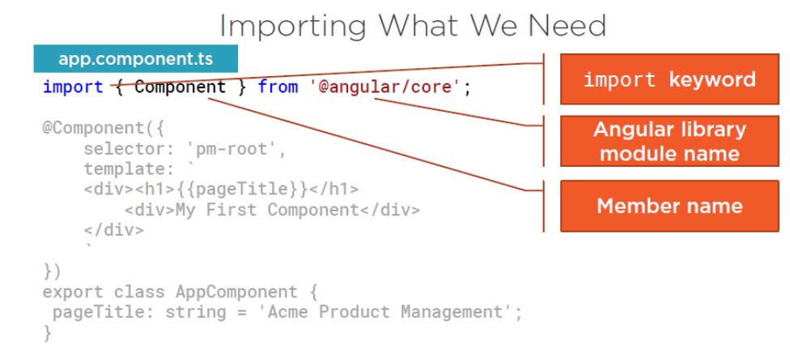

Slide 26
Lifecycle Hooks
After executing the constructor, Angular executes its lifecycle hook methods in a specific order. These stages are mainly divided into two phases – one is linked to the component itself and another is linked to the children of that component.
ngOnChanges()
ngOnInit()
ngDoCheck()
ngAfterContentInit()
ngAfterContentChecked()
ngAfterViewInit()
ngAfterViewChecked()
ngOnDestroy()
https://codecraft.tv/courses/angular/components/lifecycle-hooks/

Slide 27
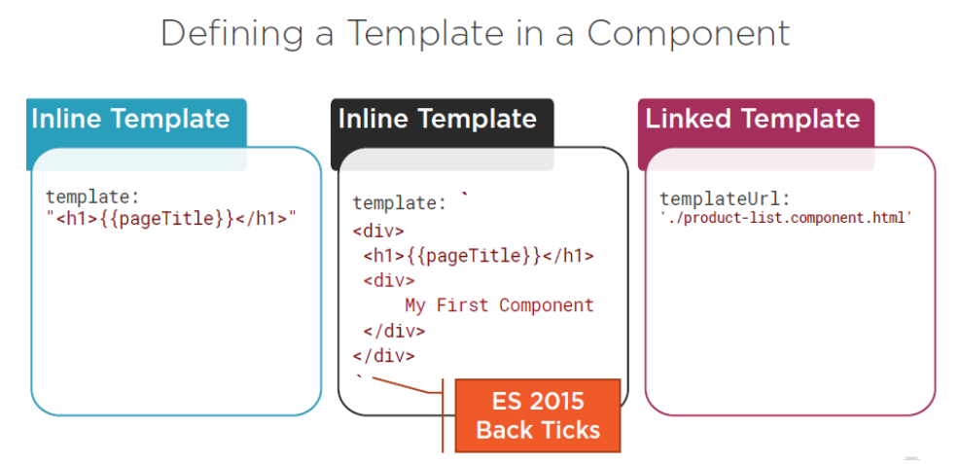
Template

Slide 28
Directive
Directives are elements which change the appearance or behavior of the DOM element. There are 3 types of Directives mainly.
Components (Directive with own template) (Custom Directive)
Structural (Change DOM by adding removing elements) (Built in directive)
Attribute (Change appearance or behavior of the DOM) (Built in directive)

Slide 29
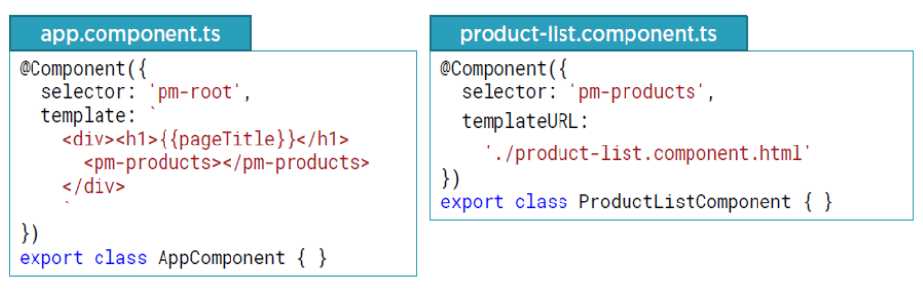
Directive
Directives in Angular is a js class
Component (Custom) Directive

Slide 30

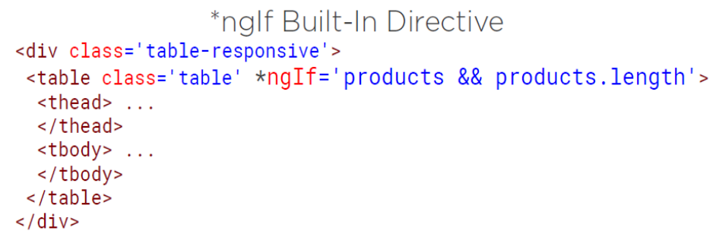
Directive
Built-In Directive

Slide 31
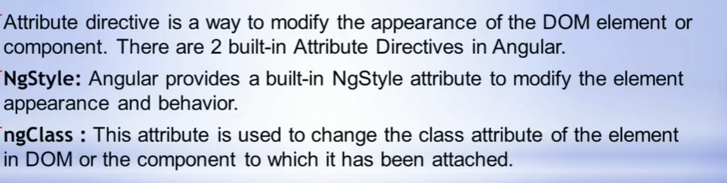
Directive
Attribute Directives

Slide 32
Data Binding
Coordinates communication between the component’s class and its template.
Data binding means to bind the View (Html Content) with Controllers's (Component's) field. That is whenever we display dynemic data on a view (HTML) from component, data binding is used
Data Binding basically means interacting with data. So we can say that the interaction between templates and business logic is called data binding
We use curly braces for data binding - {{}}; this process is called interpolation.
  Property Binding.
  Event Binding.
  Two Way Binding.

Slide 33
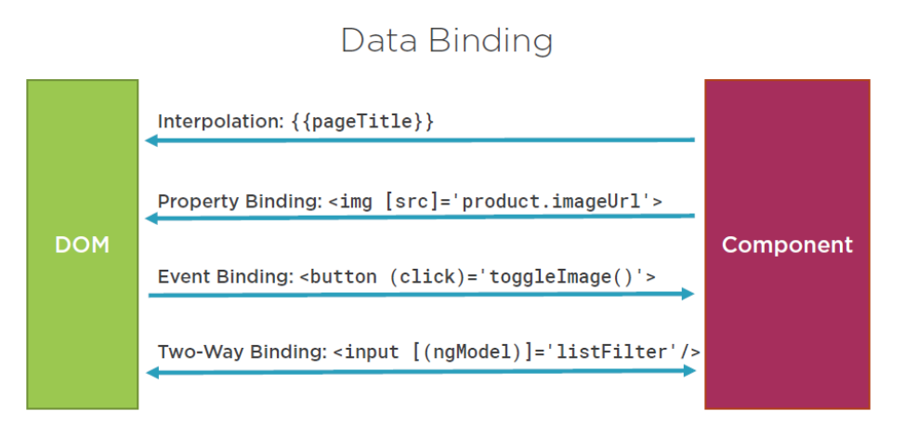
Component to view
View to Component
Two Way Binding

Slide 34
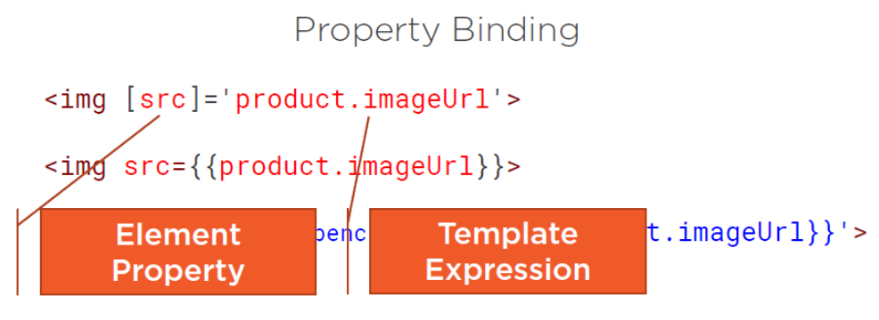
Property Data Binding.

Slide 35
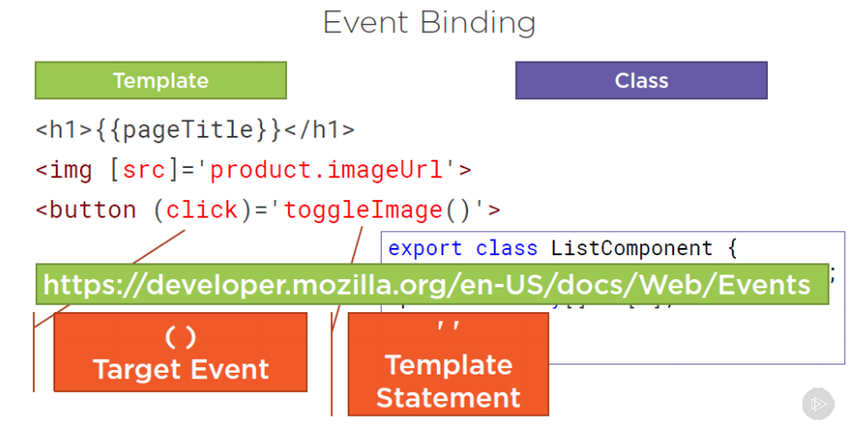
Event Data Binding

Slide 36
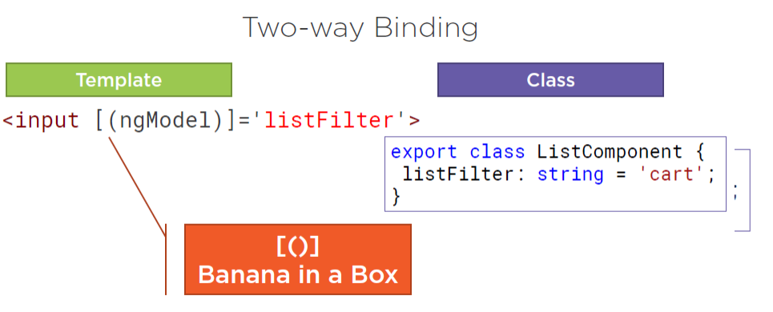
Two Way Data Binding

Slide 37
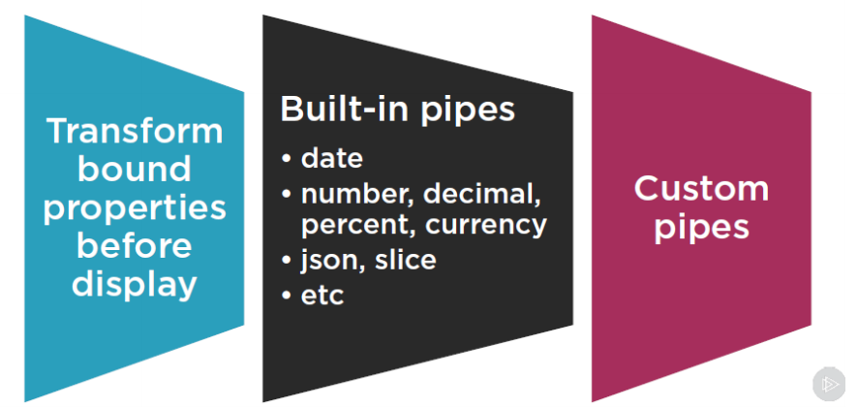
Pipes
Pipes were earlier called filters in Angular1 and called pipes in Angular 2 to 8.
The | character is used to transform data.

Slide 38
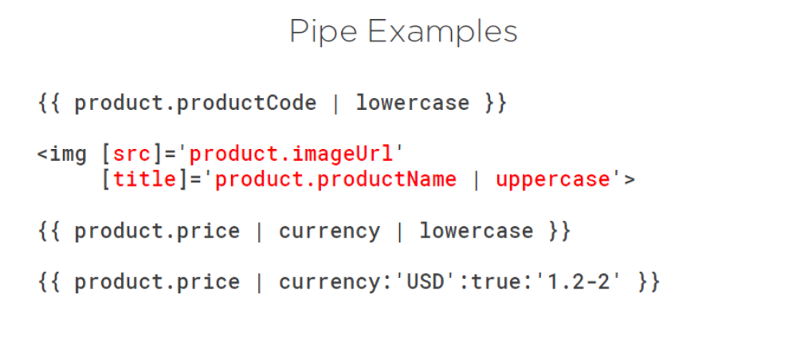

Slide 39
Service
We might come across a situation where we need some code to be used everywhere on the page. It can be for data connection that needs to be shared across components, etc. Services help us achieve that. With services, we can access methods and properties across other components in the entire project.

Slide 40
Dependency Injection
Dependency Injection (DI) is a core concept of Angular 2+ and allows a class receive dependencies from another class. Most of the time in Angular, dependency injection is done by injecting a service class into a component or module class.

Slide 41
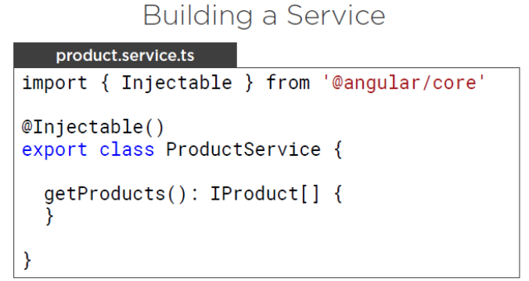
Service
Here, the Injectable module is imported from the @angular/core. It contains the @Injectable method and a class called PrductService. We will create our service function in this class.
Before creating a new service, we need to include the service created in the main parent app.module.ts.

Slide 42
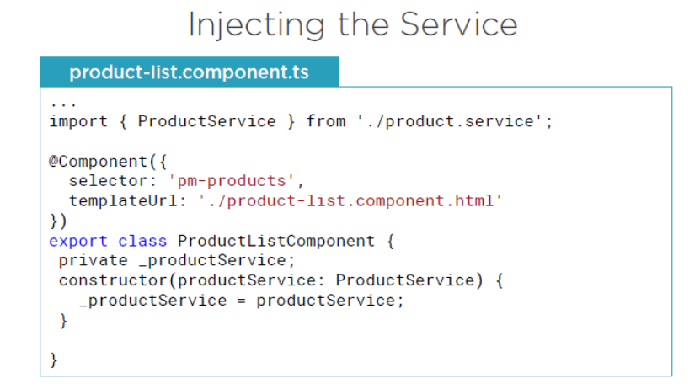

Slide 43
Observable
Observable belongs to RxJS library. To perform asynchronous programming in Angular application we can use either Observable or Promise. When we send and receive data over HTTP, we need to deal it asynchronously because fetching data over HTTP may take time. Observable is subscribed by using async pipe or by using subscribe method.
Observable is a class of RxJS library. RxJS is ReactiveX library for JavaScript that performs reactive programming.
Some methods of Observable class are subscribe, map, mergeMap, switchMap, exhaustMap, debounceTime, of, retry, catch, throw etc.

Slide 44
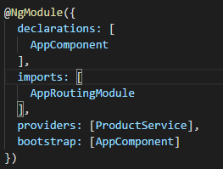
Routing and Navigation
Routing basically means navigating between pages. You have seen many sites with links that direct you to a new page. This can be achieved using routing.
Configuring Routes in app.module.ts

Slide 45
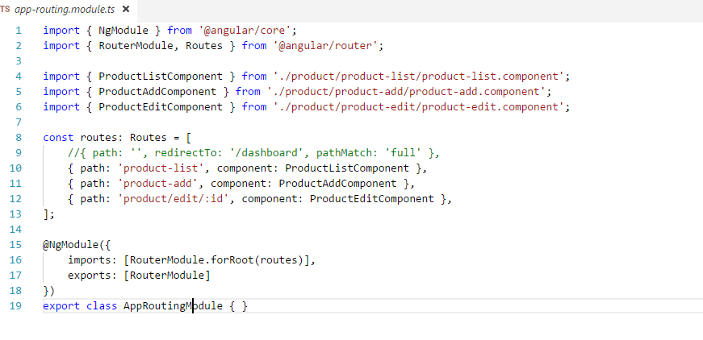

Slide 46
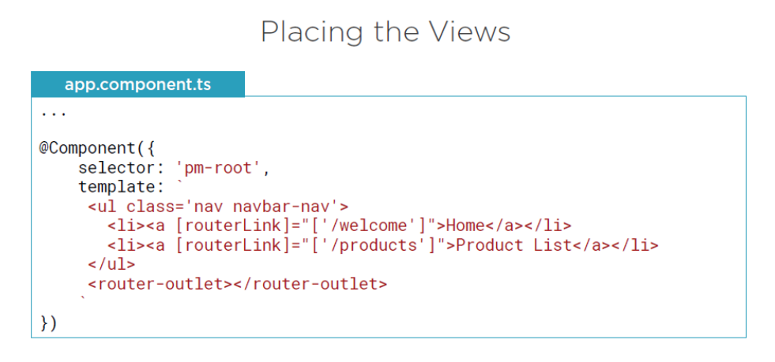

Slide 47
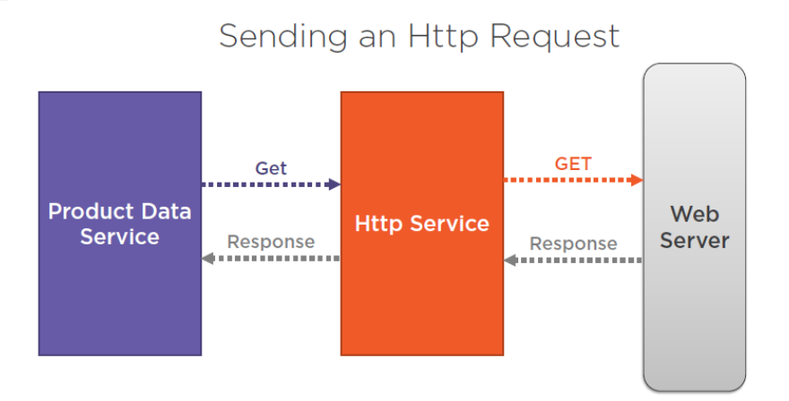
HTTP Module (Service)
Http Service will help us fetch external data, post to it, etc.

Slide 48
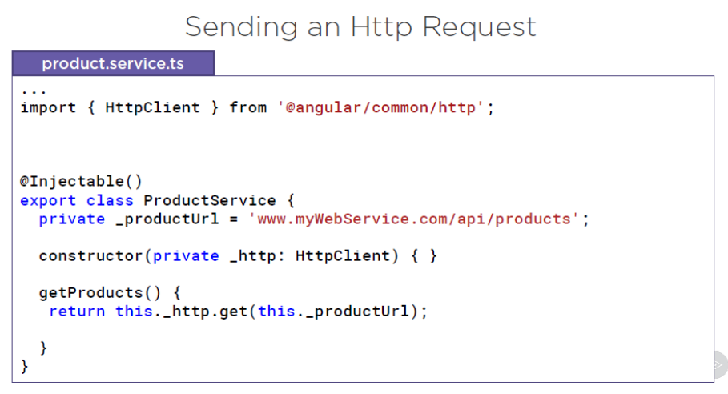

Slide 49
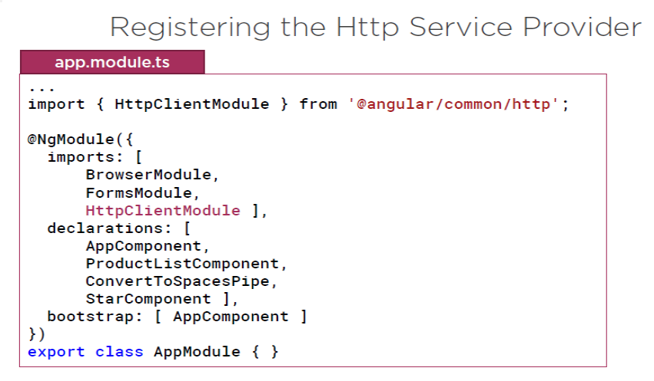

Slide 50
Form Module
we will see how forms are used in Angular 8. We will discuss two ways of working with forms - template driven form and model driven forms.
Template Driven Form
With a template driven form, most of the work is done in the template; and with the model driven form, most of the work is done in the component class.

Slide 51
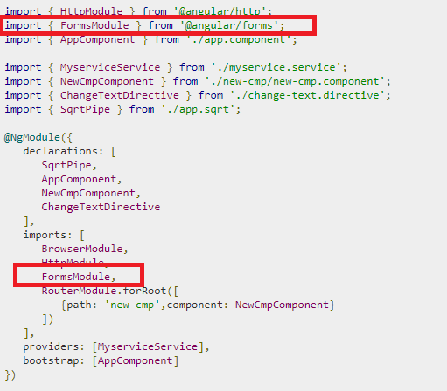
To start with, we need to import to FormsModule from @angular/core which is done in app.module.ts as follows −

Slide 52
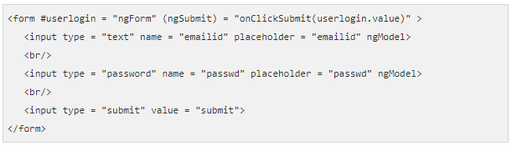
Let us now create our form in the html file

Slide 53
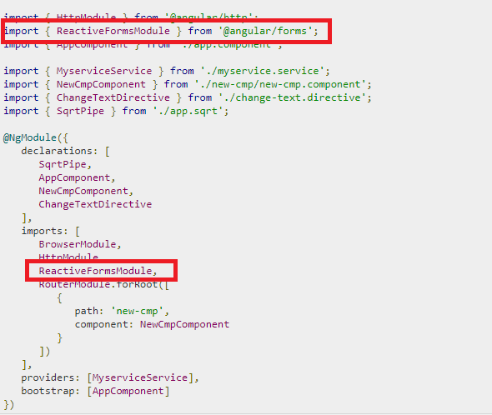
Model Driven Form
In the model driven form, we need to import the ReactiveFormsModule from @angular/forms and use the same in the imports array.
There is a change which goes in app.module.ts.

Slide 54
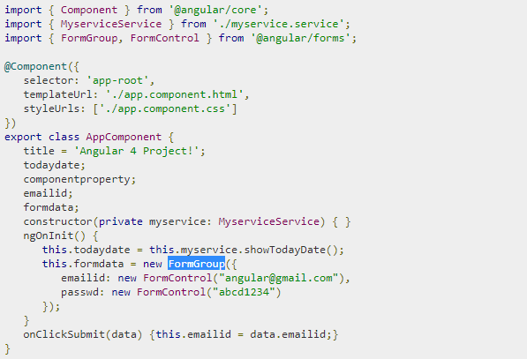
In app.component.ts, we need to import a few modules for the model driven form. For example, import { FormGroup, FormControl } from '@angular/forms'.

Slide 55
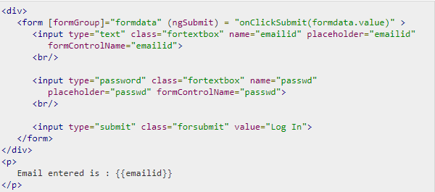
We have used formdata to initialize the form values; we need to use the same in the form UI app.component.html.
In the .html file, we have used formGroup in square bracket for the form; for example,[formGroup]=”formdata”. On submit, the function is called onClickSubmit for which formdata.value is passed.

Slide 56
Build / Deployment
It is quite an exciting moment when the development of your application is finished and it’s time to put it live
ng build --prod
main.hashvalue.bundle.js – a bundled version of your application
vendor.hashvalue.bundle.js – your bundled dependencies
polyfill.hashvalue.bundle.js – polyfill dependencies
index.html – the index file of the application
inline.hashvalue.bundle.js – the webpack loader
style.hashvalue.bundle.css – stylesheets
assets folder – all resources of your application such as images and fonts

