Slide 1
What is Node JS?

Slide 2
Open Source
Cross Platform
It Is Ideal For Building Highly-scalable
Data-intensive
Backend Services (Apis)
Runtime Environment For Executing JavaScript Code Outside Of A Browser
JavaScript Everywhere Means U Can Use Same Skill For Frontend And Backend

Slide 3
NODE Architecture
JS Code
JS Engine
Machine code

Slide 4
NODE Architecture
Spider Monkey
Google Chrome
V8
IE
Chakra
Firefox

Slide 5
NODE Architecture
In 2009 Java script runs only in bowser.
Ryan Dahl has created Node in 2009 using Gooogle chrome V8 Engine and write program in c++ so that program is know as NODE JS.
NODE JS C++ program and includes v8 and plus edition packages like fs, http etc.

Slide 6
How Node Works
Node is highly-scalable, data-intensive and real-time apps because of no-blocking and asynchronies nature of node js
Single Threaded.
Difference between synchronous and asynchronous
Kitchen example
Event loop

Slide 7
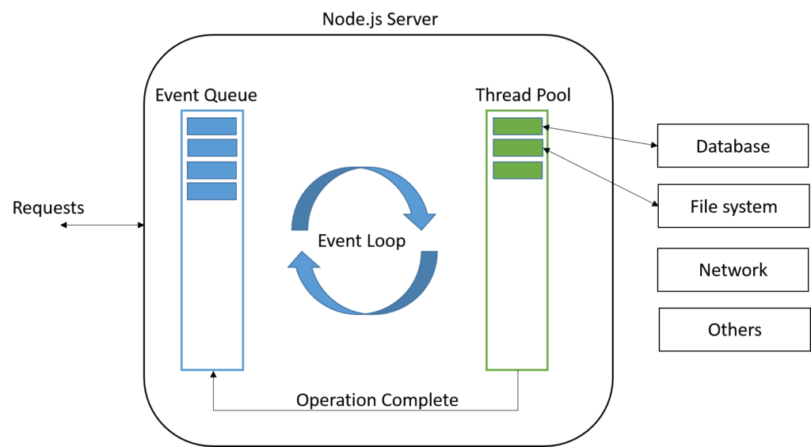
Event loop

Slide 8
Installing Node JS
https://nodejs.org/en/
Node –version
Npm –v

Slide 9
First Node Program
app.js

Slide 10
Node Module System

Slide 11
Modules
Module in Node.js is a simple or complex functionality organized in single or multiple JavaScript files which can be reused throughout the Node.js application. Each module in Node.js has its own context, so it cannot interfere with other modules
Every file consider as module
console.log(module)

Slide 12
Creating a Module
logger.js

Slide 13
Loading a Module
module_example.js

Slide 14
Inbuilt Module
https://nodejs.org/en/docs/
How to use in built module

Slide 15
Path Module
The path module provides utilities for working with file and directory paths. It can be accessed using:
const path = require('path');
path_module.js

Slide 16
OS Module
The os module provides a number of operating system-related utility methods. It can be accessed using:
const os = require(‘os’);
os_module.js

Slide 17
File System Module
The fs module provides an API for interacting with the file system. It can be accessed using:
const fs = require(‘fs');
fs_module.js

Slide 18
Events Module
Event is a core functionality of node JS. Lots off core functionality of node JS is base on events
Event is a single that something has happened.
Class: EventEmitter
event_module.js

Slide 19
Events Arguments
event_arguments.js

Slide 20
HTTP Module
Node.js has a built-in module called HTTP, which allows Node.js to transfer data over the Hyper Text Transfer Protocol (HTTP).
To include the HTTP module, use the require() method:
var http = require('http’);
Node.js as a Web Server
The HTTP module can create an HTTP server that listens to server ports and gives a response back to the client.
Use the createServer() method to create an HTTP server:
http_module.js

Slide 21
Node Package Manager (NPM)

Slide 22
NPM
NPM is command line tool
It is registry for third party library
https://www.npmjs.com/
npm –v
npm comes with node js

Slide 23
Package.json
All npm packages contain a file, usually in the project root, called package.json - this file holds various metadata relevant to the project. This file is used to give information to npm that allows it to identify the project as well as handle the project's dependencies. It can also contain other metadata such as a project description, the version of the project in a particular distribution, license information, even configuration data - all of which can be vital to both npm and to the end users of the package. The package.json file is normally located at the root directory of a Node.js project.
npm init
npm init --yes

Slide 24
Installing a Node Package
https://www.npmjs.com/
npm install underscore
npm I underscore
npm install underscore --save
npm install underscore –save-dev
npm install underscore –g
npm install underscrore@1.0

Slide 25
Using a Package
https://www.npmjs.com/
underscore_module.js
How require works ?
Core Module
File or Folder in application
node_modules
https://underscorejs.org/

Slide 26
Package Dependencies
npm install mongoose
Other dependent modules of mongoose will install at root level of node_modules

Slide 27
NPM Packages and Source Control
Exclude node_modules from source control repository
Exclude using .gitignore

Slide 28
Semantic Versioning
Mongoose : ^ 4.13.6 – Caret - SemVer
4 = Major Version
13 = Minor Version
6 = Patch Version (Bug fix)
If any bug found then developer will fix it and version increase from 4.13.6 to 4.13.7
Patch : bug fix - 4.13.7
Minor : new feature without break existing API 4.14.0
Major : new features but break existing feature 5.0.0
^(caret) sign means allow minor version means ^4.13.6 = ^4.x
~(tilde) sign means allow same major and minor but patch is allowed 4.13.6 = 4.13.x
Exact version means no changes 4.13.6

Slide 29
Listing the Installed Packages
npm list
npm list --depth=0

Slide 30
Viewing Registry Info for a Package
npm view mongoose
npm view mongoose dependencies
npm view mongoose versions

Slide 31
Installing a Specific Version of a Package
npm install mongoose@2.4.2

Slide 32
Updating Local Packages
npm outdated
npm update
npm i –g npm-check-updates
npm-check-updates
npm i

Slide 33
DevDependencies
npm install jshint --save-dev

Slide 34
Uninstalling a Package
npm uninstall mongoose
npm un jshint

Slide 35
Working with Global Packages
npm install –g mongoose
npm -g list --depth=0

Slide 36
Publishing a Package
mkdir abc
cd abc
npm init –yes
create index.js
create add function
npm login {username : maheshpate}
npm publish

Slide 37
Updating a Published Package
Add new function in existing function
npm publish
npm version minor
npm publish

Slide 38
CRON JOB in Node JS
https://www.npmjs.com/package/node-cron

Slide 39
Using JWT (Json Web Token)
https://www.npmjs.com/package/node-cron

Slide 40
RESTful API’s using Express

Slide 41
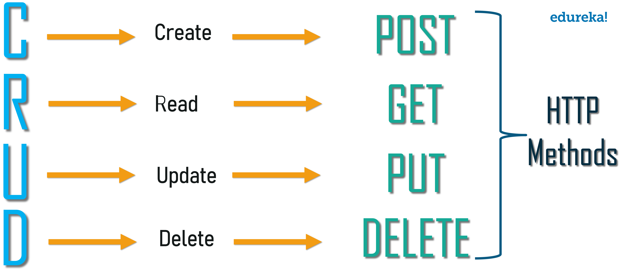
Representational state transfer

Slide 42
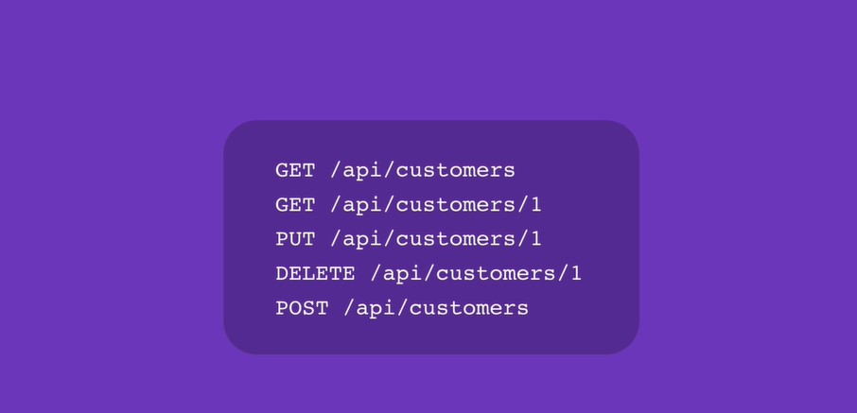
CUSTOMERS CRUD APPLICATION

Slide 43
Introducing Express
Express.js is a Node js web application server framework, which is specifically designed for building single-page, multi-page, and hybrid web applications.
Advantages of Express.js
Makes Node.js web application development fast and easy.
Easy to configure and customize.
Allows you to define routes of your application based on HTTP methods and URLs.
Allows you to create REST API server.

Slide 44
Installing Express Framework
https://expressjs.com/
mkdir express-demo
cd express-demo
npm init –yes
npm install express

Slide 45
Building Your First Web Server
const express = require("express");
const app = express(); // object
Methods
app.get();
app .post();
app.put();
app.delete();
app.get(); // Two Arguments 1) url 2) call back function
app.listen(3000, function () {
console.log("Listening on port 3000...");
});

Slide 46
Nodemon
nodemon is a tool that helps develop node.js based applications by automatically restarting the node application when file changes in the directory are detected.
npm i -g nodemon

Slide 47
Environment Variables
process.env is a global variable in Node JS.
Example : process.env.PORT;
Window : set PORT=5000 and echo %PORT%
Max or Linux : export PORT=5000 and echo PORT

Slide 48
Route Parameters
Single Param
app.get('/customers/:id', function (req, res) {
res.send(req.param.id);
});
Multi Params
app.get('/customers/:year/:month', function (req, res) {
res.send(req.params);
});

Slide 49
Handling GET Requests
GET Request : /api/customers
GET Request : /api/customers/:id
customer.js

Slide 50
Calling Endpoints Using Postman
customer.js

Slide 51
Handling POST Requests
POST Request : /api/customers
Body : req.body.name
customer.js

Slide 52
Handling PUT Requests
Put Request : /api/customers/:id
Body : req.body.name
customer.js

Slide 53
Handling DELETE Requests
Delete Request : /api/customers/:id
customer.js

Slide 54
Express: Advanced Topics
Middleware
Configuration
Debugging
Template Engines

Slide 55
Middleware
Middleware functions are functions that have access to the request object (req), the response object (res), and the next function in the application’s request-response cycle.
Middleware functions can perform the following tasks:
Execute any code.
Make changes to the request and the response objects.
End the request-response cycle.
Call the next middleware in the stack.

Slide 56
Request Processing Pipeline
Request
Middleware
Response

Slide 57
Creating Custom Middleware
app.use(function(req,res,next) {
console.log('Logging....');
next();
// res.end();
});
Separate file Example

Slide 58
Built-In Middleware
https://expressjs.com/en/resources/middleware.html
app.use(express.static('public'));

Slide 59
Third-party Middleware
Need to install
https://expressjs.com/en/resources/middleware.html

Slide 60
Environments
console.log(`NODE_ENV: ${process.env.NODE_ENV}`);
console.log(app.get('env'));

Slide 61
Configuration
https://www.npmjs.com/package/config

Slide 62
Handing session securely
https://github.com/expressjs/session
Passport JS

Slide 63
Debugging

Slide 64
Template Engines
Most Popular Template Engines
Pug (Jade)
Mustache
EJS
Each template has different syntax.
Engines use for generate dynamic HTML and returns to Client.
In this demo We will see pug
https://www.npmjs.com/package/pug
npm i pug

Slide 65
Pug Template Engine
app.set('view engine','pug') // Express will internally load this module app.set('views','./views'); // default path
Syntax
html
head
title= title
body
h1= message
app.get('/', function (req, res) {
res.render('index', { title: 'my express app', message: 'Hello World' })
// res.send('Hello World1');
});

Slide 66
Database Integration
https://expressjs.com/en/guide/database-integration.html

Slide 67
Express MVC
https://www.npmjs.com/package/express-mvc-generator

Slide 68
Asynchronous JavaScript

Slide 69
Asynchronous Code
sync_async.js

Slide 70
Async patterns
async_patterns.js
callbacks
Promises
aync/await

Slide 71
Callbacks
Node JS handle all asynchronous calls via callback. callbacks in the general definition are just functions that you pass to other functions. It is called at the completion of certain task.
callbacks.js

Slide 72
Callback Hell
callback_hell.js

Slide 73
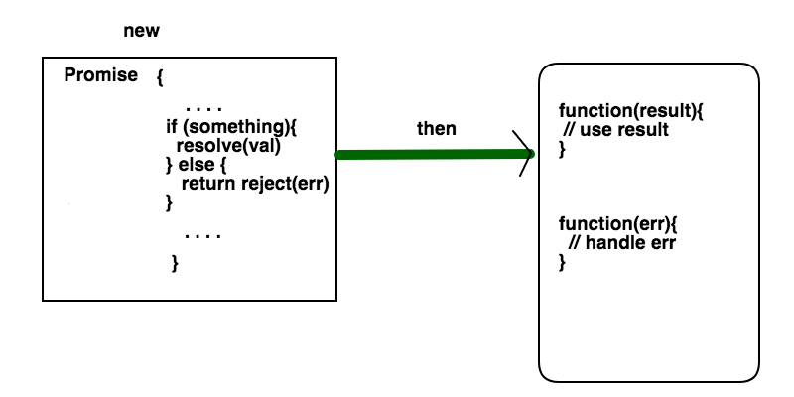
Promises
A promise can be created in our JavaScript code. Or else it can be returned from an external node package
Any promise that performs async operations should call any one of the two methods resolve or reject. Promise will consume using then method
What happens if you try to access the value from promise before it is resolved or rejected. Then promise will be in the pending state.
promise.js

Slide 74
Replacing Callbacks with Promises And Consuming Promise
calllback_to_promise.js

Slide 75
Running Parallel Promises
multi_promises.js

Slide 76
Async and Await
Operators : async and await
Error Handling: using try catch blocks
async_await.js

Slide 77
Mongo DB

Slide 78
What is MongoDB ?
MongoDB is a document-oriented NoSQL database used for high volume data storage. It is used to store JSON object.
A number of databases can be run on a single MongoDB server.
MongoDB can create databases on the fly. It is not required to create a database before you start working with it.
https://www.mongodb.com/

Slide 79
Collections
A collection may store a number of documents. A collection is like a table of an RDBMS. You don't need to define a column and it's datatype unlike in RDBMS, while working with MongoDB. A collection is created, when the first document is inserted.

Slide 80
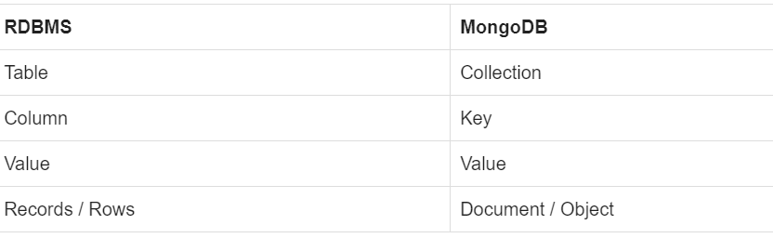
Documents
The document is the unit of storing data in a MongoDB database.
document use JSON style for storing data.
Object IDs - Every MongoDB object or document must have an Object ID which is unique. This is a BSON(Binary JavaScript Object Notation, which is the binary interpretation of JSON) object id, a 12-byte binary value which has a very rare chance of getting duplicated. This id consists of a 4-byte timestamp (seconds since epoch), a 3-byte machine id, a 2-byte process id, and a 3-byte counter.

Slide 81
Mongoose
https://www.npmjs.com/package/mongoose
https://mongoosejs.com/docs/guide.html

Slide 82
Connecting MongoDB
var mongoose = require('mongoose');
mongoose.connect('mongodb://localhost/playground', {
useNewUrlParser: true,
useUnifiedTopology: true
})
.then(function () {
console.log('Connected to mongodb...');
})
.catch(function (err) {
console.error('Connection error', err);
})

Slide 83
Schemas
Types
String
Number
Date
Buffer
Boolean
ObjectId
Array

Slide 84
Models
Models are fancy constructors compiled from Schema definitions. An instance of a model is called a document (row). Models are responsible for creating and reading documents(rows) from the MongoDB database.
Schema will compile into model.

Slide 85
CRUD using MongoDB
Post (Save New Record) | /courses
Put (Update Record) | /courses/:id
Get (Fetch All Record) | /courses
Get (Fetch Single Record) | /courses/:id
Delete (Remove Record) | /courses/:id
mongodb.js

