Slide 1

DATA ANALYST PORTFOLIO PROJECT
BANK LOAN ANALYSIS
SQL SERVER & POWER BI
MAKKENA ADITHYA SAI MAHESH

Slide 2
Problem Statement
Track
Track overall loan performance using key KPIs
(Applications, Funded Amount, Received Amount, Interest Rate, DTI)
Identify
Identify trends and risk patterns across
Time, Geography, Loan Purpose, Employment Length, Home Ownership
Provide
Provide a loan-level details view as a single source of truth
for operational monitoring and deep-dive analysis
Goal
Goal: Enable faster insights, stronger risk control, and data-driven lending decisions.

Slide 3
Project Overview
This project analyzes bank loan data to derive business insights.
Data is stored in MS SQL Server and visualized using Power BI.
The solution supports decision-making using KPIs and dashboards.

Slide 4
Part 1 – MS SQL Server
• Created Database and Tables
• Imported loan data into SQL Server
• Cleaned and transformed data
• Fired SQL queries to solve business problems

Slide 5
SQL Skills Applied
SELECT, WHERE, GROUP BY, ORDER BY
COUNT, SUM, AVG, DISTINCT
CAST, DATEPART, MONTH, YEAR
CTE, PARTITION BY

Slide 6
Part 2 – Power BI
• Connected Power BI to SQL Server
• Data Modeling and Relationships
• Power Query transformations
• Created DAX measures and KPIs

Slide 7
Good Loan vs Bad Loan Analysis
Good Loan KPIs:
• Application %
• Funded Amount
• Received Amount
Bad Loan KPIs:
• Application %
• Funded Amount
• Received Amount

Slide 8
Loan Status Grid View
Metrics shown by Loan Status:
• Total Loan Applications
• Total Funded Amount
• Total Amount Received
• MTD Funded Amount
• Average Interest Rate & DTI

Slide 9
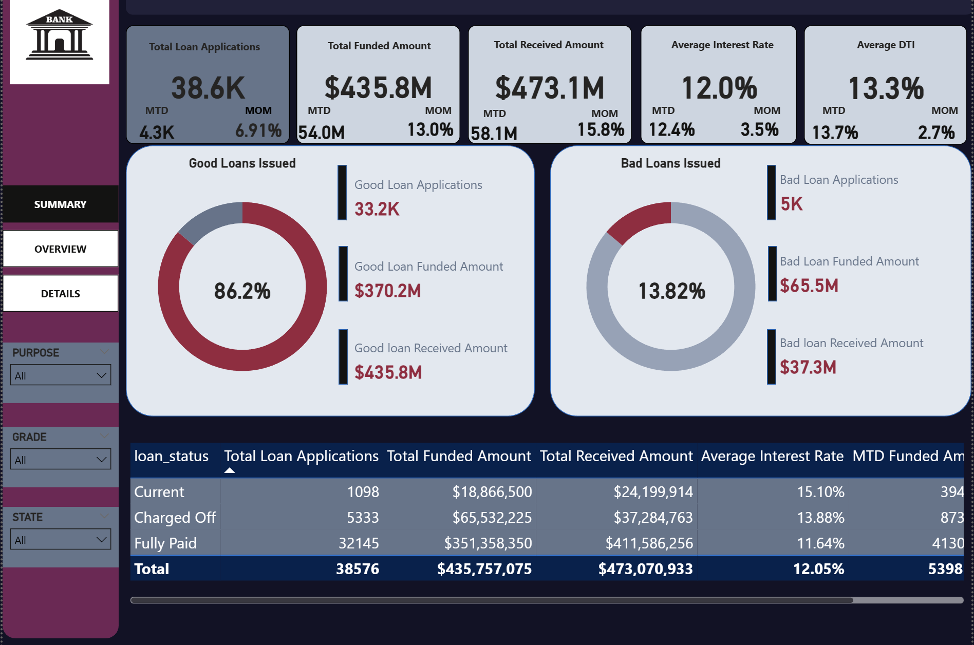
Dashboard | summary

Slide 10
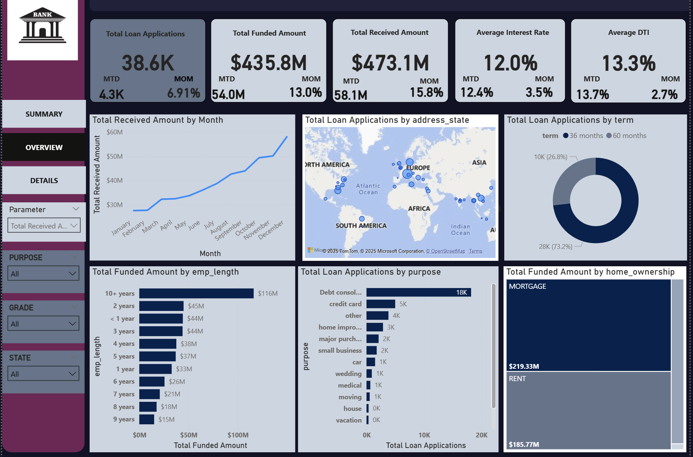
Dashboard 2 – Overview Analysis

Slide 11
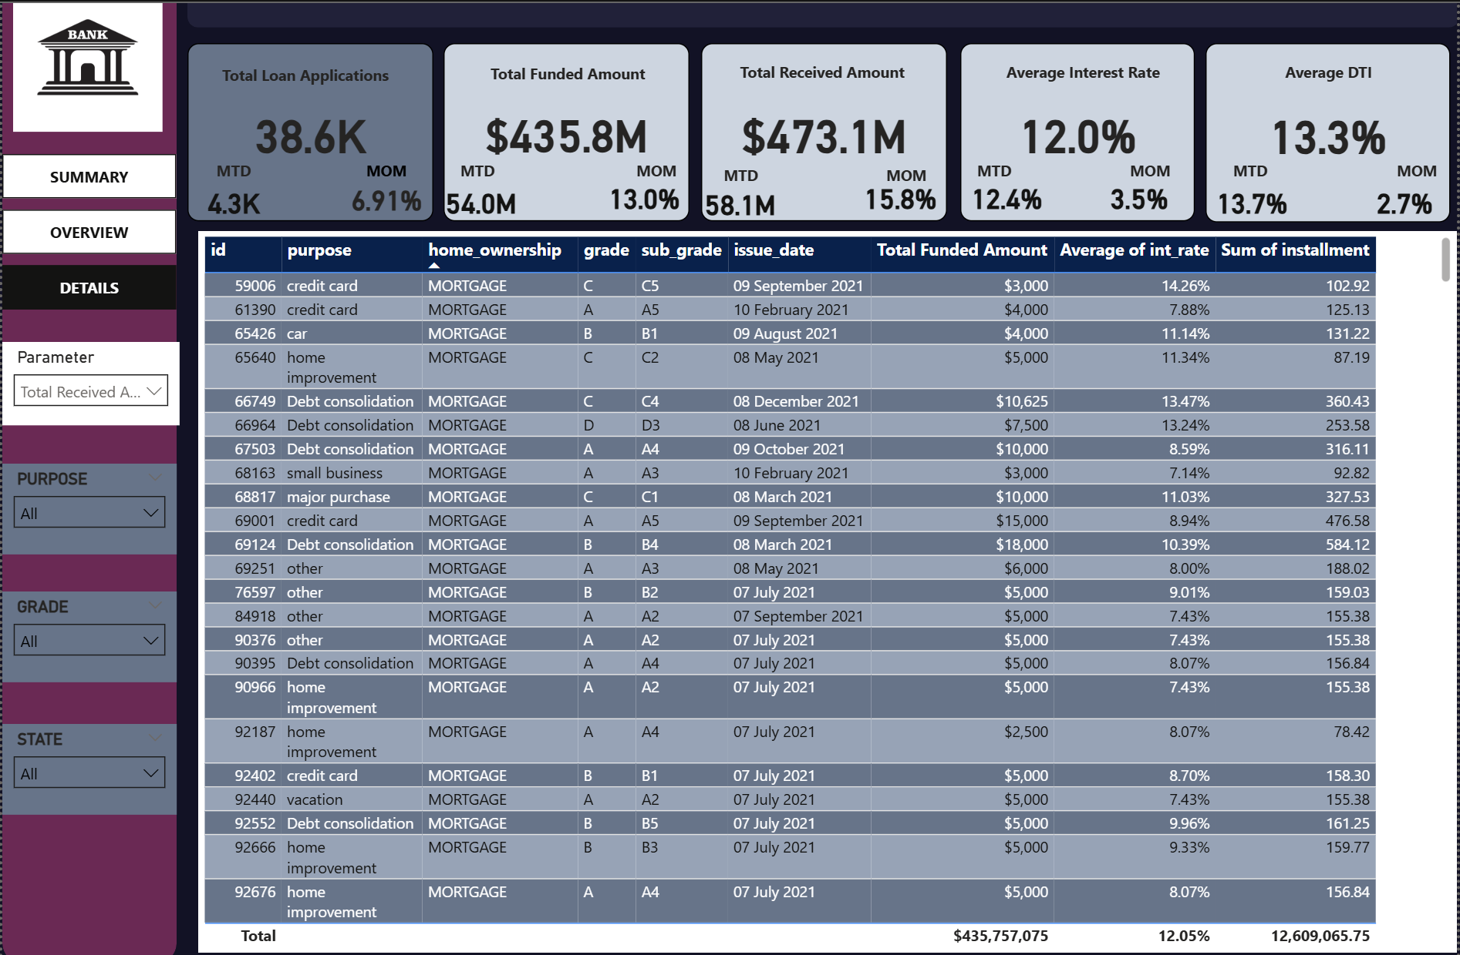
Dashboard 3 – Loan Details

Slide 12
Key Insights & Outcomes
• 86% of loans are Good Loans, indicating a strong overall portfolio health
• 14% Bad Loans pose direct revenue and risk exposure
• Total Received Amount exceeds Funded Amount, reflecting healthy cash flow
• Debt Consolidation loans dominate volume but contribute higher risk
• Mortgage customers and long-tenured employees are the most stable segments

Slide 13
Business Impact
• Focus growth on low-risk segments (Mortgage, long employment tenure)
• Tighten credit and DTI thresholds for high-risk loan purposes
• Monitor regional and long-tenure loans to control default risk
• Balance growth with portfolio quality to prevent future NPAs
• Use insights to refine pricing, approval, and risk policies

