Slide 1
SQL Data Warehouse Project
End-to-End Data Warehousing using SQL
Medallion Architecture (Bronze–Silver–Gold)
Author: Mahesh Adithya

Slide 2
Business Problem Statement
Organizations receive data from multiple operational systems such as CRM and ERP.
Challenges faced:
• Data scattered across multiple CSV files
• Inconsistent formats and duplicate records
• Poor data quality impacting business decisions
• No centralized analytics-ready data store
Business teams need a reliable, scalable, and structured data warehouse to perform accurate reporting and analysis.

Slide 3
Project Objective
• Design and implement an end-to-end SQL Data Warehouse
• Consolidate raw CRM and ERP data into a single source of truth
• Apply data cleansing and standardization rules
• Build analytics-ready fact and dimension tables
• Enable fast and reliable business reporting

Slide 4
Solution Overview
The solution implements a Medallion Architecture using SQL:
• Bronze Layer – Stores raw data as received
• Silver Layer – Applies data quality checks and transformations
• Gold Layer – Provides business-friendly analytical models
This layered approach ensures scalability, maintainability, and data reliability.

Slide 5

Architecture Overview
• Bronze Layer – Raw ingestion from source files
• Silver Layer – Data cleaning, validation, deduplication
• Gold Layer – Dimensional modeling (Star Schema)
• Optimized for analytics and BI tools

Slide 6
Data Sources
• CRM Data:
– Customers
– Products
• ERP Data:
– Sales Transactions
• Source Format: CSV files

Slide 7
Bronze Layer – Raw Data
• Stores data exactly as received from source systems
• No transformations applied
• Ensures data traceability and auditability
• Acts as a historical record of source data

Slide 8
Silver Layer – Data Transformation
• Remove duplicate records using SQL window functions
• Standardize date formats and text fields
• Validate and correct invalid values
• Handle missing and inconsistent data
• Improve overall data quality

Slide 9
Gold Layer – Analytics Ready
• Implements Star Schema design
• Fact table stores measurable business events
• Dimension tables store descriptive attributes
• Designed for fast querying and reporting

Slide 10
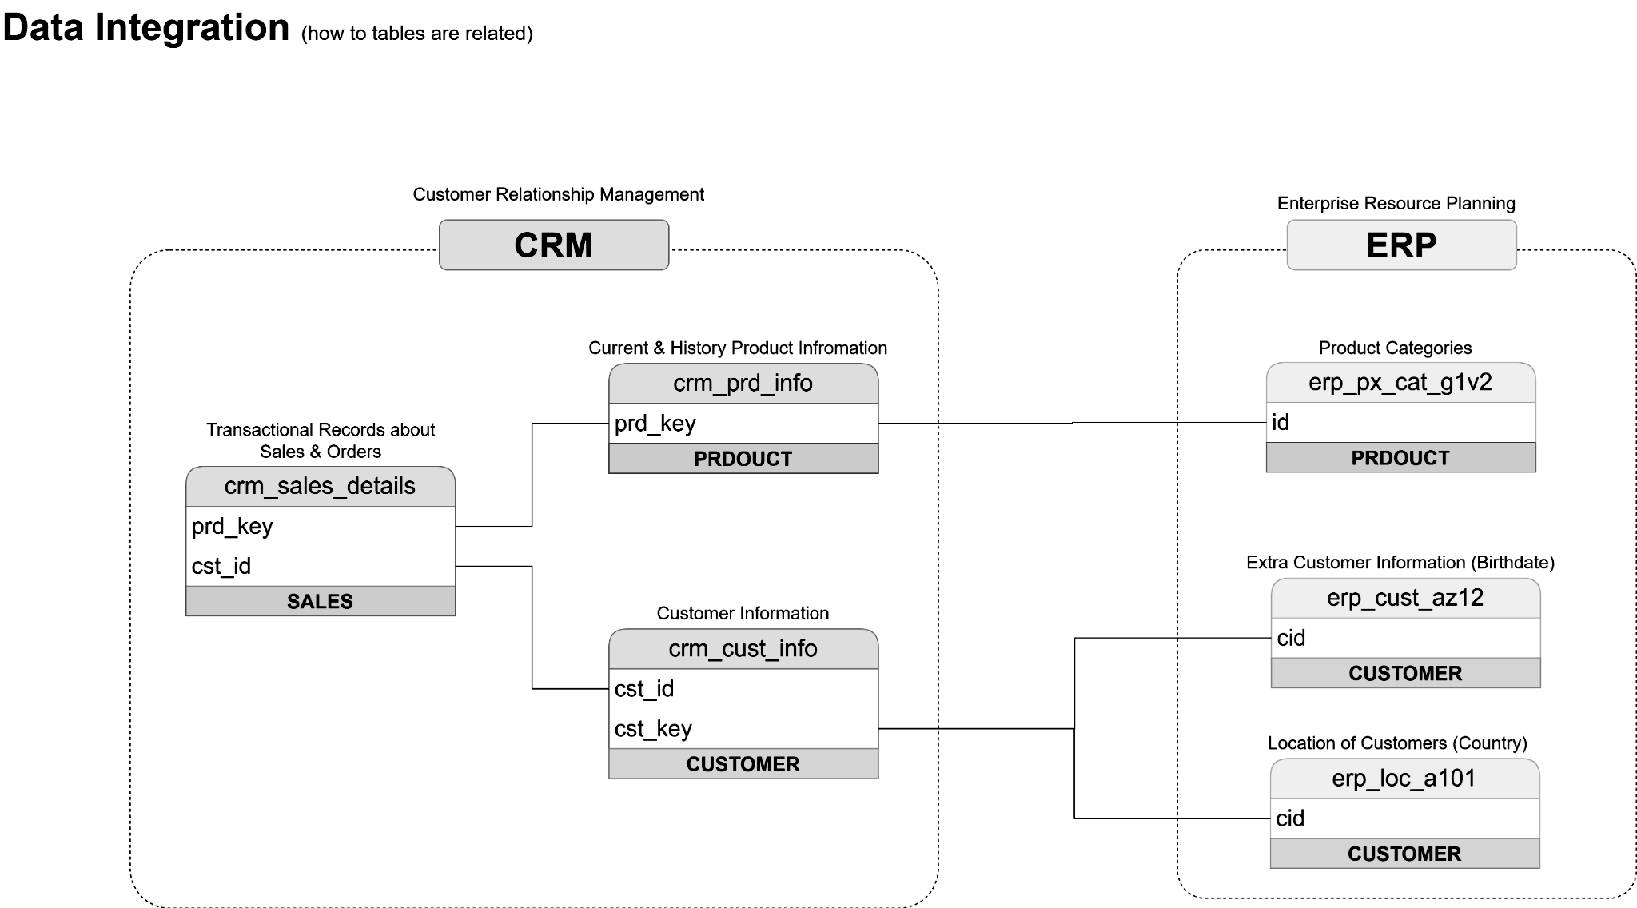

Slide 11
Data Modeling
• Fact_Sales:
– Transaction-level sales data
– Revenue, quantity, dates, keys
• Dim_Customers:
– Customer demographics and attributes
• Dim_Products:
– Product hierarchy and categories

Slide 12
Business Use Cases
• Sales performance analysis by time, product, and customer
• Identify top-performing products and categories
• Customer segmentation and behavior analysis
• Revenue trend and growth analysis

Slide 13
Key Skills Demonstrated
• SQL & Data Warehousing concepts
• ETL / ELT pipeline development
• Data cleansing and transformation
• Dimensional modeling (Star Schema)
• Analytical SQL queries

Slide 14
Project Outcome & Impact
• Centralized and reliable data warehouse
• Improved data quality and consistency
• Faster and more accurate business reporting
• Portfolio-ready real-world data engineering project

Slide 15
Conclusion
This project demonstrates how raw operational data can be transformed into valuable business insights using SQL-based data warehousing and best-practice architecture patterns.

Slide 16
Thank You
Questions?
GitHub Repository:
maheshadithya/Sql---datawarehouse-project: Data base warehouse
Sql---datawarehouse-project

