Slide 1
Problem Statement
Project Title: Power Manager Telemetry
In the era of 5G and edge computing, the deployment of devices across different locations has increased, leading to higher power consumption. To address this issue, the government is pushing enterprises and industries to reduce power usage. The goal is to achieve net-zero power consumption. Additionally, the price of electricity is increasing, making it crucial to understand the total power drawn by the system.
Researching and identifying open-source tools for power measurement.
Identifying and documenting the available knobs in a system to measure power.
Collect power telemetry data from CPU, memory, NIC, TDP, etc.
Measure and record system power utilization for CPU, NIC, and TDP based on the input parameter of system utilization percentage.
Create a report on the power problem, technical approach, and results.

Slide 2
Unique Idea Brief (Solution)
The Power Manager Telemetry project aims to develop a comprehensive solution for monitoring and analyzing system power utilization. By collecting telemetry data from various system components (CPU, Memory, NIC, TDP), the project provides insights into power consumption patterns, enabling optimizations and power-saving measures.
Solution Components:
Telemetry Data Collection
2. Load Simulation
3. Data Analysis and Reporting

Slide 3
Open-source tools for power measurement:
The following open-source tools can be leveraged for measuring power consumption and collecting telemetry data from various system components such as the CPU, memory, Network Interface Card (NIC), and Thermal Design Power (TDP):
1. PowerShell
2. Open Hardware Monitor
3. Intel Power Gadget
4. Perfmon (Performance Monitor)
5. Windows Management Instrumentation (WMI)

Slide 4
Available knobs in a system to measure power:
To measure power consumption and gather telemetry data from a system, it is essential to identify and document the various system parameters, often referred to as "knobs," that can be monitored or adjusted. These knobs provide valuable insights into the system's performance and power utilization.
CPU Utilization
  Knob: CPU Load Percentage
Memory Utilization
  Knob: Memory Usage Percentage
Network Utilization (NIC)
  Knob: Network Adapter Bytes Sent/Received per Second
Thermal Design Power (TDP)
  Knob: CPU Power Consumption (TDP)

Slide 5
Features Offered
Comprehensive Telemetry Data Collection
  CPU Utilization
  Memory Utilization
  NIC Statistics and TDP Placeholder.
2. Dynamic Load Simulation
  Customizable load generation using Docker containers
  Python script for specified CPU utilization
3. Automated Data Logging
  Multi-threaded logging-CSV, JSON files
4. Robust Data Analysis
  Calculate average CPU, memory, and TDP
  Analyze all network interfaces
5. Easy Integration and Customization
  Modular code structure
  Docker integration
6. User-Friendly Operation
  Simple command-line interface (CLI)
  Automated processes

Slide 6
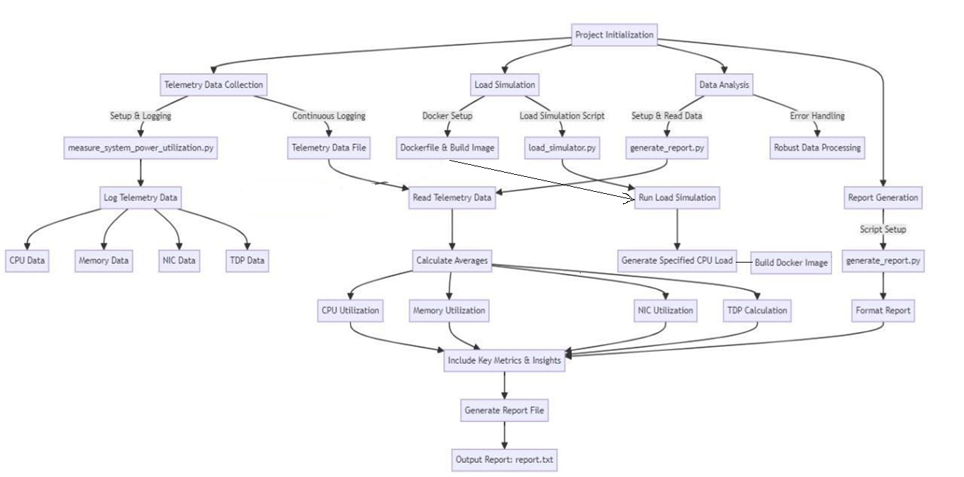
Process flow

Slide 7
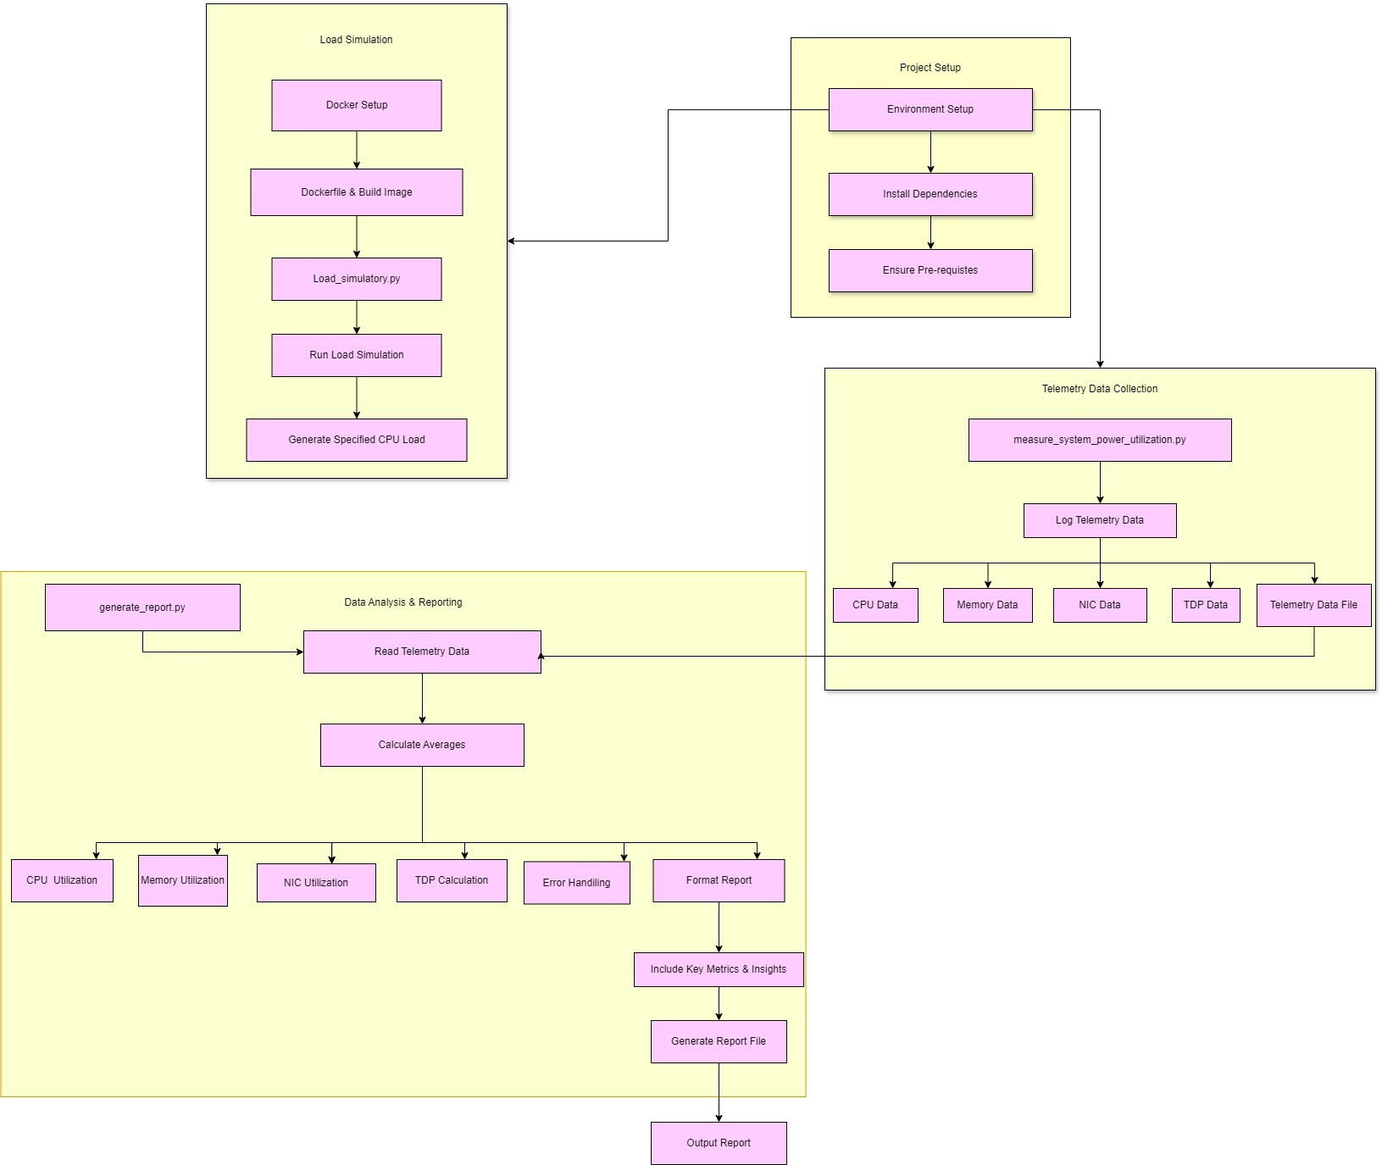
Architecture Diagram

Slide 8
Technologies used
Programming Languages:
  Python: Scripting for telemetry data collection, load simulation, and report generation. Libraries:
    psutil: Collect system telemetry data (CPU, memory, NIC).
    JSON: Read/write telemetry data.
    threading: Run parallel tasks (data logging).
    subprocess: Execute Docker commands.
Containerization:
  Docker:
    Create/manage containers for load simulation.
Data :
  JSON, CSV: Log telemetry data, enabling easy reading and writing of structured data.
Operating Systems:
  Windows: Supported with adjustments (e.g., using Docker Desktop).
Documentation:
  Markdown: Write README files and documentation.

Slide 9
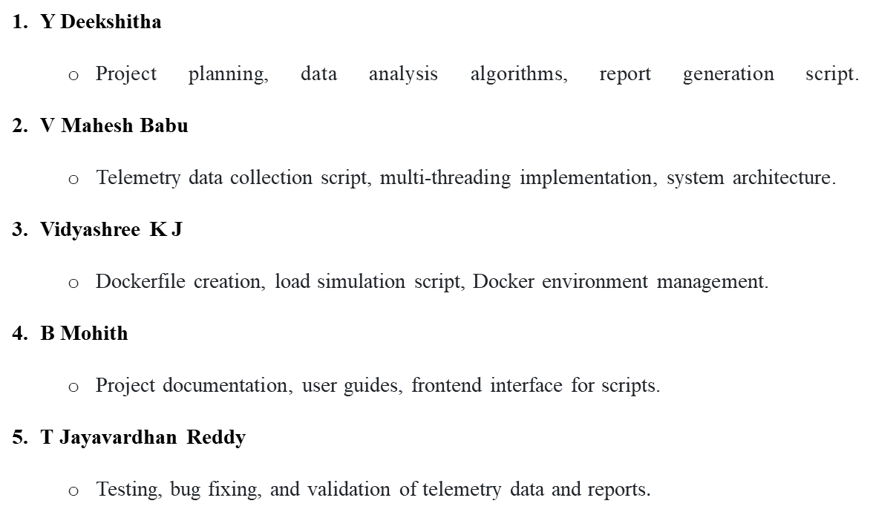
Team members and contributions:

Slide 10
Conclusion
The Power Manager Telemetry project represents a significant step forward in addressing the challenges of power consumption in modern computing environments, particularly in the context of 5G and edge computing deployments. By leveraging a combination of Python scripting, and Docker containerization this project provides a comprehensive monitoring solution.
In conclusion, the Power Manager Telemetry project not only addresses a critical issue in modern computing but also provides a scalable and adaptable framework for ongoing research and development. Through detailed data collection and insightful reporting, this project contributes to the broader goal of sustainable and efficient computing practices.

