Slide 1


Introduction to Continuous Integration with Jenkins

Slide 2
Agenda
What is Continuous Integration?
Why Jenkins?
Use Jenkins on a Java project

Slide 3

What is Continuous Integration ?
Treat integration as a non-event

Slide 4
Before CI
Integration was a long and unpredictable process
Take more than several months for a project developed in a couple of years

Slide 5
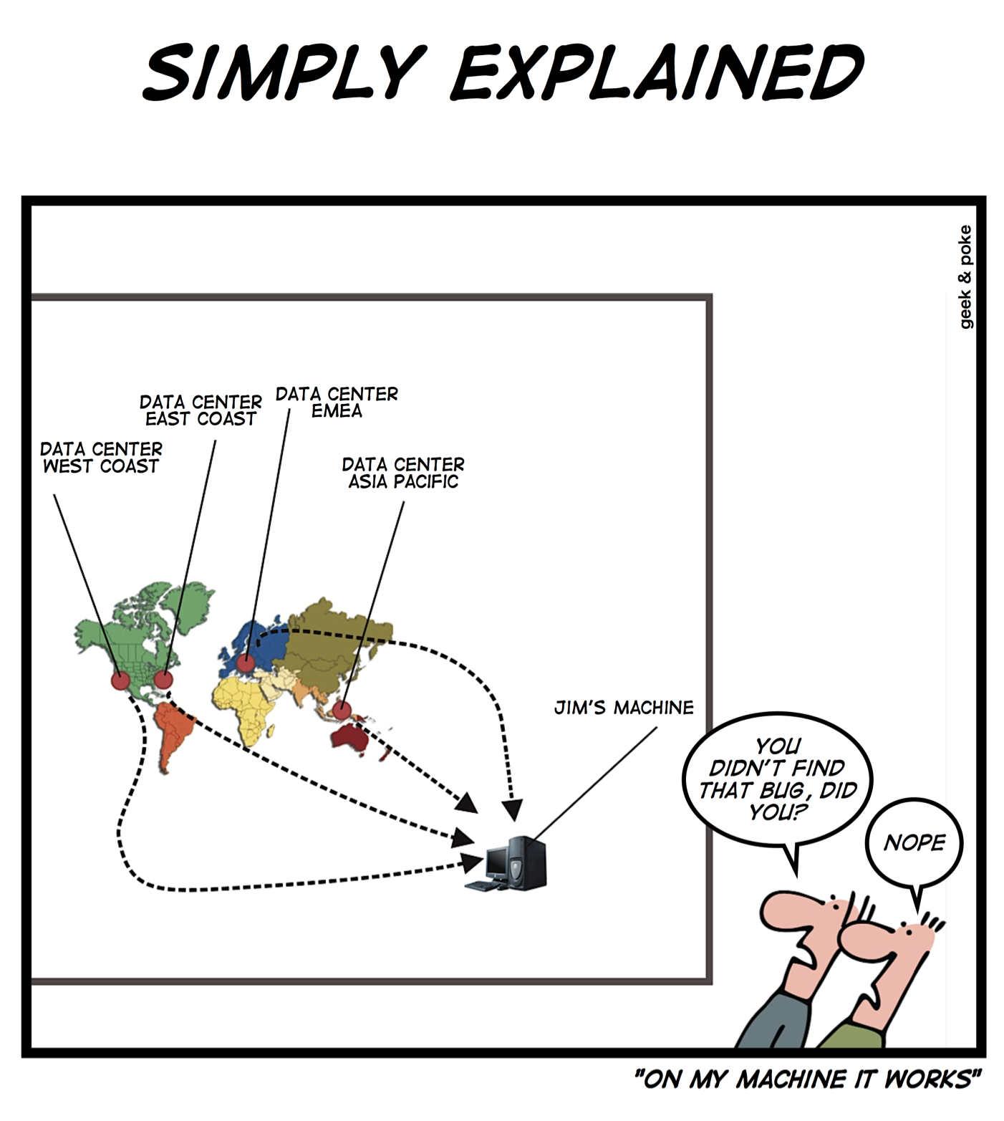

Slide 6
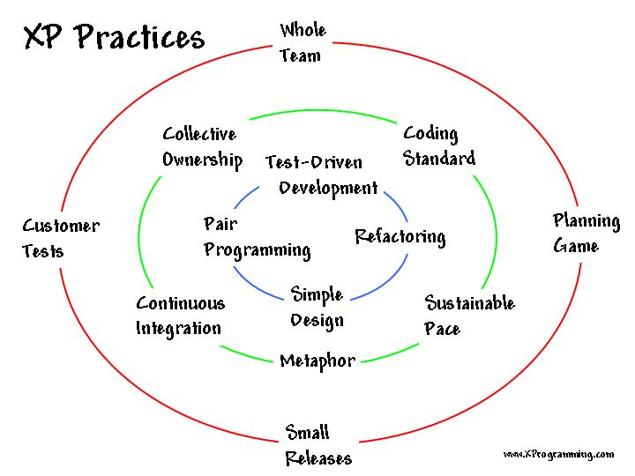
Origins
Notes:
1999

Slide 7
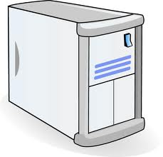


CI by Example
Mainline
Notes:
Let's assume I have to do something to a piece of software

Slide 8
CI by Example
Checkout
Mainline
Working Copy
Notes:
Let's assume I have to do something to a piece of software

Slide 9
CI by Example
Clean
Compile
Test
Package
Verify
Working Copy
Notes:
Let's assume I have to do something to a piece of software

Slide 10
CI by Example
Commit
Mainline
Working Copy
Notes:
Let's assume I have to do something to a piece of software

Slide 11
CI by Example
Commit
Mainline
Working Copy
Working Copy
Notes:
Let's assume I have to do something to a piece of software

Slide 12
CI by Example
Commit
Mainline
Working Copy
Notes:
Let's assume I have to do something to a piece of software

Slide 13
CI by Example
Update
Mainline
Working Copy
Notes:
Let's assume I have to do something to a piece of software

Slide 14

CI by Example
Clean
Compile
Test
Package
Verify
Working Copy
Notes:
Let's assume I have to do something to a piece of software

Slide 15


CI by Example
Commit
Mainline
Working Copy
CI Server
Notes:
Let's assume I have to do something to a piece of software

Slide 16
CI by Example
Checkout or Update
Mainline
Working Copy
CI Server
Notes:
Let's assume I have to do something to a piece of software

Slide 17

CI by Example
Clean
Compile
Test
Package
Verify
CI Server
Notes:
Let's assume I have to do something to a piece of software

Slide 18

CI by Example
Clean
Compile
Test
Package
Verify
CI Server
Notes:
Let's assume I have to do something to a piece of software

Slide 19
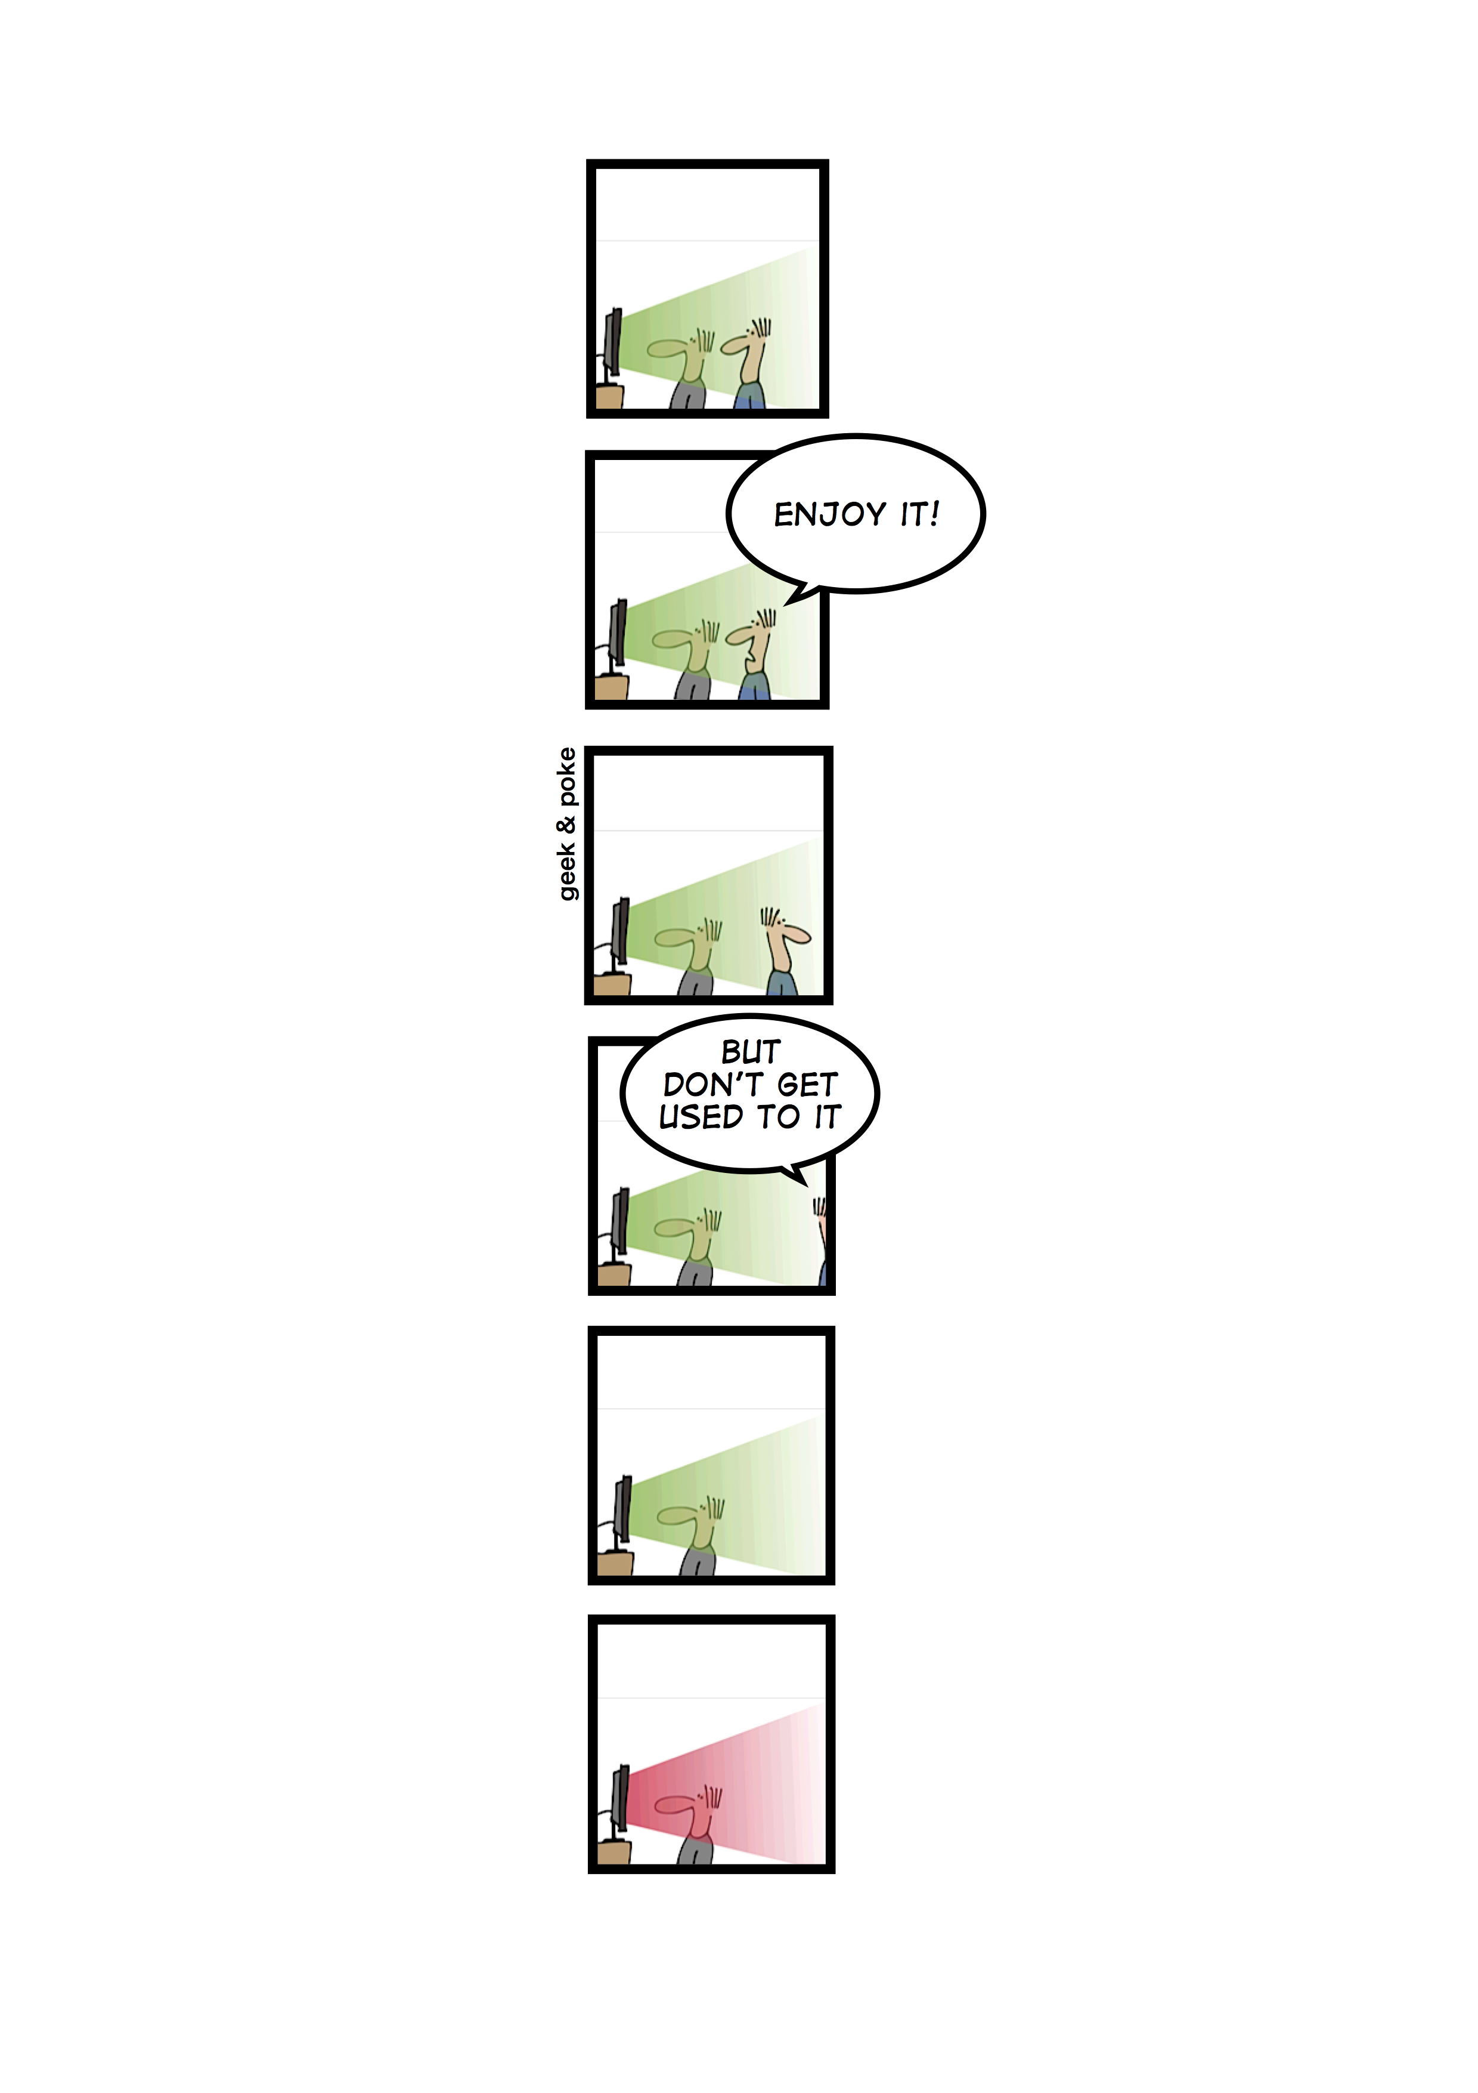

Slide 20

Questions ?

Slide 21

Why Jenkins ?
To serve you

Slide 22
Jenkins Project
Open-source CI server
Easy to install and use
jenkins.war
Or the OS-specific packages
Configure everything from the browser
Extensible
400+ plugins by the community
Easy to develop its own plugins

Slide 23
Jenkins Project
Jenkins was originally Hudson
First release in February 2005
In January 2011, Hudson become Jenkins
Hudson was a trademark of Sun and now of Oracle

Slide 24



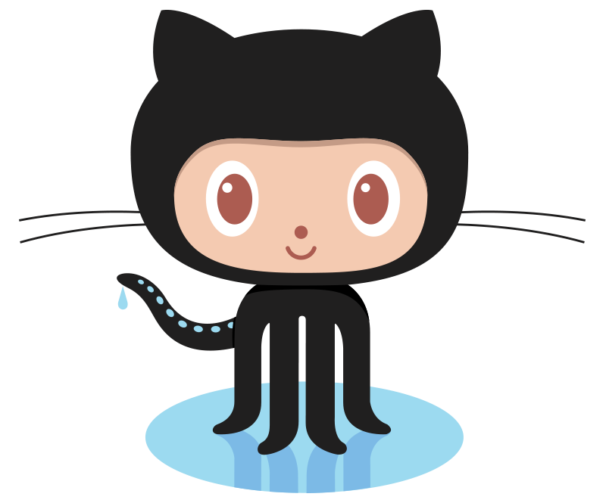




Who use Jenkins ?

Slide 25
Who use Jenkins ?
Number of Jobs on Dice.com
Notes:
Dice.com is a career website based in Urbandale, Iowa. It serves information technology and engineering professionals. Dice.com is owned by Dice Holdings, Inc (NYSE: DHX). On any given day, Dice.com has approximately 60,000 tech job listings. The website claims to have 3 million registered technology professionals and approximately 2 million unique visitors each month. Of those registered users, 75% have a bachelor's degree or higher and 65% have 10 or more years of experience in their field.

Slide 26

Use Jenkins on Java Projects
Some usage examples

Slide 27

Demonstration

Slide 28
Questions ?

Slide 29
More resources
The most famous article on the subject :
http://www.martinfowler.com/articles/continuousIntegration.html
More information about XP :
http://www.extremeprogramming.org/
An introduction in video of Jenkins by its creator :
http://vimeo.com/35678536
http://jenkins-ci.org/

