Slide 1
Seven Habits of Highly Effective Jenkins Users
Andrew Bayer
Cloudera
OSCON Java 2011

Slide 2
Introduction – Who am I?
I'm a build guy, with a focus on Java builds.
I've been using and working on Jenkins since early 2009.
I am currently working at Cloudera.
I am a contributor to Jenkins core, and maintainer of a number of Jenkins plugins, including the git plugin and the Throttle Concurrent Builds plugin.
I'm a member of the Jenkins interim governance board.
@abayer on Twitter

Slide 3

What is Jenkins?
Jenkins is the leading open source continuous integration server.
It is primarily written in Java, but also used for Ruby, Python, Objective-C, and much, much more.
It's essential to development workflow at such companies as GitHub, Netflix, LinkedIn, and many, many more.

Slide 4
HABIT #1:
Use plugins productively.

Slide 5
Habit #1: Use plugins productively
Search for plugins to fit your needs.
  Plugins available are listed in the update center and at https://wiki.jenkins-ci.org/display/JENKINS/Plugins
  Plugins are organized by category on the wiki and in the update center.
  Plugins may have overlapping functionality.
If you're not using a plugin any more, disable it.
  Save memory.
  Reduce clutter on job configuration pages.

Slide 6
Habit #1: Use plugins productively, continued
Plugins you should be using:
  JobConfigHistory
    See the difference between job configurations now and then.
    With authentication enabled, see who changed the job and how.
    Not quite as nice as true SCM-backed Jenkins configurations, but far, far simpler to put in place.
    Seriously, this is my favorite plugin. Go install it!

Slide 7
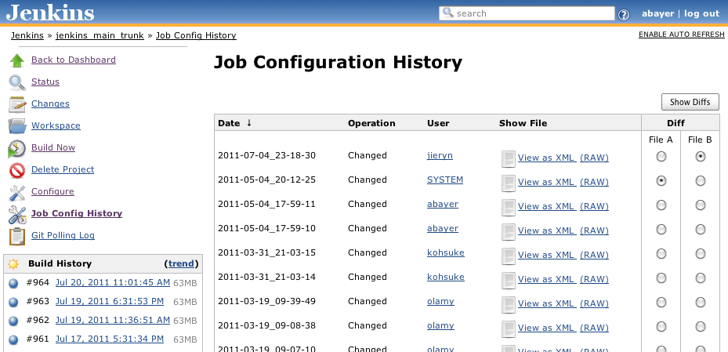
Habit #1: Use plugins productively, continued

Slide 8
Habit #1: Use plugins productively, continued
Plugins you should be using, continued:
  Disk Usage
    How much space is that job taking up on the slave? How large ar the archived artifacts for that build? Find the answers easily.
  Build Timeout
    Hanging tests a problem? Set a timeout – the build will be aborted if it takes longer.

Slide 9
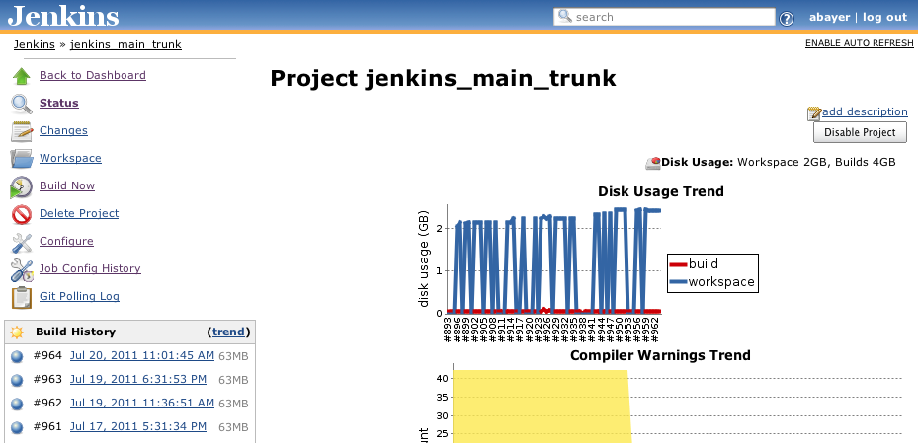
Habit #1: Use plugins productively, continued

Slide 10
Habit #1: Use plugins productively, continued
Plugins you should be using, continued:
  Email-ext
    Better control of when emails get sent and who they get sent to.
    Format the emails the way you want, using information from your builds.
  Parameterized Trigger
    Kick off downstream builds with information from upstream – i.e., tell a system test where to find the packages it needs to install, etc.

Slide 11
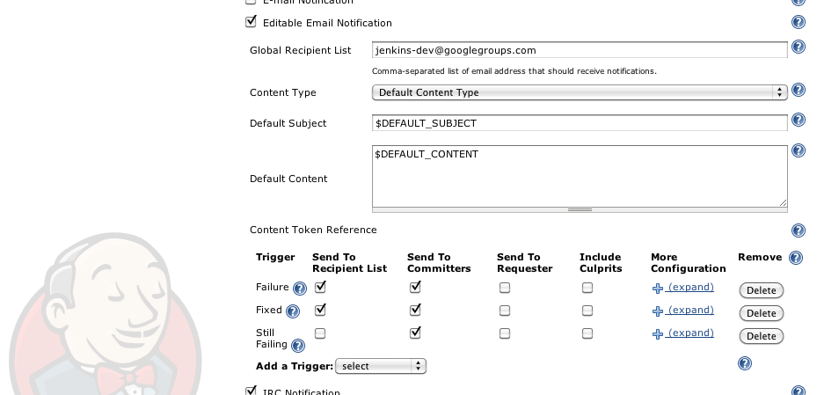
Habit #1: Use plugins productively, continued

Slide 12
HABIT #2:
Standardize your slaves.

Slide 13
Habit #2: Standardize your slaves
If you've got more than a couple builds, you've probably got multiple slaves.
Ad hoc slaves may be convenient, but if your slaves have different environments, you're in for trouble eventually.
If you have multiple slaves playing the same role, they should be as identical as you can make them.

Slide 14
Habit #2: Standardize your slaves, continued
Puppet, Chef, etc
  Sysadmins are used to these tools already.
  Configuring your build slaves is the same as configuring any other puppet/chef/etc-managed machine.
Have Jenkins or your job install your tools
  Jenkins tool installation for Maven, Ant, JDK, etc.
  Scripting downloading/installation of tools in the job itself.
  May not be possible for all tools – e.g., RPM/Debian packages.

Slide 15
Habit #2: Standardize your slaves, continued
Cloud or VMs
  Spin up your slaves from a pre-configured image.
  When you need to change your slave configurations, update the image and spin up new slaves, rather than updating the existing slaves.
Whatever method you choose, just make sure your slaves are consistent!

Slide 16
Habit #2: Standardize your slaves, continued
Side note!
Don't build on master. Always build on slaves.
  No conflict on memory/CPU/IO between master process and builds.
  Easier to add slaves than to beef up master.
  Mixing builds on master with builds on slaves means inconsistencies between builds – as before, consistency is always good.

Slide 17
HABIT #3:
Use incremental builds.

Slide 18
Habit #3: Use incremental builds
...if possible.
Why use incremental builds?
  If your build takes 4-8 hours to run end-to-end, you can't do real continuous integration on every change.
  If you're integrating with code review or otherwise using pre-tested commit processes, you want to verify changes as fast as possible.

Slide 19
Habit #3: Use incremental builds, continued
Incremental builds are complementary to full builds, not replacements.
Don't do QA/deployments of incremental builds – use full, clean builds for that.
  e.g., incremental build whenever a change is detected, full build once a day.
Either use multiple jobs (one for incremental, one for full) or configure one job to behave differently, depending on parameters.

Slide 20
Habit #3: Use incremental builds, continued
Maven project type has built-in support for incremental builds.
  Look in Advanced Options in the Maven configuration section.
  When enabled, checks the changelist for the build and compares to Maven module layout.
  Any modules containing changed files are built.
    As are modules depending on changed modules, and any modules with failures in the previous build.

Slide 21
Habit #3: Use incremental builds, continued
Incremental builds may not be possible in all cases.
Freestyle projects would require custom work to determine what needs to be run for incremental builds.
  e.g., use code coverage data to determine what tests need to be run when a given source file is changed.

Slide 22
HABIT #4:
Integrate with other tools.

Slide 23
Habit #4: Integrate with other tools
Jenkins plugins are available for integrating with any number of other tools. For example...
Pre-tested commits with Gerrit (git code review)
  When a change gets submitted, a build runs automatically and reports back to Gerrit.
  Code can't be merged if the build doesn't pass.
  Pre-tested commits have been implemented elsewhere – see Apache Hadoop build process, e.g.

Slide 24
Habit #4: Integrate with other tools, continued
JIRA and other bug trackers
  Update bug tracker when a fix gets built, automatically.
Sonar
  Code metrics, code coverage, unit test results, etc, all in one place.
  Great graphs, charts, etc – fantastic manager candy!

Slide 25
Habit #4: Integrate with other tools, continued
Artifactory
  Control staging of Maven/Gradle/Ivy release candidates.
  Report on dependencies.
  See http://blogs.jfrog.org/2011/06/jenkins-new-maven-and-gradle-release.html for more details.
Mylyn
  See build and test results, launch new builds and more, all from within Eclipse.

Slide 26
Habit #4: Integrate with other tools, continued
Chat/IM notifications
  Most organizations have some chat/IM solution in place.
  Jenkins can integrate with many of them – Jabber, IRC, Campfire, etc.
  Notify committers when builds with their changes break!

Slide 27
HABIT #5:
Break up bloat.

Slide 28
Habit #5: Break up bloat
Too many builds make it hard to navigate the Jenkins UI and hurt performance.
Builds that try to do too much take too long and make it impossible to restart a build process partway through.
Two similar problems, with similar solutions.
Break up the bloat!

Slide 29
Habit #5: Break up bloat, continued
Don't be afraid to spread your jobs across multiple Jenkins masters.
Easier to navigate each instance than the one big one.
Better performance with less jobs per instance.
Restarting Jenkins can be done much more readily when there are less jobs on the instance.
Split jobs in a logical way – separate instances per group, per product, per physical location, etc.

Slide 30
Habit #5: Break up bloat, continued
Big, long builds are unwieldy.
Split builds up logically as well, into coherent phases.
Pass data/binaries from one phase to the next (using the Parameterized Trigger plugin!)
When the last of 6 phases fails due to network problems or the like, just re-run that phase without having to run the whole pipeline again. Much faster!

Slide 31
HABIT #6:
Stick with stable releases.

Slide 32
Habit #6: Stick with stable releases
Jenkins releases weekly.
This means rapid turnaround on fixes, new features, etc, but, inherently, not 100% stability for every release.
Plugins release whenever their developers choose to.
Update center makes it easy to upgrade core and plugins to the latest at any time, but that's not always the smart move.

Slide 33
Habit #6: Stick with stable releases, continued
Use Jenkins core LTS releases.
  LTS – Long Term Support, similar to Ubuntu.
  Every ~3 months, a particularly stable release is chosen, a branch is created from it and the new branch is rigorously tested.
  Backports of critical fixes are made to this branch and new releases (e.g., 1.409.1, 1.409.2, etc) are made.

Slide 34
Habit #6: Stick with stable releases, continued
Use Jenkins core LTS releases, continued.
  Plugin developers are encouraged to build against the latest LTS release, helping keep new plugin releases compatible.
  If you don't have a specific reason to be on the bleeding edge, you should probably be running an LTS release.
  See https://wiki.jenkins-ci.org/display/JENKINS/LTS+Release+Line for more information.

Slide 35
Habit #6: Stick with stable releases, continued
Upgrade plugins carefully.
Check plugin wiki pages for changelog.
  In the update center, click the link for the plugin name – that will take you to the wiki page.
If you don't need a bugfix or new feature, you probably don't need to upgrade.
Stick with what works until it doesn't work any longer.

Slide 36
HABIT #7:
Join the community.

Slide 37
Habit #7: Join the community
Write a plugin or work on an existing one.
Improve docs and the wiki.
Get on the mailing list and help out.
Join the IRC channel.
If you run into a bug, submit it at https://issues.jenkins-ci.org!

Slide 38
Conclusion
These are just one person's thoughts and experiences.
There are many ways to use Jenkins – there is no single “Right Way” to do things.
Your organization's requirements should dictate your build process and tool usage, within reason.

Slide 39
Questions?

