Slide 1

Jenkins: A complete solution
From Continuous Integration to Continuous Delivery
Virendra Singh Bhalothia
Relevance Lab
bhalothia@gmail.com

Slide 2
Agenda
Introduction and some facts about Jenkins
Supported tech stacks and platforms
Why Jenkins?
Security
Leveraging Jenkins across various projects
Enabling continuous delivery
Best practices

Slide 3
Jenkins: Introduction and facts
Jenkins is an award-winning application that monitors executions of repeated jobs, such as building a software project or jobs run by cron. Among those things, current Jenkins focuses on the following two jobs:
Building/testing software projects continuously
Monitoring executions of externally-run jobs
Facts:
Written in Java and initially was supposed to be used as a CI tool
Over 600 plugins to customize Jenkins as per your need
Over 1000+ public repositories on Github, 500+ contributors, strong commit activity
Free open source and most widely used tool for maintaining continuous integration cycle. Google trend says it all

Slide 4
Supported tech stacks and platforms
Other popular non java projects supported by Jenkins:
.Net
Ruby
PHP
Drupal
Perl
C++
Node.js
Python
Android
Scala

Slide 5
Platforms supported by Jenkins:
Windows
Ubuntu/Debian
Red Hat/Fedora/CentOS
Mac OS X
openSUSE
FreeBSD
OpenBSD
Solaris/OpenIndiana
Gentoo

Slide 6
Why Jenkins?
Easy install, easy upgrade, easy configuration
Distributed builds – Arguably most powerful feature.
Monitoring external jobs
No limit to the number of jobs, number of slave nodes
Plugin architecture: Support for various version control systems, authentication methods, notification, workflow building, and many more features can be added.
Jenkins provides machine-consumable remote access API to its functionalities
Actually there are lot of useful plugins. The list is too long to mention here. Go on, explore on your own. There’s plugin available for almost everything you would want.

Slide 7
Securing Jenkins
In the default configuration, Jenkins does not perform any security check. This means any person accessing the website can configure Jenkins and jobs, and perform builds. While this configuration is acceptable during initial evaluation of the software, Jenkins should be configured to authenticate users and enforce access control in most other situations, especially when exposed to the Internet.
This article explains in detail how to secure your Jenkins.
What I usually do is: As an administrator set up ‘Project-based Matrix Authorization Strategy’ and give only read right to users globally. At job level, you can give required rights to the users. This would help us create separate jobs for separate project teams on the same Jenkins instance.

Slide 8
Sharing Jenkins across projects
So here’s the use case: You are an Ops guy, maintaining the Jenkins Infrastructure and there are a lot of product teams wanting to use Jenkins for their continuous integration and delivery. Would you install a separate Jenkins instance for each team? Obviously No.
Also, each team should get access (after logging into Jenkins server) to view/run/modify only their project’s configured jobs. They shouldn’t be able to view anything else.
Everything mentioned above can be easily achieved with Jenkins:
Depending upon the disk and resources usage of each project, you can decide whether the same master Jenkins can be used as a build server or you need a slave instance. This is the most powerful feature of Jenkins – Distributed builds.
For restricting access to project teams, use ‘Project-based Matrix Authorization Strategy’ and create separate ‘views’ for each project. As described in the previous slide.

Slide 9
Enabling Continuous Delivery
Continuous Integration: It is the practice of merging development work with a Master/Trunk/Mainline branch constantly so that you can test changes, and test that changes work with other changes. The idea here is to test your code as often as possible to catch issues early. Most of the work is done by automated tests, and this technique requires a unit test framework. Typically there is a build server performing these tests, so developers can continue working while tests are being performed.
Continuous Delivery: It is the continual delivery of code to an environment once the developer feels the code is ready to ship. This could be UAT or Staging or could be Production. But the idea is you are delivering code to a user base, whether it be QA or customers for continual review and inspection.

Slide 10
In other words, Continuous Delivery is a process that merges Continuous Integration with automated deployment, test, and release; creating a Continuous Delivery solution. Continuous Delivery doesn't mean every change is deployed to production ASAP. It means every change is proven to be deployable at any time. Check this article to get more insight.
Here, we would talk about enabling Continuous Delivery using Jenkins and it’s plugins. By using Build pipeline plugin in Jenkins, we can orchestrate the promotion of a version of software through quality gates and into production. By extending the concepts of CI you can create a chain of jobs each one subjecting your build to quality assurance steps. These QA steps may be a combination of manual and automated steps. Once a build has passed all these, it can be automatically deployed into production.

Slide 11
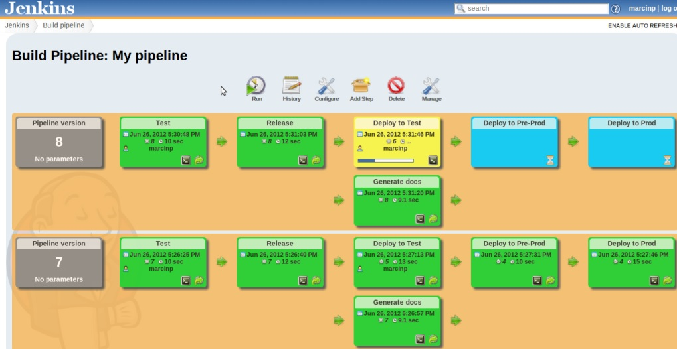
Sample build pipeline

Slide 12
Phases of Continuous Delivery
Unit Test
Code Quality Analysis
Deploy to Test Environment
Integration Test
Packaging and Archiving
Deploy to Preproduction Environment
Acceptance Test
Deploy to Production Environment
Jenkins has every plugin required for the ideal Continuous Delivery process, that too free of cost.
With the help of Jenkins, we can create customized build pipeline to create a dashboard of our own and enable Continuous Delivery in easy steps

Slide 13
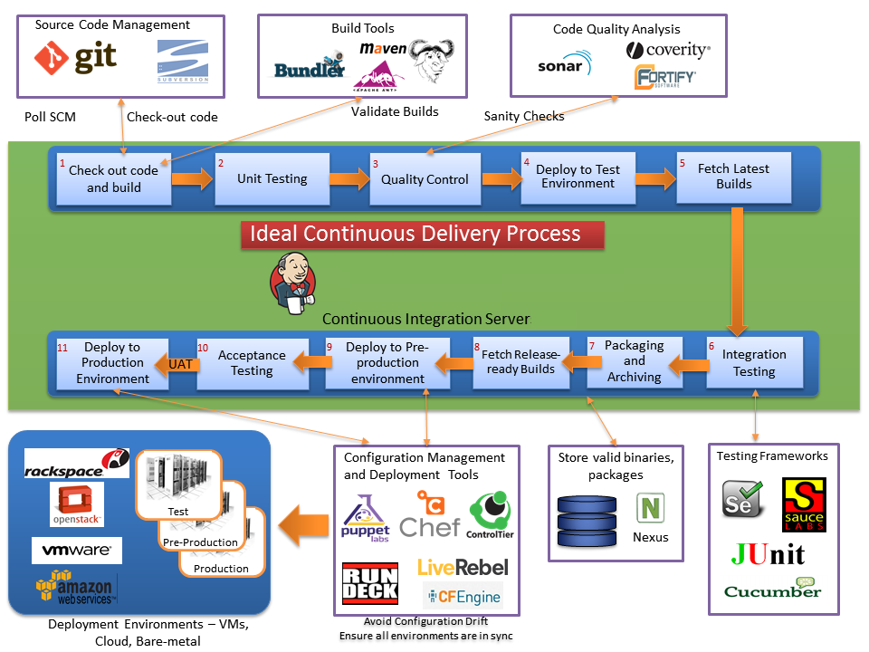
Continuous Delivery Process

Slide 14
Best Practices
Make sure you have backups – better late than never
Plan disk usage – make sure it’s expandable
For easier installation and migration, use native packages if possible
Do distributed builds
Use labels to optimize resource utilization and improve manageability
Make your Jenkins URL short and memorable
Discard old build records to keep your Jenkins instance healthy
Check this Jenkins official page for best practices or download the white paper from the Jenkins founder Kohsuke Kawaguchi.

Slide 15
Questions?

