Slide 1
Jenkins and Chef Infrastructure CI and Application Deployment
Dan Stine
Copyright Clearance Center
www.copyright.com
June 18, 2014
#jenkinsconf

Slide 2
About Me
Software Architect
Library & Framework Developer
Infrastructure Lead & Product Owner
Enemy of Inefficiency and Needless Inconsistency
dstine at copyright.com
sw at stinemail.com
github.com/dstine

Slide 3
About Copyright Clearance Center
Global licensing solutions that
make © work for everyone
Get, share, and manage content
Rights broker for world’s most sought after materials
Global company (US, Europe, Asia) – HQ in Danvers, MA
Industry-specific software systems
Internal and external user base
Applications, services, databases
Organic growth over many years
In 2011, CCC adopted a Product Platform strategy for growing its software portfolio

Slide 4
Agenda
Context
Primer
Deployment Process Design
Cookbook Builds
Application Deployment
Wrap Up

Slide 5
Context

Slide 6
Standard Software Platform
Started platform definition in 2011
Homogeneous by default
Tools
Java, Spring, Tomcat, Postgres
Git/GitHub, Gradle, Jenkins, Artifactory, Liquibase
Process
Standard development workflow
Standard application shape & operational profile
Notes:
Exceptions are possible but rare
Just as sampling – many other technologies and standards and libraries and tools (project management) and processes
This presentation is a point-in-time-report

Slide 7

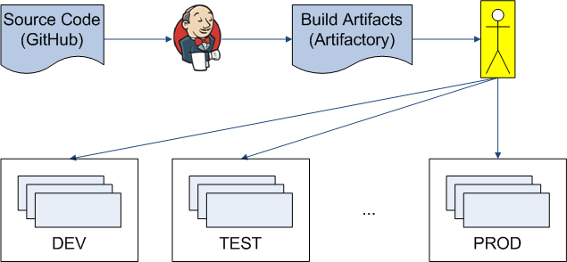
Initial Delivery Pipeline
“Don”

Slide 8
Initial Delivery Pipeline
Automated build process
Publish build artifacts to Artifactory
Application WARs
Liquibase JARs
Manual deploys
(Many apps) x (many versions) x (multiple environments) = TIME & EFFORT
The more frequently a task is performed, the greater the return from improved efficiency

Slide 9
Improved Deployment Process
Goals
Reduce effort
Improve speed, reliability, and frequency
Handle app deploys and db schema updates
Enable self-service
Process Changes
Manual → Automated
Prose instructions → Infrastructure as code
Notes:
Java tech lead first comment: now the “UI guy” can do deploys

Slide 10
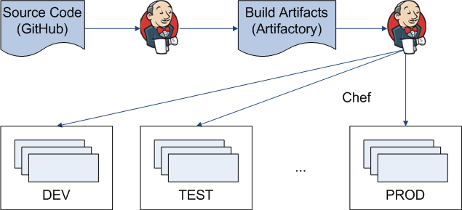
Target Delivery Pipeline

Slide 11
Primer
Notes:
Everyone at this conference is familiar with Jenkins
May be less familiar with Chef, and we’ll be talking about it a lot, so here is a whirlwind introduction

Slide 12
Layers of System Management
Orchestration
Processes collaborating in a distributed
system
Configuration
Install and configure packages and software
Provisioning
Hypervisor (VMware, EC2)

Slide 13
Infrastructure as Code
Develop and manage software infrastructure with practices similar to
those used to develop software applications
Examples
Source Code
Modularity
Abstraction
Testing

Slide 14
Configuration Management
“Process for establishing and maintaining consistency
of a product’s performance, functional and physical
attributes with its requirements, design and operational information throughout its life” (wikipedia)
CM tools for managing software systems
CFEngine, Puppet, Chef, Salt, Ansible
Embody Infrastructure as Code principles
Define desired state of machine
Each run inspects state and makes necessary changes, if any

Slide 15
Chef
Configuration management tool
Exposes DSL hosted in Ruby
Express “what” not “how”
Clean, purposeful capture of intent
Favor DSL when writing code
Ruby is available, if required

Slide 16
Chef Terminology (1)
Chef client is installed on nodes
(machines) which are registered with
the Chef server
Developers write code on workstations and use tools such as knife to interact with server
Chef models node configuration as a set of DSL resources (e.g. package, service, directory) which are mapped to internal providers (actual code to execute)
Can define custom resources

Slide 17
Example Chef Code
This resource declaration
directory '/a/b/c' do
owner 'admin'
group 'admin
mode '0755'
action :create
recursive true
end
ensures that
$ ls -ld /a/b/c
drwxr-xr-x. 5 admin admin 4096 Feb 14 11:22 /a/b/c
Notes:
No mkdir command & flags

Slide 18
Chef Terminology (2)
A recipe declares a set of resources with desired configuration
A cookbook contains a set of semantically-related code and is the fundamental unit of distribution for Chef code
Compare to JAR for Java code
A data bag holds JSON information in one or more data bag items accessible from Chef code
Chef environments model deployed environments
Each node has a run list containing recipes
Notes:
There is a lot more to Chef – we covered the very basics

Slide 19
DEPLOYMENT Process DESIGN

Slide 20
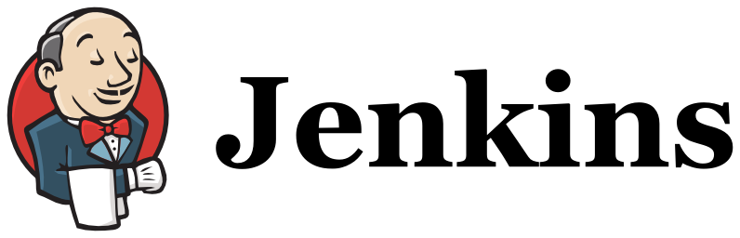
Basic Approach
Deploy custom applications with Chef
Execute schema updates with Liquibase
Coordinate everything with:

Slide 21
Jenkins as Coordinator
General purpose job executor
Shell script steps for Chef API
Gradle steps for Liquibase updates
Arbitrary code at any point in lifecycle
UI
Smooth integration with Active Directory
Authentication and authorization
Administration
Familiar with Jenkins from application build jobs

Slide 22
CCC Application Group
Set of deployable units that are
versioned and released together
For example, a group might have
UI
REST service
Message consumer
DB
Build with a single command
Deploy with a single command

Slide 23
Technical Design Goals
Provide clean API
Specify only essential differences between
apps
Custom Chef resource is the interface
Codify & enforce standards
Balance consistency & flexibility
Code in semantically-versioned cookbooks
Configuration in data bags
Controlled cookbook promotion
Chef environment specifies cookbook version constraint

Slide 24
Cookbook Types
Library Cookbooks
Encapsulate common re-usable logic
Define custom resource to install an app
And the implementing provider
Application Cookbooks
Depend on library cookbooks
One cookbook per application group
One recipe per application
Recipes use custom resource
Lightweight

Slide 25
Data Bags
Contain application configuration
Service endpoints, JAVA_OPTS, etc.
One data bag per application group
One data bag item per environment
“Live” reflection of deployed configuration
Edit → push to Chef server → deploy
Master always matches state of Chef server

Slide 26
Custom Resource Usage
Ensure my-app-ui WAR is deployed:
ccc_webapp "my-app-ui" do
provider :ccc_webapp
artifact_group 'com.copyright.myapp'
artifact 'my-app-ui'
container 'MY-APP-UI'
http_port '8080'
shutdown_port '8900'
properties_template 'ccc.properties.erb'
app_group_data_bag 'my_app'
end

Slide 27
Custom Resource Actions
Retrieves Java, Tomcat & WAR from Artifactory
Installs Java and Tomcat in standard locations
Creates and configures Tomcat container
Installs WAR in the container
Opens port in host firewall
Generates application properties file
Starts container
(Each action taken only if necessary)

Slide 28
Data Bag Structure
data_bags/my_app/DEV.json (data bag item)
"version": "1.4.9",
"runtime": {
"my-app-ui": {
"java_opts": "-Xmx2G -XX:MaxPermSize=1024m"
}
},
"app_config": {
"db.url": "jdbc:postgresql://devdb:5432/myapp",
"svc.foo.url": "http://devsvc:9000/foo"
}
data_bags/my_app/TEST.json
...
data_bags/my_app/PROD.json

Slide 29
Cookbook Data Bag Code *
ccc/providers/webapp.rb (library cookbook)
app_group_data = data_bag_item(app_group_data_bag, node.chef_environment)
java_opts = app_group_data['runtime'][artifact]['java_opts']
// pass java_opts to Tomcat container
app_config = app_group_data['app_config']
// pass app_config to template resource declaration
my_app/templates/ccc.properties.erb (application cookbook)
db.url=<%= @app_config['db.url'] %>
svc.foo.url=<%= @app_config['svc.foo.url'] %>
* Included for future reference

Slide 30
Roles
Deployers
Update data bags & environment files
Initiate deployments
Tech leads
Maintain application cookbooks
Framework developers
Maintain library cookbooks
Maintain framework
Process improvement
Notes:
More and more people will / must learn Jenkins and Chef at some level

Slide 31
COOKBOOK BUILDS

Slide 32
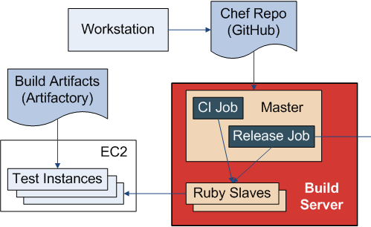

Cookbook Build Process

Slide 33
Jenkins Build Server
For each application group
Cookbook CI job
Cookbook release job
Same master as application build jobs
New class of slaves
Ruby with required gems
Chef with credentials for Chef server
EC2 credentials to create test nodes

Slide 34
Cookbook CI Job
Triggered when new Chef code is
merged
Static analysis
JSON syntax (json gem)
Ruby syntax and style (Tailor)
Chef syntax (Knife)
Chef style and correctness (Foodcritic)
Integration testing
Test Kitchen with kitchen-ec2 plugin
Notes:
Compare to Java tools such as Checkstyle and FindBugs

Slide 35
Integration Testing Lifecycle
Spin up EC2 instance(s) to mimic
actual deployment topology of
application group
Run Chef on each instance (node)
Execute asserts – pass or fail
Dispose of instance(s)

Slide 36
Integration Testing Details
Instances created from AMI
Preconfigured with Ruby and Chef
Using Chef Solo
Avoid adding ephemeral nodes to Chef server
Faux Chef environment “CHEFDEV”
JSON for real environments is reserved
Tag EC2 instances for traceability
Troubleshoot by running Test Kitchen from workstation

Slide 37
Cookbook Release Job
Triggered manually
Runs same tests as CI job
Uploads new cookbook version to Chef server
Tags Git repo

Slide 38
APPLICATION DEPLOYMENT

Slide 39
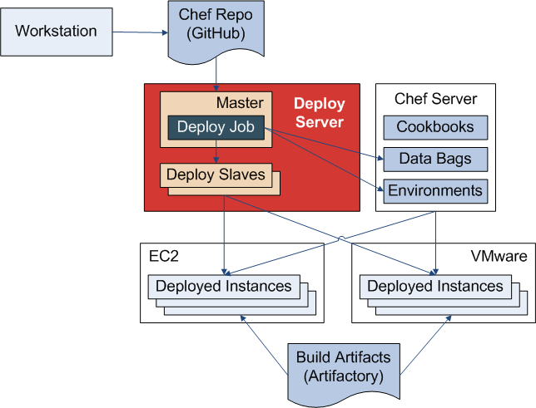
Application Deploy Process

Slide 40
Jenkins Deploy Server
Separate master for deploys
Slaves
Ruby with required gems
Chef with credentials for Chef server
SSH keys for nodes

Slide 41
Deploy Job Types
Each app group has two deploy jobs
DEV deploy for Development
Non-DEV deploy for Operations
Will provide more flavors over time
Job parameters
Environment (non-DEV jobs only)
Application group version

Slide 42
What Does a Deployer Do?
Makes configuration changes
Edits application data bag item
Edits environment file (if necessary)
Merges code
Executes job in Jenkins

Slide 43
Example Deploy Job Run
Deployer enters parameters
Application version = 1.4.9
Environment = TEST
Then automation takes over
Confirms my_app data bag has TEST version 1.4.9
Uploads TEST environment file and my_app data bag item for TEST to Chef server
Finds all nodes in TEST environment with run list containing my_app recipes
Runs Chef client on each found node
Sends email notification

Slide 44
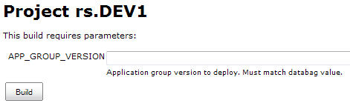
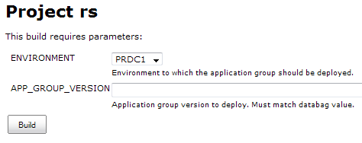
Push-Button Deploys

Slide 45
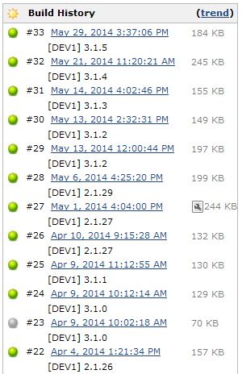
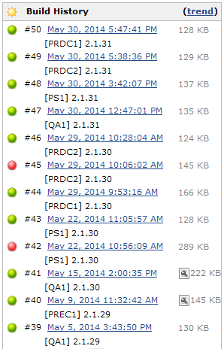
Deploy History

Slide 46
WRAP UP

Slide 47
Most Important Advice
Beware of overly prescriptive “lessons learned” and “best practices”
Synthesize a solution for your context
That said…

Slide 48
Principles & Guidelines (1)
Standardize wherever possible
Technology, design, process
Achieve economies of scale
Exceptions are permissible but rare
Every tool must have an API
Avoid “hitting the wall” down the road
Tradeoff some out-of-the-box capabilities

Slide 49
Principles & Guidelines (2)
Use multiple communication paths
All-hands presentations
Kickoff meetings with each team
Developer walkthroughs
Documentation
Be opportunistic
Find and nurture your early adopters

Slide 50
Principles & Guidelines (3)
Balance process and progress
Must provide tangible results
And also build foundation for future
Just like with application development!
Start with a big pain point
Providing relief builds credibility going forward
Hopefully recoups bandwidth to reinvest

Slide 51
“When Will You Be Done?”
DONE is a dangerous word
Business won’t stop evolving
Neither will the supporting applications
Nor should the supporting infrastructure
X is a journey, not a destination
For many values of X
Deployment automation
Continuous delivery
DevOps

Slide 52
Thank You
Copyright Clearance Center
Engineering Team
Jenkins User Conference
Organizers and Sponsors

Slide 53
Resources
“Infrastructure in the Cloud Era”
Adam Jacob and Ezra Zygmuntowicz
http://www.slideshare.net/adamhjk/infrastructure-in-the-cloud-era
http://www.youtube.com/watch?v=HaABapTwQ2c
Chef cookbook versioning policy
http://chef-community.github.io/cvp/

Slide 54








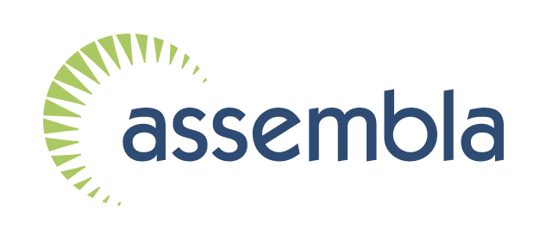

Thank You To Our Sponsors
Platinum
Gold
Silver

