Slide 2


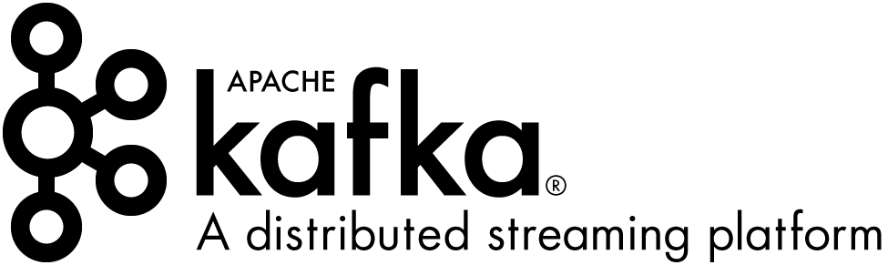
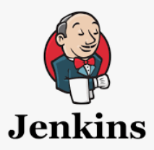

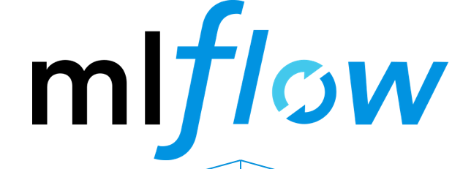
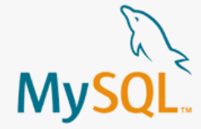


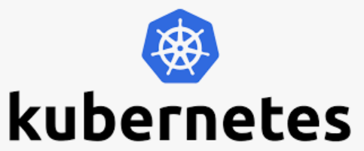

AI Studio
No Code UI
Data Prep Operators
Auto Model
Algorithms
Trained Models
Performance monitoring
Developer Console
Feature Engineering
Data Analysis
Code Generators
Prediction Pipelines
Scheduling
Code Repo
Scheduling UI
Tracking and Model Repo UI
Prediction Pipeline UI
Prediction Data
Model Output
Prediction Service
Model Output
Model Training Services
Dockerize & Schedule Deployments
Tracking
Trained Model
Model Repository

Slide 3
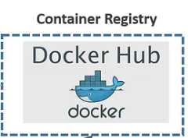
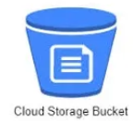
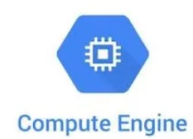

Deloitte’s Framework to Implement AIOps
Key components & roles for implementing AIOps
Orchestration of services
Model Analysis
CI/CD Build ,test, package pipeline components
2
Use Cases/Models(Development,UAT)
Source Code
Data Analysis
(Univariate & Bivariate)
Data Validation Checks
Feature Engineering
Model Training
Hyper parameter tuning
Model Validation
Packages/API
Aurigene Data
1
Auto scaling and resource management(CPU,GPU)
Model Registry
Changes in business drivers leads to manual model re-building
CT: continuous training
Trigger to refresh existing model
Source Code
7
Automated pipeline to refresh models in Prod (If Triggered )
Technology & Business SME
Trained model
8
Model Analysis
Data Extraction
Data Validation Checks
Feature Engineering
Model Training
Hyper parameter tuning
Model Validation
Cockpits & CM
Machine Learning Metadata
Data & Model Logs
Triggers
6
Model Scoring
Model Performance / Distribution of Key Variables / Customer Segments
Email Alerts
Performance monitor
CI, CD, CT
Data Management & Reports
Model Building

Slide 4
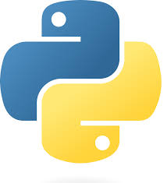

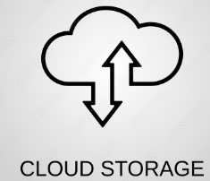
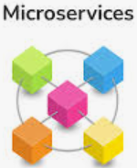


Deloitte’s Framework to Implement AIOps
Key components & roles for implementing AIOps
Note: Its for representation purpose only, will finalize Architecture post evaluation of current Architecture
CI/CD Build ,test, package pipeline components
Model Analysis
2
Use Cases/Models(Development, UAT)
Source Code
Data Analysis
(Univariate & Bivariate)
Data Validation Checks
Feature Engineering
Model Training
Hyper parameter tuning
Model Validation
Packages/API
Aurigene Data
1
Model Registry
Model Catalog
Experiment tracking
Kubernetes AutoScaling(CPU,GPU)
Changes in business drivers leads to manual model re-building
CT: continuous training
Trigger to refresh existing model
Source Code
7
Automated pipeline to refresh models in Prod (If Triggered )
Technology & Business SME
8
Model Analysis
Data Extraction
Data Validation Checks
Feature Engineering
Model Training
Hyper parameter tuning
Model Validation
Orchestration of services
Cockpits & CM
Machine Learning Metadata
Data & Model Logs
Triggers
6
Model Performance / Distribution of Key Variables / Customer Segments
Model Scoring
Email Alerts
Performance monitor
CI, CD, CT
Data Management & Reports
Model Building

Slide 5
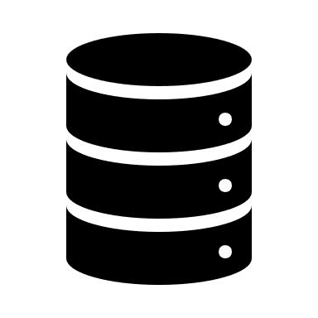
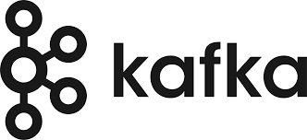

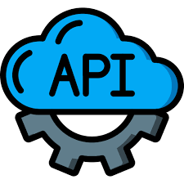
Deloitte’s Framework to Implement AIOps
Key components & roles for implementing AIOps
Note: Its for representation purpose only, will finalize Architecture post evaluation of current Architecture
CI/CD Build ,test, package pipeline components
Model Analysis
3
2
Use Cases/Models(Development, UAT)
Source Code
Data Analysis
(Univariate & Bivariate)
Data Validation Checks
Feature Engineering
Model Training
Hyper parameter tuning
Model Validation
Packages/API
1
Real Time Ingestion
Model Registry
Model Catalog
Experiment tracking
Kubernetes AutoScaling(CPU,GPU)
Batch Ingestion
Changes in business drivers leads to manual model re-building
CT: continuous training
4
Trigger to refresh existing model
Source Code
7
Automated pipeline to refresh models in Prod (If Triggered )
Technology & Business SME
8
API Gateway
Model Analysis
Data Extraction
Data Validation Checks
Feature Engineering
Model Training
Hyper parameter tuning
Model Validation
Orchestration of services
Cockpits & CM
5
Machine Learning Metadata
Data & Model Logs
Triggers
6
Model Performance / Distribution of Key Variables / Customer Segments
Model Scoring
Email Alerts
Performance monitor
CI, CD, CT
Data Management & Reports
Model Building

Slide 6
Detailed Architecture to Implement Operational Framework for solutions present in Applications
Key components & roles for implementing AI Ops
Orchestration of services
Model Analysis
CI/CD Build ,test, package pipeline components
2
Use Cases/Models(Development,UAT)
Source Code
Data Analysis
(Univariate & Bivariate)
Data Validation Checks
Feature Engineering
Model Training
Hyper parameter tuning
Model Validation
Packages/API
Aurigene Data
1
Auto scaling and resource management(CPU,GPU)
Model Registry
Changes in business drivers leads to manual model re-building
CT: continuous training
Trigger to refresh existing model
Source Code
7
Automated pipeline to refresh models in Prod (If Triggered )
Technology & Business SME
Trained model
8
Model Analysis
Data Extraction
Data Validation Checks
Feature Engineering
Model Training
Hyper parameter tuning
Model Validation
Cockpits & CM
Machine Learning Metadata
Data & Model Logs
Triggers
6
Model Scoring
Model Performance / Distribution of Key Variables / Customer Segments
Email Alerts
Performance monitor
CI, CD, CT
Data Management & Reports
Model Building

Slide 7
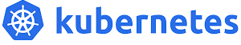
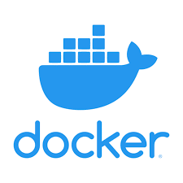


2
Existing Use Cases/Models
Source Code
3
Data Analysis
(Univariate & Bivariate)
Data Validation Checks
Feature Engineering
Model Training
(GPU/CPU)
Hyper parameter tuning
Model Validation
Source Repository
CI: Build, Test & Package Pipeline components
Packages
1
SAP data
Nielsen data
Household panel data
Brand health data
Media data
4
ETL Development, Staging, Testing, Preproduction, Production
Model Tracking & alerts.
Model registry
Scheduling
CD: Pipeline Deployment
Source Code
Model Analysis
CT: continuous training
Trigger to refresh existing model
Changes in business drivers leads to manual model re-building
Automated pipeline to refresh models (If Triggered)
Trained model
7
Data Extraction
Data Validation Checks
Feature Engineering
Model Training
Hyper parameter tuning
Model Validation
5
CD: Model Serving
Machine Learning Metadata
Data & Model Logs
Model Performance / Distribution of Key Variables / Customer Segments
6
Triggers
Performance Monitoring
Model Scoring

Slide 8
AI Studio
No Code UI
Data Prep Operators
Auto Model
Algorithms
Trained Models
Performance monitoring
Developer Console
Feature Engineering
Data Analysis
Code Generators
Prediction Pipelines
Scheduling
Code Repo
Scheduling UI
Tracking and Model Repo UI
Prediction Pipeline UI
Prediction Data
Model Output
Prediction Service
Model Output
Model Training Services
Dockerize & Schedule Deployments
Tracking
Trained Model
Model Repository

