Slide 1
Department of Computer Science and Engineering Amrita School of Computing Malicious network traffic classification using CNN and RNN
Team Members : Project Guide :
Dasari Mahesh Chandra – CH.EN.U4CSE19119 Dr. P Dhavakumar
Kanishq. R. Purohit - CH.EN.U4CSE19131

Slide 2
Flow of Presentation
A. Abstract
B. Objective
C. Introduction
D. Literature Survey
E. Existing work with limitations
E. Proposed Work
F. Novelty of the Project
G. Software and hardware Requirement
H. System architecture
Implementation and results
References

Slide 3
Abstract
This project presents a novel approach for classifying malware network traffic using a hybrid system that combines CNN and RNN models.
The proposed system is designed to effectively classify network traffic as either benign or malicious.
The model has an interface which prompts the user to take a decision whether to block or ignore any malicious packets arriving from a source IP address.
It is a pre-trained model which can be deployed in real time.

Slide 4
Objective
To build a malware network traffic Classification model using a hybrid neural network which can run in real-time.
The model also should have ability to block all packets from the source IP address which sent the malicious packet.
To check if the accuracy is increased upon combining both the neural networks.
To choose appropriate evaluation metrics to compare the efficiencies of the pre-trained models.

Slide 5
Introduction
Convoluted Neural Networks (CNN):
The CNN model is responsible for extracting features from the preprocessed data. It is trained on a labeled dataset of network traffic data, it takes the images of the packets as input and applies convolutional and pooling layers to extract features from the images.
Recurrent Neural Networks (RNN):
The RNN model is responsible for processing the sequences of packet features generated by the CNN model. The RNN model is trained on a labeled dataset of network traffic data, it takes the sequences of features as input and applies a recurrent layer to process the sequences.

Slide 6
Literature Survey
SNo | Title | Survey
1. | Deep Learning-based Network Intrusion Detection | This paper presents a comprehensive survey on the use of deep learning techniques in intrusion detection. The paper focuses on the use of deep neural networks, for network traffic classification and highlights the advantages of using these methods over traditional machine learning techniques.
2. | HCRNNIDS: Hybrid Convolutional Recurrent Neural Network-Based Network Intrusion Detection System | The authors propose a hybrid model that combines convolutional neural networks and recurrent neural networks for extracting features from network traffic and classifying it as either benign or malicious. The system is trained on a dataset of network traffic data, including both benign and malicious traffic,
3. | Malware Traffic Classification Using Convolutional Neural Network for Representation Learning | In this paper they first presented a new taxonomy of traffic classification from an artificial intelligence perspective, and then proposed a malware traffic classification method. This method needed no hand-designed features but directly took raw traffic as input data of classifier.

Slide 7
Existing work with limitations
People have used many different traffic classifications like Rule-based, Classic machine-learning approach and Representational learning.
In rule based they have used hard-designed data rather than using the raw one .
In representational based there are no hardcoded features and mapping. Use of CNN for traffic classification has been made where the incoming packets are classified based on image as an input. They have an accuracy of 99%. But they faced a problem taking the packets live through the firewall.

Slide 8
Proposed Work
For training we will take the incoming traffic and do some data pre-processing over it ,for example, removing duplicate files. We then will feed the data from CICIDS-2017 dataset, linearly to the CNN and RNN models successively.
For testing we will take live input through the firewall and do the same as we did it for training and if malicious packet is found then the user will have the privilege to decide whether to block that packet or not.

Slide 9
Novelty of the Project
We will work on the live packets , and this idea was not used by any of the researches conducted till date.
We gave privilege to the user so that they can decide what to do with that packet.
We have added RNN to the system architecture and fed the data in a linearly way to the Conv1D model.

Slide 10
Software and hardware Requirement
Software Required:
Jupyter Notebook
Anaconda Navigator
Main Libraries Required:
Convoluted Neural Networks library
Recurrent Neural Networks library
Scapy library
Datasets - CICIDS2017

Slide 11
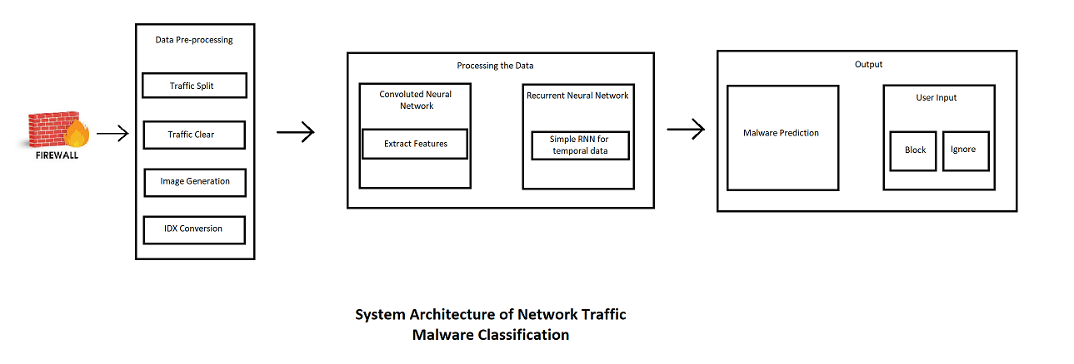
System architecture

Slide 12
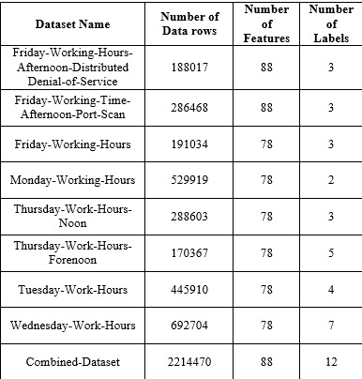
Implementation and results

Slide 13
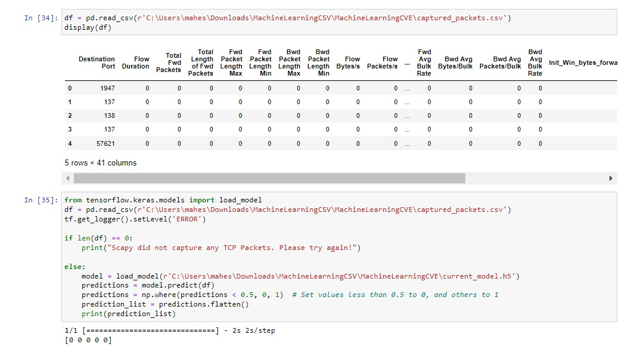
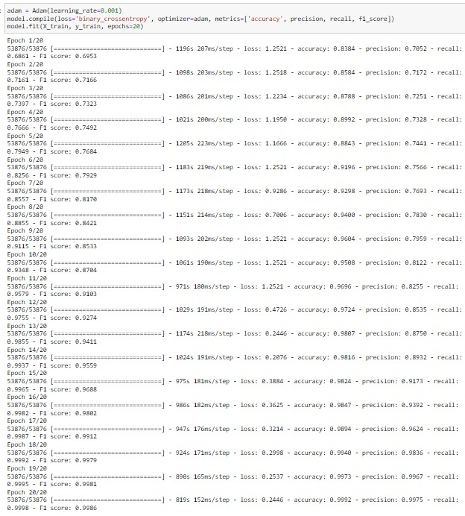
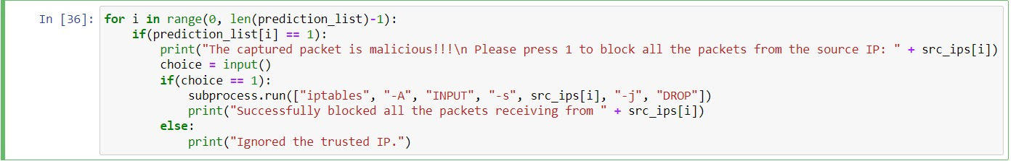

Slide 14
References
https://www.researchgate.net/publication/316176048_Malware_traffic_classification_using_convolutional_neural_network_for_representation_learning
https://www.researchgate.net/publication/327255979_Using_convolutional_neural_networks_for_classification_of_malware_represented_as_images
https://www.researchgate.net/publication/338355873_The_rise_of_machine_learning_for_detection_and_classification_of_malware_Research_developments_trends_and_challenges
https://www.researchgate.net/publication/334698504_A_Review_Paper_of_Malware_Detection_Using_API_Call_Sequences
https://www.sciencedirect.com/science/article/abs/pii/S1361372314705317
(Using feature generation from API calls for malware detection).

Slide 15
Thank You

