Slide 1

Comparative Analysis of Transformer Models for NLP Tasks
4 February 2026
Presentation focusing on BERT and RoBERTa architectures comparative analysis
Mahesh Dethe
Nihal Khan
Samuel Ravi Tej

Slide 2
Business Objective & Dataset Details
Conduct a comparative analysis of different transformer models (such as BERT, RoBERTa) on sentiment analysis to evaluate performance, efficiency, and applicability.
Sentiment Analysis using the IMDB Movie Reviews Dataset, featuring a large dataset of movie reviews labeled as positive or negative.

Slide 3
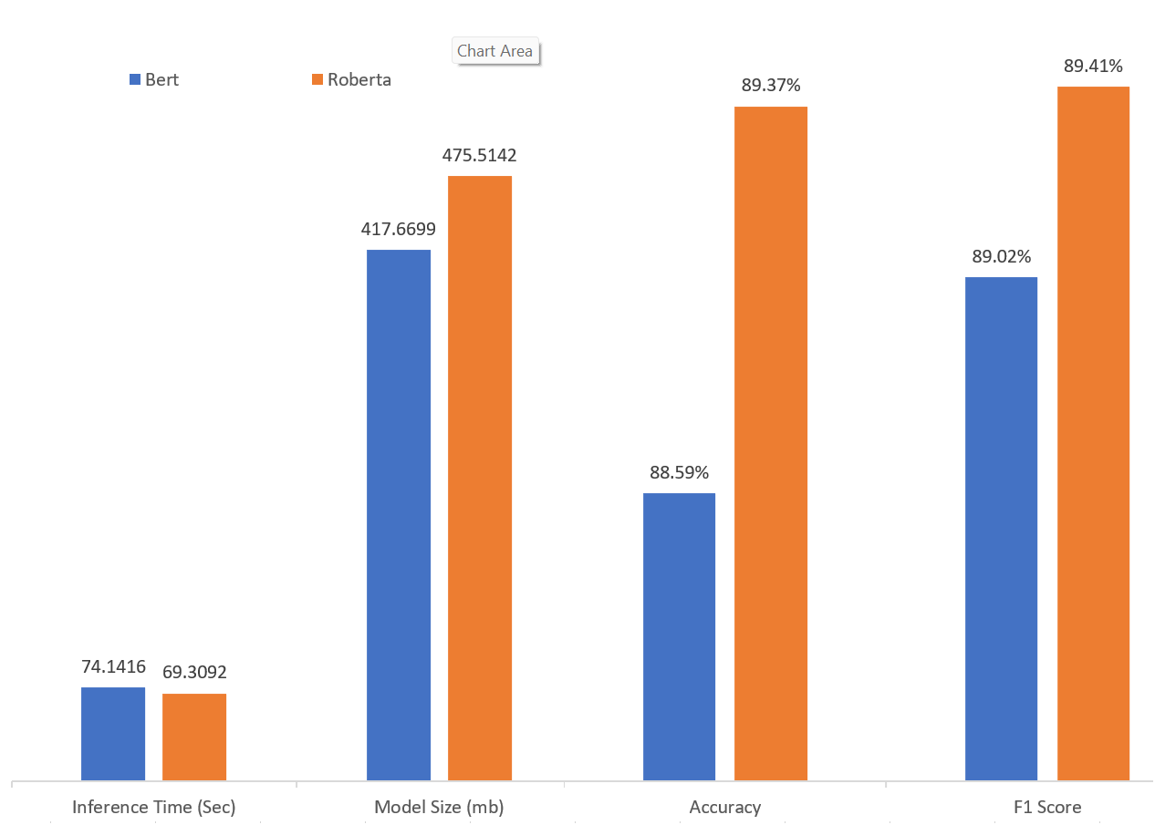

Comparative Performance and Metrics
Model Name | Bert | Roberta
Inference Time (Sec) | 74.1416 | 69.3092
Model Size (mb) | 417.6699 | 475.5142
Accuracy | 88.59% | 89.37%
F1 Score | 89.02% | 89.41%

Slide 4
Conclusion
The comparative analysis reveals that while both models perform exceptionally well on the IMDB sentiment analysis task, they exhibit different strengths:
Accuracy & Quality: RoBERTa is the superior model in terms of predictive power, achieving a higher Accuracy (89.37%) and F1 Score (89.41%) compared to BERT.
Speed: RoBERTa also demonstrates higher efficiency during inference, completing the task in 69.31 seconds, which is roughly 6.5% faster than BERT’s 74.14 seconds.
Resource Efficiency: BERT is the more "lightweight" option, with a model size of 417.67 MB, making it approximately 12% smaller than RoBERTa (475.51 MB).

Slide 5

Thank You !!!
Project hyperlinks and source files are available for review as detailed in the project documentation. Access the project file via the provided hyperlinks for deeper insights.

