Slide 1
MS-Azure Devops Demo by Sekhar
Welcome to “MS-Azure Devops Demo” Session

Slide 2
Agenda
What is Devops
What is AzureDevops
Advantages of Azure Devops
Implementation Azure Devops for projects.

Slide 3
Devops
DevOps is the combination of cultural philosophies, practices, and tools that increases an organization's ability to deliver applications and services at high velocity: evolving and improving products at a faster pace than organizations using traditional software development and infrastructure management processes.
How its works:
DevOps is Development and Operation's Collaboration, It's a Union of Process, People and Working Product that enable continuous integration and continuous delivery of value to our end users. DevOps accelerate the process to deliver applications and software services at high speed and high velocity.

Slide 4
Azure Devops
What is Azure DevOps?
Azure DevOps is a Software as a service (SaaS) platform from Microsoft that provides an end-to-end DevOps toolchain for developing and deploying software. It also integrates with most leading tools on the market and is a great option for orchestrating a DevOps toolchain. At DevOpsGroup, we have lots of customers who have found Azure DevOps fits their needs irrespective of their language, platform or cloud.

Slide 5
What can Azure DevOps do?
Azure DevOps comprises a range of services covering the full development life-cycle. At the time of writing these are:
Azure Boards: agile planning, work item tracking, visualisation and reporting tool.
Azure Pipelines: a language, platform and cloud agnostic CI/CD platform with support for containers or Kubernetes.
Azure Repos: provides cloud-hosted private git repos.
Azure Artifacts: provides integrated package management with support for Maven, npm, Python and NuGet package feeds from public or private sources.
Azure Test Plans: provides an integrated planned and exploratory testing solution.
Azure DevOps can also be used to orchestrate third-party tools.

Slide 6
When was Azure DevOps launched?
Despite being launched in October 2018, Azure DevOps is not the new kid on the DevOps block.

Slide 7
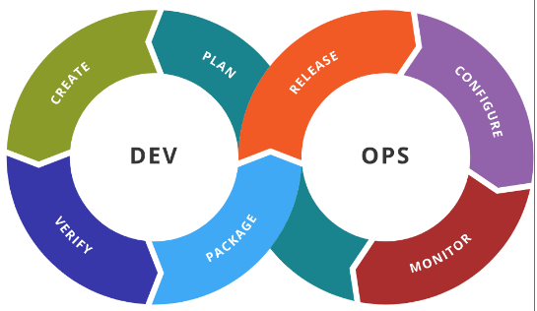
Devops
DevOps is a set of practices that combines software development (Dev) and information-technology operations (Ops)
DevOps (development and operations) is an enterprise software development phrase used to mean a type of agile relationship between development and IT operations. The goal of DevOps is to change and improve the relationship by advocating better communication and collaboration between these two business units.

Slide 8
What is Azure Devops
Azure DevOps is the evolution of VSTS and github.
Azure DevOps integrates with the tools of your choice(VSTS and Github etc..)
Bring development, IT operations and quality engineering teams together to build, test, deploy, monitor and manage applications in the cloud.
With Azure DevOps you get Azure Boards, Azure Repos, Azure Pipelines, Azure Test Plans and Azure Artifacts

Slide 9
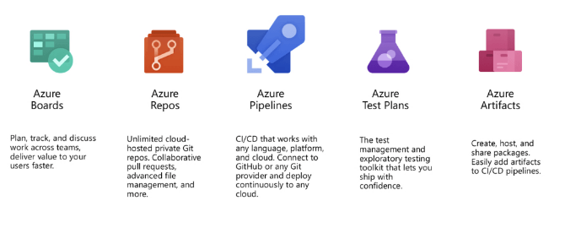
Azure Devops Components

Slide 10
Azure DevOps Components:
Azure Boards
Deliver value to your users faster using proven agile tools to plan, track and discuss work across your teams
Define and update issues, bugs, user stories, & other work with customizable Scrum, Kanban, and Agile tools.
Get unlimited, cloud-hosted private Git repos and collaborate to build better code with pull requests and advanced file management.
Get unlimited private Git repository hosting and support for TFVC which scales from a hobby project to the world’s largest repository.
Azure Repos

Slide 11
Cloud Service Models
Build, test and deploy with CI/CD which works with any language, platform and cloud. Connect to GitHub or any other Git provider and deploy continuously.
Test and ship with confidence using manual and exploratory testing tools.
Create, host and share packages with your team and add artifacts to your CI/CD pipelines with a single click.
Azure Pipelines
Azure Test Plans
Azure Artifacts

Slide 12
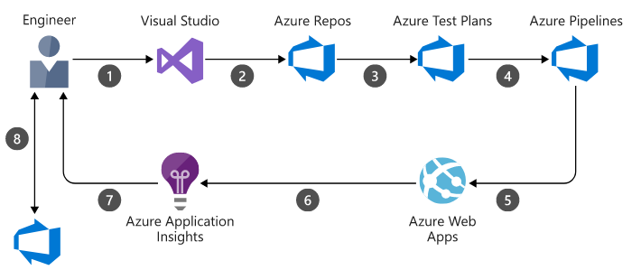
Architecture

Slide 13
EPIC
Epic Definition in Agile Scrum Methodology An Epic can be defined as a big chunk of work that has one common objective. It could be a feature, customer request or business requirement. ... These details are defined in User Stories. An epic usually takes more than one sprint to complete

Slide 14
Azure Devops benefits
The app is easy to install and takes only a few minutes in configuration. You can run other apps with it and enjoy effortless multitasking.
It supports various platforms and a runs on multiple frameworks. The developers using Java, Node, PHP, .NET, and Python can efficiently work on it.
You can start your own app or bring a new app from Git as DevOps projects let you avail both options.
Make an instant analysis of the applications by using built-in applications while you can also use cloud features by using Visual Studio Team Services.

Slide 15


