Slide 1
VpK Visual parsed Kubernetes

Slide 2
VpK - Visual parsed Kubernetes What is it?
VpK was created as the result of needing to understand and visualize what is defined in all those Kubernetes configuration files.

Slide 3

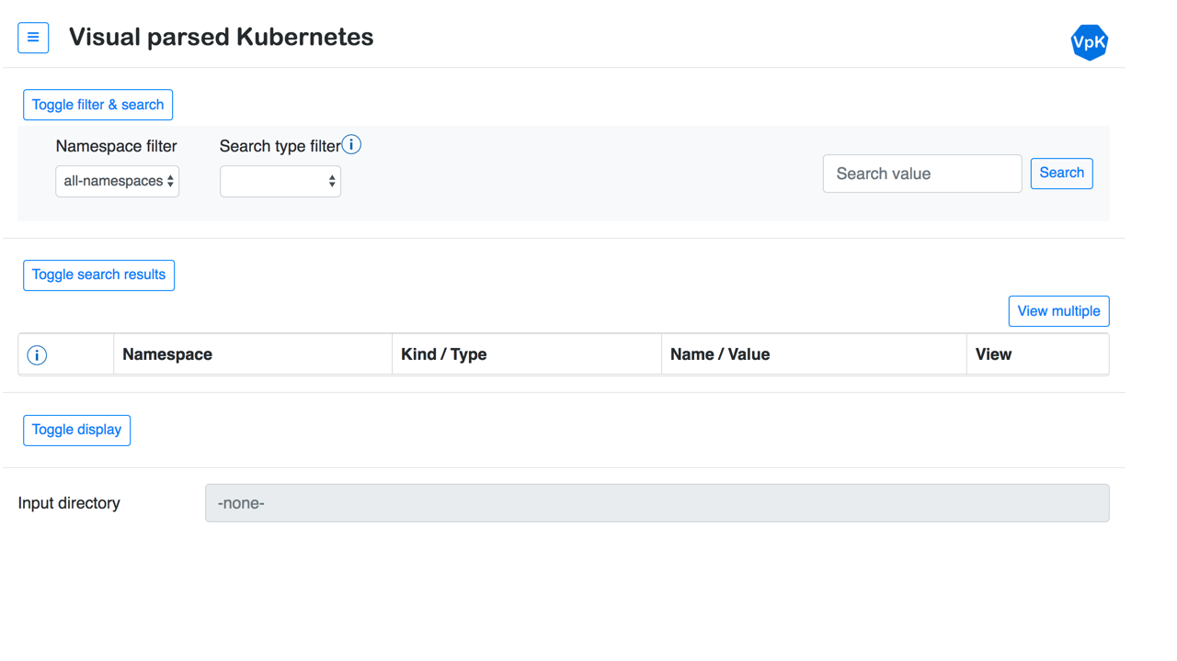
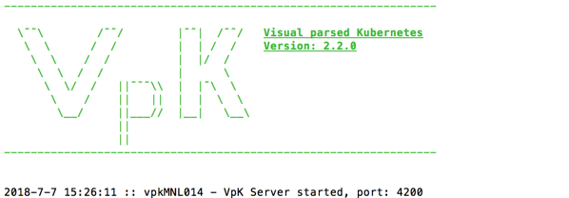


VpK - Visual parsed Kubernetes Architecture
IBM Cloud Private
and / or
Application UI running in client browser
Application Server running on desktop
Folders with yaml config files
Typically installed on desktop machine

Slide 4
VpK - Visual parsed Kubernetes Prerequisites
Web browser that supports html version 5
node js is required to run the server component
npm is required to install required node js packages
kubectl command line tool, this is invoked by the server

Slide 5
VpK - Visual parsed Kubernetes Getting started
Clone or download source code from GitHub link:
https://github.com/IBM-ICP-CoC/VpK

Slide 6
VpK - Visual parsed Kubernetes User Guide
The user guide and installation documentation is available at the same GitHub link:
https://github.com/IBM-ICP-CoC/VpK

