Slide 1


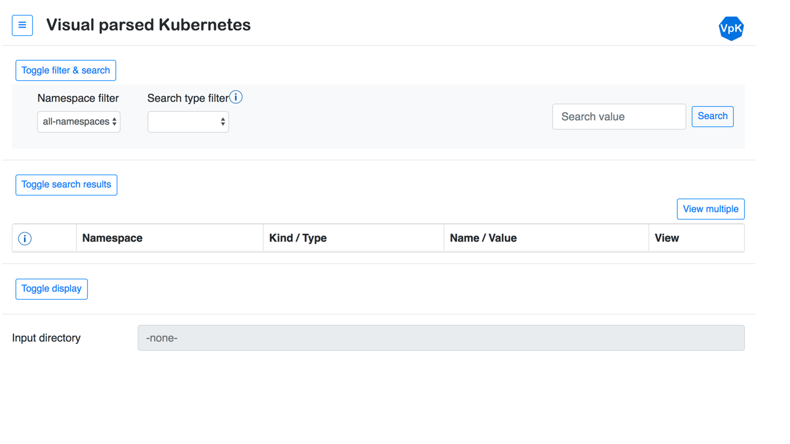
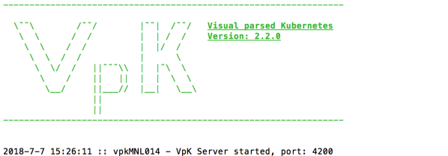

Visual parsed Kubernetes (VpK) architecture
App running in client browser
Server software
IBM Cloud Private or folders with yaml files

