Slide 1



THEME
AR/VR/XR- Epidemic.
TITLE
AR Portal for Dr and Student (Public Awareness)
PRESENTED BY:
Sanket Patil (Leader) (https://github.com/sanket9006)
Mahesh Gavhane (https://github.com/maheshgavhane)
Prasad Wakchoure (https://github.com/prasad323122)
Chaitanya Abhang (https://github.com/chaitanya9299)
Team Name
Iotians
Link to GitHub
(Click on it)
Link to Demo Video
(Click on it)

Slide 2
CONTENTS-
1. Problem Statement
2. Problem Description
3. Project Description
4. Current Out Break
5. Innovation
6. Implementation of AZURE services
7. Business Impact
8. Tools Used
9. Coding Style
10. Flowchart

Slide 3
PROBLEM STATEMENT
An Augmented Portal in Real World for Doctors and Students to study/detections the epidemic and for citizens to get information about Epidemic diseases and inspecting the affecting human body parts in 3D.

Slide 4
DESCRIPTIONS
EPIDEMIC
Rapid spread .
Type-Infections disease.
Take small period of time to spread.
(usually 2 weeks).
4. Common source outbreak (affected individuals).
5. Propagate outbreak (disease spread person-to-person .)

Slide 5
PROJECT DESCRIPTION
An APP (android ) using Unity for visualizing the basic information about the epidemics without actually going to any where physically.
It is digital for students ,doctors for studying about the diseases and for citizens to get to know about the epidemics spreading sitting at home.
This app is provided with a login which is implemented using Azure services for using the application.
It uses the phones camera for surface detection using Google ARCore and then places the Lab as per the user convenience.
This lab provides you the information about human organs, viruses , the organs affected by the viruses, the regions affected by the virus and also the live data is tracked and displayed in the app itself.

Slide 6
CURRENT OUTBREAK
1. Coronavirus disease (COVID‑19)
2. Ebola virus disease.
3. MERS- CoV.
4. Pandemic(H1N1)2009.
5. Infuenza at the human-Animal interface(HAI).

Slide 7
INNOVATION
We have provided Real Time statistics of the current data of epidemics.
We have tried to provide a real-time experience to the students in the medical field to demonstrate the human body practically.
Awareness is spread through the portal .
The symptoms and precautions are effectively shown , so that the common people know it easily

Slide 8
IMPLEMENTATION OF AZURE SERVICES
Used for authentication of the user at login time.
Provides built-in authentication support.
Provides built-in authorization support.
Spend more time and energy on providing business value to your customer.
Secure authentication and authorization require deep understanding of security, including federation, encryption, JSON web tokens (JWT) management, grant types, and so on.

Slide 9
BUSINESS IMPACT
Use to instruct and guide the worker.
Real time statistics can be obtained.
3 . Through AR common people who are unaware of the impact of epidemic diseases can be made
aware.
4. Used in recovery and rehabilitation process.
5. Helps peoples/doctors to understand the symptoms and precautions.
6. Provide visual guidance .

Slide 10
TOOL USED :-
1. Unity
2. Blender
3. Visual Studio
4. Google ARCore SDK

Slide 11
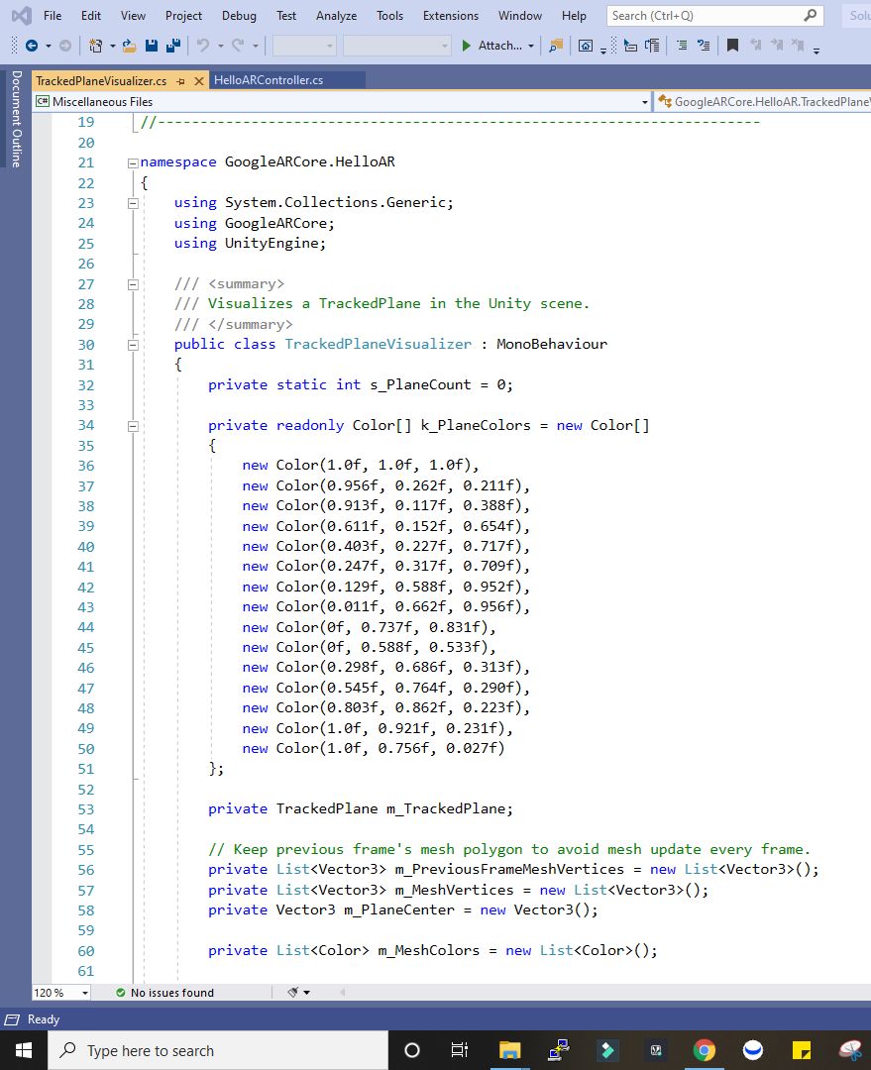
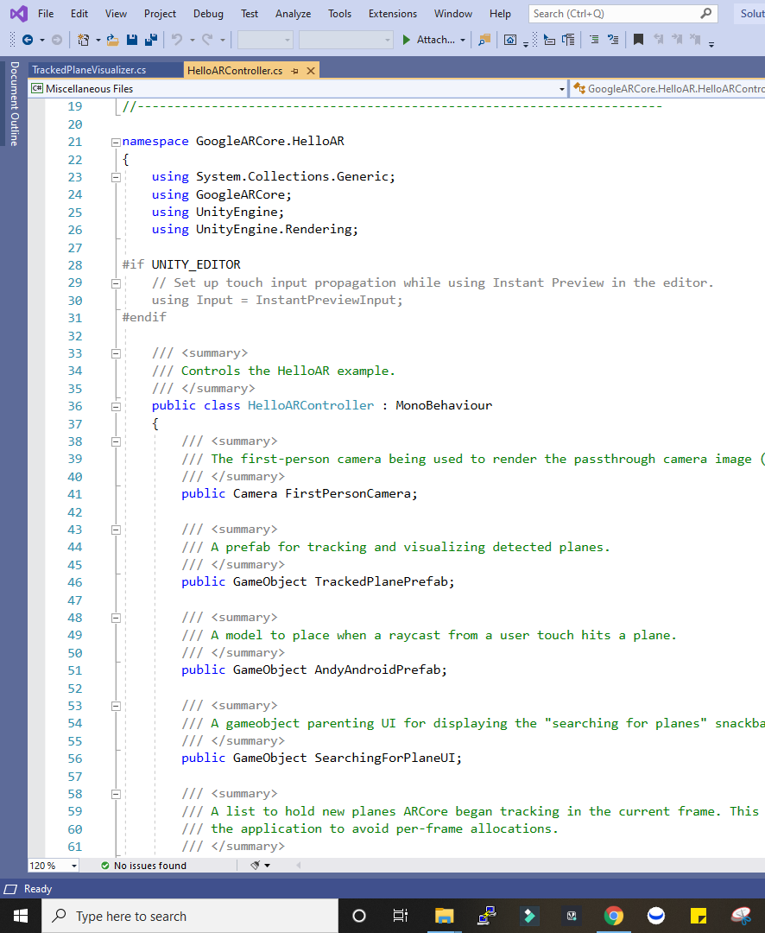
CODING STYLE
Coding language Used :-
1) C #
HelloARController.cs
TrackedPlaneVisualizer.cs

Slide 12
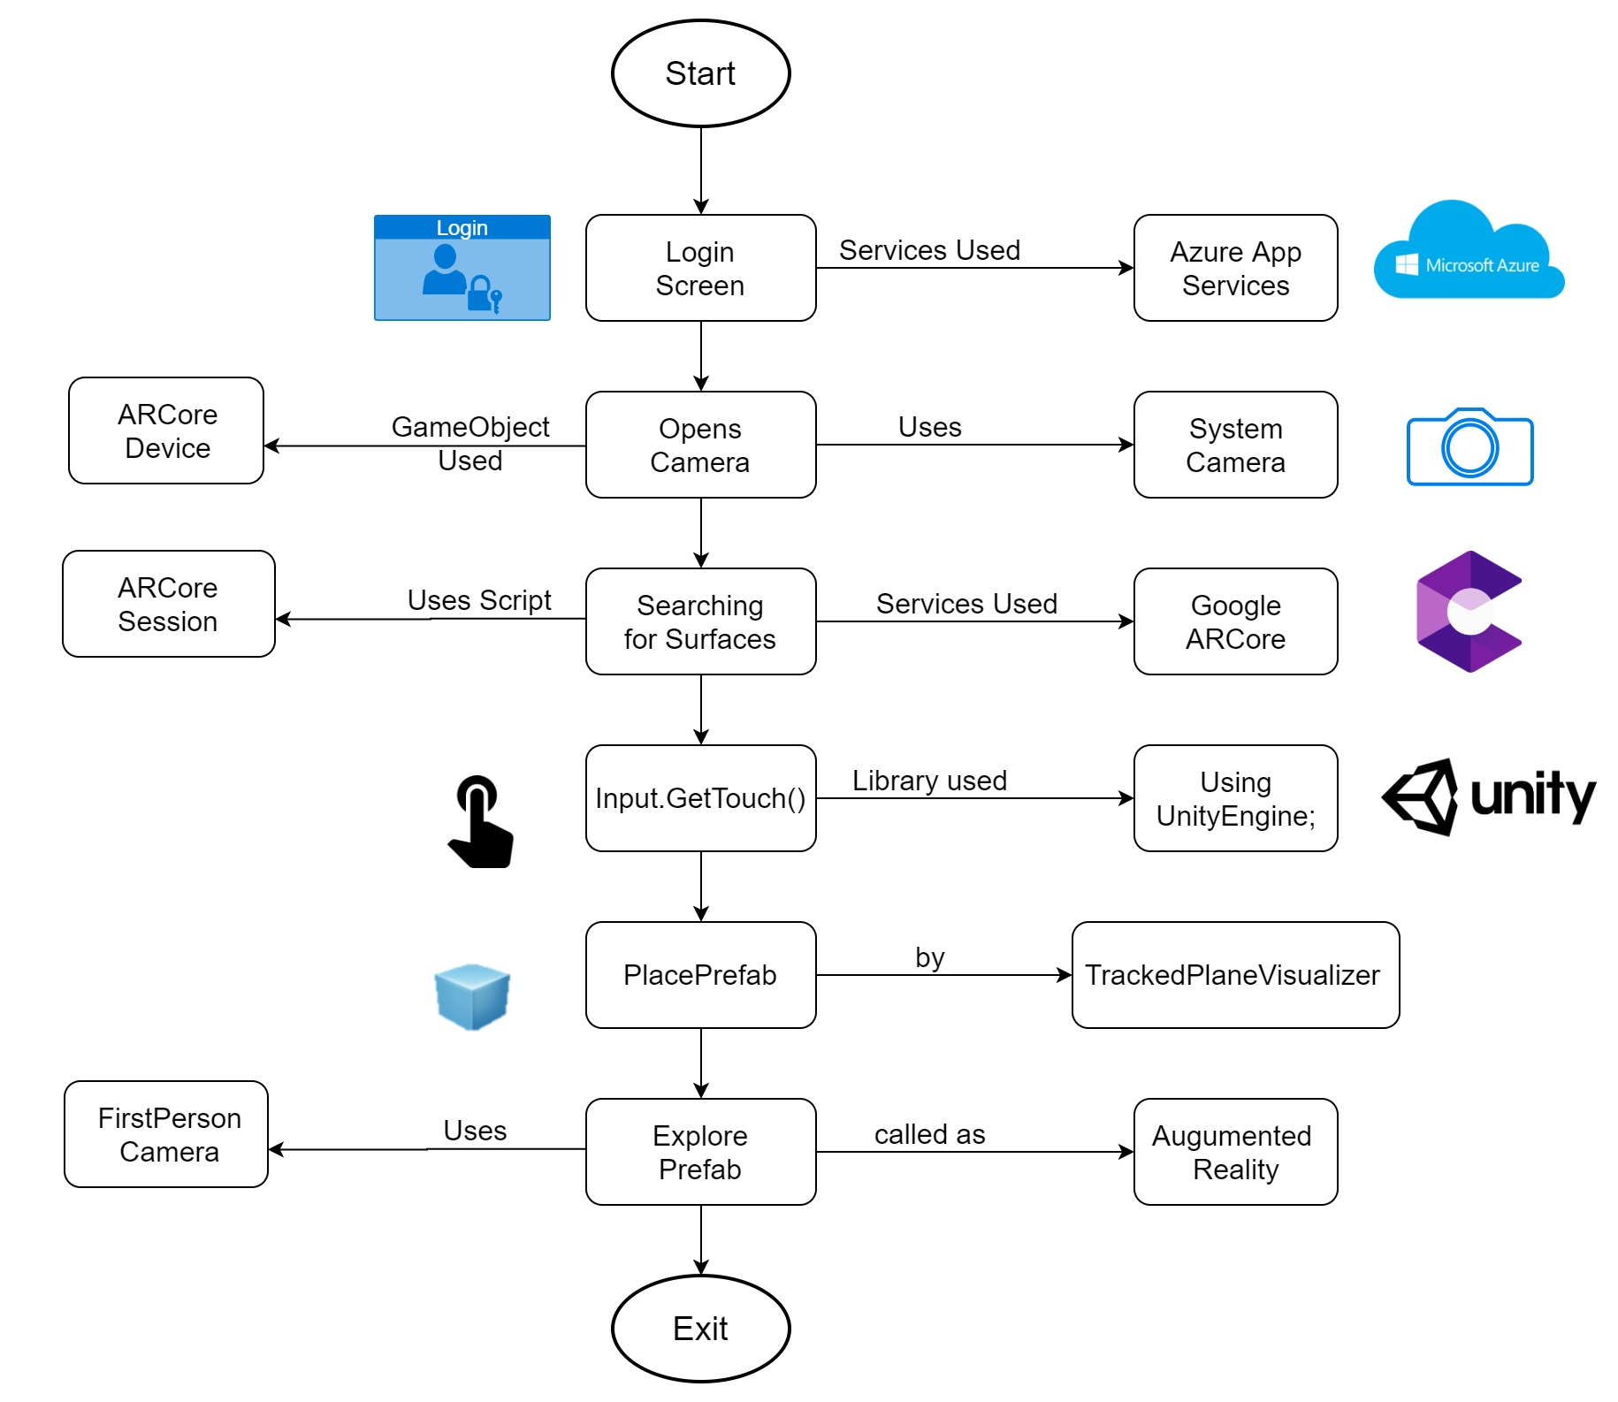
Flowchart :-

Slide 13
THANK YOU…

