Slide 1
Lending club case study
Created by : Jagadish & Mahesh

Slide 2
Problem statement
A consumer finance company wants to accesses the loan application and find out the chances of default.
Past data with many parameters are available for analysis.
Based on this dataset important parameters driving the loan defaults needs to be identified.

Slide 3
Solution approach
Read the data in python file
Data Exploration and Cleaning:
Check the missing values
Handle missing values through imputation or data removal
Check for data types and convert if required
Analyse the data and identify the parameters impacting defaults
Plot the data for visual representation

Slide 4
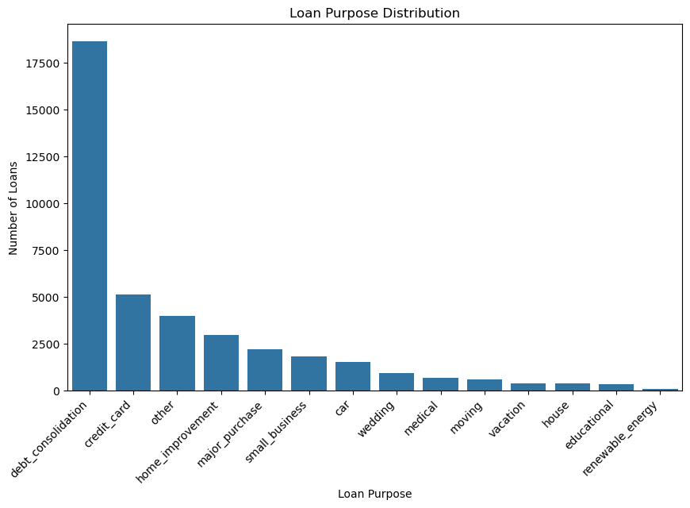
Purpose of loans
Customers request loan for various purposes . Graph shows the count of loan applications based on purpose

Slide 5
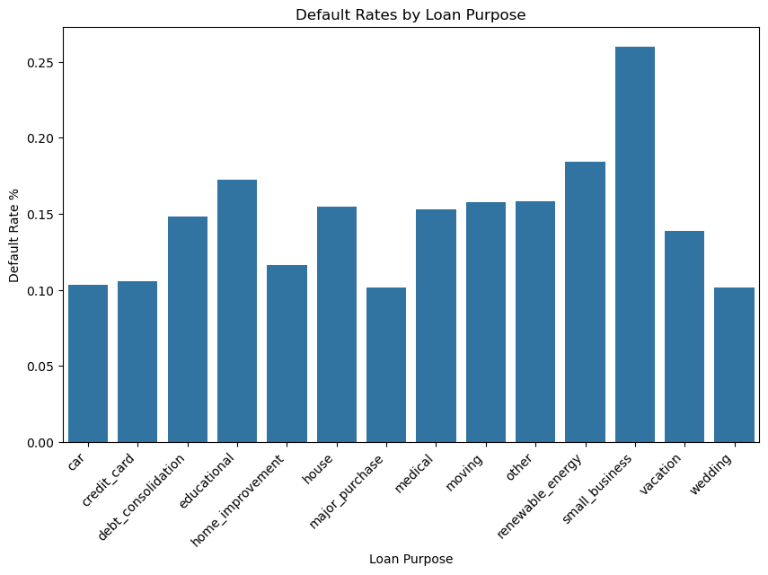
Default rates based on loan purpose
Loans taken for small_business carries higher risk Of defaulting.

Slide 6
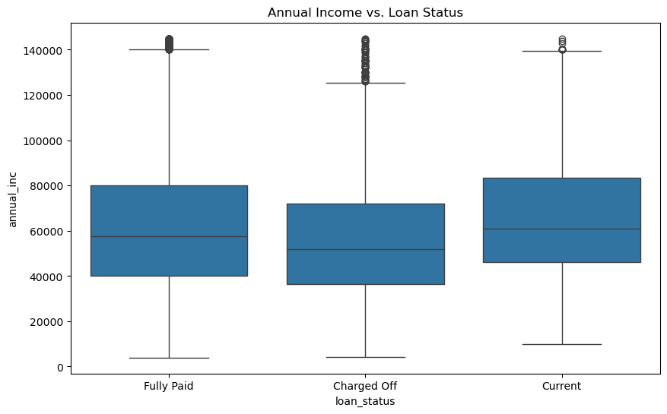
Loan status vs annual income
Defaulters have average annual income lesser than fully paid category by 1000$.
Lower annual income indicates higher default rate

Slide 7
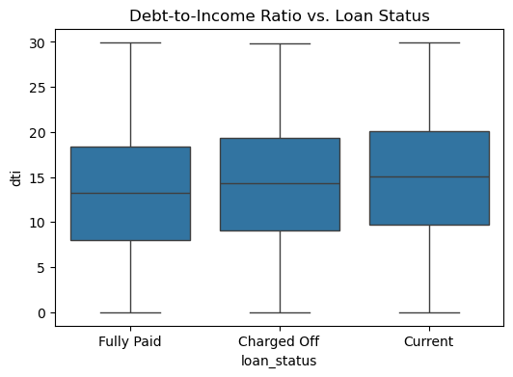
Debt to income ratio
Higher debt to income ratio indicates more financial stress and leads to defaults as shown in figure
Parameter : dti

Slide 8
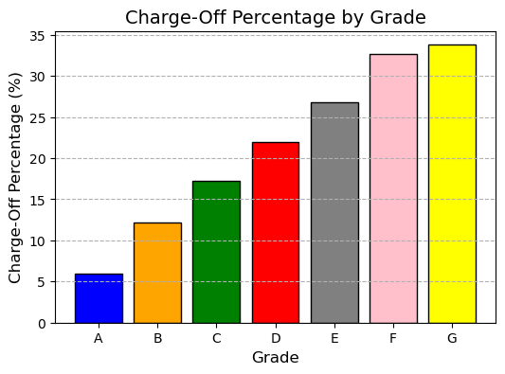
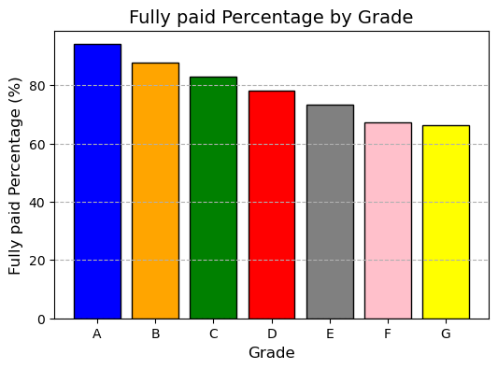
Default rates based on LC assigned grades
From both the graphs Grade A has low chance of default compared to other higher grades. Risk of default increases towards higher grades as we go on to B..C……..G

Slide 9
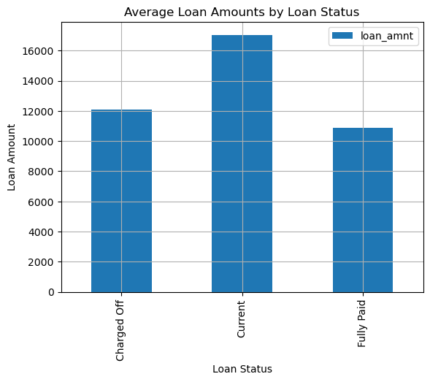
Loan status vs average loan amount
Average loan amount different categories is as follows
Charged off loans have ~1500 $ higher value compared to
Fully Paid loans.
Note : Current is ignored in the analysis as the loan is not closed yet

Slide 10
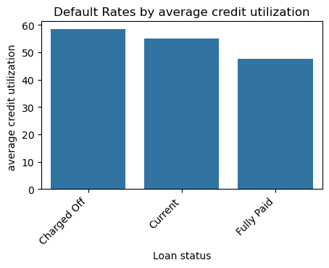
Default rates based on credit utilization
Higher defaults seen for higher average credit utilization %
Parameter : revol_uti
0 Charged Off 58.40
1 Current 54.95
2 Fully Paid 47.60

Slide 11
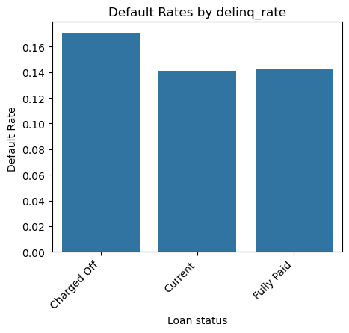
Default rates based on delinq_2yrs
Delinq_2yrs talks about number of times a borrower missed the scheduled payment date in 2 years. Higer rate indicates more financial stress.
Higher average rate for this parameter indicates higher chances of defaults a shown in the graph for Charged off

Slide 12
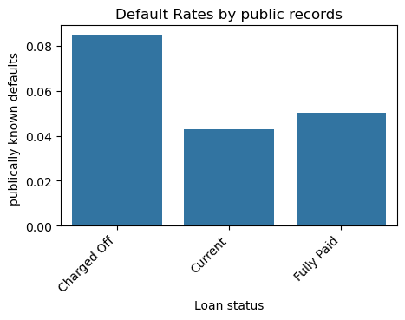
Defaults based on public records
Chances of defaults are higher in case some one has
Higher public records

Slide 13
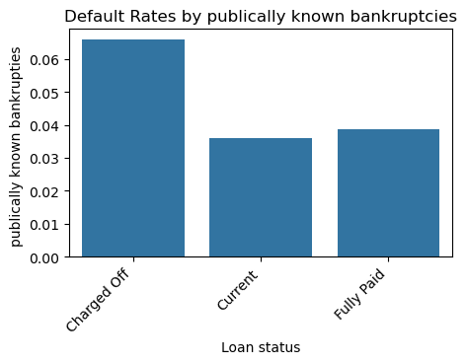
Defaults based on publicly known bankruptcies
Chances of defaults are higher in where a borrower has
Undergone bankruptcies

Slide 14
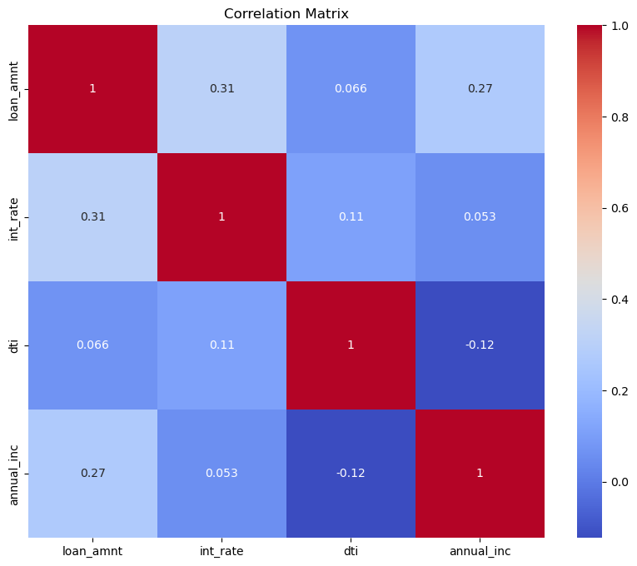
Correlation matrix
loan_amnt & int_rate: There's a moderate positive correlation. This suggests that larger loan amounts are generally associated with higher interest rates.
loan_amnt & annual_inc: There's a moderate positive correlation. This indicates that individuals with higher annual incomes tend to borrow larger amounts.
int_rate & dti: A weak positive correlation is observed. This suggests a slight tendency for higher interest rates to be associated with higher debt-to-income ratios.
annual_inc & dti: A weak negative correlation is present. This implies that individuals with higher annual incomes might have slightly lower debt-to-income ratios.

Slide 15
Summary
Parameters influencing the default situation
Parameters | Remarks
Grade | LC assigned grade A – lowest risk ….G- highest risk
Loan purpose | Small_business has higher risk
dti (debt to income ratio) | Higher debt to income ratio , higher risk
Credit utilization | Higer credit utilization leads to higher chance of defaults
Delequncy_2yr | Delinq_2yrs talks about number of times a borrower missed the scheduled payment date in 2 years. Higer rate indicates more financial stress.
Publicly known bankruptcies, and issues | Defaults known in public space has shown impacts of defaults

Slide 16
THANK YOU

