Slide 1
Lending case study
details

Slide 2
Data insights
application_type : Only individual types of loan applications available – not relevant data.

Slide 3
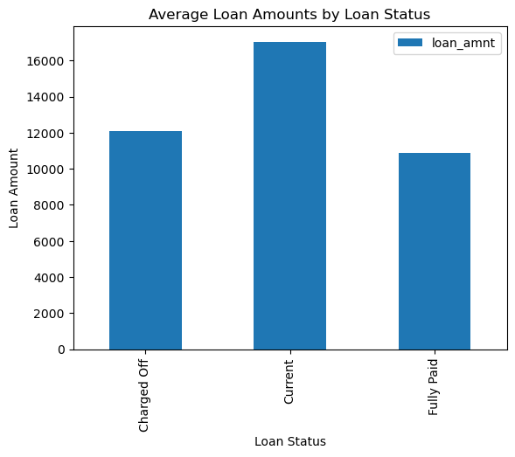
Loan status vs average loan amount
Average loan amount different categories is as follows
Charged off loans have ~2000 $ higher value compared to
Fully Paid loans.
Note : Current is ignored in the analysis

Slide 4
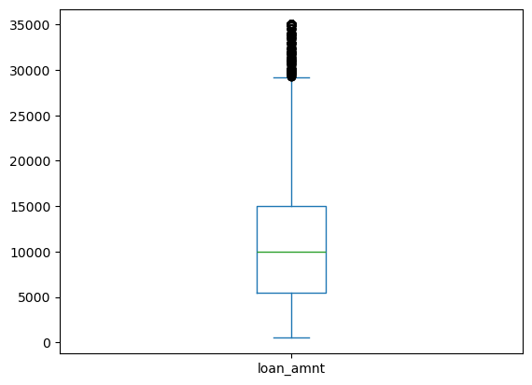
Loan amount analysis
mean 11219.443815 std 7456.670694 min 500.000000 25% 5500.000000 50% 10000.000000 75% 15000.000000 max 35000.000000

Slide 5
Home ownership
home_ownership RENT: 18899 MORTGAGE: 17659 OWN: 3058
OTHER: 98
NONE: 3

Slide 6
open_acc
Indicates how many lines of credits are used by a person. When used in combination with delinque and % utilization , we get good insights
mean 9.294408 std 4.400282 min 2.000000 25% 6.000000 50% 9.000000 75% 12.000000 max 44.000000
mean 22.088828 std 11.401709 min 2.000000 25% 13.000000 50% 20.000000 75% 29.000000 max 90.000000

Slide 7
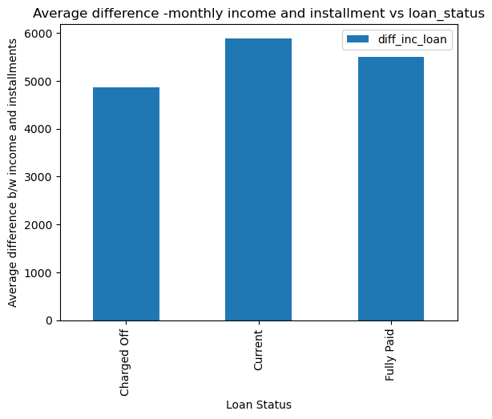
Loan status vs income-instalment difference
Defaulters have average monthly income and instalment difference lesser than fully paid category by 800$
Note : Current is ignored in analysis

Slide 8
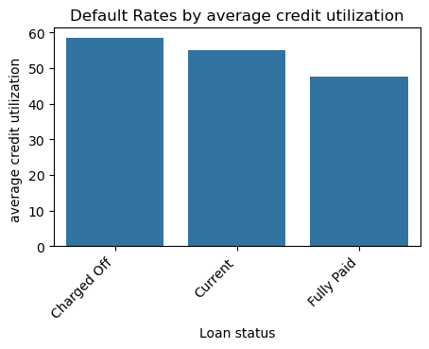
Default rate based on average credit utilization
Pay attention to revol_uti – this parameter indicates
The utilization of credit, higher the value more riskier
0 Charged Off 58.40
1 Current 54.95
2 Fully Paid 47.60

