Slide 1
Lending club case study

Slide 2
Problem statement
A consumer finance company wants to accesses the loan application and find out the chances of default.
Past data with many parameters are available for analysis.
Based on this dataset important parameters driving the loan defaults needs to be identified.

Slide 3
Solution approach
Read the data in python file
Clean the data
Analyse the data and identify the parameters impacting defaults
Plot the data for visual representation

Slide 4
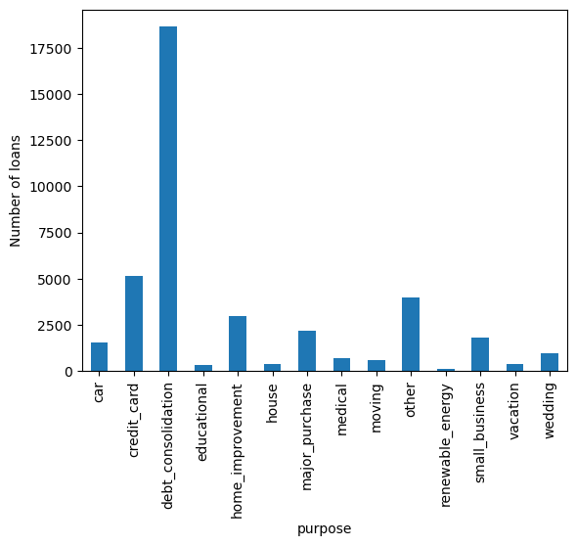
Purpose of loans
Customers request loan for various purposes . Graph shows the count of loan applications based on purpose

Slide 5
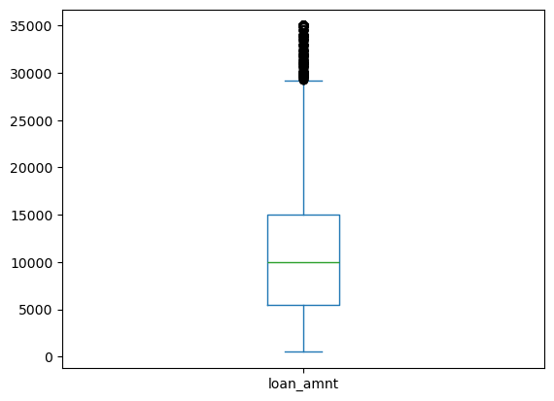
Loan amount analysis
mean 11219.443815 std 7456.670694 min 500.000000 25% 5500.000000 50% 10000.000000 75% 15000.000000 max 35000.000000

Slide 6
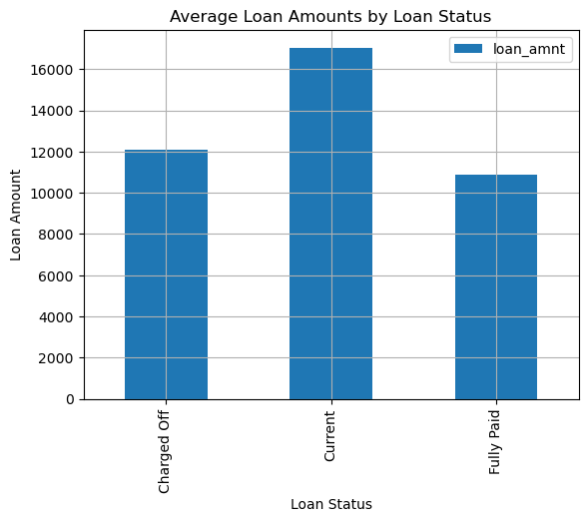
Loan status vs average loan amount
Average loan amount different categories is as follows
Charged off loans have ~1500 $ higher value compared to
Fully Paid loans.
Note : Current is ignored in the analysis as the loan is not closed yet

Slide 7
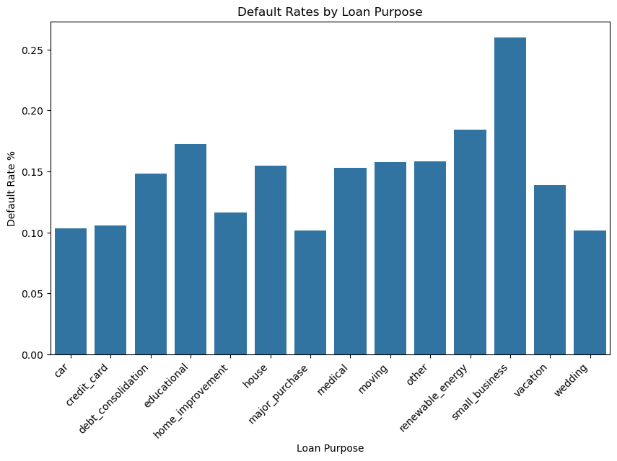
Default rates based on loan purpose
Loans taken for small_business carries higher risk
Of defaulting.

Slide 8
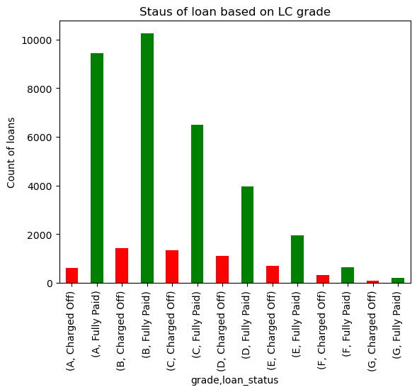
Default rates based on LC assigned grades
From the graph ratio Grade A has low chance of default compared to other higher grades. Risk of default increases towards G.

Slide 9
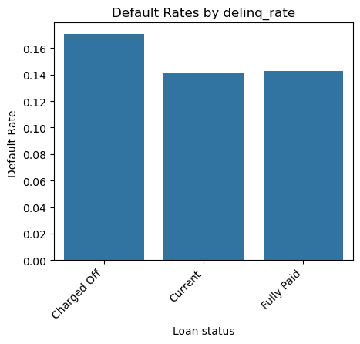
Default rates based on delinq_2yrs
Higher defaults seen for higher delinq_2 years

Slide 10
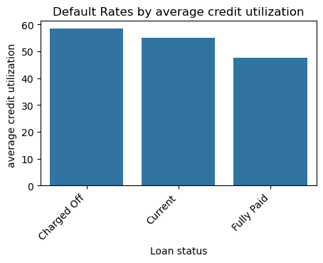
Default rates based on credit utilization
Higher defaults seen for higher average credit utilization %
Parameter : revol_uti
0 Charged Off 58.40
1 Current 54.95
2 Fully Paid 47.60

Slide 11
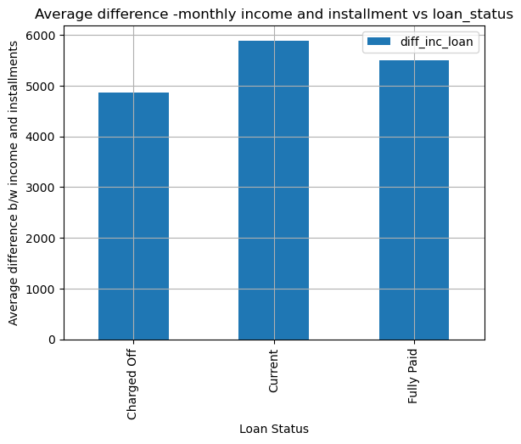
Loan status vs monthly income-instalment difference
Defaulters have average monthly income and instalment difference lesser than fully paid category by 800$

Slide 12
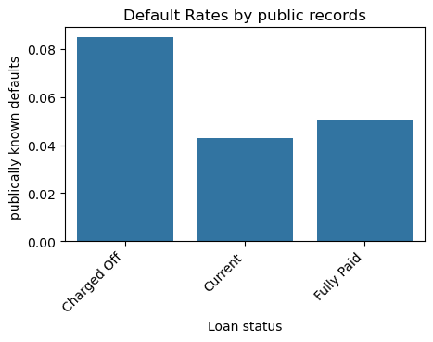
Defaults based on public records

Slide 13
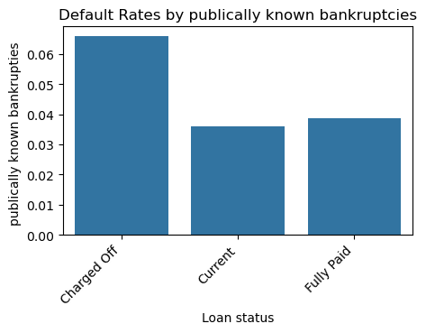
Defaults based on publicly known bankruptcies

Slide 14
Summary
Parameters influencing the Charge off situation
Grade
Loan purpose
Credit utilization
Delequncy_2yr
Publicly known bankruptcies

