Slide 1
users
File created on: 10-11-2023 11.37.26 PM

Slide 2
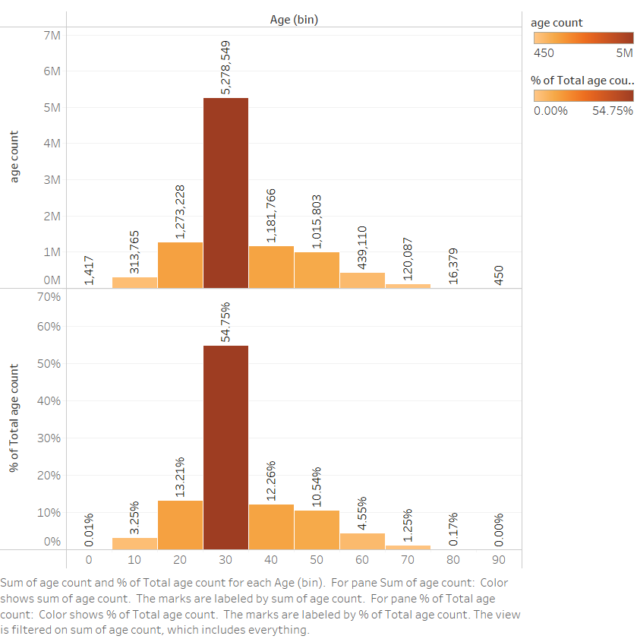

Slide 3
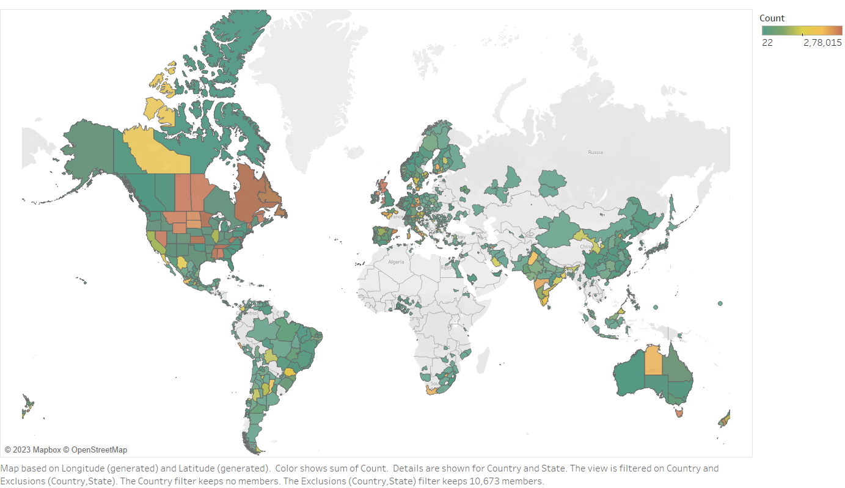

Slide 4
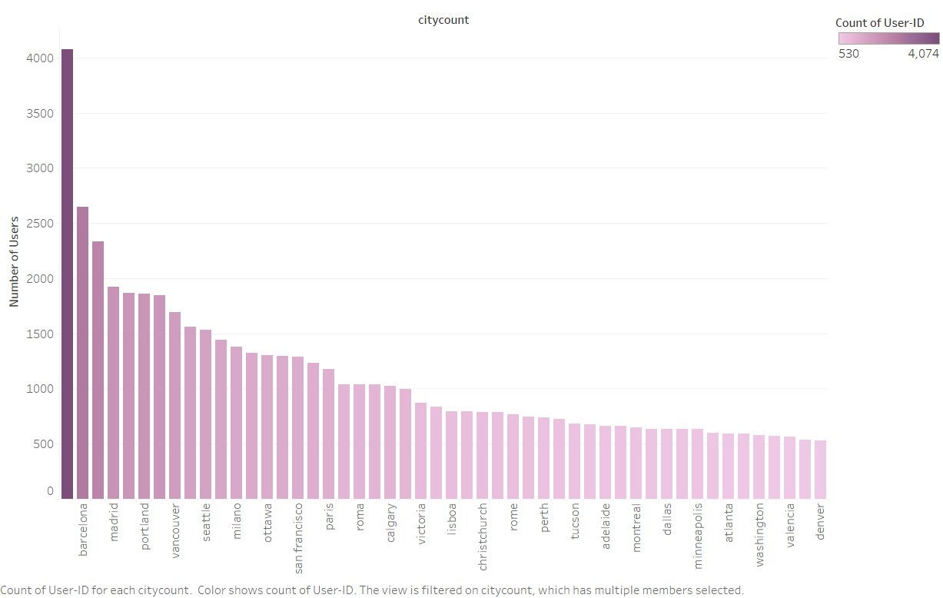

Slide 5
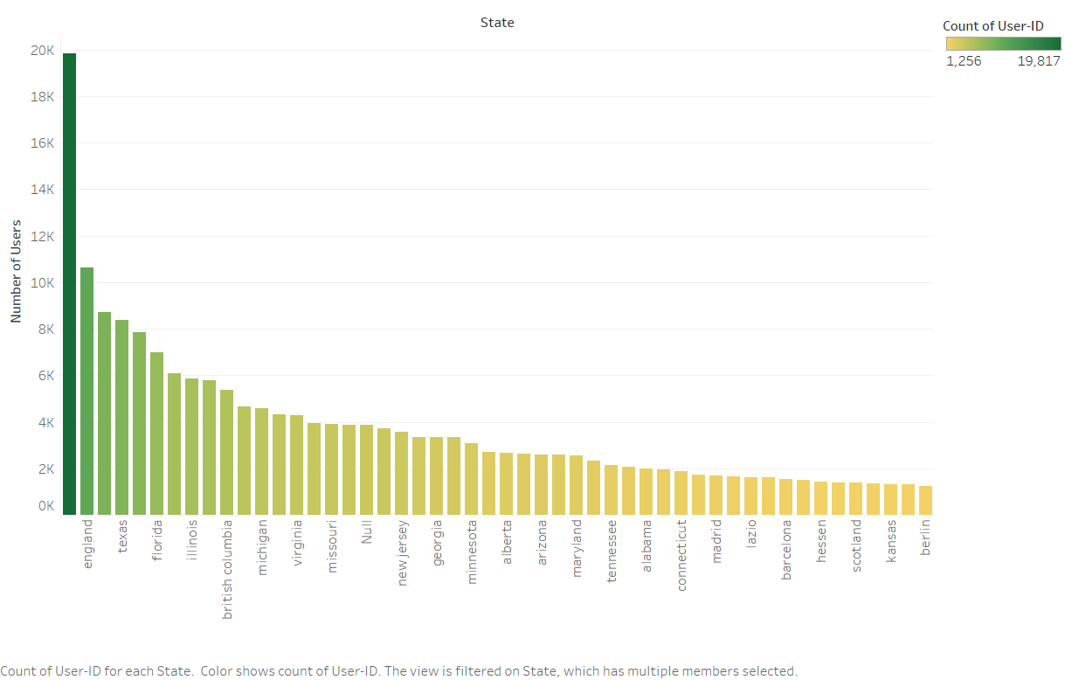

Slide 6


Slide 7
