Slide 1
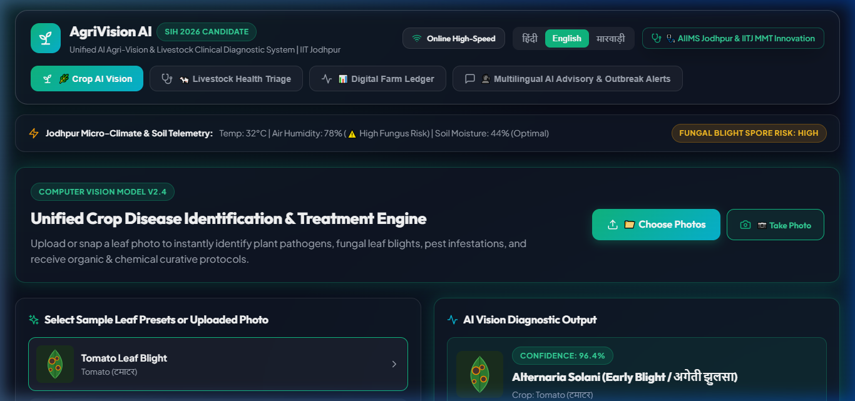
SLIDE 1 | PRODUCTION PLATFORM DEPLOYED
AgriVision AI (Production Platform)
Unified AI Agri-Vision & Veterinary Clinical Diagnostic System
✔ Smart India Hackathon 2026 Candidate - IIT Jodhpur
✔ Team Name: NeoMedtech | Problem Statement 1: Software Domain
✔ Team Lead: MAHESHIV PRAJAPAT (Asst Nursing Superintendent, AIIMS Jodhpur & MMT Scholar, IIT Jodhpur)
✔ Live Product Status: Fully Deployed Working Product on Vercel & GitHub
Team NeoMedtech • AgriVision AI • SIH 2026 Internal Hackathon • IIT Jodhpur & AIIMS Jodhpur

Slide 2
SLIDE 2 | PROBLEM & RURAL IMPACT
The Rural Challenge: Fragmented Care & Loss
Why 120M+ Indian Farmers Suffer Severe Annual Losses
✔ Separated Systems: Farmers rely on fragmented crop tools with ZERO digital diagnostic systems for livestock.
✔ Acute Specialist Deficit: Severe shortage of rural agronomists & vets (1 veterinarian per 15,000+ livestock in India).
✔ Catastrophic Shocks: Lumpy Skin Disease & fungal crop blights devastate family incomes within 48 hours.
Team NeoMedtech • AgriVision AI • SIH 2026 Internal Hackathon • IIT Jodhpur & AIIMS Jodhpur

Slide 3
SLIDE 3 | CORE INNOVATION & ARCHITECTURE
The Solution: Unified Dual-Domain AI Architecture
Single Digital Gateway for Crop Pathology + Livestock Clinical Triage
✔ Integrated Doorway: Crop disease detection AND livestock health triage in ONE intuitive interface.
✔ AIIMS Clinical Triage Protocol: Adapting medical emergency triage scoring to animal epidemiology.
✔ Hybrid AI Engine: Real-time Multimodal Neural Vision AI + Offline Rural Field Fallback.
Team NeoMedtech • AgriVision AI • SIH 2026 Internal Hackathon • IIT Jodhpur & AIIMS Jodhpur

Slide 4
SLIDE 4 | CROP AI PATHOLOGY ENGINE
Live Crop Pathology & ICAR Dosage Calculator
Multi-Image Selection, Live Camera Stream & AI Heatmap Overlay
✔ Multi-Angle Photo Inspection: Upload up to 5 leaf photos or capture live stream via Mobile/Webcam.
✔ AI Pathology Heatmap: Visual bounding overlay pinpointing exact leaf lesions and fungal spores.
✔ ICAR Dosage Calculator: Computes exact chemical spray grams/liters & tank refills based on land area.
Team NeoMedtech • AgriVision AI • SIH 2026 Internal Hackathon • IIT Jodhpur & AIIMS Jodhpur

Slide 5
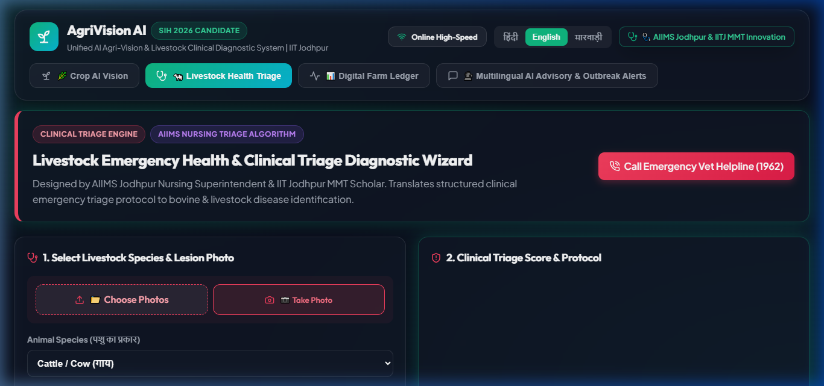
SLIDE 5 | LIVESTOCK TRIAGE & DIGITAL LEDGER
Livestock Emergency Health Triage & Ledger
AIIMS Nursing Triage Protocol + 1-Click Sync to Digital Herd Ledger
✔ Animal Lesion & Symptom Triage: Evaluates cattle, cow, buffalo, goat, & poultry for FMD, Lumpy Skin, & Mastitis.
✔ Emergency Action & Vet SOS: Displays Tier-1 emergency steps & direct call button for 1962 Helpline.
✔ 1-Click Digital Ledger Sync: Automatically logs diagnoses and treatments into Farm & Herd Ledger.
Team NeoMedtech • AgriVision AI • SIH 2026 Internal Hackathon • IIT Jodhpur & AIIMS Jodhpur

Slide 6
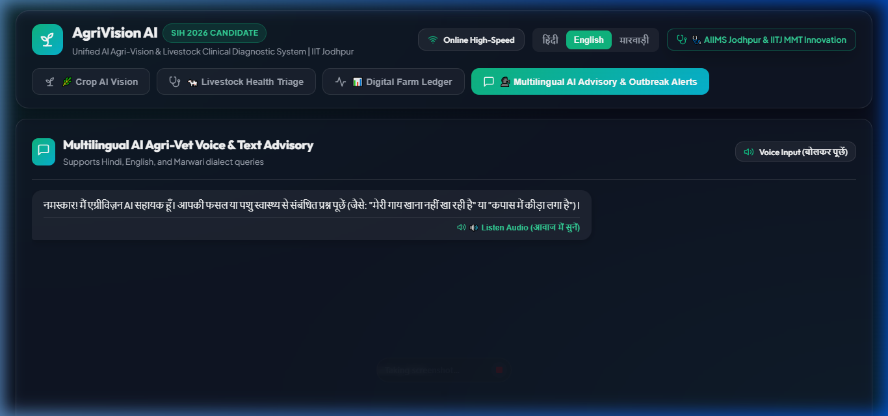
SLIDE 6 | ACCESSIBILITY & VOICE AI
Multilingual Audio Doctor & Conversational AI
Natural Voice Assistance in Hindi, English, and Marwari
✔ Conversational Text-To-Speech: Reads out treatment protocols in natural Hindi, English, & Marwari.
✔ Smart Intent Chatbot: Responds intelligently to Hinglish queries ('meri gaay chara nahi kha rahi he', 'chhale/laar').
✔ A4 PDF Official Certificate: Generates downloadable single-page official diagnostic reports with seal.
Team NeoMedtech • AgriVision AI • SIH 2026 Internal Hackathon • IIT Jodhpur & AIIMS Jodhpur

Slide 7
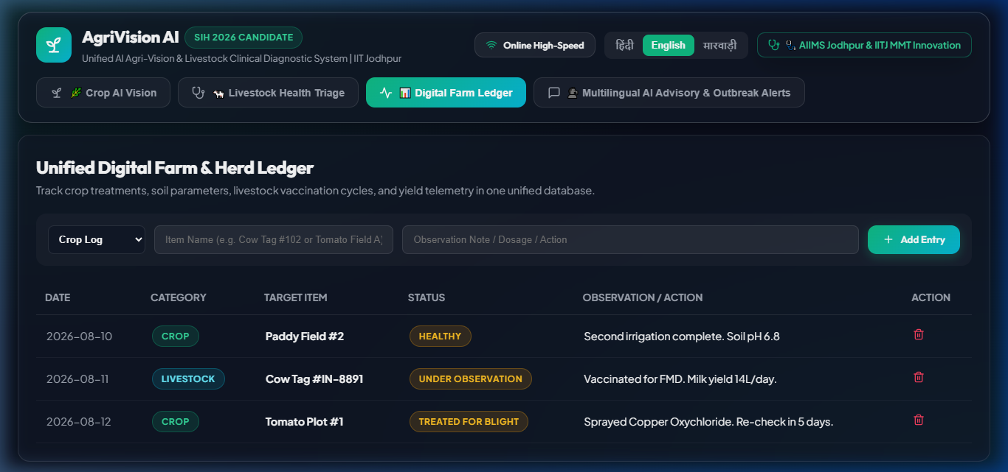
SLIDE 7 | TEAM NEOMEDTECH & CLINICAL RIGOR
Team NeoMedtech: Interdisciplinary Excellence
IIT Jodhpur MMT Scholars & AIIMS Clinical Expertise
✔ MAHESHIV PRAJAPAT (Team Lead): Asst Nursing Superintendent (AIIMS Jodhpur) - Clinical Triage Protocols.
✔ Dr. Eshitaa Panwar (BDS): Clinical Dental & Health Strategy Lead.
✔ SIDDHANT SHENVI (B.Tech): Software Engineering & AI Pipeline Lead.
✔ Mrunal Sonawale (B.Pharma): Pharmacological Remedial & Dosage Protocol Specialist.
✔ KISHORE VIJAYAKUMAR (MedTech): Hardware & Edge Sensor Integration Lead.
✔ MEGHA (Design): Rural User Experience & Visual Communication Lead.
Team NeoMedtech • AgriVision AI • SIH 2026 Internal Hackathon • IIT Jodhpur & AIIMS Jodhpur

Slide 8
SLIDE 8 | EPIDEMIC SURVEILLANCE
GIS Outbreak Radar & KVK Early Warning Network
Epidemic Surveillance & Proactive Outbreak Containment
✔ District Outbreak Heatmap: Real-time telemetry tracking pest/pathogen cases across Western Rajasthan.
✔ Proactive Radius Alerts: Sends SMS/Voice alerts when Lumpy Skin or Fungal Blight is detected within 15 km.
✔ Prevents Local Spikes: Enables KVKs and animal husbandry departments to halt regional epidemics early.
Team NeoMedtech • AgriVision AI • SIH 2026 Internal Hackathon • IIT Jodhpur & AIIMS Jodhpur

Slide 9
SLIDE 9 | PRODUCTION STACK & DEPLOYMENT
Live Production Stack & Deployment Model
Fully Built, Tested & Deployed Today
✔ Production Stack: React 18, Vite, Vanilla CSS, Lucide Icons, Canvas API, WebRTC MediaDevices.
✔ AI Services: Multimodal Neural Vision Model API + Local Edge Diagnostics Engine.
✔ Live Deployment: Hosted live on Vercel with automatic GitHub CI/CD integration.
Team NeoMedtech • AgriVision AI • SIH 2026 Internal Hackathon • IIT Jodhpur & AIIMS Jodhpur

Slide 10
SLIDE 10 | CONCLUSION & Q&A
Summary & Call to Action
Ready for SIH 2026 Internal Hackathon Evaluation
✔ 100% Mandate Fulfilled: Crop AI, Livestock Triage, Farm Records, Advisory Services, & Outbreak Radar in one app.
✔ Fully Functional Live Product: Tested with real crop leaves, cattle lesion photos, and multi-lingual voice audio.
✔ Thank You! Team NeoMedtech (IIT Jodhpur) is Ready for Evaluator Q&A & Live Demonstration.
Team NeoMedtech • AgriVision AI • SIH 2026 Internal Hackathon • IIT Jodhpur & AIIMS Jodhpur

