Slide 1
Wells Fargo Technology Hackathon 2022
Seagulls
- sky is the limit
Increasing our Diverse Customer Reach – Leveraging Innovative Technologies to Identify Growth Opportunities
Seª_{g}ullsV22
Trivia – each letter used in SeagullsV22 is written using different font, font size, style and font color ☺
revere - respect diversity in color, strength, ability and origin

Slide 2



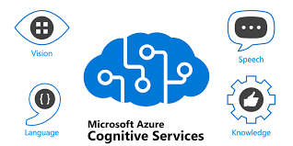







revere - Diversified Technology Stack
Public Cloud

Slide 3






revere - Architecture
Publicly Available Govt owned Dataset
Assumptions
Data sourced from Govt or Govt authorized Entities are accurate
NMSDC, NGLCC, WBENC issued certificates are reliable
Data fetched from DnB is authentic
Diversity Crawler
Dashboard
upload file
7
1
read file
2
3
4
5
Blob Storage
search for business in local data store
search for business in DnB
search for certificates in the web
file upload event
poll for master
data files
Seagulls Storage API
Seagulls DnB Adapter
Seagulls Web Search API
Seagulls Scan API
Seagulls Media API
Azure Event Hub
poll for raw
data files
6
Seagulls NLP API
store processed information
SerpApi
Azure Computer Vision
Azure
SQL Server

Slide 4
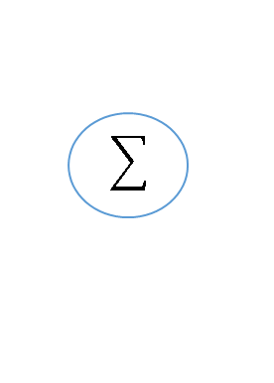
NLP Based Diversity Model Diagram
Scrapper module
Azure Blob
Search engine
Data
Storage
Web search
Text Wrangling
Scrapper
Parse
& Extract
Azure
Web app service
Client
Fast
API
NLP
Knowledge
Base
Similarity Matrix
Graph DB
Tokenization
Ranking
Vectorization
Information Retrieval
NER/ML Model
Similarity Score

Slide 5
Web Search
Example:
Company Name: The Natori Company
Result Found: 83 webpages
Sample Result:
https://rocketreach.co/the-natori-company-management_b5c23f1df42e0e84
https://www.crunchbase.com/organization/natori
https://rocketreach.co/the-natori-company-profile_b5c23f1df42e0e84
https://www.datanyze.com/companies/the-natori-company/26870048
https://www.natori.com/
https://en.wikipedia.org/wiki/The_Natori_Company
https://www.natori.com/world-of-natori/biography/
https://www.zoominfo.com/c/the-natori-company/26870048
https://www.linkedin.com/company/the-natori-company
https://en.wikipedia.org/wiki/Josie_Natori
https://rocketreach.co/ken-natori-email_18823547
Sub Search tags:
about us
company profile
leadership team
holding patterns
diversity
diverse certificate
management
chief executive officer
chief operating officer
chief financial office
president
director
chairman

Slide 6
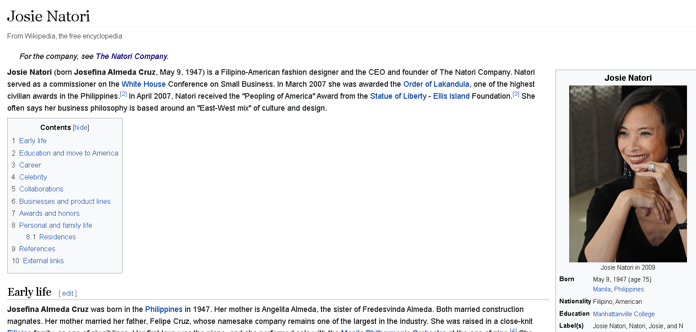
Web Scrapping
Content Extraction (unstructured text):
Josie Natori From Wikipedia, the free encyclopedia Jump to navigation Jump to search Filipino-American fashion designer For the company, see The Natori Company . Josie Natori Josie Natori in 2009 Born ( 1947-05-09 ) May 9, 1947 (age\u00a075) Manila , Philippines Nationality Filipino, American Education Manhattanville College Label(s) Josie Natori, Natori, Josie, and N Natori Awards Order of Lakandula ; Peopling of America, 2007; commissioner on the White House Conference on Small Business. Josie Natori (born Josefina Almeda Cruz , May 9, 1947) is a Filipino-American fashion designer and the CEO and founder of The Natori Company. Natori served as a commissioner on the White House Conference on Small Business. In March 2007 she was awarded the Order of Lakandula , one of the highest civilian awards in the Philippines. [2] In April 2007, Natori received the \"Peopling of America\" Award from the Statue of Liberty - Ellis Island Foundation. [3] She often says her business philosophy is based around an \"East-West mix\" of culture and design. .
Example URL: https://en.wikipedia.org/wiki/Josie_Natori

Slide 7
Information Retrieval
From
Unstructured Text
Approaches:
Entity extraction
Parts of Speech(POS) tagging
Relationship Extraction

Slide 8
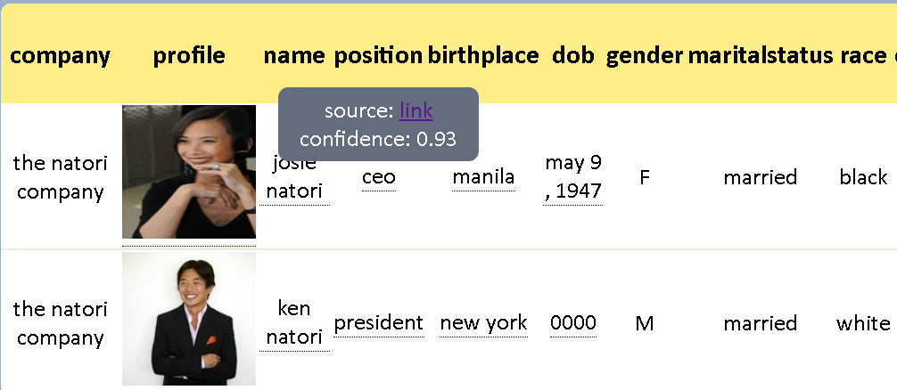
NLP - Output
Source Hyperlink: https://en.wikipedia.org/wiki/Josie_Natori

Slide 9
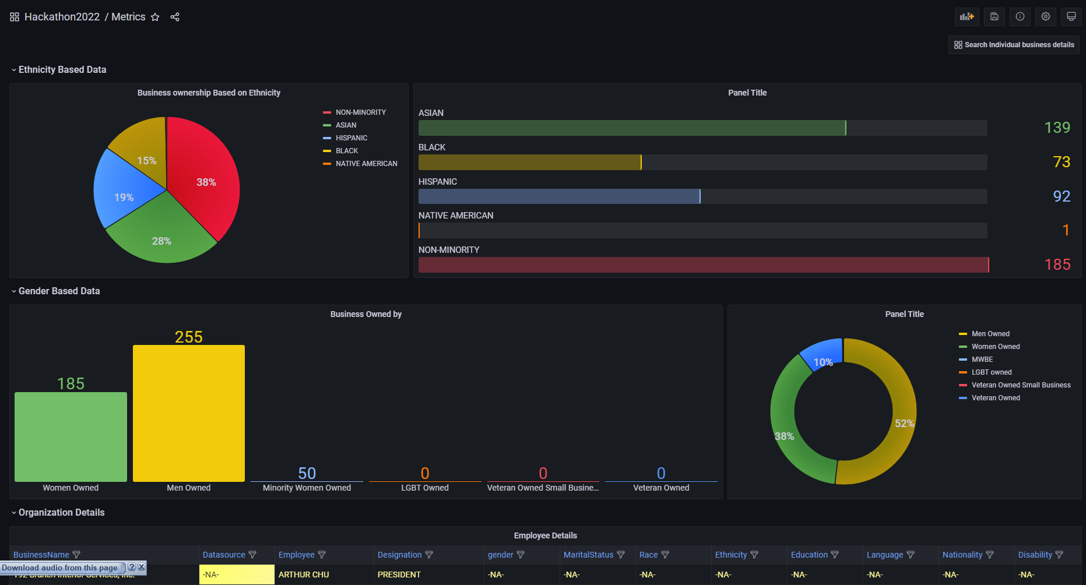
Diversity Dashboard

Slide 10
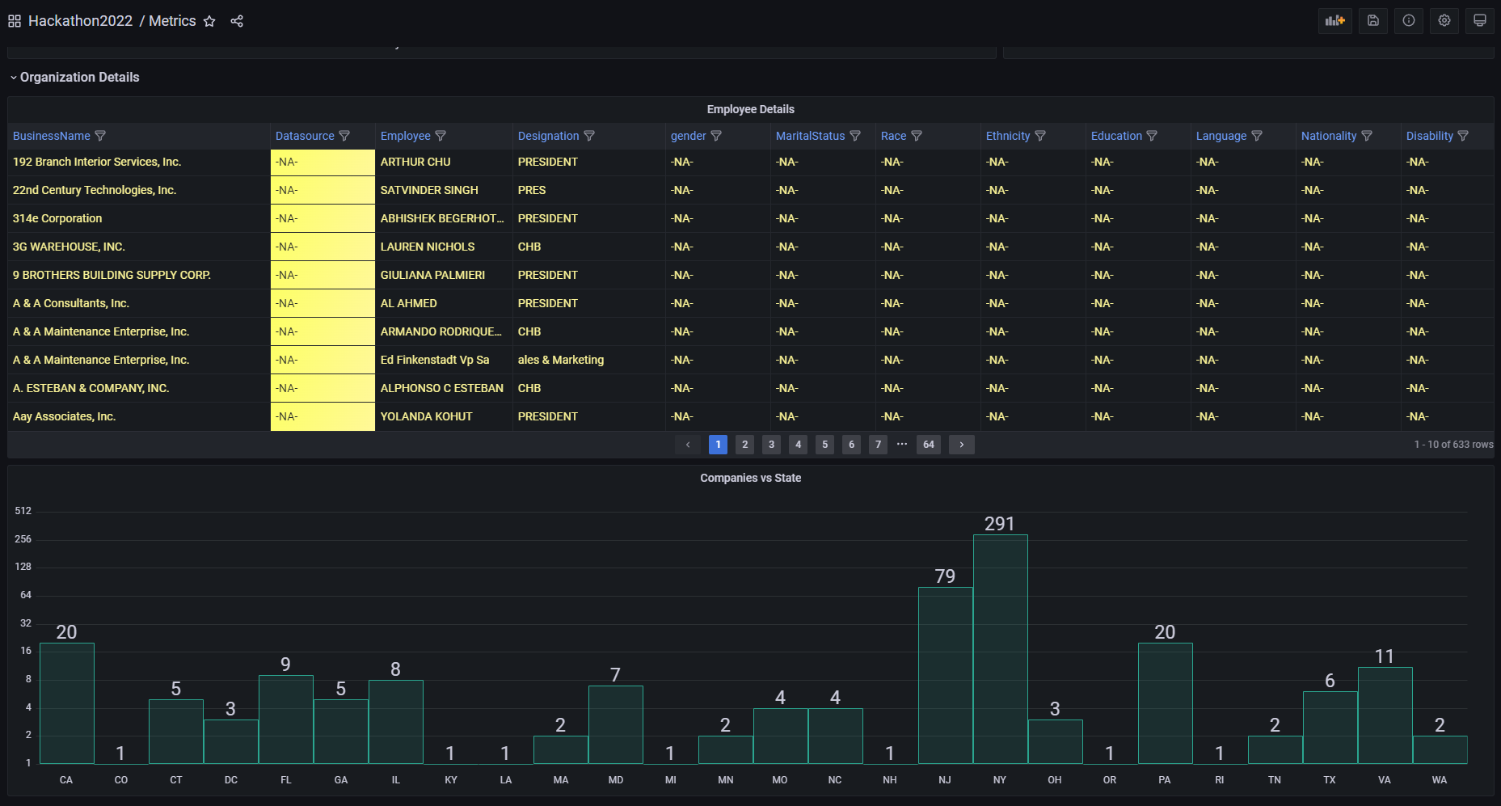
Diversity Dashboard (continued)

Slide 11
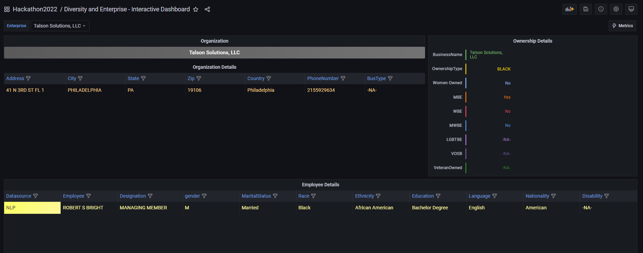
Business level diversity data

Slide 12
“revere” – Closing comments
Highlights
Solution continuum
Frugal architecture – do more with less
Visualization
Novelty or patentable idea
Knowledge base of diversity information as a data union
Feedback cycle to maintain data accuracy & periodic data refresh
Crowdsource less authentic and less accurate data to determine authenticity using distributed ledger
Expose diversity information to public
Engage, Collaborate and be transparent
Future scope
Adaptive UI to initiate search and view workflow observability
Analyze audio and video content to extract diversity dimensions
Orchestrate and integrate all components as a search pipeline

Slide 13
“revere” summary
Deliver a comprehensive digital solution to extract, process, curate and offer diversity dimensions of businesses
Top 5 (business perspective)
Analysis of publicly available data offered by Govt / Govt authorized entities
Comprehensive search for business information in the public domain
Optical Character Recognition to get text from images
Analyze data and derive diversity insights
Report of diversity dimensions of the business across factors such as women or minority ownership, ethnicity, Veterans & LTBT.
Top 5 (technical implementation)
APIs to extract and store authentic datasets
Web crawler to search for Company data in the internet including LinkedIn
Computer Vision to process and extract text from images
Natural Language Processing (NLP) to clean and analyze information to derive diversity data points
Dashboard to display diversity dimension and insights
Solution alignment to Technology 6S Strategy
Secure
Azure Cloud Resource groups, IAM and RBAC
Stable
Resiliency of services are achieved by HA
Scalable
Services can be auto scaled on Cloud on demand
Skill
Team learnt and used Managed Services in Azure
Speed
Agile practices, single responsibility
Success
Solution caters to all asks of problem

Slide 14
Solution continuum
high
solution continuum of services
low
authenticity of data, confidence level of assessment
Data from Govt / Govt authorized sources
OCR of Diversity Certificates
Social media – profile and other info
Web search and analysis

Slide 15
User Stories
Users Business Leader, Commercial Banker, DE&I Leader, Marketing Leader, Digital Product Owner
I would like to identify diversity dimensions of ownership and / or leadership of commercial customers and / or prospects
I would like to know if a given business entity is diverse or women owned
I would like to have a tool that could provide me diversity dimensions of a prospect within few seconds
I would like to have a Dashboard that could provide me diversity and ethnicity information of prospects / customers
I would like to gather MBE, WBE, LGBTBE, VOSB data from authentic Govt owned or Govt authorized entities regularly
I would like to build a product that could search the web for details of a company real time or near real time; the information could be text, images or reports
I would like to build a product that could analyze text, images and other data in the web to indicate diverse owned / led business

Slide 16
Services
Service | Purpose | How it works? | Technology
Diversity Crawler | The core Orchestrator. This is the entry point for client requests. | This drives the execution of other services to identify diverse dimensions for given input | Spring Boot application
Storage API | Performs all data management operations on the company profile | API that executes CRUD operations on company entity. Access to the Company entity and all its diversity dimension data is managed by this Service | Azure Functions .Net Core component Azure SQL Server
DnB Adapter | Connects to DnB API | Searches information about a given company in DnB registry via the API | Spring Boot application
Web Search API | Searches for information such as text, images or documents in the web | Gathers information from the web for a given query and stores the information as blobs | SerpAPI Azure blobstore
Social Media API | Searches for information in social media sites such as LinkedIn and Twitter | Gathers information from the LinkedIn and Twitter for a given query and stores the information as blobs | LinkedIn API Azure blobstore Selenium Web driver
Scan API | Extracts text from an image and provides diversity certification data | Performs OCR on given set of images to identify if a given business is certified from WBENC, NMSDC, NGLC etc. | Azure Computer Vision
NLP API | Analyses text information collated from web to identify diversity dimension | Executes ML on the text data | Python ML libraries Beautiful Soup Selenium Web driver, NLTK
Reports | Dashboard to display diversity insights | Extracts data from the company profile data store and displays the data in various perspectives | Grafana

Slide 17
Sequence Diagram
API Client
Diversity Crawler
Seagulls Storage API
Seagulls DnB Adapter
Seagulls Web Search API
Seagulls Scan API
Seagulls LinkedIn API
Seagulls NLP API
search in master data
data found
search in DnB
data found
search in the web for text, certificate images
OCR images for certification data
data found
search in LinkedIn; store content in blob store
Run NLP on content in blobstore
data found
return response

Slide 18
Publicly available Datasets
List of few datasets published by few States in United States of America are identified.
These data were loaded into our data base and considered as master data.
Source | URL
Virginia State Small Business Supplier Diversity (SBSD) | https://www.sbsd.virginia.gov/directory/
Maryland – Department of Transportation (MDOT) | https://www.mdot.maryland.gov/tso/pages/index.aspx?pageid=90
California - Caltrans | https://dot.ca.gov/programs/civil-rights/dbe-search https://ucp.dot.ca.gov/licenseForm.htm
New York – Data catalog M/WBE, LBE and EBE certified business list | https://catalog.data.gov/dataset/m-wbe-lbe-and-ebe-certified-business-list

