Slide 1
Time Series Forecasting ATM Cash in Transit
Yasar Arafath

Slide 2

What we forecast?
ATM/BTM/CRS cash demand using historical data and using the various machine & resource constraints to plan the cash replenishment trips.
Method Used:
Aggregate to day level
Identify Changepoints
Fit trends for different changepoints
Identify Holiday Performance Pattern (Yet to be implemented)
Outlier Adjustment (Yet to be implemented)
Decompose Seasonality for multiple levels
Find Randomness
Identify Randomness Pattern (Yet to be implemented)
Combine the components to obtain fitted values
Cash in Transit

Slide 3
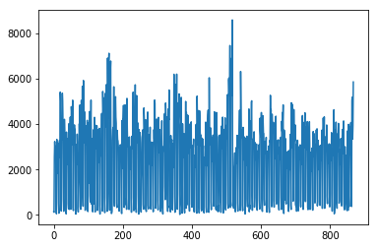
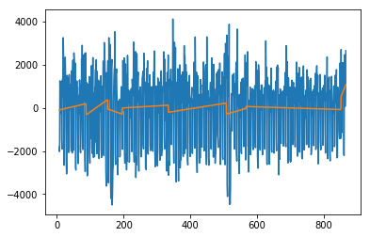
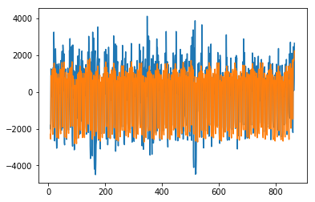
Components of Series
ATM – Day-wise Cash Demand
Fitted Trend vs Demand
Fitted Values vs Demand

Slide 4
Performance of Model

Slide 5
Predicting for the dataset: ATM_8959_ALL.csv
Week 1:
Start date = 2013-11-01
Split date = 2016-11-01
End date = 2016-11-07
Train Error = 17.88%
Test Error = 24.13%
Week 2:
Start date = 2013-11-08
Split date = 2016-11-08
End date = 2016-11-14
Train Error = 21.35%
Test Error = 9.97%
Week 3:
Start date = 2013-11-15
Split date = 2016-11-15
End date = 2016-11-21
Train Error = 21.4%
Test Error = 14.4%
Week 4:
Start date = 2013-11-22
Split date = 2016-11-22
End date = 2016-11-28
Train Error = 19.3%
Test Error = 10.4%

Slide 6
Predicting for the dataset: ATM_5384_ALL.csv
Week 1:
Start date = 2013-11-01
Split date = 2016-11-01
End date = 2016-11-07
Train Error = 38.8%
Test Error = 36.14%
Week 2:
Start date = 2013-11-08
Split date = 2016-11-08
End date = 2016-11-14
Train Error = 36.5%
Test Error = 12.4%
Week 3:
Start date = 2013-11-15
Split date = 2016-11-15
End date = 2016-11-21
Train Error = 43.2%
Test Error = 10.8%
Week 4:
Start date = 2013-11-22
Split date = 2016-11-22
End date = 2016-11-28
Train Error = 45.0%
Test Error = 10.4%

Slide 7
Predicting for the dataset: ATM_8877_ALL.csv
Week 1:
Start date = 2013-11-01
Split date = 2016-11-01
End date = 2016-11-07
Train Error = 24.0%
Test Error = 22.1%
Week 2:
Start date = 2013-11-08
Split date = 2016-11-08
End date = 2016-11-14
Train Error = 20.11%
Test Error = 11.02%
Week 3:
Start date = 2013-11-15
Split date = 2016-11-15
End date = 2016-11-21
Train Error = 20.4%
Test Error = 9.15%
Week 4:
Start date = 2013-11-22
Split date = 2016-11-22
End date = 2016-11-28
Train Error = 23.6%
Test Error = 23.7%

