Slide 1
FINANCIAL MANAGEMENT SYSTEM
Presented By
Mahesh Karthik Duraisamy

Slide 2
INTRODUCTION
Financial Management involves planning for a person or an organization in order to achieve a positive cash flow.
Maintenance of Financial assets.
Identify and manage risks.

Slide 3
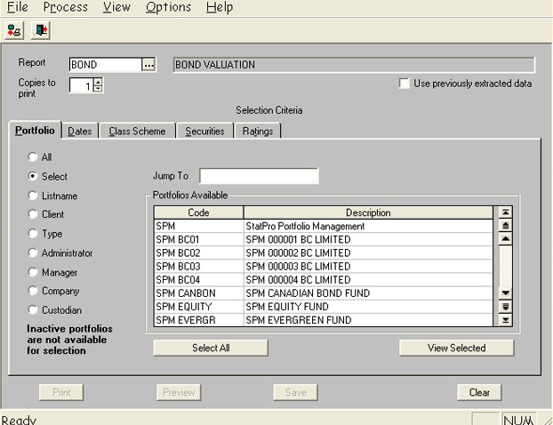
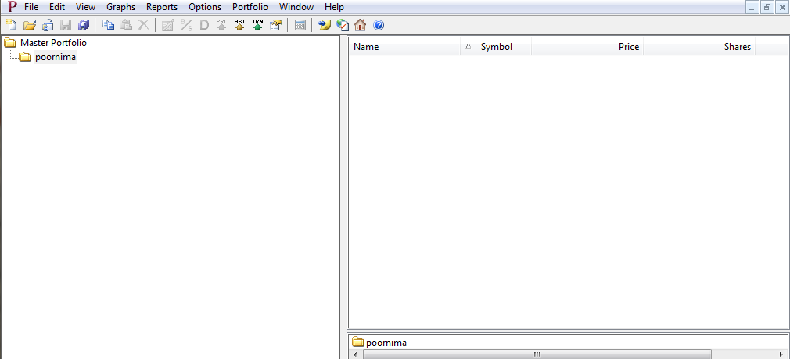
DRAWBACKS OF EXISTING SYSTEMS

Slide 4
PROJECT SCOPE
Improved usability of the software.
24/7 online customer support
Real Time Market Updates
Ability to manage investments in multiple countries
Email and text notifications
Data presentation in the form of graph & charts

Slide 5

PERSONA
Name | TS Parameshwaran
Background | Parameshwaran is based in Dubai and has few dollar based investments. He also invests in India and Dubai market. He tracks various investments in Indian Rupees, UAE Dirhams and US Dollars
Needs | He is looking for software that can help him track his credit card, debit card and loans too He requires software system that has ability to provide fast support at any given time and also can help in resolving any financial detail related requests He also needs a ticker in the software that provides real-time value of all shares pertaining to the market.

Slide 6
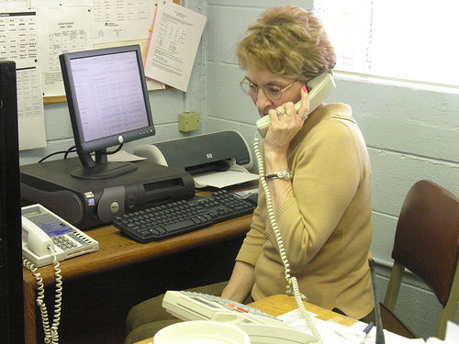
PERSONA
Name | Amy
Background | Amy is a 56 years old who retired two years ago after her 30 years of tenure with the USOC. She has saved up some money from the employment and she also has few other fund sources. She is neither that much acquainted with the computer and she has very basic knowledge of the share market.
Needs | Easy to use software rather than a software with a complicated user interface She needs to specify the upper and lower limit of the buying and selling of shares and she also wants to be notified if any of the share or stock reaches that specified limit. This will enable her to take care of her day to day work and involve in the market only when she is notified. She also needs a system which suggests her with the market trends rather that letting her play with the market

Slide 7
USER SCREENS

Slide 8
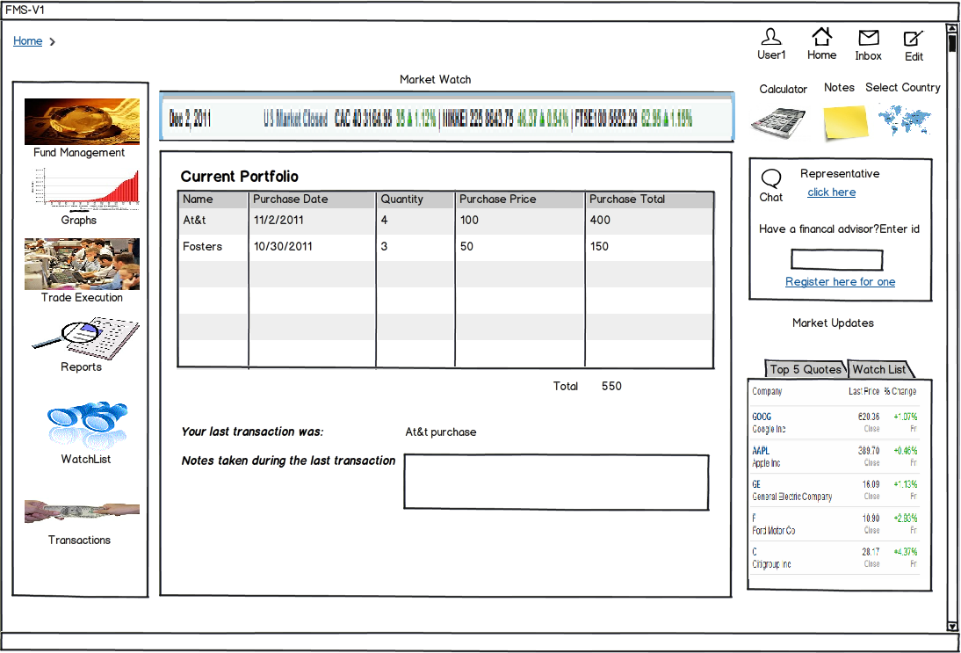

Slide 9
FUND MANAGEMENT MODULE
FUND STATUS
- Check the status of all the funds in the user account
User selects the fund status tab
A table containing the status of all the funds purchased by the investor is displayed.
Data is presented to the user in the form of graphs

Slide 10
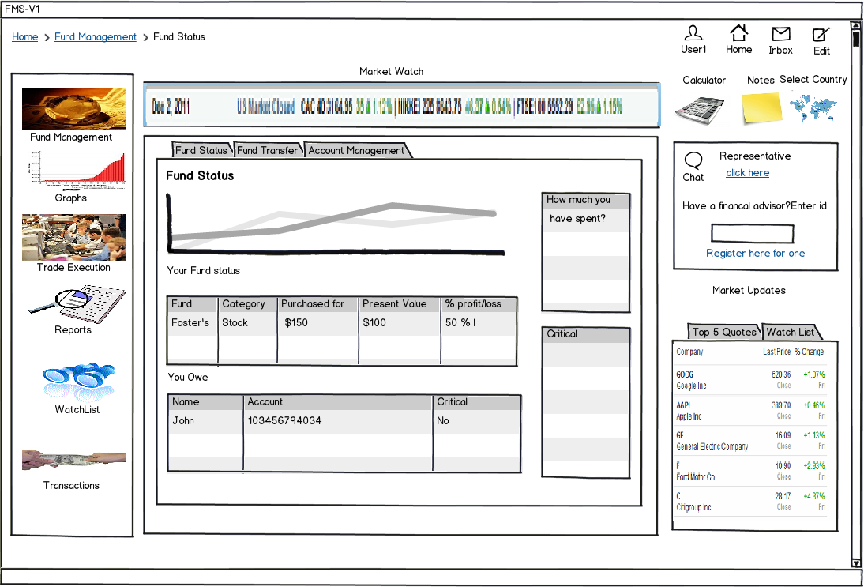

Slide 11
FUND MANAGEMENT MODULE
FUND TRANSFER
- Transfer funds to individuals/organizations
User selects the fund transfer tab.
User selects the recipient to transfer funds.
User enters his account details.
User is given the option to go back and do a different transfer

Slide 12
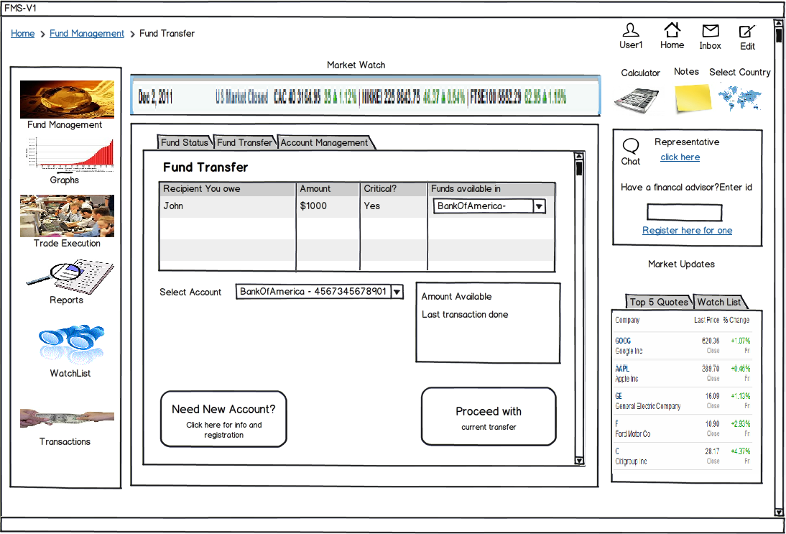

Slide 13
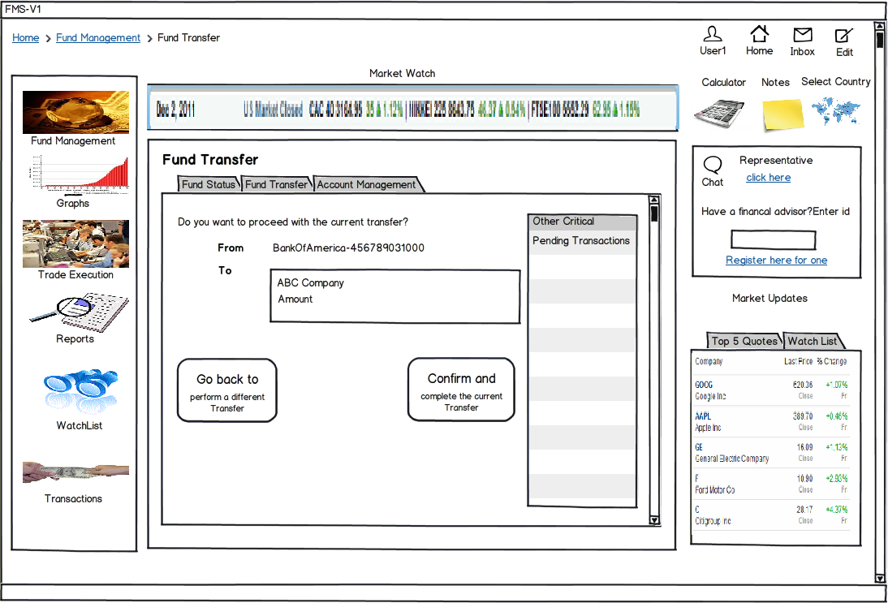

Slide 14
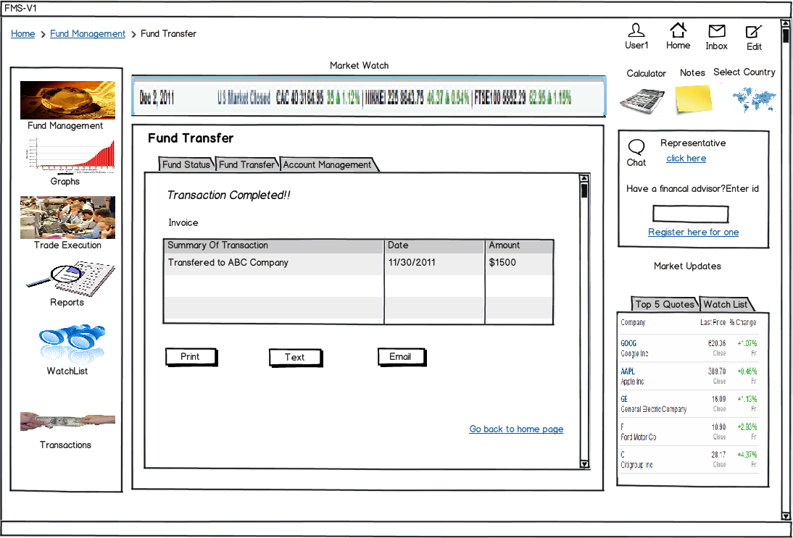

Slide 15
FUND MANAGEMENT MODULE
ACCOUNT MANAGEMENT
- Allows the user to manage the various bank accounts and view the account balances and transactions
The user clicks on the account management tab
A table displaying the details of all the last transactions is displayed
The user can transfer funds from one account to another
User is given the option to view information and details for opening new accounts

Slide 16
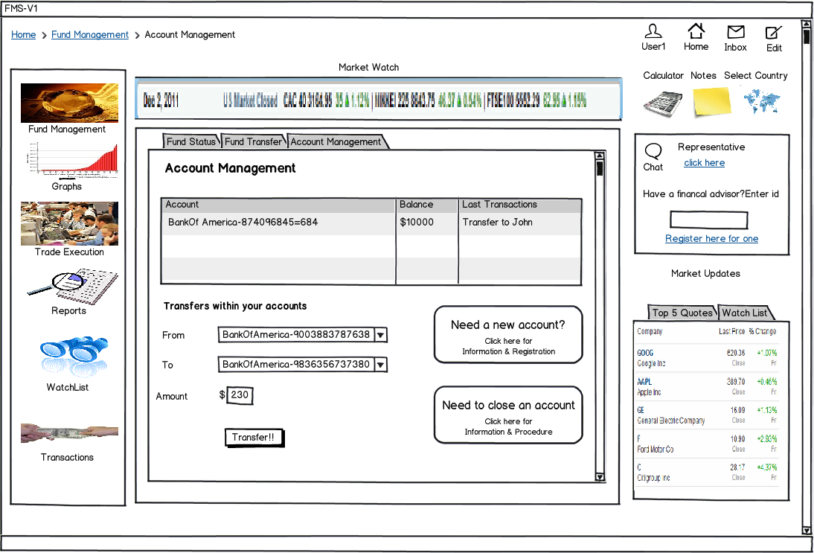

Slide 17
TRADE EXECUTION
Buying
- User can purchase different shares, stocks, bonds and other types of funds
The user clicks on the buying tab
The user selects the category and type of fund
A narrowed down list of funds are displayed in a table along with price and market size
User is given the option to go back and do a different purchase

Slide 18
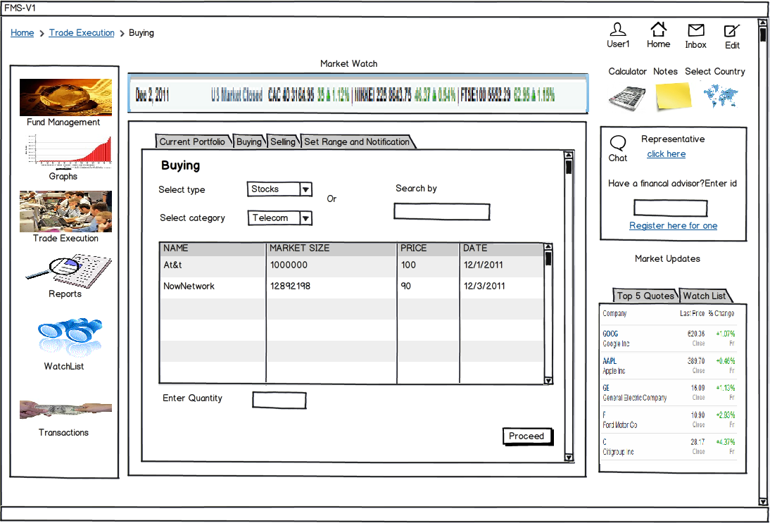

Slide 19
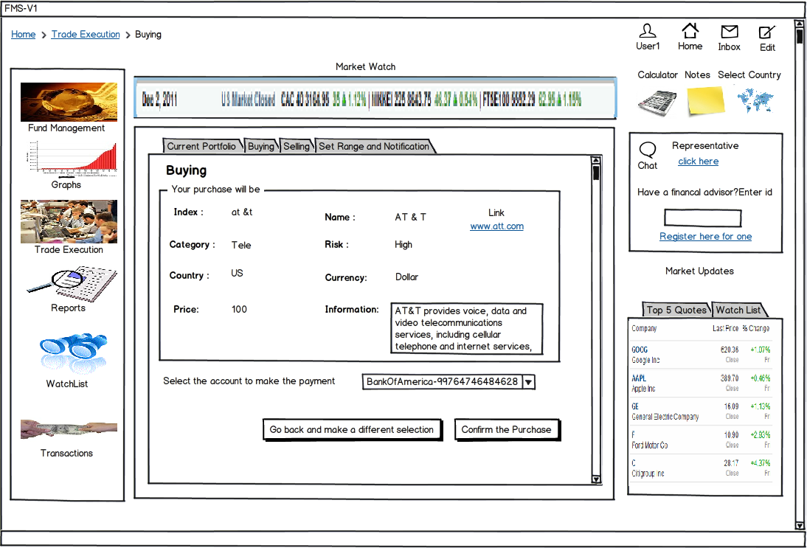

Slide 20
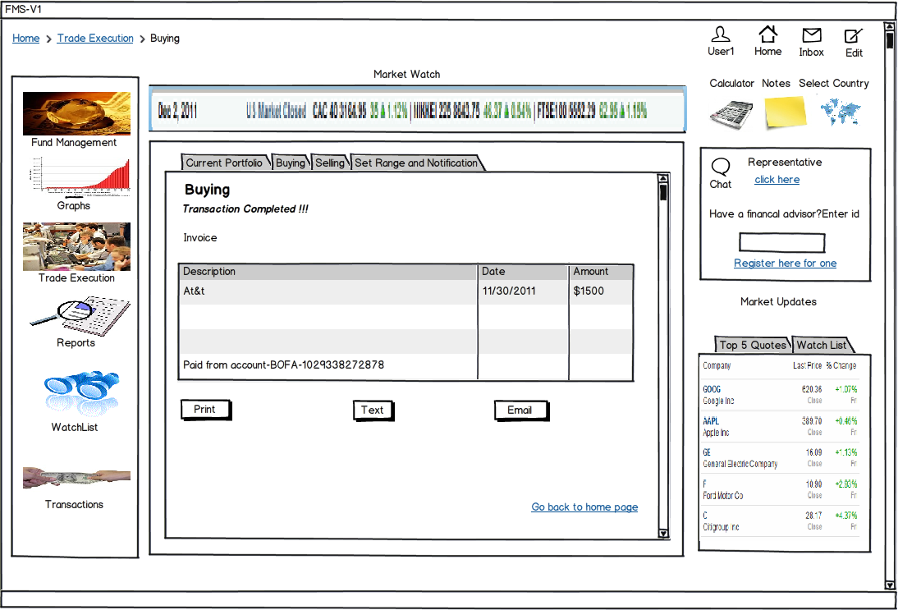

Slide 21
TRADE EXECUTION
Selling
- User can purchase different shares, stocks, bonds and other types of funds
The user clicks on the selling tab
The user can view the funds in his/her portfolio
He can choose one to sell
The user is given option to cancel the current transaction and select a new one

Slide 22
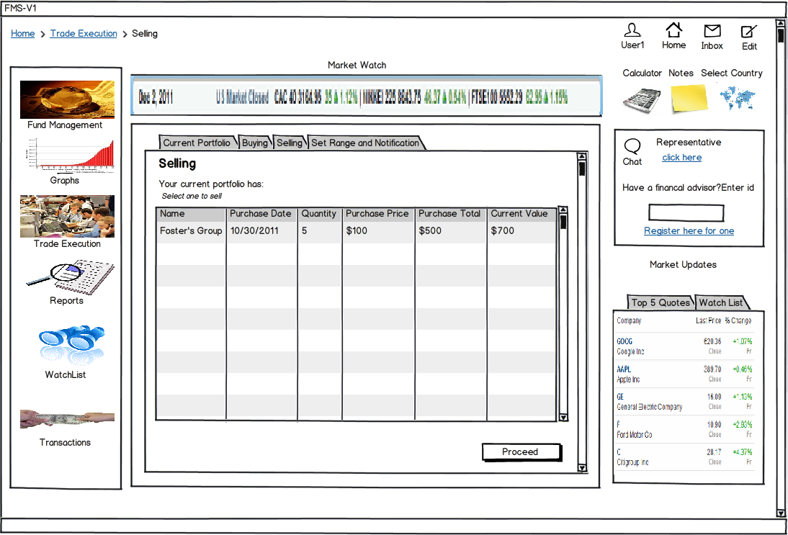

Slide 23
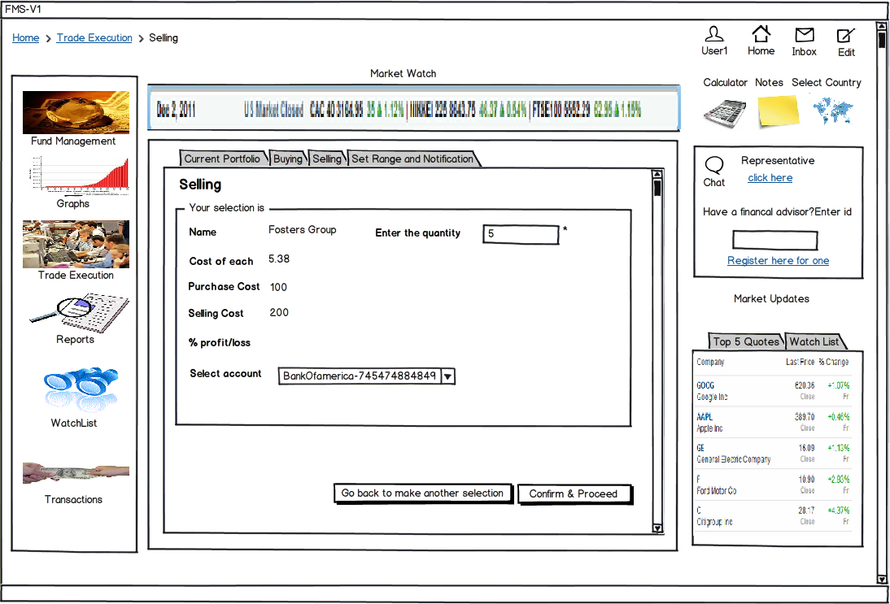

Slide 24
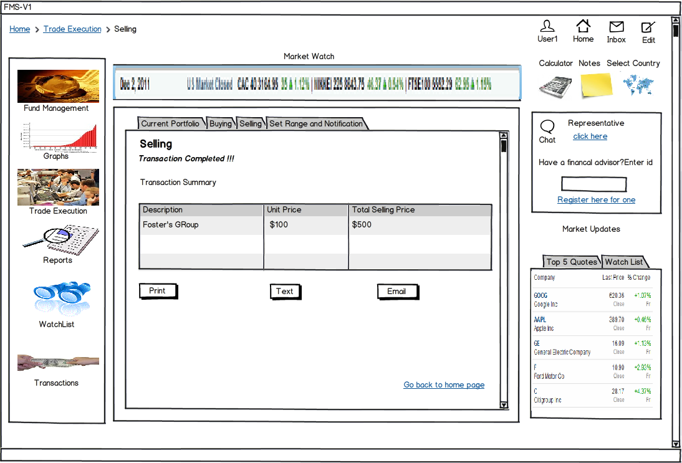

Slide 25
TRADE EXECUTION
Set Range and Notification
- Allows the user to be notified when the minimum/maximum market value for a particular fund is reached
The user selects the set range and notification tab
The user selects the category and type of fund
A narrowed down list of funds are displayed in a table
The user sets the minimum and maximum value and type of notification he/she wishes to receive

Slide 26
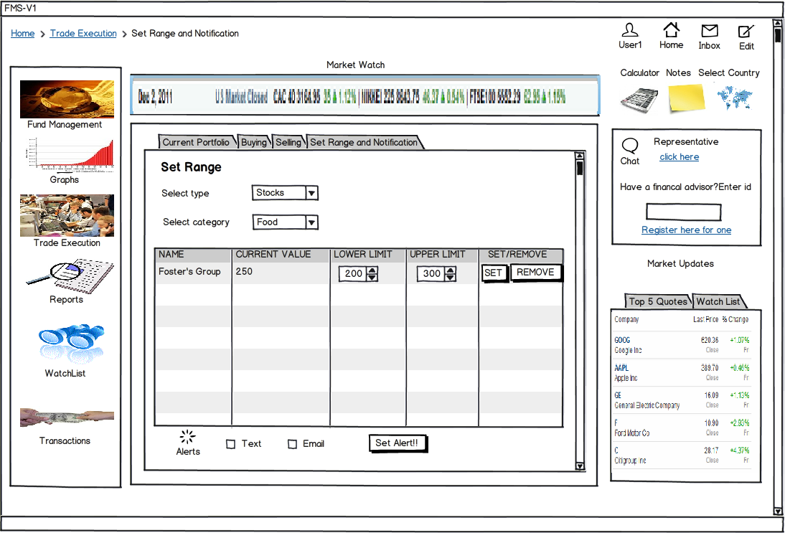

Slide 27
REPORT MANAGEMENT
Generate Statement
- The user can monthly statements
The user clicks on the Statements tab
The user selects the month for which he wishes to view the statement
The user is given the option of printing/emailing the statement

Slide 28
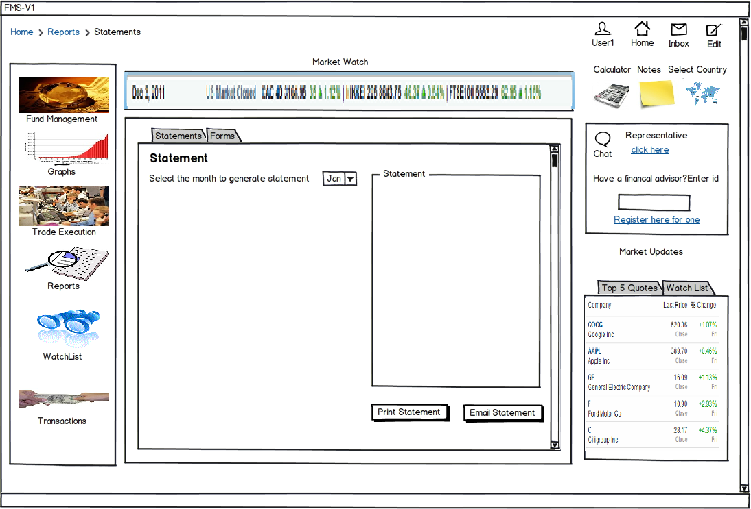

Slide 29
REPORT MANAGEMENT
Forms
- View different types of forms such as tax forms, print the forms
The user selects on the forms tab
The user selects the form which he/she wishes to view
The user is given the option of printing the form
The user is provided with a link to the web page containing more information about the form

Slide 30
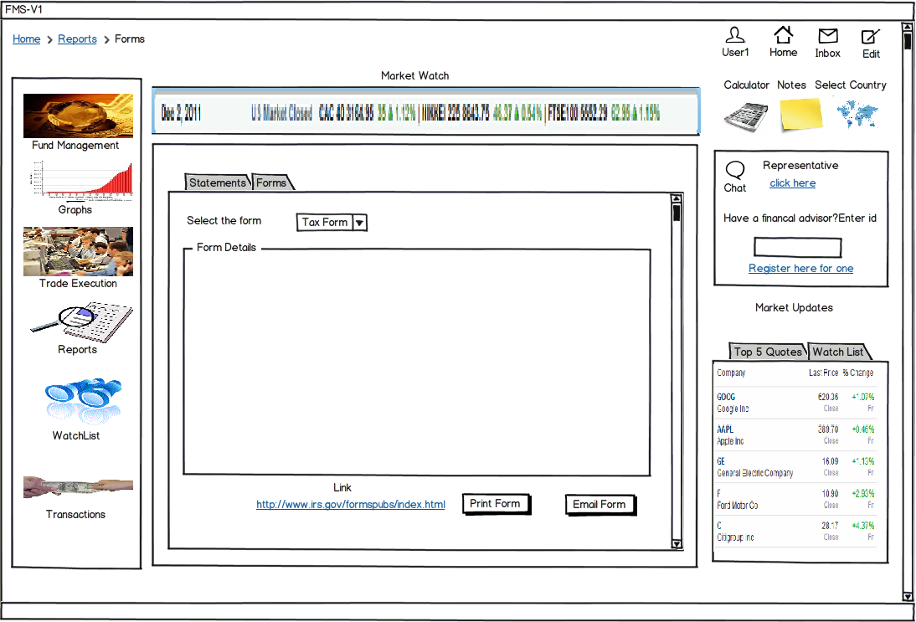

Slide 31
GRAPHS
Display graphs
- The prices of various funds over time is presented graphically to the user
The user clicks on the graph tab
The user selects the category and type of fund
A graph is displayed
The user can change the type of graph he/she wishes to view

Slide 32
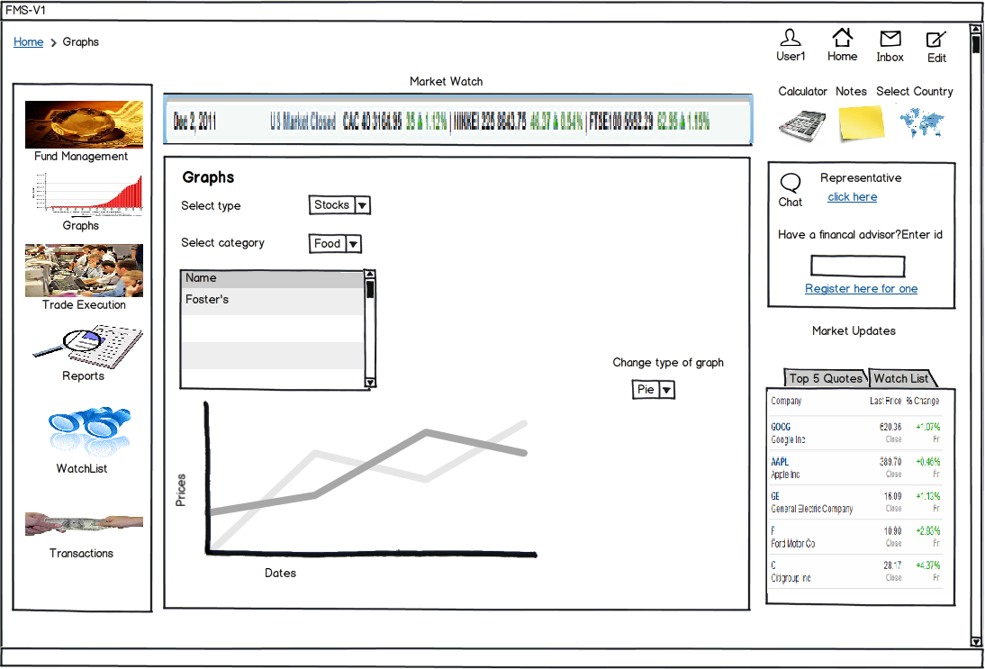

Slide 33
WATCHLIST
Watch list
- The user can add/remove a fund from watch list. If a fund is added to watch list, period updates about the fund are presented to the user
The user clicks on the watch list tab
The user selects the category and type of the fund which he/she wishes to add in watch list
The user selects on a particular entry to add it to watch list
The user is presented with a table of funds which are already in the watch list
The user is given the option to remove any fund from this list

Slide 34
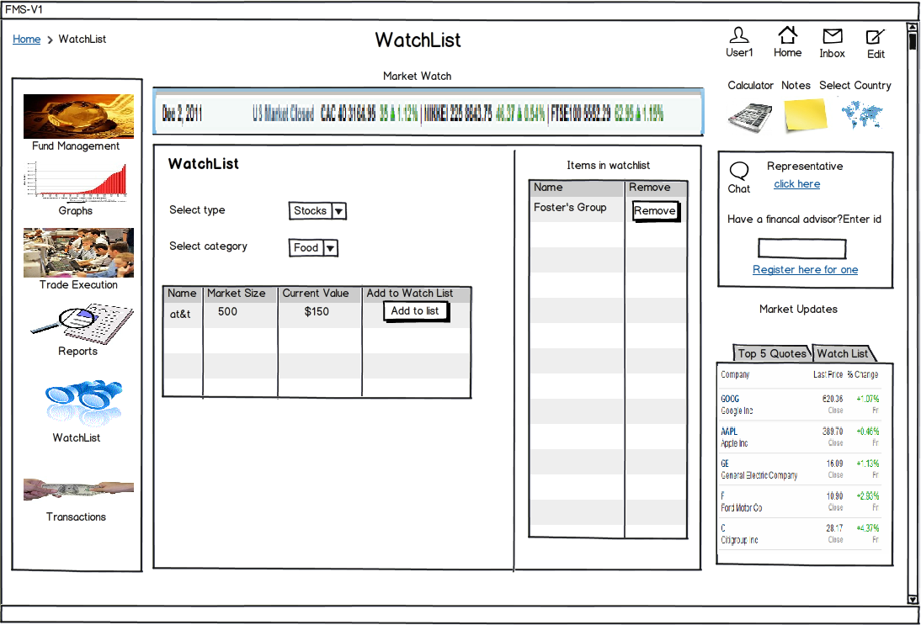

Slide 35


Slide 36

QUESTIONS

