Slide 1
Blood Supply Management
Web Application
By
Mahesh Karthik Duraisamy
04/29/2011

Slide 2
Blood Supply Management
Objective:
To create an web application for a blood bank system to help its donors, blood bank branches and its hospitals to automate the blood supply.

Slide 3
Blood Bank Org
Hospital Admin
Hospital Inventory
Has
Hospital creates order and the system finds the nearest organization based on the zip code and inventory
Blood Bank
Admin
Nurse
Lab Technician
Barcodes and sends to
Tests and if usable goes to inventory
Forwards
Receptionist
Inventory Manager
Donor
Receptionist views the req
Schedule
Fixes schedule
Basic Data Flow Model

Slide 4
Use Case Diagram
Admin
Donor
Inventory Manager
Blood Bank
Receptionist
Lab Technician
Nurse

Slide 5
Use Case Description
Master Admin:
Creates new organizations (Blood Bank and Hospitals).
Admin:
Creates staff for the organizations.
Donor :
Registers and schedules for donation in the blood bank.
Receptionist:
Sets up a donation request for a particular donor.

Slide 6
Use Case Description
Nurse:
Performs the actual blood extraction and bar codes the extracted blood packet
Lab Technician:
Tests the incoming blood packet and grades the blood as usable or not usable.
Inventory Manager:
If the blood packet status is accepted then it is added to the blood bank inventory. He also processes the incoming request from the hospitals

Slide 7
Project Flow
Master Admin creates the blood banks admins and hospitals admin for a particular blood bank organization.(Support for multiple blood banks and hospitals)
The blood bank admins create their employees namely receptionist, nurse, lab technician, inventory manager.
Donors register themselves. They have a login and they schedule for their donation.
Receptionist assigns the incoming donation request to the nurse.
Nurse then performs the blood extraction and then barcodes the extracted blood and passes it to the lab technician for testing.
The lab technician tests the blood and grades it as usable or not usable.
If usable the quantity is added to the blood bank inventory.

Slide 8
Project Flow
Hospital raises request for the blood and the system automatically finds the nearest Blood Bank based on zip code and inventory.
Once the nearest blood bank is identified the request is processed order is created with the amount and the blood quantity increases in the hospital and the corresponding amount decreases in the blood bank.

Slide 9
DataBase Design
Organization table, role table-created separate of these tables so that further roles can be added in the future and a list of organizations associated can be found and maintained.
Donor table-Contains the details of the donor and contains organization as a foreign key.
User table-Contains the details of all the employees in the organization and has organization and role as foreign key
Schedule table-Contains the list of schedules by different donors(foreign key) and the organization the schedule is linked to.
Donation Details table-Contains the details about the donation from the nurse and has schedule as foreign key.
Test Details Table-Contains the details about the test status of the blood and has donation details as foreign key.

Slide 10
DataBase Design
HosOrder table-Contains the order if the system finds the nearest blood bank with the request given and also the amount associated with the order.
HosRequest table-Contains the requests in the orders if the order is created.

Slide 11
Featured & Creative Challenges
Functionalities Implemented:
Reporting of inventory status through graphical dashboards.
Virtual Distribution Center-When the request is raised by the hospital the system automatically finds the nearest Blood Bank based on zip code and inventory.
Included google gadgets in the home page to find the driving directions and maps.
Promotion of blood donation by sending emails to all the donors belonging to the blood bank.
Print the reports for both nurse and lab manager from their screen.
Added CSS to all the pages and also java script validation for all the forms in the web page.

Slide 12
Featured & Creative Challenges
Functionalities Implemented:
If no blood bank can cater to the needs of a hospital I have added google maps which will display other blood bank organizations near the hospital.
Implemented AJAX in superadmin , admin and hospital order pages to view the records in the same screen.
Provide upload a document feature to donor to upload his vital stat documents to the blood bank once registered.
Promotion of the blood bank through follow us on Twitter , Follow us on Facebook and youtube videos about my blood bank.
Error handling is done by directing the error cases to jsps and suggesting the user with suggestions to correct them.
Clock with mouse pointer using javascript

Slide 13
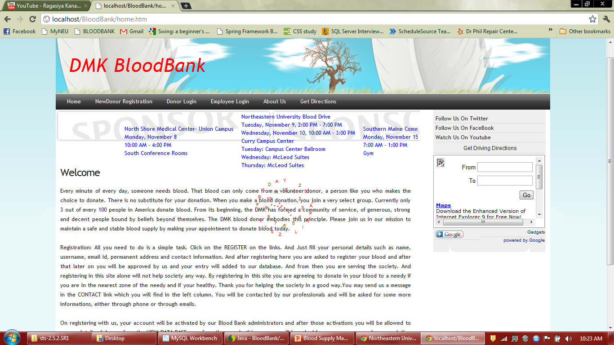
Sample Screen Shots

Slide 14
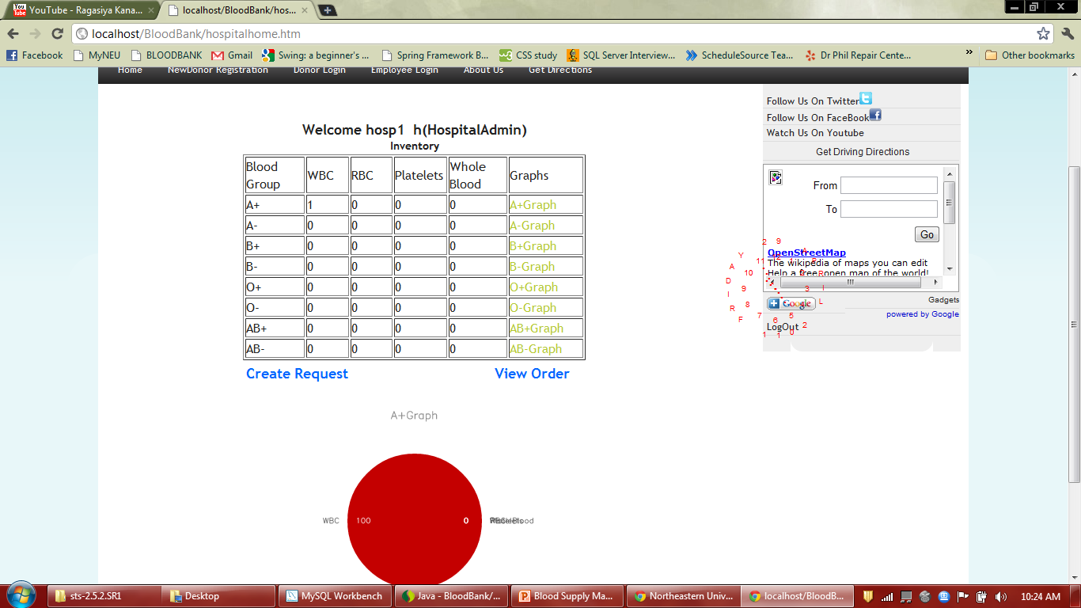
Sample Screen Shots

Slide 15
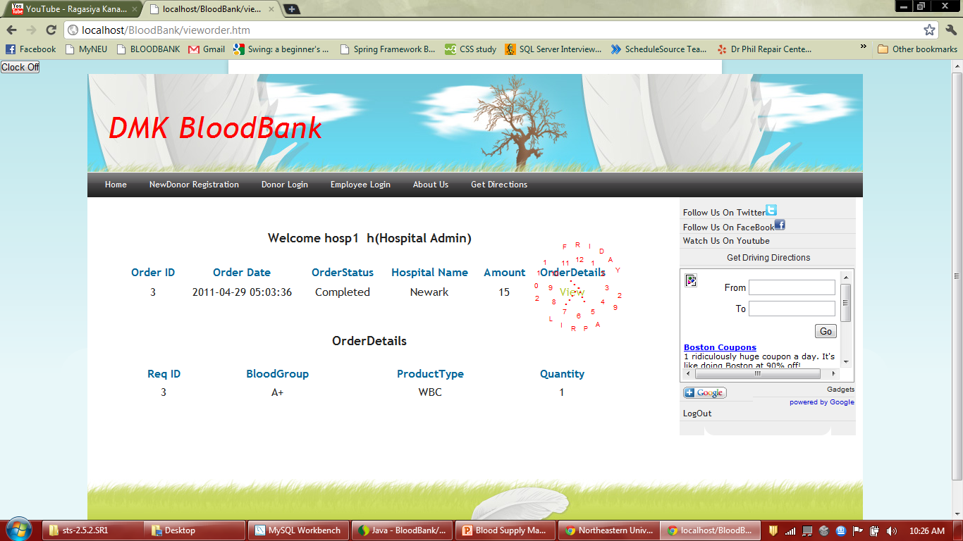
Sample Screen Shots

Slide 16
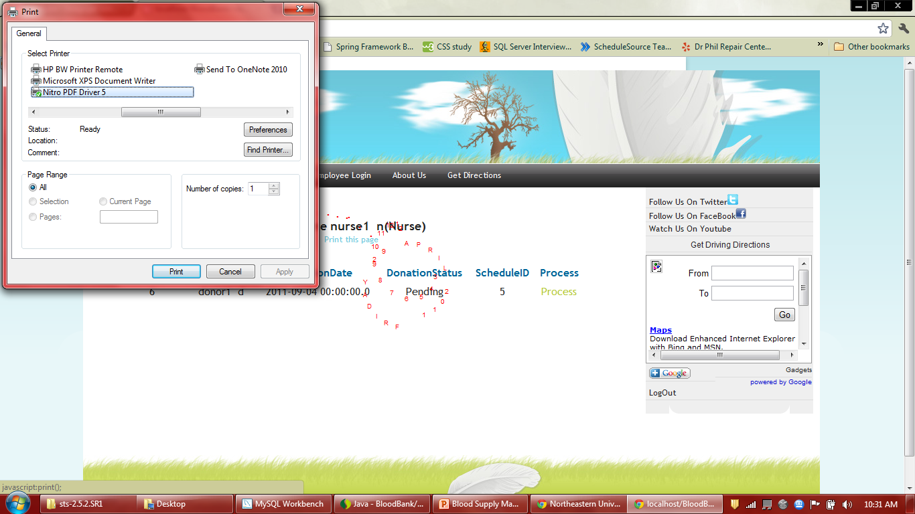
Sample Screen Shots

Slide 17
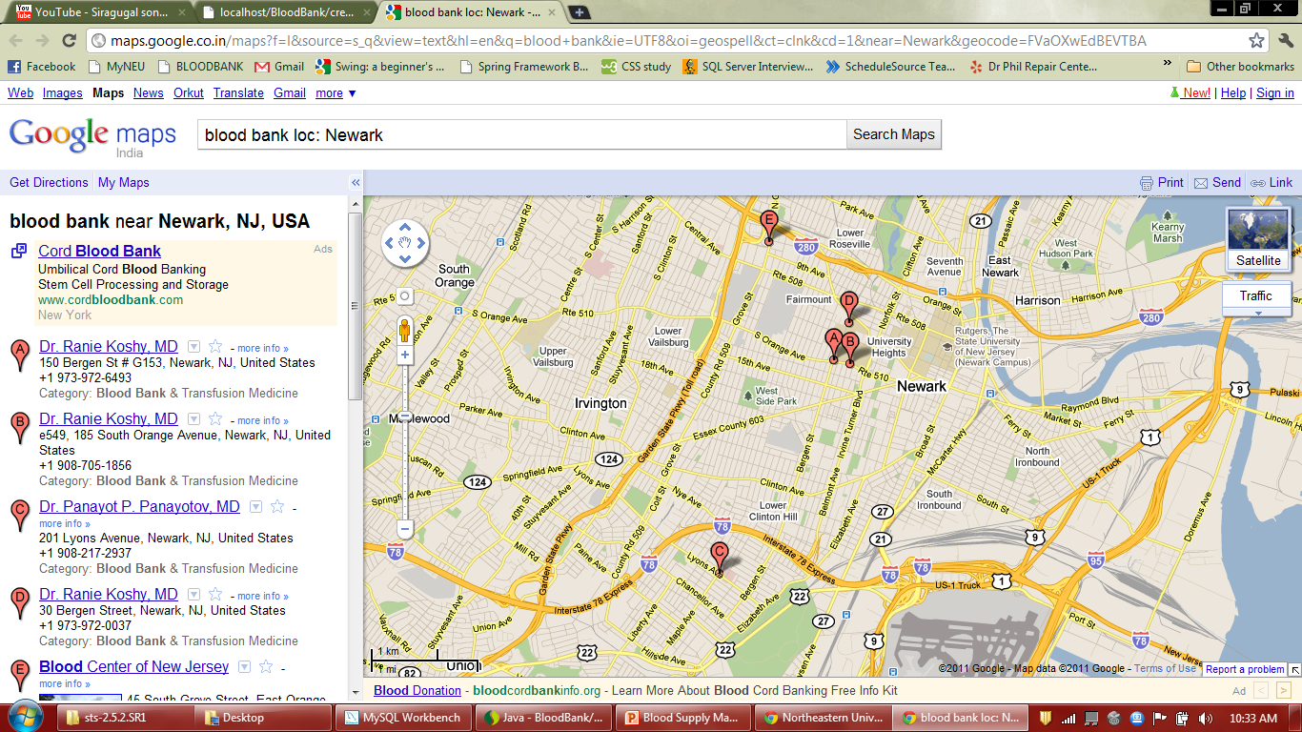
Sample Screen Shots

Slide 18
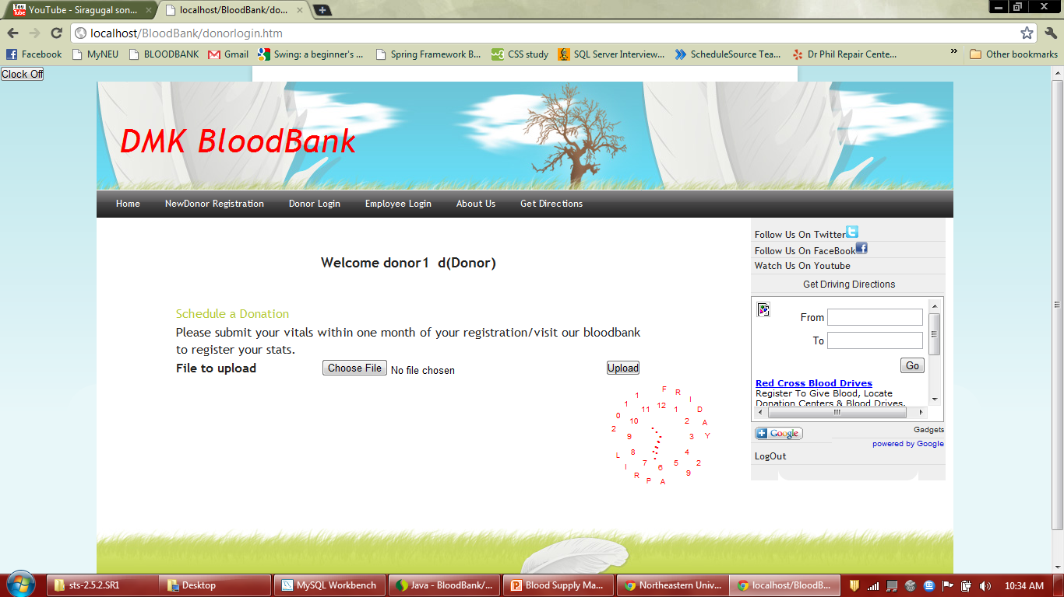
Sample Screen Shots

Slide 19

Thank You!

