Slide 1
DoctorPro
-Iphone based application
By
Mahesh Karthik Duraisamy
04/28/2012

Slide 2
Why do we need an on the go health advisor?
Health problems can arise anytime including after hospital hours and weekends to anyone. When such situations arise, There should be medical guidance easily available to people. Having a smartphone take a smart decision would help people having medical problems identify if there is medical emergency or decide on over the counter medication considering the side effects and interactions. This can avoid the patient from getting panic and do the necessary first aid. It will also increase the confidence of the people and help them in taking precautionary.The application doesnot act as a substitute for professional medical advice, diagnosis or treatment, they are for informational purposes only.

Slide 3
Doctor Pro
Objective:
To create a iphone based application where the user can look at the diseases based on body parts, treatements,care to be taken ,call in case of emergency and create accounts and save their data for reference.

Slide 4
Specs used
-All the controllers
Frameworks:
-Mqmapkit
-Mapkit
-MessageUI
-CFNetwork
-MobileCoreServices
-QuartzCore
-iAd framework and more…
-Sqlite database and Sqlite Manager for managing the database
-FBConnect
-ASIHTTP ,DropBox, AdBanners and more…..

Slide 5
Notable Features of the app
The app has both a generic part and a User profile.
Data based on user login
Google maps to find the nearest doctor with a particular speciality and also the nearest hospitals(Web View-Real time)
Google maps to find the users current location and view the place in satellite view and hybrid view to get an idea of your location(Map View-Real time)
Hit on the body part to list the diseases

Slide 6
Notable Features of the app
Share the information on the facebook(post on the wall) on a click.
Email the disease info to the required recipients.
Update the app data on click of the update button(Forced update)
The database file is stored in my dropbox and I am using the download link.
Googlehealth and Microsoft health vault
Displaying images for the diseases.
AdBanners for promoting the insurance policies.
Maintaining sessions between users.
Easy to use and robust UI

Slide 7
Creative Challenges
Using the socialize sdk to connect to all social networking sites.
Placing googleAds into the iAd banner view.
Button handling for the facebook connect.
Automatic downloads of the database when an update is available(Time constraint).

Slide 8
Future Enhancements
Increased content in the database with medication advice for the users.
Create appointments and start the location services and when the user is 10 miles from the place of appointment notify him with alert about the distance and the appointment.
Automatic updates by using the plist file in my dropbox and comparing the dates with both the plist and the do an update automatically.
Social plugins.
Connectin with permissions from health vaults.
Promote the app using the iAds with insurance companies and make money.
Robust use of ASIHttp

Slide 9
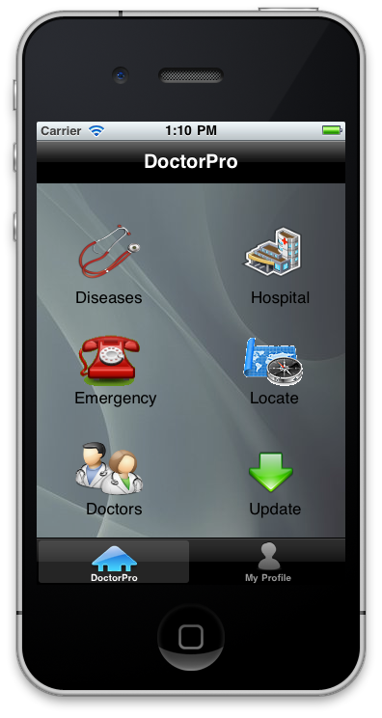
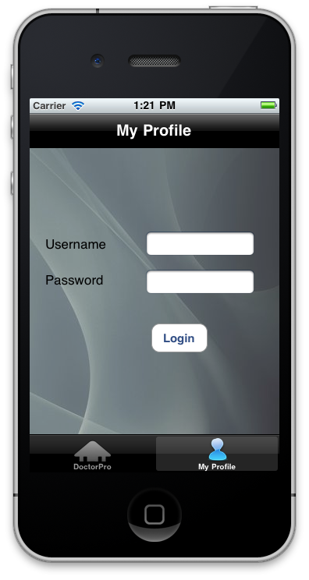
Sample
Screen
Shots

Slide 10
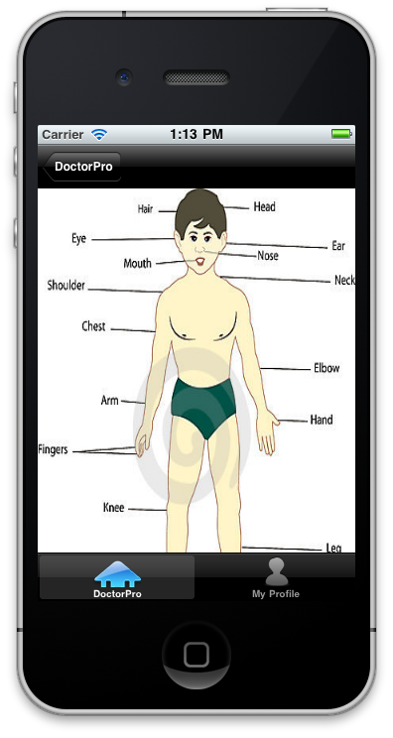
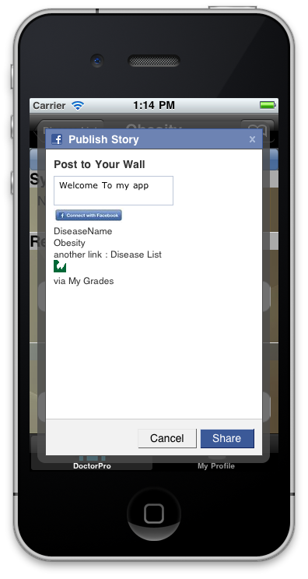

Slide 11
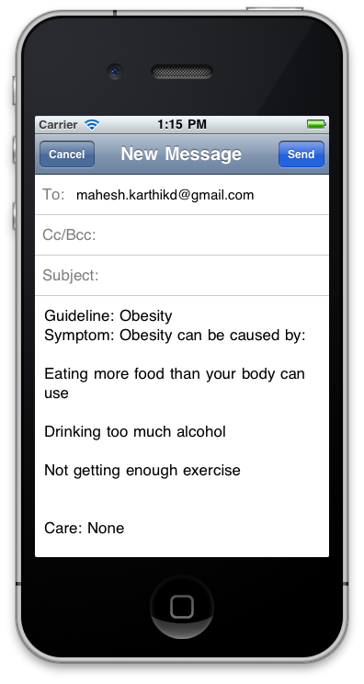
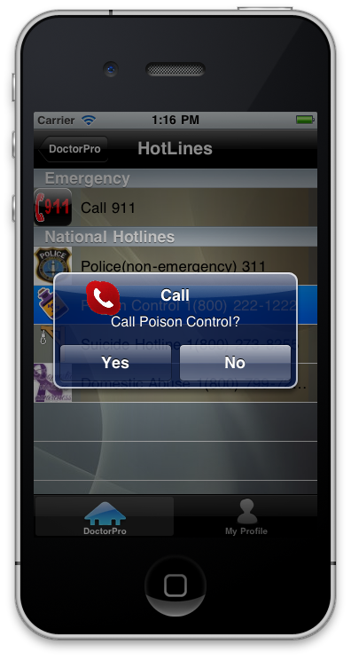

Slide 12
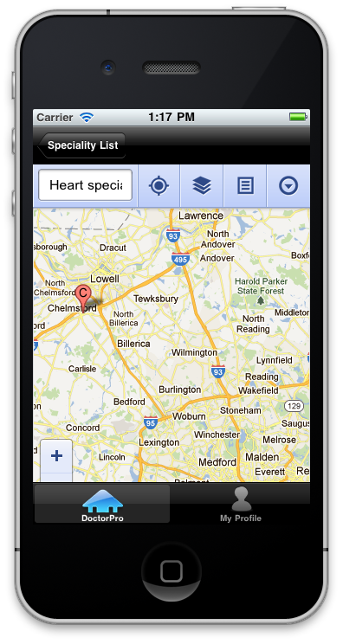
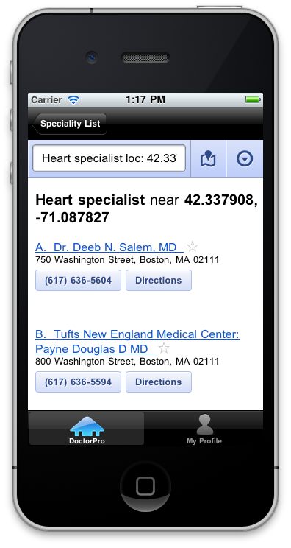

Slide 13
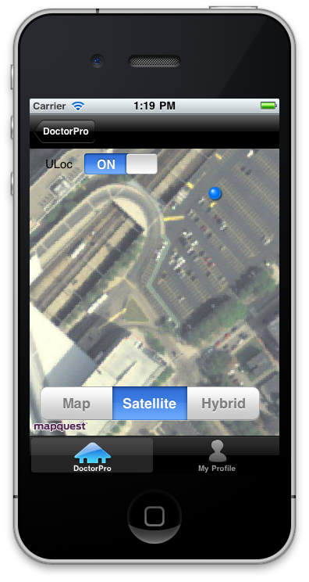
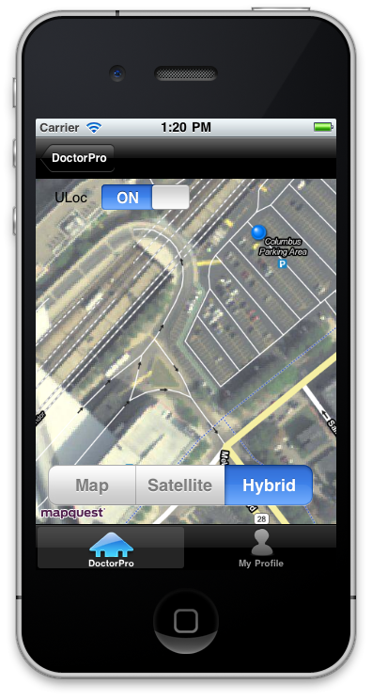

Slide 14
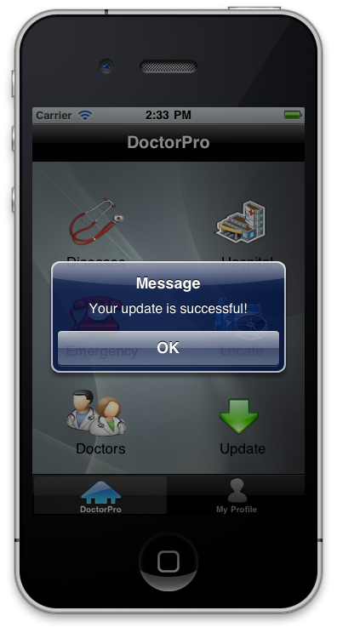
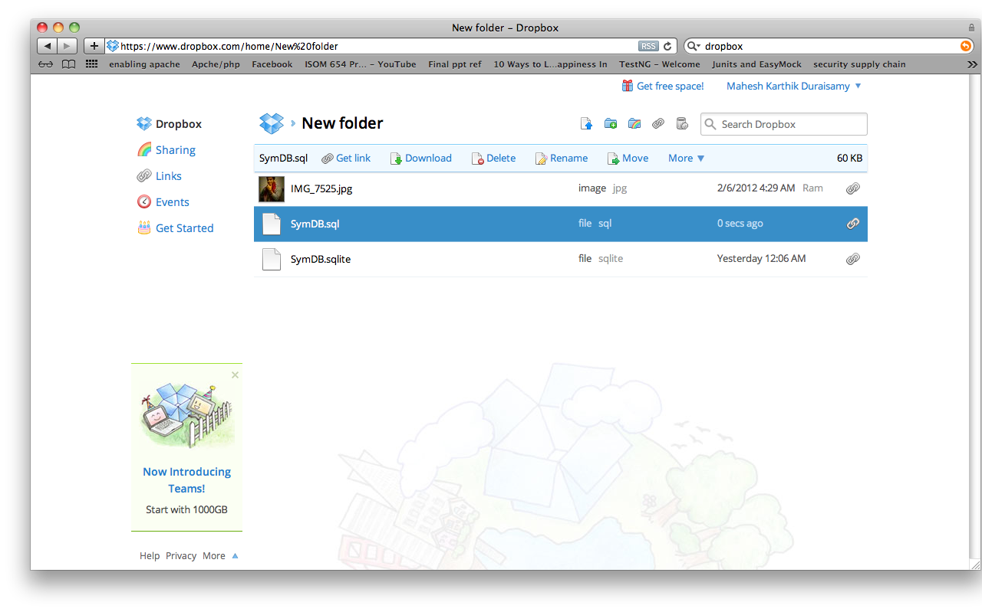

Slide 15
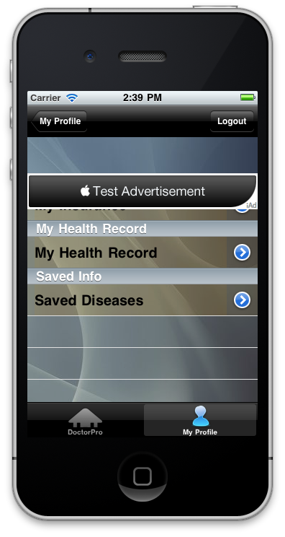
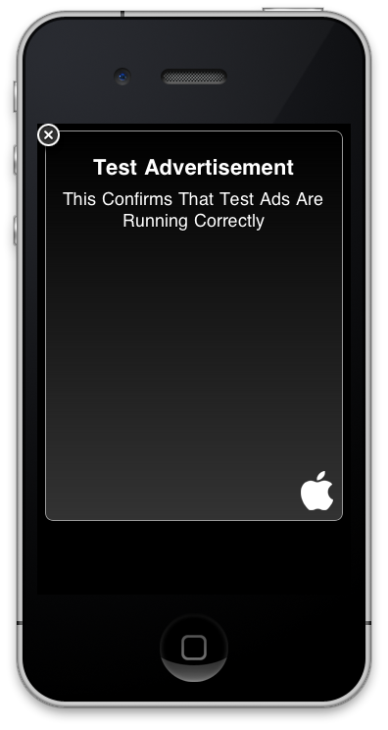

Slide 16
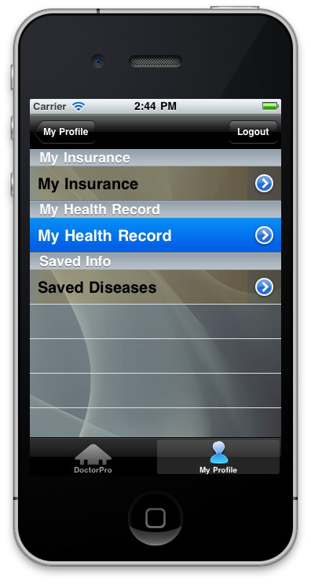
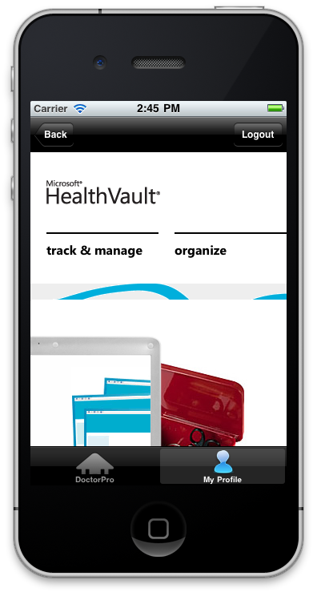

Slide 17

Thank You!

