Slide 1
Roosevelt Paper Company
Presented By:
NOVUS , The Company
Mahesh Karthik Duraisamy
Mithil Jani
Poornima Ravishankar
Rahul Patil
Zhechao Liu

Slide 2
AGENGA
Project Background
Problem Statement
Objectives
Project Plan

Slide 3
PROJECT BACKGROUND
Roosevelt Paper Company needed to eliminate the manual paper based production system that guided every step in the production process.
Paper based system did not provide the ability to effectively manage orders and track status.
The company sought a solution that would eliminate the paper forms and provide greater visibility into progress of an order.

Slide 4

PROBLEM STATEMENT
In 2002 Roosevelt Paper company’s form based production system did not provide the ability to effectively manage order changes, track the status of the order and redistribute and replace obsolete customer orders and specifications which resulted in a increase of ratio of faulty orders from 0.1 to 0.6. This led to a loss of 1.5 million and poor customer satisfaction.

Slide 5

PROJECT OBJECTIVES
By early 2004, the new automated production system will help organization in saving $1.5 million and reduce the ratio of faulty orders from 0.6 to 0.1 The system will also introduce an unified production process throughout the organization to effectively manage orders changes and track status of orders which will result in a profit of 20%.

Slide 6
ASSUMPTIONS
The project plan may change as information or decisions change.
Order fault is the ratio of total number of faulty orders delivered to the customers/ total number of orders.
Faulty orders include orders not delivered on time, orders delivered with inaccurate quantity, orders delivered with poor quality and also damaged orders
The paper based data that exists currently will be stored for future references.
Availability of Data Back up facility.

Slide 7

FISH BONE DIAGRAM

Slide 8
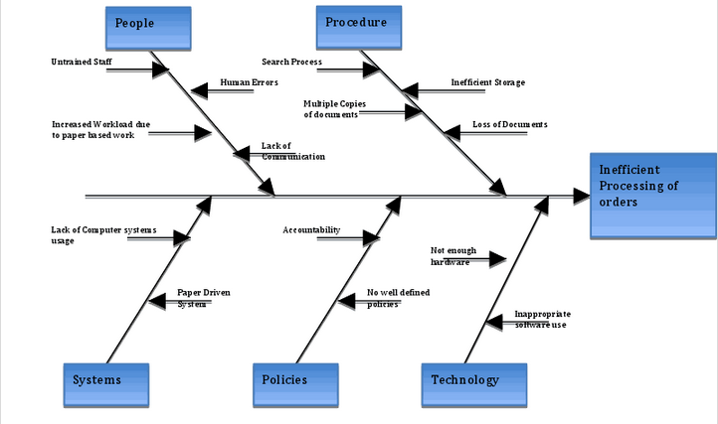

Slide 9
INFRASTRUCTURE PLANNING
Steering Committee
System Architect
Risk Analyst
Project Manager
Business Analyst
Financial Analyst
Technical Analyst
Technical Lead
Developer
Data Analyst
Database Administrator
Database Developers
QA Analyst
Testers
Application Team
Database Team
Testing Team

Slide 10
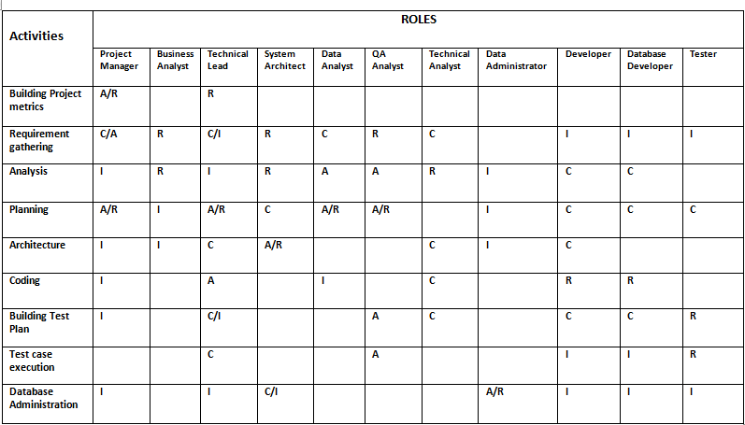

Slide 11
COMMUNICATION PLAN
Communication | Purpose | Audience | Author | Mode Of Communication | Frequency
Monthly status report to executive committee | To keep the senior members of the company informed of the project progress and key upcoming activities | Steering committee. | Project manager | Email, Post on project website | Monthly
Technical design Meetings | Discuss and design technical solutions for the project | Technical Lead, Technical Analyst, System Architect | Technical Lead | Meetings | As and when needed
Project Advisory meetings | Discuss critical issues and change requests | Project manager, Steering Committee, Business analyst | Project manager | Meetings, Emails | As and when needed

Slide 12
Communication | Purpose | Audience | Author | Mode of communication | Frequency
Weekly status meeting of application team | Review progress of project with the team members and communicate the objectives to team members | Technical Lead, Technical Analyst, Developers | Technical Lead | Meetings, Email | Weekly
Weekly status meeting of QA team | Review test cases and testing plan, track testing execution | QA Analyst, Testers | QA Analyst | Meetings | Weekly
Weekly status meeting of Database team | Review progress of database development and how to administer it. | Data Analyst, Database Developers, Database Administrator | Data Analyst | Meetings | Weekly

Slide 13
SWOT ANALYSIS
STRENGTHS ➢ Good and decision taking leadership. ➢ Well allocated budget. ➢ Well defined hierarchical structure of organization. ➢ Good understanding of core business process | WEAKNESS ➢ Unorganized paperwork ➢ Staff to work ratio is low. ➢ Limited usage of computer systems due to untrained staff.
OPPORTUNITY ➢ Increase use of computer resources to organize the flow. ➢ Improve employee productivity by saving their time. ➢ Improve accuracy of orders by going paperless. ➢ Reduce quality‐control issues and wasted stock ➢ Meet more deadlines and deliver a consistently high‐quality product | THREATS ➢ Business may not be able to cope with increased workload. ➢ Scheduling problems may occur because of the hiring of outside consultants and professionals for automating the process. ➢ Loss of data might occur while migrating the data from paper to paperless.

Slide 14
PROJECT SCOPE
The project will be completed in 20 months.
The budget of the project is $2.5 million.
The project will introduce a new unified automated production system that will reduce order fault by 0.4.
Training will be provided to help the employees get acquainted to the automated system.
Rigorous testing will be done before the project goes live
The project will follow EDI standards for data received and barcode labeling for the paper received from supplying mills.

Slide 15
WBS
Installation, Testing and Maintenance
System Analysis
System Planning
Testing
System Analysis
System Planning
Risk Management
System Evaluation
Design Phase
Procurement Management
Data Conversion
System Development
Testing
Installation, Training and Maintenance
Risk Management
System Development
System Evaluation
Data Conversion
Design Phase
Procurement Management

Slide 16

SCHEDULE

Slide 17
SCHEDULING
Milestone | Time | Date
System Planning | 12 | 1/25/2002
System Analysis | 12 | 2/12/2002
Risk Management | 12 | 2/28/2002
System Evaluation | 12 | 3/18/2002
Design Phase | 110 | 8/19/2002
Procurement Management | 15 | 9/9/2002
Data Conversion | 50 | 11/18/2002
System Development | 110 | 4/21/2003
Testing | 90 | 8/25/2003
Installation, Training and Maintenance | 60 | 11/17/2003

Slide 18
CRITICAL SUCCESS FACTORS
OBJECTIVE | SUCCESS FACTOR | KPI
Create a customer satisfaction rate of 98% | 1)Create successful relationship with suppliers 2)Attract and satisfy new customers. | 1)Average time required to deliver an order. 2)Number of defective orders delivered. 3)Average time spent per customer
Deliver the project by 20 months | 1)Avoid poor schedule estimations. 2)Deliver each deliverable as scheduled. 3)Avoid changes in project scope | 1)Delays in the deliverable
Deliver the project within the planned budget of $4 million | 1)Avoid poor cost estimations. 2)Avoid poor resource estimations 3)Avoid changes in project scope | 1)Deviations from the planned budget

Slide 19
CRITICAL SUCCESS FACTORS
OBJECTIVE | SUCCESS FACTORS | KPI
Ease of use of the system | 1)Provide effective training to the employees. 2)Provide documentation for each of the step in the production process | 1)Amount of time spent by each employee to process the order
Ensure high quality implementation process | 1)Avoid changes in project scope 2)Establish clear objectives. 3)Communicate frequently with customers. 4)Establish resource planning | 1)Frequency of meetings with customer. 2)Deviations from the planned budget. 3)Delays in deliverable.
Complete project within scope | 1)Establish well defined project and product scope | 1) Delays in project deliverables 2) Deviations from planned budget

Slide 20

RISK

Slide 21
RISKS
Technology Risks
Insufficient hardware and software resources.
Unable to access required information.
No access to hardware or software
Budget Risk
People related Risk
Project Implementation. overshoots budget
Wrong budget estimation.
Unexpected scope
expansion
Risk Identification
No proper user involvement
Lack of management commitment
Employees reject the new system
Schedule Risk
Project implementation overshoots schedule
Wrong schedule estimation.
Unexpected scope expansion

Slide 22
RISKS
Technology Risks
Low
Insufficient hardware and software resources.
Unable to access required information.
No access to hardware or software
Medium
High
Extreme
Budget Risk
People related Risk
Project Implementation. overshoots budget
Wrong budget estimation.
Unexpected scope
expansion
Risk Prioritization
No proper user involvement
Lack of management commitment
Employees reject the new system
Schedule Risk
Project implementation overshoots schedule
Wrong schedule estimation.
Unexpected scope expansion

Slide 23
RISK MITIGATION
Risk Statement | Impact on Project | Mitigation Action
If the funding is redirected or costs increase then Project Implementation overshoots budget | 1) Reduced Quality 2)Extended Time frames 3) Outcomes delayed/reduced | 1) Re-scope project taking into consideration time and cost. 2)Compare with the original plan
If the scope of the project is not clearly defined or there is inappropriate resource planning then it can lead us to wrong budget estimation | 1) Extended time frames 2) Outcomes delayed | 1) Establish scope control plan if it is not in place 2)Re-scope the project
If there is unavailability of certain resources or slow client decision making or scope mismanagement then project implementation overshoots schedule | 1)Increased costs( purchase of more resources to make up for time) 2)Reduced Quality | 1) Take expert opinion 2)Increase resources. 3)Re-scope the project taking into consideration cost and time

Slide 24
Risk Statement | Impact on Project | Mitigation Action
If the staff reject the new system then there can be delays in the project | 1) More time and resources required for successful implementation 2)More training(more cost & time) 3)Loss of credibility for project | 1)High level re-enforcement of policy changes. 2)Provide opportunity for staff feedback before procedure finalization. 3)Develop training plan in stages and repeat attendance 4)Promote how the new system will improve business and reduce time
If there is insufficient hardware and software resources then it would lead to improper resource estimation | 1)Delayed outcomes. 2)Increased costs. 3)Poor quality | 1) Re-do resource estimation taking into account existing resources 2)Ensure proper impact analysis

Slide 25
Performance Management
Schedule
Weekly reviewing the progress with project team
Ensure man-hours are utilized efficiently
Rebalance team assignments as required
Budget
Weekly cost performance assessment
Review budget/actual costs

Slide 26

BUDGET

Slide 27
BUDGET
Resources | Budgeted Cost
Fixed Costs | $630,000
Man Power | $761,360
Hardware Costs | $400,000
Software Costs | $180,000

Slide 28
COST BENEFIT ANALYSIS
Benefit Element | Benefit Amount
Increase in Net Profit Margins from 7% to 10% | $30,000,000
Reduction in Process Operations Cost from 30% to 16% | $50,000,000
Reduction in Employee Cost by 10% | $16,650,000
Reduction Margin % for Benefits | 15%
Total Benefits | $98,000,000

Slide 29
PROJECT MONITORING
WHAT? | WHEN? | WHERE? | HOW?
Input: Time Output: Progress | At Milestones | No specific place. Usually at head office | Update CPA, PERT Charts, Update Gantt Charts
Input: Money Output: Costs | At Milestones | No specific place. Usually at the head office | Using Earned Value Analysis And Cost Benefit Analysis
Input: Material used Output: Task completion | At task completion | Site office | Reports, Inventory list
Input: Quality/ Technical Performance | Regularly | Site Office/ Head Office | Tests and Inspections, Reports

Slide 30
PROJECT CONTROL
Control the triple constraints
Time
Cost
Performance
By the use of
Earned Value Analysis
Critical Ratio

Slide 31

THANK YOU

