Slide 1

For Further Questions?
WWW.ETHANS.CO.IN

Slide 2
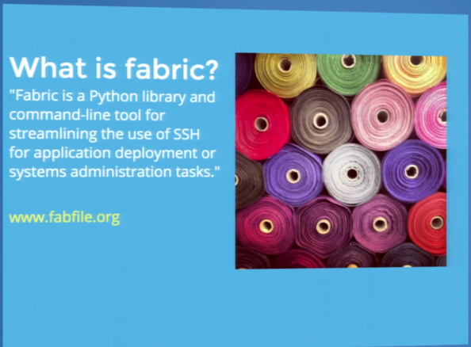

Slide 3
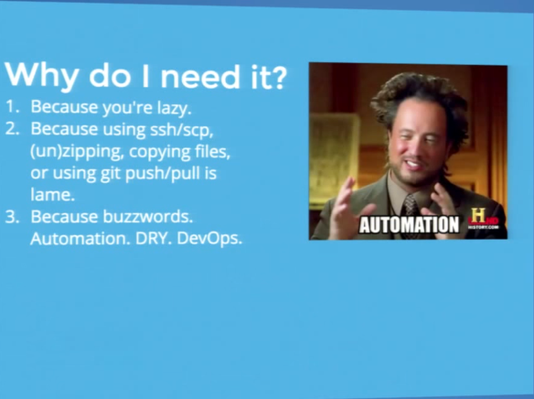

Slide 4
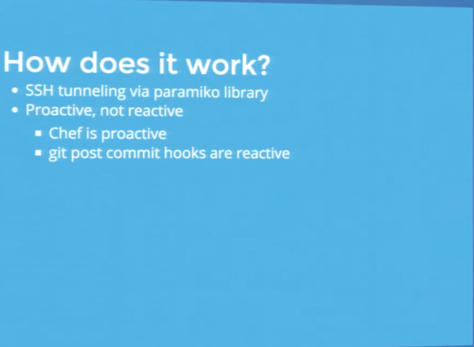

Slide 5
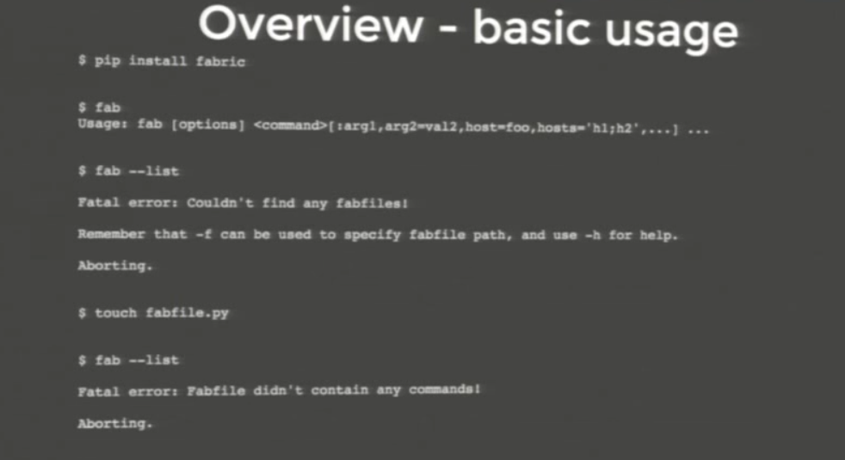
Fabric Commands

Slide 6
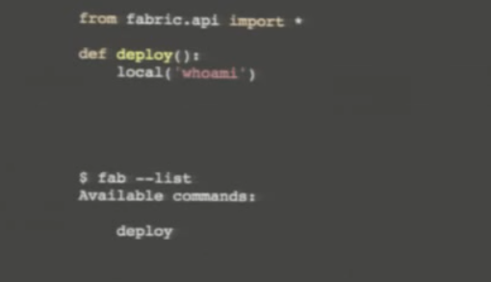

Slide 7
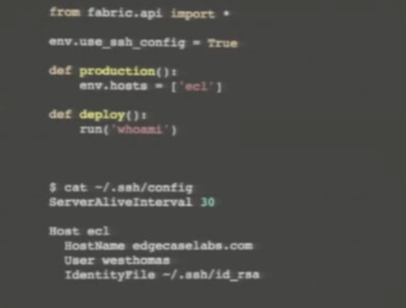

Slide 8
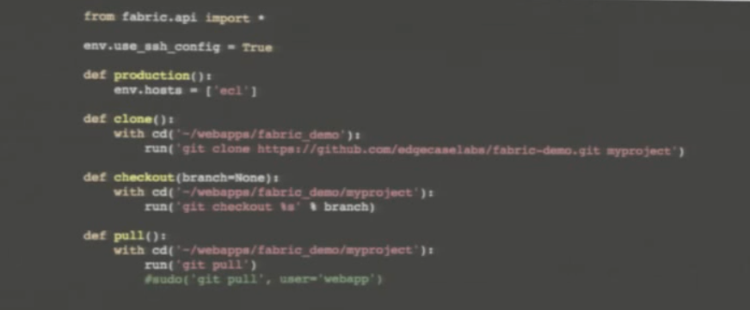

Slide 9
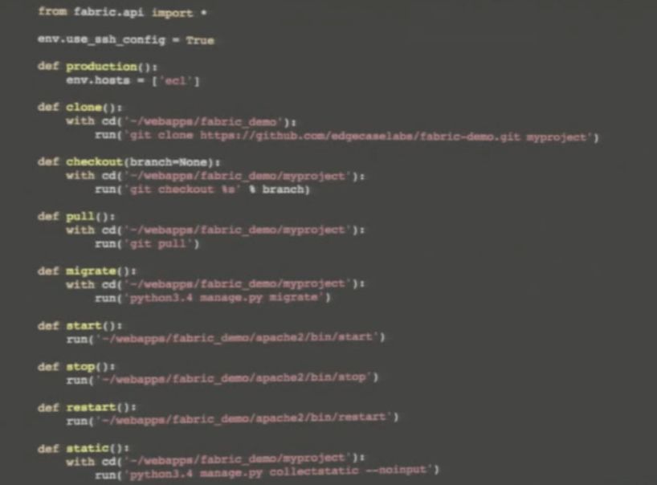

Slide 10
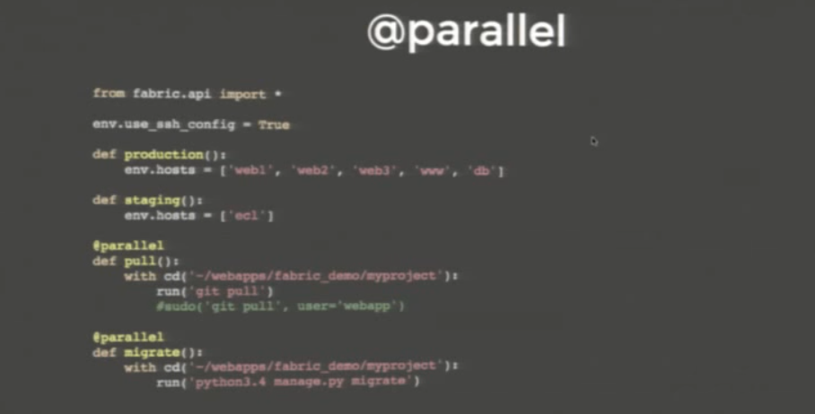

Slide 11
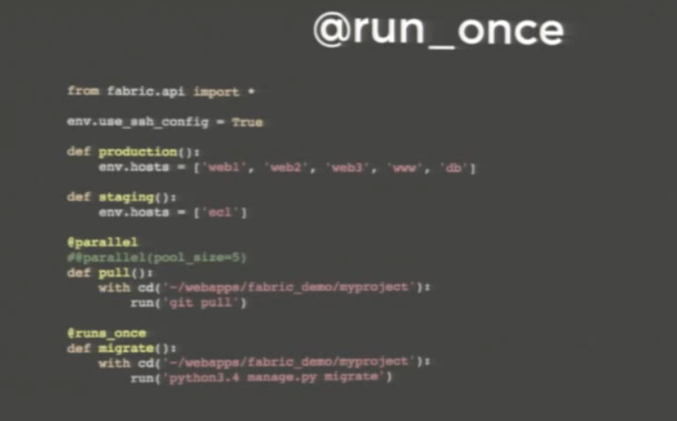

Slide 12
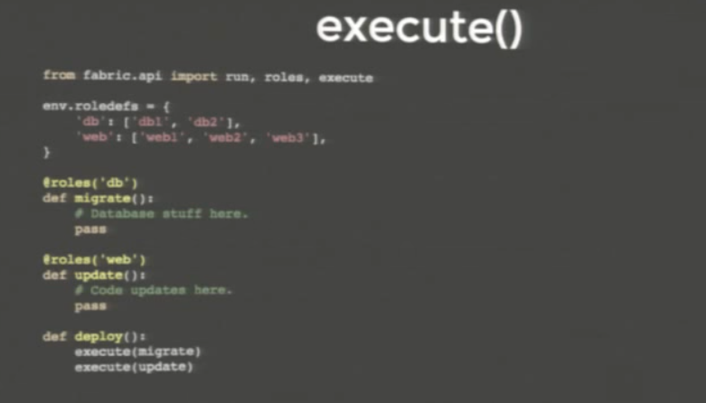

Slide 13
https://github.com/becloudready/devopstraining
https://gist.github.com/jasonkeene/2ac5e552f2ba75d0295b#python-for-system-admins-operators
https://github.com/EdgeCaseLabs/fabric-demo
https://www.youtube.com/watch?v=ZpZkKbZwPoA

Slide 14
