Slide 1

Module-5
Puppet

Slide 2
Objectives
At the end of this module, you will be able to
Desired state Automation /Idempotent
Puppet Management and Configuration
Puppet Manifests for various Servers.
Demo

Slide 3
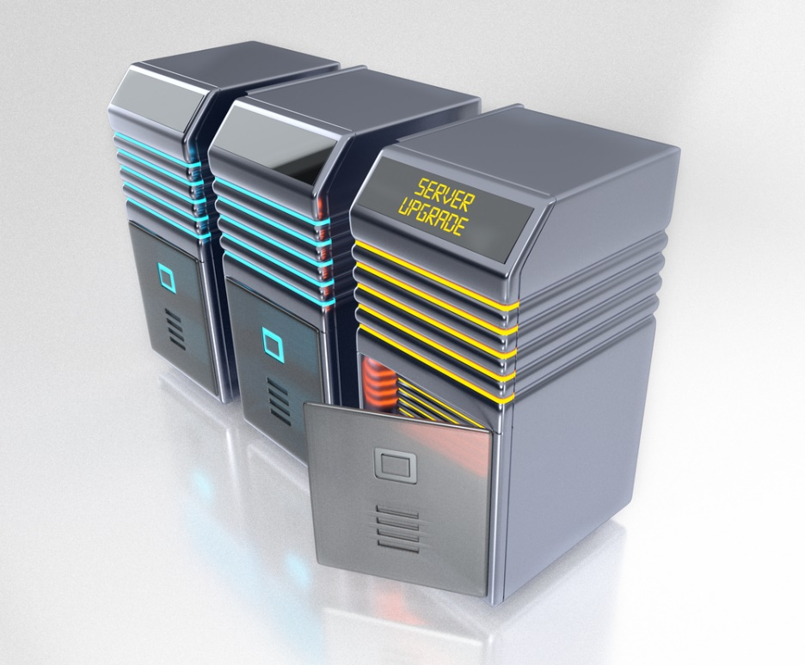
Why Puppet?
Work of a system administrator:
install servers
configure them
maintain them
change the configuration
Notes:
3

Slide 4
Desire State Automation
idempotent:
Actions on resources in Puppet are designed to be idempotent
. I.e. they can be applied multiple times but the end
result is still the same - like multiplying by 1 in math!
Or in mathematical terms, F(F(x))=F(x) Íx
Puppet is a "desired state configuration" system - if a
resource is already configured, no action is taken.
This is called convergence
Notes:
4

Slide 5


Why Puppet?
It is tough to do this on one node…what happens when there are 1000 nodes

Slide 6

What is Puppet?
Puppet is a configuration management tool that is used for deploying, configuring, managing a server machine
Features:
It controls all the steps, right from the bootstrapping to the end of Server life
Can define configuration at the node level
Can group them according to roles
Example: Web Severs, Database Servers.
Maintains consistency across nodes
Example: if a change is done locally, it is rolled back to the original configuration
Notes:
6

Slide 7
Advantages of Puppet
Keeps verifying the configuration at specific interval
It defines configuration with the help of host
Large open-source developer base
It works smoothly even with large infrastructure
The language used is very easy, unlike Ruby or others

Slide 8
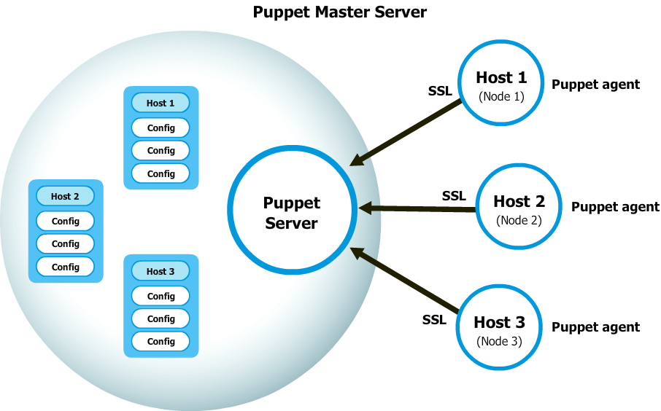
How Puppet Works?
Puppet works on the Master Server model
Puppet Master: This machine contains all the configuration for different hosts. Puppet master will run as a daemon on this master server
Puppet Agent: This is daemon which runs on each node and talks to the master
The connection between this two machine is made in a secure encrypted channel with the help of SSL
Notes:
8

Slide 9
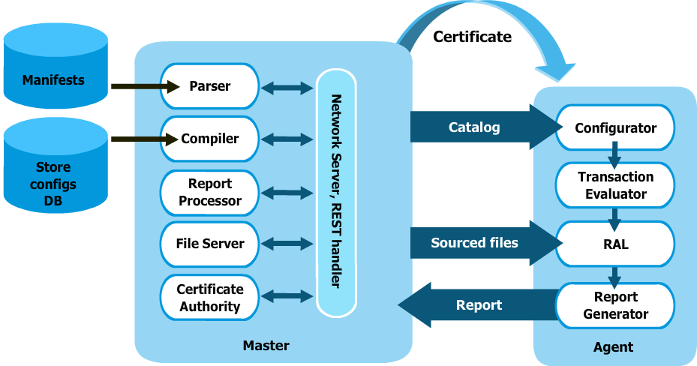
How Puppet Works?

Slide 10
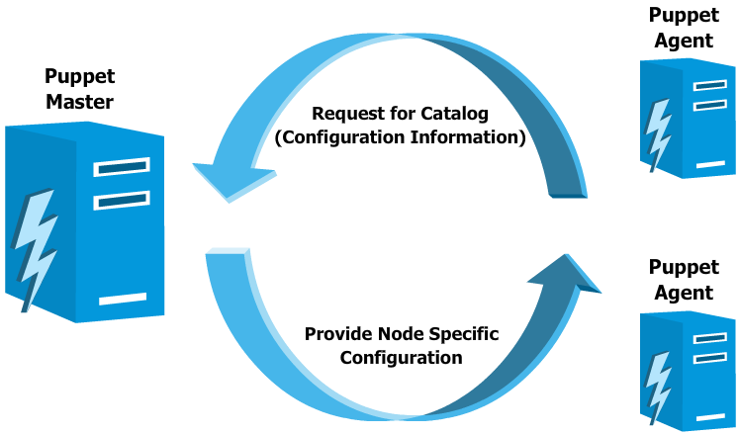
Puppet Configuration
Following are the steps for Puppet configuration:
1. Clients connect to the master and master identifies the configuration according to the client
2. Master builds the Configuration that needs to be applied to a host, compiles it and makes it ready
3. Clients pull the Configuration and apply them on the respective nodes
Notes:
10

Slide 11
Puppet Terminology
Resources
Puppet code is primarily composed of resource declarations
A resource describes about the state of the system, e.g. a certain user or file should exist, or a package should be installed
Resource declarations can be formatted as follows:
resource_type
{ 'resource_name'
attribute => value
...
}

Slide 12
Puppet Terminology (Contd.)
Example for Resource declaration :
user
{ 'mitchell':
ensure => present,
uid => '1000',
gid => '1000',
shell => '/bin/bash',
home => '/home/mitchell'
}
This resource declaration describes a user resource named 'mitchell', with the specified attributes
To list all of the default resource types that are available to Puppet, enter the following command:
puppet resource --types

Slide 13
Puppet Terminology (Contd.)
Manifests
Puppet programs are called manifests
Manifests are composed of puppet code and their filenames use the .pp extension
The default main manifest in Puppet installed via apt is :
/etc/puppet/manifests/site.pp.

Slide 14
Puppet Terminology (Contd.)
Class
In Puppet, classes are code blocks that can be called in a code elsewhere. Using classes allows you reuse Puppet code, and can make reading manifests easier
Class Definition
class example_class {
...
code
...
}

Slide 15
Puppet Terminology (Contd.)
Class declaration occurs when a class is called in a manifest
A class declaration tells Puppet to evaluate the code within the class
Class declarations come in two different flavors: normal and resource-like
A normal class declaration occurs when the include keyword is used in Puppet code, like so:
include example_class
A resource-like class declaration occurs when a class is declared like a resource, like so:
class { 'example_class': }

Slide 16
Puppet Terminology (Contd.)
Modules
A module is a collection of manifests and data (such as facts, files, and templates), and they have a specific directory structure
Modules are useful for organizing your Puppet code, because they allow you to split your code into multiple manifests
It is considered best practice to use modules to organize almost all of your Puppet manifests
To add a module to Puppet, place it in the /etc/puppet/modules directory

Slide 17
Puppet Installations
Puppet Master
Adding Puppet repos
rpm -ivh http://yum.puppetlabs.com/puppetlabs-release-el-6.noarch.rpm
yum install puppet-server
Add your puppet server hostnames to the conf file under the [main] section
vim /etc/puppet/puppet.conf
dns_alt_names = puppet,puppet.yourserver.com
service puppetmaster start
Notes:
17

Slide 18
Puppet Installations (Contd.)
Puppet Agent
yum install puppet
Opening the conf file to add the puppet server hostname
vim /etc/puppet/puppet.conf
Adding the Puppet Master server
server=puppet.yourserver.com
service puppet start
Notes:
18

Slide 19
Puppet Installations
Demo
Notes:
19

