Slide 1
Kubernetes 101
SPIT KAVACH - April 2023
Mahesh Kasbe

Slide 2
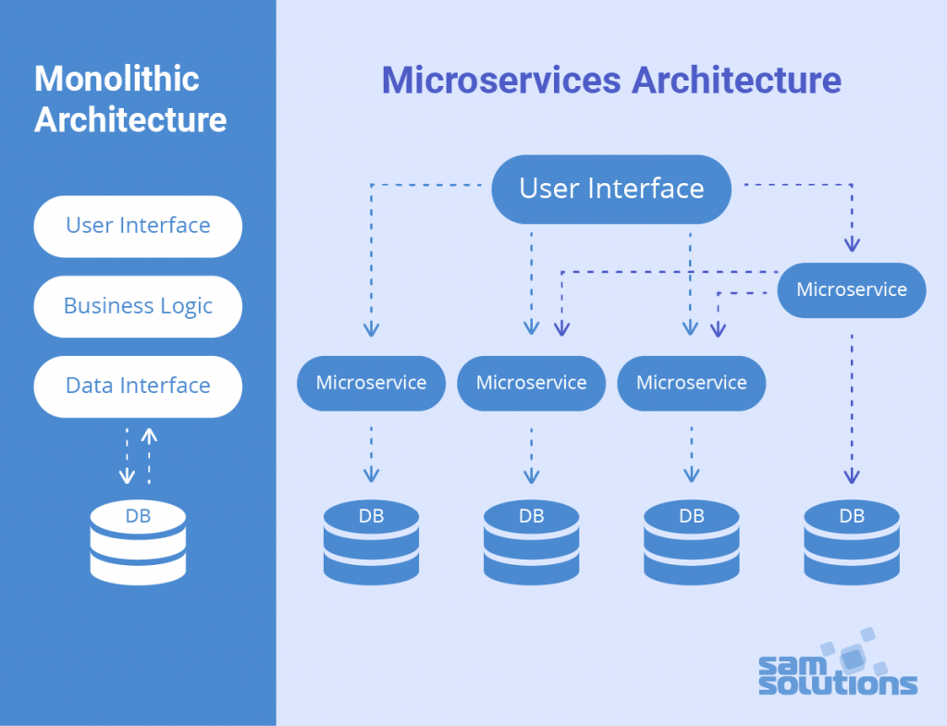
Monolith Applications Vs Microservices
Drawbacks of Monolith Structure
Testing is harder in this systems
Not really cost effective
Redeploy after one major update
Due to tight coupling can run into downtime difficulties
One bug can become a nightmare

Slide 3
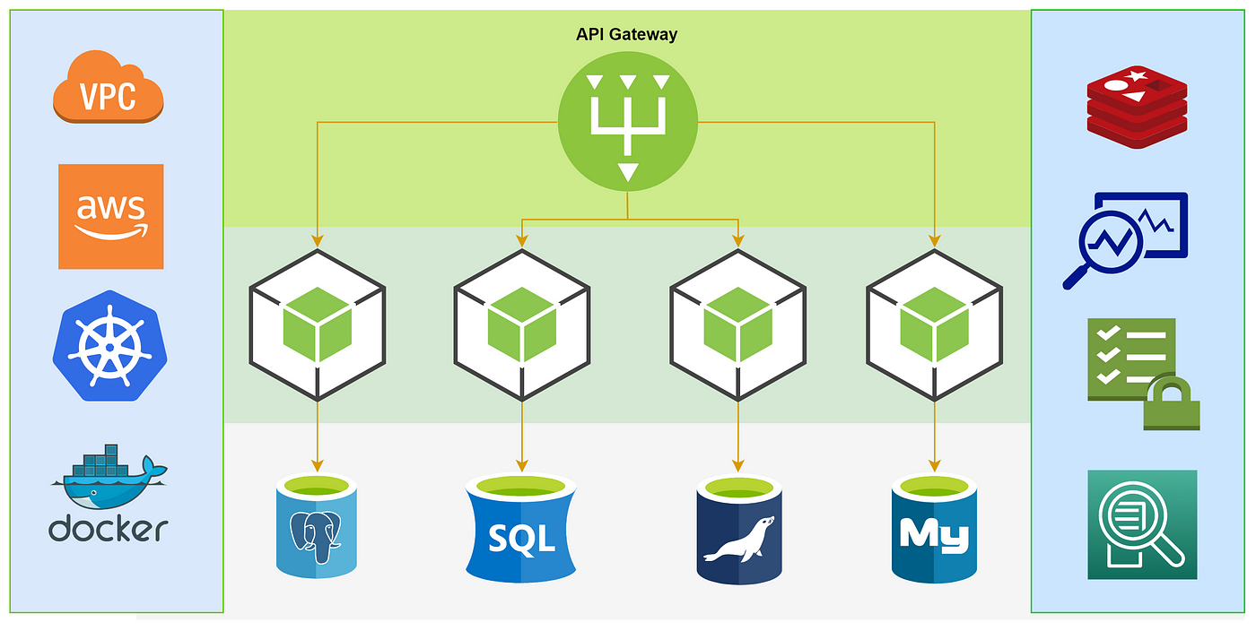
The beauty of Microservices
Scalable
Very much cost effective
Less pain while testing compared to Monolith structure
Changes can be deployed pretty smoothly even after a minor update or bug fix
Easily adapt with emerging and new technology stacks

Slide 4
What are Containers ?
Containers are lightweight packages of your application code together with dependencies such as specific versions of programming language runtimes and libraries required to run your software services.

Slide 5
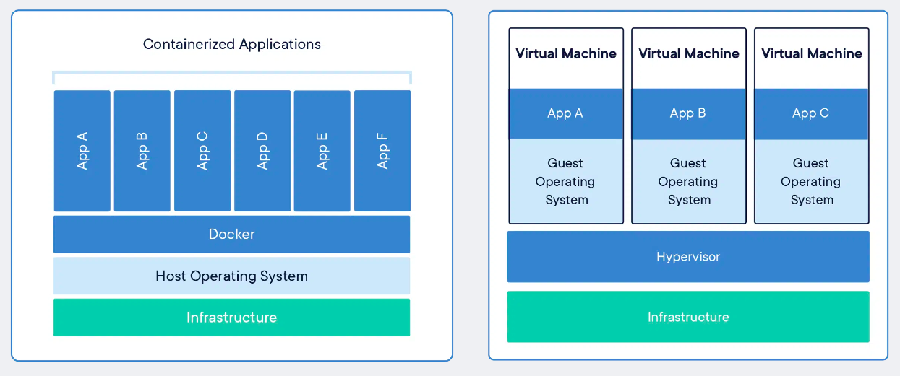
Containers Vs Virtual Machine

Slide 6
Container Orchestration
Advantages
Container deployment.
Rollouts.
Service discovery.
Storage provisioning. .
Load balancing and scalability.
Self-healing for high availability. .
Support and portability across multiple cloud providers.
Growing ecosystem of open-source tools.
Container orchestration is the automation of much of the operational effort required to run containerized workloads and services.

Slide 7
Kubernetes
Kubernetes, also known as K8s, is an open-source system for automating deployment, scaling, and management of containerized applications.
Increased DevOps efficiency for microservices architecture
More portability with less chance of vendor lock-in
Automation of deployment and scalability
App stability and availability in a cloud environment
Open-source benefits of Kubernetes

Slide 8
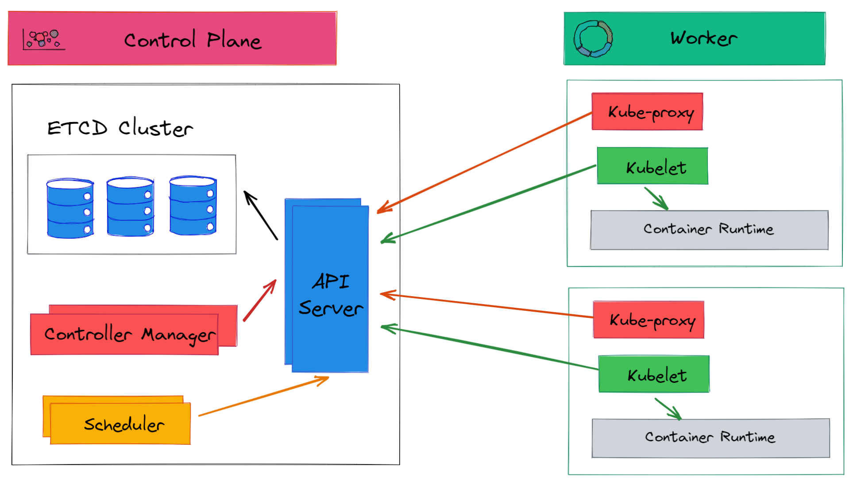
Architecture of Kubernetes
Kubernetes is made up of a control plane and one or more worker nodes. The control plane consists of several components, including the Kubernetes API server, etcd, the controller manager, and the scheduler. The worker nodes are responsible for running the containers that make up the application. Each worker node runs a container runtime, such as Docker or CRI-O, as well as a Kubernetes component called the kubelet, which communicates with the control plane to manage the containers.

Slide 9
What’s in a Pod ?
Pods are the smallest deployable units of computing that you can create and manage in Kubernetes.

Slide 10
Let’s get our hands dirty
Installing minikube and docker
Creating a Kubernetes cluster
Deploying an application to kubernetes

Slide 11
Thank You!
Say hi to me!
Twitter: @maheshstwt
Linkedin: Mahesh Kasbe

