Slide 1
Introduction to Web Development and HTML5
MODULE-1

Slide 2
HTML5 Fundamentals:

Slide 3
Html introduction
What is HTML?
HTML stands for Hyper Text Markup Language
HTML is the standard markup language for creating Web pages
HTML describes the structure of a Web page
HTML consists of a series of elements
HTML elements tell the browser how to display the content
HTML elements label pieces of content such as "this is a heading", "this is a paragraph", "this is a link", etc.

Slide 4
The <!DOCTYPE html> declaration defines that this document is an HTML5 document
The <html> element is the root element of an HTML page
The <head> element contains meta information about the HTML page
The <title> element specifies a title for the HTML page (which is shown in the browser's title bar or in the page's tab)
The <body> element defines the document's body, and is a container for all the visible contents, such as headings, paragraphs, images, hyperlinks, tables, lists, etc.
The <h1> element defines a large heading
The <p> element defines a paragraph
<!DOCTYPE html> <html> <head> <title>Page Title</title> </head> <body> <h1>My First Heading</h1> <p>My first paragraph.</p> </body> </html>

Slide 5
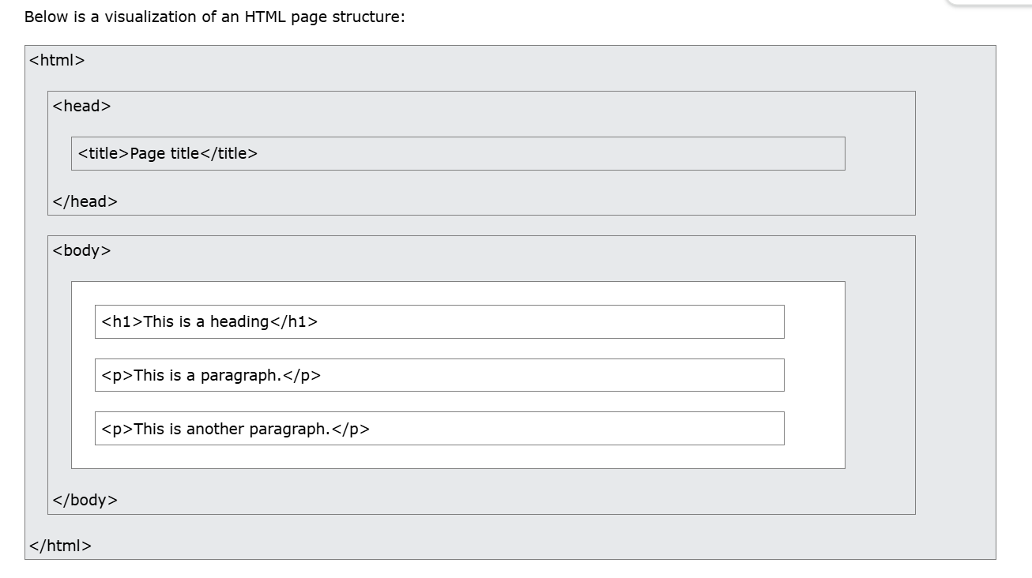

Slide 6
What is an HTML Element?
An HTML element is defined by a start tag, some content, and an end tag:
<tagname> Content goes here... </tagname>
The HTML element is everything from the start tag to the end tag:
<h1>My First Heading</h1>
<p>My first paragraph.</p>

Slide 7
Nested HTML Elements
HTML elements can be nested (this means that elements can contain other elements).
All HTML documents consist of nested HTML elements.
The following example contains four HTML elements (<html>, <body>, <h1> and <p>):
<!DOCTYPE html> <html> <body> <h1>My First Heading</h1> <p>My first paragraph.</p> </body> </html>

Slide 8
Empty HTML Elements
HTML elements with no content are called empty elements.
The <br> tag defines a line break, and is an empty element without a closing tag.
Eg:
<p>This is a <br> paragraph with a line break.</p>

Slide 9
HTML Attributes
All HTML elements can have attributes
Attributes provide additional information about elements
Attributes are always specified in the start tag
Attributes usually come in name/value pairs like: name="value“
The href Attribute
The <a> tag defines a hyperlink.
The href attribute specifies the URL of the page the link goes to:
<a href="https://www.w3schools.com">Visit W3Schools</a>

Slide 10
<!DOCTYPE html>
<html>
<body>
<h2>The href Attribute</h2>
<p>HTML links are defined with the a tag. The link address is specified in the href attribute:</p>
<a href="https://www.google.com">Visit GOOGLE</a>
</body>
</html>

Slide 11
The src Attribute
The <img> tag is used to embed an image in an HTML page.
The src attribute specifies the path to the image to be displayed:
Eg:
<img src="img_girl.jpg">

Slide 12
There are two ways to specify the URL in the src attribute:
Absolute URL - Links to an external image that is hosted on another website. Example: src="https://www.w3schools.com/images/img_girl.jpg".
Relative URL - Links to an image that is hosted within the website. Here, the URL does not include the domain name.
If the URL begins without a slash, it will be relative to the current page.
Example: src="img_girl.jpg".
If the URL begins with a slash, it will be relative to the domain.
Example: src="/images/img_girl.jpg".
It is almost always best to use relative URLs. They will not break if you change domain.

Slide 13
The width and height Attributes
The <img> tag should also contain the width and height attributes, which specify the width and height of the image (in pixels).
Eg:
<img src="img_girl.jpg" width="500" height="600">

Slide 14
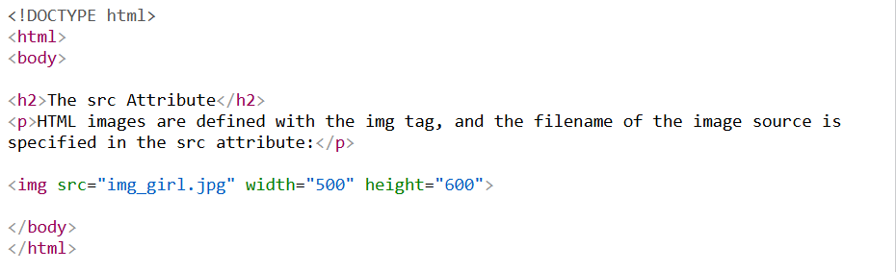

Slide 15
The alt Attribute
The required alt attribute for the <img> tag specifies an alternate text for an image, if the image for some reason cannot be displayed.
This can be due to a slow connection, or an error in the src attribute, or if the user uses a screen reader.
Eg:
<img src="img_girl.jpg" alt="Girl with a jacket">

Slide 16
<!DOCTYPE html>
<html>
<body>
<h2>The alt Attribute</h2>
<p>The alt attribute should reflect the image content, so users who cannot see the image get an understanding of what the image contains:</p>
<img src="img_girl.jpg" alt="Girl with a jacket" width="500" height="600">
</body>
</html>

Slide 17
The style Attribute
The style attribute is used to add styles to an element, such as color, font, size, and more.
<p style="color:red;">This is a red paragraph.</p>

Slide 18
The lang Attribute
You should always include the lang attribute inside the <html> tag, to declare the language of the Web page.
This is meant to assist search engines and browsers.
The following example specifies English as the language:
<!DOCTYPE html> <html lang="en"> <body> ... </body> </html>

Slide 19
Country codes can also be added to the language code in the lang attribute.
So, the first two characters define the language of the HTML page, and the last two characters define the country.
The following example specifies English as the language and United States as the country:
<!DOCTYPE html> <html lang="en-US"> <body> ... </body> </html>

Slide 20
The title Attribute
The title attribute defines some extra information about an element.
The value of the title attribute will be displayed as a tooltip when you mouse over the element:
<p title="I'm a tooltip">This is a paragraph.</p>

Slide 21
HTML Attributes with Explanation
1. id – Assigns a unique identifier to an HTML element.
2. class – Assigns one or more class names to an element for CSS or JS.
3. style – Applies inline CSS styles to an element.
4. title – Displays extra information as a tooltip when hovered.
5. lang – Specifies the language of the content.
6. hidden – Hides an element from the page.
7. tabindex – Specifies the tab order for keyboard navigation.
8. contenteditable – Makes the content of the element editable by the user.

Slide 22
9. draggable – Allows the element to be dragged.
10. data- attributes* – Custom attributes for storing extra data on elements.
11. href – Specifies the URL in a tag.
12. src – Specifies the source file for images, audio, or video.
13. alt – Provides alternative text for an image if it fails to load.
14. type – Defines the type of element (e.g., text, email, submit).
15. placeholder – Provides a hint inside input fields.
16. required – Makes a form field mandatory to fill out before submitting.
17. readonly – Prevents editing of the field.
18. disabled – Disables the input element.

Slide 23
19. value – Specifies the initial value of the input or button.
20. name – Assigns a name to the form element for identification when submitted.
21. autoplay – Starts audio or video automatically on load.
22. controls – Adds play, pause, and volume controls to audio/video.
23. loop – Plays the audio/video repeatedly.
24. muted – Mutes the audio/video by default.
25. width, height – Sets the dimensions of images or videos.

Slide 24
HTML Semantic Elements
What are Semantic Elements?
A semantic element clearly describes its meaning to both the browser and the developer.
Examples of semantic elements: <img>, <table>, and <article> - Clearly defines its content.
Examples of non-semantic elements: <div> and <span> - Tells nothing about its content.

Slide 25
HTML <section> Element
The <section> element defines a section in a document.
"A section is a thematic grouping of content, typically with a heading.“
Examples of where a <section> element can be used:
Chapters
Introduction
News items
Contact information
A web page could normally be split into sections for introduction, content, and contact information.

Slide 26
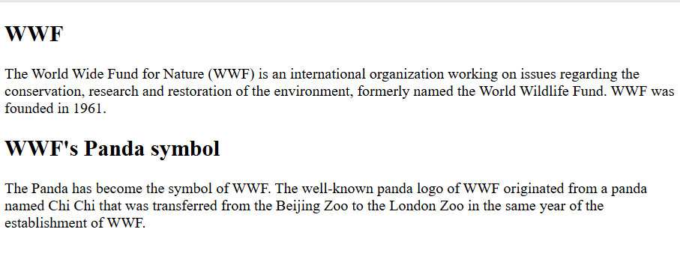
section> <h1>WWF</h1> <p>The World Wide Fund for Nature (WWF) is an international organization working on issues regarding the conservation, research and restoration of the environment, formerly named the World Wildlife Fund. WWF was founded in 1961.</p> </section> <section> <h1>WWF's Panda symbol</h1> <p>The Panda has become the symbol of WWF. The well-known panda logo of WWF originated from a panda named Chi Chi that was transferred from the Beijing Zoo to the London Zoo in the same year of the establishment of WWF.</p> </section>

Slide 27
HTML <article> Element
The <article> element specifies independent, self-contained content.
An article should make sense on its own, and it should be possible to distribute it independently from the rest of the web site.
Examples of where the <article> element can be used:
Forum posts
Blog posts
User comments
Product cards
Newspaper articles

Slide 28
<article>
<h2>Google Chrome</h2>
<p>Google Chrome is a web browser developed by Google, released in 2008. Chrome is the world's most popular web browser today!</p>
</article>
<article>
<h2>Mozilla Firefox</h2>
<p>Mozilla Firefox is an open-source web browser developed by Mozilla. Firefox has been the second most popular web browser since January, 2018.</p>
</article>
<article>
<h2>Microsoft Edge</h2>
<p>Microsoft Edge is a web browser developed by Microsoft, released in 2015. Microsoft Edge replaced Internet Explorer.</p>
</article>

Slide 29
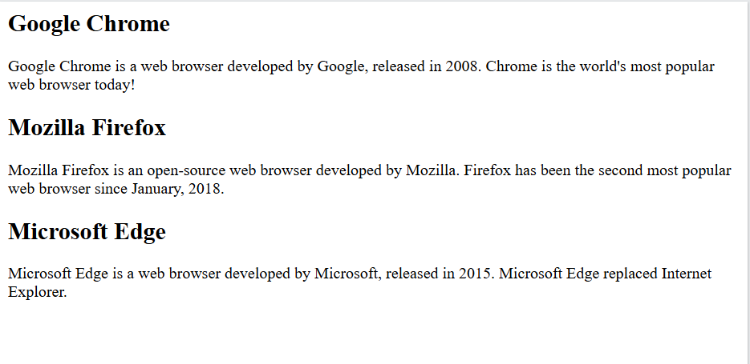

Slide 30
HTML <header> Element
The <header> element represents a container for introductory content or a set of navigational links.
A <header> element typically contains:
one or more heading elements (<h1> - <h6>)
logo or icon
authorship information

Slide 31
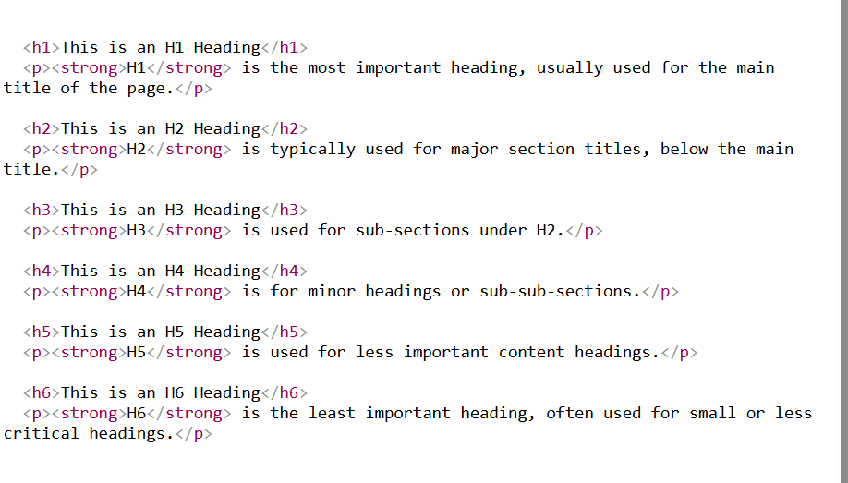

Slide 32
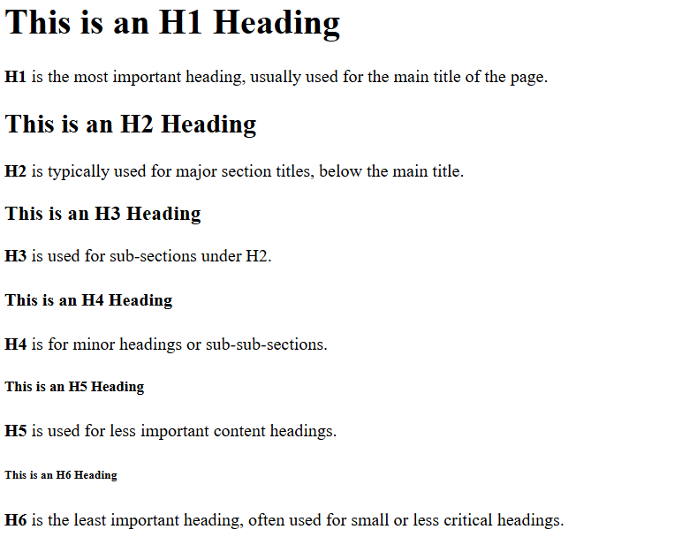

Slide 33
HTML <footer> Element
The <footer> element defines a footer for a document or section.
A <footer> element typically contains:
authorship information
copyright information
contact information
sitemap
back to top links
related documents
You can have several <footer> elements in one document.

Slide 34
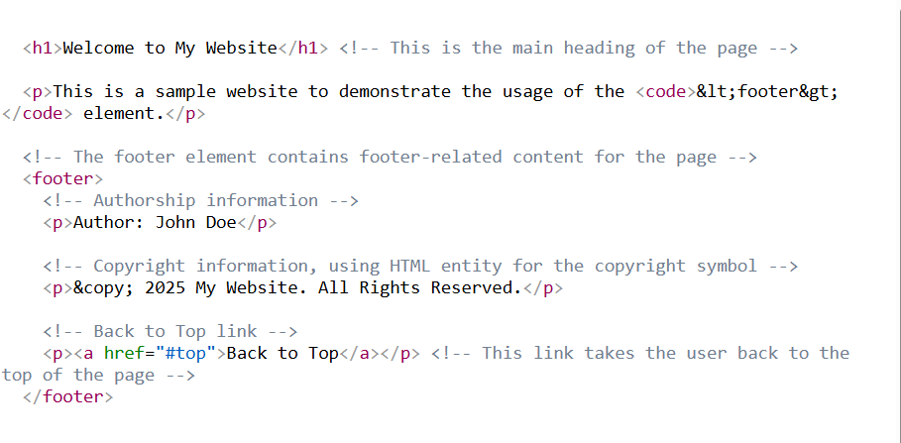

Slide 35
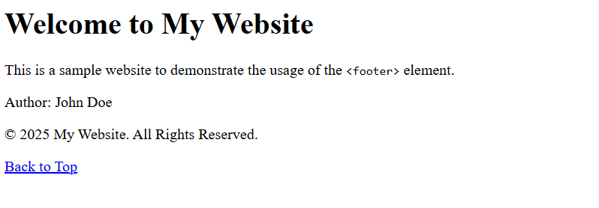

Slide 36

HTML <nav> Element
The <nav> element defines a set of navigation links.
<nav> <a href="/html/">HTML</a> | <a href="/css/">CSS</a> | <a href="/js/">JavaScript</a> | <a href="/jquery/">jQuery</a> </nav>

Slide 37
HTML <aside> Element
The <aside> element defines some content aside from the content it is placed in (like a sidebar).
The <aside> content should be indirectly related to the surrounding content.

Slide 38
<!-- Main article content -->
<article>
<h2>How to Grow Indoor Plants</h2>
<p>Indoor plants improve air quality and bring a sense of calm to your space. Make sure they get enough light and water.</p>
<!-- Aside content that's related but not part of the main article -->
<aside>
<!-- This is extra information relevant to the article, like a tip or a note -->
<h4>Quick Tip:</h4>
<p>Succulents need less water and are great for beginners.</p>
</aside>
</article>

Slide 39
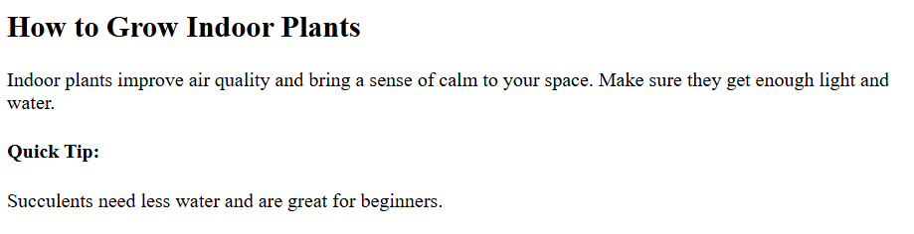

Slide 40
<table> Element in HTML?
The <table> element is used to create a table in HTML for displaying tabular data — information arranged in rows and columns.
A basic table consists of:
<table> — wraps the entire table
<tr> (table row) — defines a row
<th> (table header) — defines a header cell (bold and centered by default)
<td> (table data) — defines a regular data cell

Slide 41
h2>Student Marks Table</h2>
<!-- Start of the table -->
<table border="1"> <!-- border="1" adds a visible border -->
<!-- Table header row -->
<tr>
<th>Student Name</th> <!-- Header cell -->
<th>Subject</th>
<th>Marks</th>
</tr>
<!-- First data row -->

Slide 42
<tr>
<td>Alice</td> <!-- Data cell -->
<td>Math</td>
<td>95</td>
</tr>
<!-- Second data row -->
<tr>
<td>Bob</td>
<td>Science</td>
<td>88</td>
</tr>
</tr>
</table>

Slide 43
HTML <figure> and <figcaption> Elements
The <figure> tag specifies self-contained content, like illustrations, diagrams, photos, code listings, etc.
The <figcaption> tag defines a caption for a <figure> element.
The <figcaption> element can be placed as the first or as the last child of a <figure> element.
The <img> element defines the actual image/illustration.

Slide 44
<h1>Famous Landmark</h1>
<!-- The figure element wraps an image and its caption -->
<!-- The image to be displayed -->
<figure>
<img src="https://upload.wikimedia.org/wikipedia/commons/a/a8/Tour_Eiffel_Wikimedia_Commons.jpg" alt="Eiffel Tower" width="300">
<!-- The figcaption provides a description or caption for the image -->
<figcaption>
The Eiffel Tower in Paris, France
</figcaption>
</figure>

Slide 45
<summary> Element
The <summary> element is used inside the <details> element.
It defines the visible heading or label that users can click to show or hide the rest of the content.
Think of it as a toggle title for a collapsible box.

Slide 46
<!-- Collapsible section starts here -->
<details>
<!-- This is the clickable heading that shows/hides the content -->
<summary>
Click to learn about HTML
</summary>
<!-- This content is hidden until the user clicks the summary -->
<p>HTML stands for HyperText Markup Language and is used to structure web content.</p>
</details>

Slide 47
.
<time> Element
The <time> element represents a specific time or date (or both).
It makes date/time machine-readable (for search engines, accessibility tools, etc.) while showing a human-readable version on the screen

Slide 48
<!-- The date shown to user is readable -->
<p>The event will take place on <time datetime="2025-06-01">June 1, 2025</time>.</p>
<!-- The time shown to user is friendly -->
<p>The session starts at <time datetime="14:00">2:00 PM</time>.</p>

Slide 49
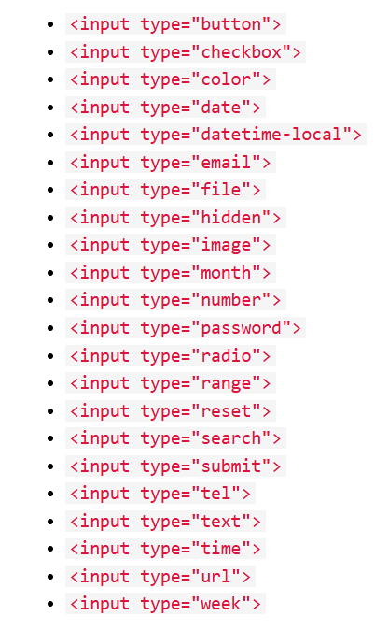
HTML Input
Types

Slide 50
Input Type Text
<input type="text"> defines a single-line text input field:
<form> <label for="fname">Firstname:</label><br> <input type="text" id="fname" name="fname"><br> <label for="lname">Last name:</label><br> <input type="text" id="lname" name="lname"> </form>

Slide 51
Input Type Password
<input type="password"> defines a password field:
<form> <label for="username">Username:</label><br> <input type="text" id="username" name="username"><br> <label for="pwd">Password:</label><br> <input type="password" id="pwd" name="pwd"> </form>

Slide 52
Input Type Submit
<input type="submit"> defines a button for submitting form data to a form-handler.
The form-handler is typically a server page with a script for processing input data.
The form-handler is specified in the form's action attribute:

Slide 53
Input Type Reset
<input type="reset"> defines a reset button that will reset all form values to their default values:
<form> <label for="fname">Firstname:</label><br> <input type="text" id="fname" name="fname" value="John"><br> <label for="lname">Last name:</label><br> <input type="text" id="lname" name="lname" value="Doe"><br><br> <input type="submit" value="Submit"> <input type="reset" value="Reset"> </form>

Slide 54
Input Type Radio
<input type="radio"> defines a radio button.
Radio buttons let a user select ONLY ONE of a limited number of choices:
<p>Choose your favorite Web language:</p> <form> <input type="radio" id="html" name="fav_language" value="HTML"> <label for="html">HTML</label><br> <input type="radio" id="css" name="fav_language" value="CSS"> <label for="css">CSS</label><br> <input type="radio" id="javascript" name="fav_language" value="JavaScript"> <label for="javascript">JavaScript</label> </form>

Slide 55
Input Type Checkbox
<input type="checkbox"> defines a checkbox.
Checkboxes let a user select ZERO or MORE options of a limited number of choices.
<form> <input type="checkbox" id="vehicle1" name="vehicle1" value="Bike"> <label for="vehicle1"> I have a bike</label><br> <input type="checkbox" id="vehicle2" name="vehicle2" value="Car"> <label for="vehicle2"> I have a car</label><br> <input type="checkbox" id="vehicle3" name="vehicle3" value="Boat"> <label for="vehicle3"> I have a boat</label> </form>

Slide 56
.
Input Type Button
<input type="button"> defines a button:
<input type="button" onclick="alert('Hello World!')" value="Click Me!">
Input Type Color
The <input type="color"> is used for input fields that should contain a color.
Depending on browser support, a color picker can show up in the input field
<form> <label for="favcolor">Select your favorite color:</label> <input type="color" id="favcolor" name="favcolor"> </form

Slide 57
Input Type Date
The <input type="date"> is used for input fields that should contain a date.
Depending on browser support, a date picker can show up in the input field.
<form> <label for="birthday">Birthday:</label> <input type="date" id="birthday" name="birthday"> </form>

Slide 58
Input Type Email
The <input type="email"> is used for input fields that should contain an e-mail address.
Depending on browser support, the e-mail address can be automatically validated when submitted.
Some smartphones recognize the email type, and add ".com" to the keyboard to match email input.
<form> <label for="email">Enter your email: </label> <input type="email" id="email" name="email"> </form>

Slide 59
Input Type Image
The <input type="image"> defines an image as a submit button.
The path to the image is specified in the src attribute.
<form> <input type="image" src="img_submit.gif" alt="Submit" width="48" height="48"> </form>
Input Type File
The <input type="file"> defines a file-select field and a "Browse" button for file uploads.
<form> <label for="myfile">Select a file:</label> <input type="file" id="myfile" name="myfile"> </form>

Slide 60
Input Type Hidden
The <input type="hidden"> defines a hidden input field (not visible to a user).
A hidden field lets web developers include data that cannot be seen or modified by users when a form is submitted.
A hidden field often stores what database record that needs to be updated when the form is submitted.
<form> <label for="fname">First name:</label> <input type="text" id="fname" name="fname"><br><br> <input type="hidden" id="custId" name="custId" value="3487"> <input type="submit" value="Submit"> </form>

Slide 61
.
Input Type Number
The <input type="number"> defines a numeric input field.
You can also set restrictions on what numbers are accepted.
It also brings up number-specific input controls, like a spinner (up/down arrows), especially on mobile devices and browsers that support it.
<form>
<label for="age">Age (between 18 and 60):</label><br>
<input type="number" id="age" name="age" min="18" max="60">
</form>

Slide 62
Adding Restrictions
can control what kind of numbers are accepted using attributes like
:min – minimum value allowed
max – maximum value allowed
step – interval between legal numbers
Example with Step:
<form>
<label for="rating">Rating (step of 0.5):</label><br>
<input type="number" id="rating" name="rating" min="1" max="5" step="0.5">
</form>

Slide 63
Input Type Url
The <input type="url"> is used for input fields that should contain a URL address.
Depending on browser support, the url field can be automatically validated when submitted.
Some smartphones recognize the url type, and adds ".com" to the keyboard to match url input.
<form>
<label for="site">Your website:</label>
<input type="url" id="site" name="site" required>
<input type="submit" value="Submit">
</form>

Slide 64
Input Type Week
The <input type="week"> allows the user to select a week number and year.
It’s useful when working with schedules, reports, or data grouped by weeks.
<form>
<label for="week">Select a week:</label><br>
<input type="week" id="week" name="week">
<br><br>
<input type="submit" value="Submit">
</form>

Slide 65
HTML Multimedia
What is Multimedia?
Multimedia comes in many different formats.
It can be almost anything you can hear or see, like images, music, sound, videos, records, films, animations, and more.
Web pages often contain multimedia elements of different types and formats
Multimedia Formats
Multimedia elements (like audio or video) are stored in media files.
The most common way to discover the type of a file, is to look at the file extension.
Multimedia files have formats and different extensions like: .wav, .mp3, .mp4, .mpg, .wmv, and .avi.

Slide 66
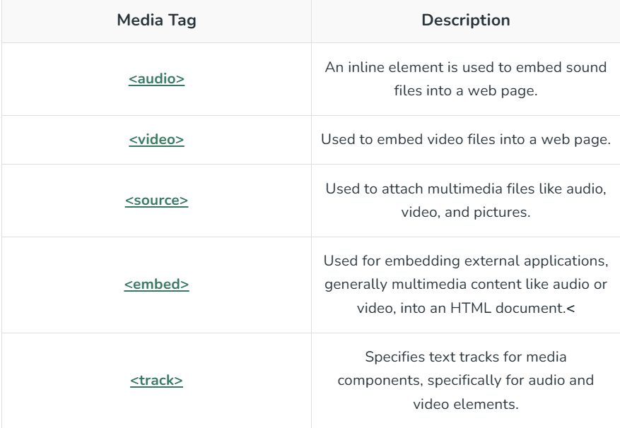
HTML5 introduced 5 most popular media element tags i.e. <audio>, <video>, <source>, <embed>, <track>.

Slide 67
<audio> Tag:
It is a useful tag if we want to add audio such as songs, or any sound files into our webpage.
<audio controls> <source src="sample.mp3" type="audio/mpeg"> </audio>

Slide 68
HTML Audio - How It Works
The controls attribute adds audio controls, like play, pause, and volume.
The <source> element allows you to specify alternative audio files which the browser may choose from. The browser will use the first recognized format.
The text between the <audio> and </audio> tags will only be displayed in browsers that do not support the <audio> element.

Slide 69
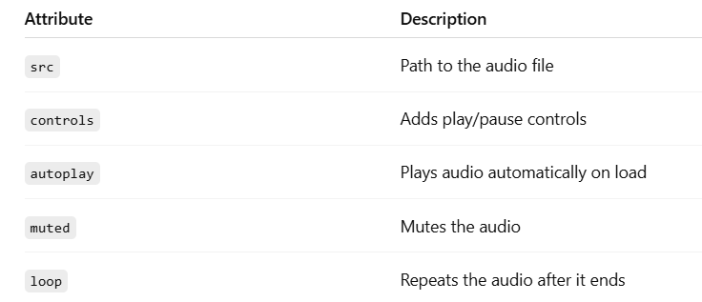

Slide 70
1. src
Specifies the path to the audio file.
Can also be specified using <source> tags inside the <audio> element.
example
<h2>Audio with src attribute</h2>
<!-- Audio tag with src and controls -->
<audio src ="https://www.soundhelix.com/examples/mp3/SoundHelix-Song-1.mp3" controls>
</audio>

Slide 71
2. controls
Adds audio playback controls like play, pause, volume, etc.
The controls attribute in the <audio> (and <video>) tag is used to display built-in browser controls for media playback — such as:
▶️ Play / ⏸️ Pause button
🔊 Volume control
⏩ Seek bar (timeline)
⏹ Stop button (in some browsers)
Without this, users won't see a way to play the audio.
<audio controls> <source src="horse.ogg" type="audio/ogg"> <source src="horse.mp3" type="audio/mpeg"> Your browser does not support the audio element. </audio>

Slide 72
3. autoplay
Makes the audio start playing automatically when the page loads.
Modern browsers often block autoplay unless muted or triggered by user interaction.
Example
<h2>Autoplay Audio</h2>
<!-- The audio will start playing automatically when the page loads -->
<audio src ="https://www.soundhelix.com/examples/mp3/SoundHelix-Song-1.mp3" autoplay controls>
</audio>

Slide 73
4. Muted
Starts the audio in a muted state.
Useful with autoplay, because many browsers allow autoplay only if muted.
<audio controls autoplay muted> <source src="horse.ogg" type="audio/ogg"> <source src="horse.mp3" type="audio/mpeg"> Your browser does not support the audio element. </audio>

Slide 74
5. loop
Makes the audio repeat continuously after it ends.
Example
<h2>loop</h2>
<audio controls loop>
<source src
="https://media.geeksforgeeks.org/wp-
content/uploads/20190531165842/Recording1514.
ogg" type="audio/ogg">
</audio>

Slide 75
HTML Video
The <video> tag in HTML is used to embed video content into a web page.
It is a powerful feature in HTML5 that allows you to play videos without needing a plugin like Flash.
h2>Sample Video</h2>
<video >
<source src="https://www.w3schools.com/html/mov_bbb.mp4" type="video/mp4">
<source src="movie.ogg" type="video/ogg">
Your browser does not support the video tag.
</video>

Slide 76
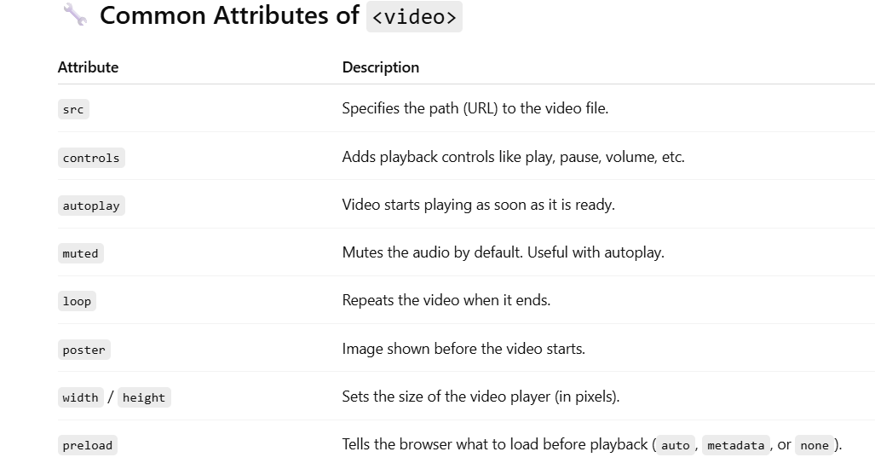

Slide 77
width and height
Set the width and height of the video player (in pixels).
<center>
<h1>GeeksforGeeks</h1>
<p>Video Sample</p>
<video width="400" height ="350" controls preload>
<source src="myvid.mp4" type="video/mp4">
<source src="myvid.ogg" type="video/ogg">
</video>
</center>

Slide 78
.
preload
Hints how much of the video should be loaded when the page loads
preload="none“
The browser will not preload any part of the video.
Best for saving bandwidth if the user may not play the video.
<h3>Preload = "none"</h3>
<video width="320" height="240" controls preload="none">
<source src ="https://www.w3schools.com/html/mov_bbb.mp4" type="video/mp4">
Your browser does not support the video tag.
</video>

Slide 79
preload="metadata”
Only loads video metadata like duration and dimensions, not the video itself.
<h3>Preload = "metadata"</h3>
<video width="320" height="240" controls preload="metadata">
<source src ="https://www.w3schools.com/html/mov_bbb.mp4" type="video/mp4">
Your browser does not support the video tag.
</video>

Slide 80
When the page loads:
The first frame is displayed.
The length of the video is visible.
But the full video hasn't been downloaded yet.
When you press Play:
The browser starts streaming the video from the server.

Slide 81
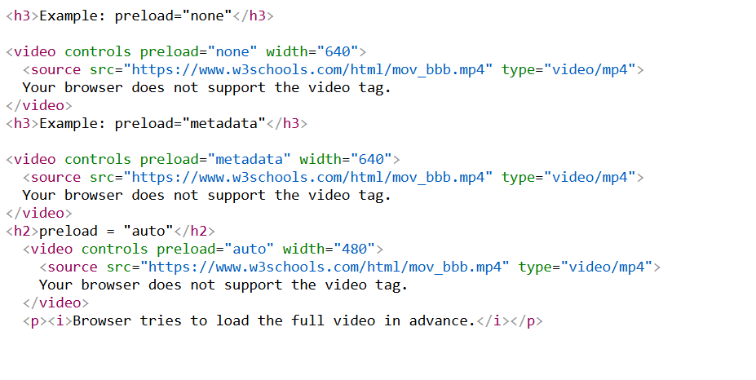

Slide 82
Advanced HTML5

Slide 83
SVG
What is SVG?
SVG stands for Scalable Vector Graphics.
It is used to draw 2D graphics like shapes, lines, text, and more.
SVG is resolution independent, meaning it looks sharp on any screen size.
You can style SVG with CSS and make it interactive with JavaScript.
It is XML-based and written directly in the HTML.

Slide 84
The <svg> Element
The HTML <svg> element is a container for SVG graphics.
The <svg> element is a container that holds SVG graphics.
It can contain shapes like <circle>, <rect>, <line>, <path>, and more.

Slide 85
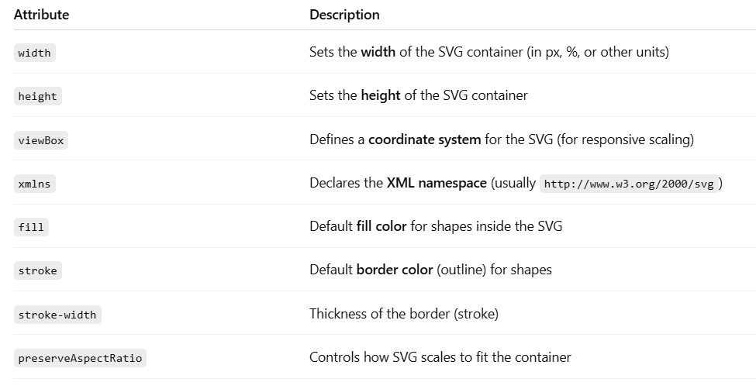
Common Attributes of <svg>

Slide 86
SVG Shapes
SVG has some predefined shape elements that can be used by developers:
Rectangle <rect>
Circle <circle>
Ellipse <ellipse>
Line <line>
Polyline <polyline>
Polygon <polygon>
Path <path>

Slide 87
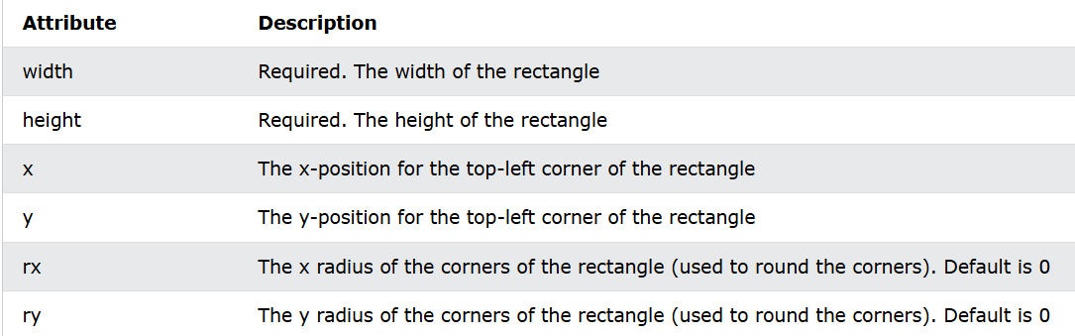
SVG Rectangle - <rect>
The <rect> element is used to create a rectangle and variations of a rectangle shape.
The <rect> element has six basic attributes to position and shape the rectangle:

Slide 88
Eg:
<svg width="300" height="130" xmlns="http://www.w3.org/2000/svg"> <rect width="200" height="100" x="10" y="10" rx="20" ry="20" fill="blue" /> </svg>

Slide 89
A Rectangle With Border
<svg width="220" height="120" viewBox="0 0 220 120" xmlns="http://www.w3.org/2000/svg">
<rect
width="200"
height="100"
x="10"
y="10"
rx="20"
ry="20"
fill="blue"
stroke=“yellow"
stroke-width="4"
/>
</svg>

Slide 90
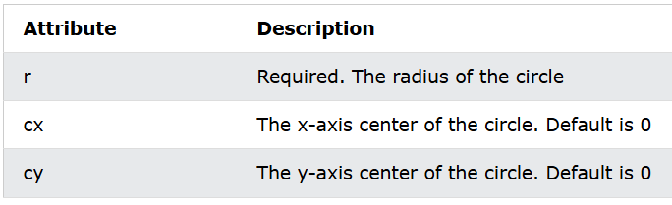
SVG Circle - <circle>
The <circle> element is used to create a circle.
The <circle> element has three basic attributes to position and set the size of the circle:

Slide 91
An SVG Circle
Example
<svg height="100" width="100" xmlns="http://www.w3.org/2000/svg"> <circle r="45" cx="50" cy="50" fill="red"/> </svg>

Slide 92
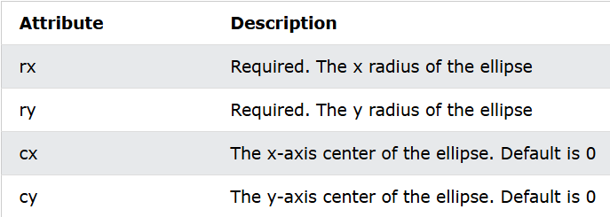
SVG Ellipse - <ellipse>
The <ellipse> element is used to create an ellipse.
An ellipse is closely related to a circle. The difference is that an ellipse has an x and a y radius that differs from each other, while a circle has equal x and y radius.
The <ellipse> element has four basic attributes to position and set the size of the ellipse:

Slide 93
An SVG Ellipse
Example:
<svg height="140" width="500" xmlns="http://www.w3.org/2000/svg"> <ellipse rx="100" ry="50" cx="120" cy="80" style="fill:yellow;stroke:green;stroke-width:3" /> </svg>
The rx attribute defines the x (horizontal) radius
The ry attribute defines the y (vertical) radius
The cx attribute defines the x-coordinate of the center
The cy attribute defines the y-coordinate of the center

Slide 94
<svg height="150" width="500" xmlns="http://www.w3.org/2000/svg"> <ellipse cx="240" cy="100" rx="220" ry="30" fill="purple" /> <ellipse cx="220" cy="70" rx="190" ry="20" fill="lime" /> <ellipse cx="210" cy="45" rx="170" ry="15" fill="yellow" /> </svg>

Slide 95
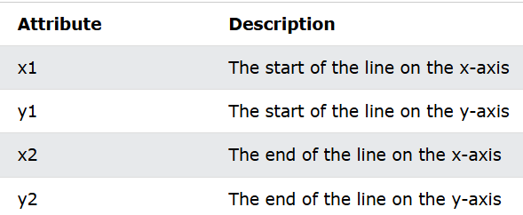
SVG Line - <line>
The <line> element is used to create a line.
The <line> element creates a line between the start position (x1,y1) and the end position (x2,y2).
The <line> element has four basic attributes to position and set the length of the line:

Slide 96
<svg height="200" width="300" xmlns="http://www.w3.org/2000/svg"> <line x1="0" y1="0" x2="300" y2="200" style="stroke:red;stroke-width:2" /> </svg>
The <x1> and <y1> attributes define the start of the line (0,0)
The <x2> and <y2> attributes define the end of the line (300,200)

Slide 97
A Horizontal Line
<svg height="50" width="300" xmlns="http://www.w3.org/2000/svg"> <line x1="0" y1="10" x2="250" y2="10" style="stroke:red;stroke-width:12" /> </svg>

Slide 98
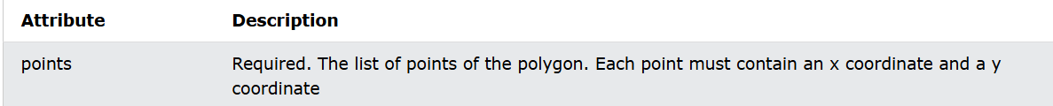
SVG Polygon - <polygon>
The <polygon> element is used to create a graphic that contains at least three sides.
Polygons are made of straight lines, and the shape is "closed" (it automatically connects the last point with the first).
The <polygon> element has one basic attribute that defines the points of the polygon:

Slide 99
A Polygon Star
<svg height="210" width="500" xmlns="http://www.w3.org/2000/svg"> <polygon points="100,10 40,198 190,78 10,78 160,198" style="fill:lime;stroke:purple;stroke-width:5;" /> </svg>

Slide 100
A Polygon With Three Sides
<svg height="220" width="500" xmlns="http://www.w3.org/2000/svg"> <polygon points="100,10 150,190 50,190" style="fill:lime;stroke:purple;stroke-width:3" /> </svg>

Slide 101
A Polygon With Six Sides
<svg height="280" width="360" xmlns="http://www.w3.org/2000/svg"> <polygon points="150,15 258,77 258,202 150,265 42,202 42,77" style="fill:lime;stroke:purple;stroke-width:3" /> </svg>

Slide 102
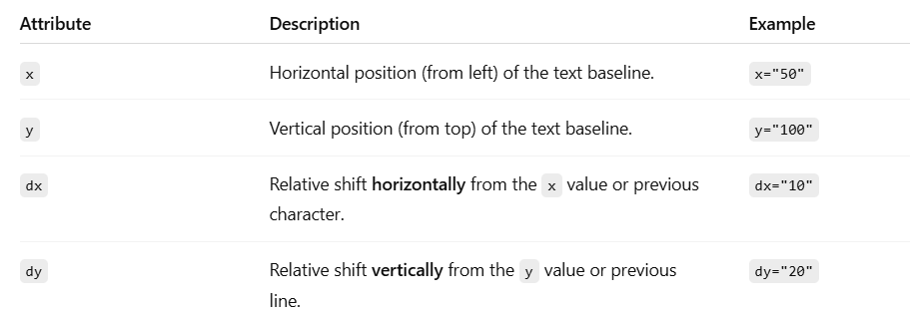
<text> in SVG
The <text> element in SVG is used to display text directly within the SVG canvas, just like shapes (e.g., <rect>, <circle>).
It supports positioning, styling, and transformation.

Slide 103
dx shifts each character horizontally by the specified amount (in pixels):
In Spaced, each letter moves farther right.
dy shifts each character vertically by the specified amount:
In Ladder, each letter appears lower than the one before—like a staircase.

Slide 104
</svg>
<svg width="600" height="200" xmlns="http://www.w3.org/2000/svg">
<!-- Normal text without dx or dy -->
<text x="20" y="30" fill="black" font-size="20">
NormalText
</text>
<!-- Text with dx: spaced horizontally -->
<text x="20" y="70" fill="blue" font-size="20" dx="0 10 20 30 40 50 60 70">
Spaced
</text>
<!-- Text with dy: staggered vertically -->
<text x="20" y="110" fill="red" font-size="20" dy="0 5 10 15 20 25">
Ladder
</text>
</svg>

Slide 105
.
HTML Canvas Graphics
The HTML <canvas> element is used to draw graphics on a web page.
The HTML <canvas> element is used to draw graphics, on the fly, via JavaScript.
The <canvas> element is only a container for graphics.
We must use JavaScript to actually draw the graphics.
Canvas has several methods for drawing paths, boxes, circles, text, and adding images.
Canvas is supported by all major browsers

Slide 106
Canvas Example
In HTML, a <canvas> element looks like this:
<canvas id="myCanvas" width="200" height="100"></canvas>
The id attribute is required (so it can be referred to by JavaScript).
The width and height attribute defines the size of the canvas.
The default size of the canvas is 300px (width) x 150px (height).
We can have multiple <canvas> elements on one HTML page.
By default, the <canvas> element has no border and no content.

Slide 107
To add a border, use a style attribute:
<canvas id="myCanvas" width="200" height="100" style="border:1px solid #000000;"></canvas>

Slide 108
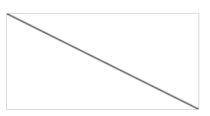
Draw a Line
<script> var c = document.getElementById("myCanvas"); var ctx = c.getContext("2d"); ctx.moveTo(0, 0); ctx.lineTo(200, 100); ctx.stroke(); </script>

Slide 109
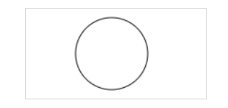
Draw a Circle
<script> var c = document.getElementById("myCanvas"); var ctx = c.getContext("2d"); ctx.beginPath(); ctx.arc(95, 50, 40, 0, 2 * Math.PI); ctx.stroke(); </script>

Slide 110
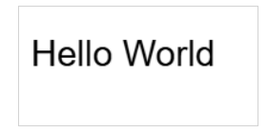
)
Draw a Text
<script> var c = document.getElementById("myCanvas"); var ctx = c.getContext("2d"); ctx.font = "30px Arial"; ctx.fillText("Hello World", 10, 50);
10 = x-coordinate (distance from the left)
50 = y-coordinate (distance from the top — baseline of the text </script>

Slide 111
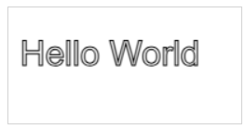
Stroke Text
<script> var c = document.getElementById("myCanvas"); var ctx = c.getContext("2d"); ctx.font = "30px Arial"; ctx.strokeText("Hello World", 10, 50); </script>

Slide 112
Draw Linear Gradient
<script> var c = document.getElementById("myCanvas"); var ctx = c.getContext("2d"); // Create gradient var grd = ctx.createLinearGradient(0, 0, 200, 0); grd.addColorStop(0, "red"); grd.addColorStop(1, "white"); // Fill with gradient ctx.fillStyle = grd; ctx.fillRect(10, 10, 150, 80); </script>

Slide 113
Draw Image
<script> var c = document.getElementById("myCanvas"); var ctx = c.getContext("2d"); var img = document.getElementById("scream"); ctx.drawImage(img, 10, 10); </script>

Slide 114
HTML - What is a Web API?
API (Application Programming Interface) is a set of rules and protocols that allow one software program to interact with another.
Think of it as a messenger that lets programs "talk" to each other.
A Web API is an API that can be accessed over the web using the HTTP/HTTPS protocol.
It allows client applications (like browsers, mobile apps, or other web servers) to communicate with a web server to send and retrieve data.

Slide 115
Characteristics of a Web API
Accessible via HTTP/HTTPS
Stateless: Each request is independent.
Usually returns data in JSON or XML format
Can be public, private, or restricted
Supports CRUD operations: Create, Read, Update, Delete

Slide 116
How Does It Work?
Client sends an HTTP request (GET, POST, etc.) to the API endpoint (a URL).
Server processes the request and accesses data or logic.
Server sends a response, often in JSON or XML format.

Slide 117
HTML APIs
All browsers have a set of built-in Web APIs to support complex operations, and to help accessing data.
Here are some of the main HTML5 APIs:
1. Geolocation API - This API is used to access the current location of a user (with latitude and longitude).
2. Drag and Drop API - This API enables you to use drag-and-drop features in browsers.
3. Web Storage API - This API has mechanisms to let browsers store key/value pairs (in a more intuitive way than cookies).

Slide 118
4. Web Workers API - This API allows a JavaScript to run in the background, without affecting the performance of the page.
Users can continue to do whatever they want: clicking, selecting things, etc., while the web worker runs in the background.
5. Server-Sent Events API - This API allows a web page to automatically get updates from a server.
6. Canvas API - This API lets you draw graphics, on the fly, via JavaScript.

Slide 119
HTML Geolocation API
The Geolocation API is used to get the user's current location.
Locate the User's Position
The Geolocation API is used to access the user's current location.
Since this can compromise privacy, the location is not available unless the user approves it.

Slide 120
<script> const x = document.getElementById("demo"); function getLocation() { if (navigator.geolocation) { navigator.geolocation.getCurrentPosition(success, error); } else { x.innerHTML = "Geolocation is not supported by this browser."; } } function success(position) { x.innerHTML = "Latitude: " + position.coords.latitude + "<br>Longitude: " + position.coords.longitude; } function error() { alert("Sorry, no position available."); } </script>

Slide 121
Location-specific Information
Geolocation is also very useful for location-specific information, like:
Up-to-date local information
Showing Points-of-interest near the user
Turn-by-turn navigation (GPS)

Slide 122
The getCurrentPosition() Method - Return Data
The getCurrentPosition() method returns an object on success.
The latitude, longitude and accuracy properties are always returned.

Slide 123
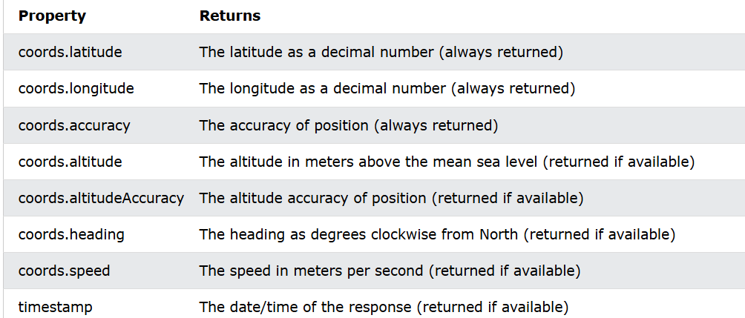
The other properties are returned if available:

Slide 124
Geolocation Object - Other interesting Methods
The Geolocation object also has other interesting methods:
watchPosition() - Returns the current location of the user and continues to return updated location as the user moves (like the GPS in a car).
clearWatch() - Stops the watchPosition() method.
The example below shows the watchPosition() method.
You need an accurate GPS device to test this (like a smartphone):

Slide 125
<script>
let watchId; // Variable to hold watch ID
const output = document.getElementById("location");
function startTracking() {
if (navigator.geolocation) {
watchId = navigator.geolocation.watchPosition(showPosition, showError);
} else {
output.innerHTML = "Geolocation is not supported by this browser.";
}
}

Slide 126
function showPosition(position) {
output.innerHTML =
"Latitude: " + position.coords.latitude + "<br>" "Longitude: " + position.coords.longitude + "<br>" + "Accuracy: " + position.coords.accuracy + " meters<br>" + "Timestamp: " + new Date(position.timestamp);
}
function showError(error) {
output.innerHTML = "Error getting location: " + error.message;
}

Slide 127
function stopTracking() {
if (watchId) {
navigator.geolocation.clearWatch(watchId);
output.innerHTML += "<br><strong>Tracking stopped.</strong>";
}
}
</script>

Slide 128
HTML Web Storage API
What is HTML Web Storage?
HTML Web Storage is a way to store data directly in the user's browser, without using cookies or sending it to a server.
Web Storage lets websites remember things on our computer—like our preferences, or shopping cart items—even after we close or refresh the page.
Before HTML5, application data had to be stored in cookies, included in every server request.
We can store key-value data (like name–value pairs) inside the browser itself.
No need to send it to a server or store it in a database—data stays on the user’s device.

Slide 129
.
Web storage is not automatically sent to the server—so it's safer from leaking sensitive info unintentionally.
It’s isolated per domain—other websites cannot access your stored data.
While cookies store about 4KB, Web Storage can store 5MB or more (depending on the browser).
That’s enough for things like: Caching form input , Saving game progress , Shopping carts , Settings or themes
Web storage is per origin (per domain and protocol).
All pages, from one origin, can store and access the same data.
https://example.com and http://example.com are different origins.
Data stored by one origin cannot be accessed by another for security reasons

Slide 130
Web Storage API Objects
Web storage provides two objects for storing data in the browser:
window.localStorage - stores data with no expiration date (data is not lost when the browser tab is closed)
window.sessionStorage - stores data for one session (data is lost when the browser tab is closed)

Slide 131
<script> const x = document.getElementById("result"); if (typeof(Storage) !== "undefined") { x.innerHTML = "Your browser supports Web storage!"; } else { x.innerHTML = "Sorry, no Web storage support!"; } </script>

Slide 132
The localStorage Object
The localStorage object stores the data with no expiration date. The data will not be lost when the browser is closed, and will be available the next day, week, or year.

Slide 133
<script> const x = document.getElementById("result"); if (typeof(Storage) !== "undefined") { // Store localStorage.setItem("lastname", “xyz"); localStorage.setItem("bgcolor", "yellow"); // Retrieve x.innerHTML = localStorage.getItem("lastname"); x.style.backgroundColor = localStorage.getItem("bgcolor"); } else { x.innerHTML = "Sorry, no Web storage support!"; } </script>

Slide 134
The sessionStorage Object
The sessionStorage object is equal to the localStorage object, except that it stores the data for only one session.
The data is deleted when the user closes the specific browser tab.

Slide 135
<script>
function saveEmail() {
const email = document.getElementById("email").value;
sessionStorage.setItem("sessionEmail", email); // Save to session storage
} function showEmail() {
const savedEmail = sessionStorage.getItem("sessionEmail");
document.getElementById("output").innerHTML =
savedEmail ? "Saved email: " + savedEmail : "No email saved.";
}
</script>

Slide 136
HTML Web Workers API
A web worker is an external JavaScript file that runs in the background, without affecting the performance of the page.
What is a Web Worker?
A Web Worker is a feature of HTML5 that let run JavaScript in the background—outside the main browser thread .
It allows to do heavy computations or long-running tasks without freezing or slowing down the web page.

Slide 137
Why Use Web Workers?
Normally, JavaScript runs on the main thread.
If we run heavy code (like big calculations, loops, or data processing), it will block:
User clicks
Page updates
Animations
The page becomes unresponsive until your script finishes.
Web Workers solve this by offloading the task to a background thread.

Slide 138
Check Web Worker API Support
Before using web worker, we can quickly check browser support:
<script> const x = document.getElementById("result"); if(typeof(Worker) !== "undefined") { x.innerHTML = "Your browser support Web Workers!"; } else { x.innerHTML = "Sorry, your browser does not support Web Workers."; } </script>

Slide 139
method used to send data to a Web Worker is
postMessage()
method used to receive messages from a Web Worker in the main thread onmessage

Slide 140
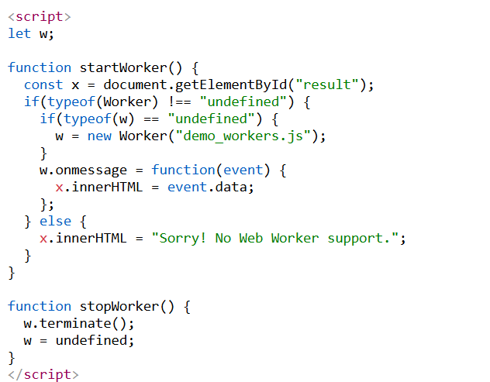

Slide 141
.
w that will hold the Web Worker object.
If the worker is not already started, it creates a new worker from the file demo_workers.js

Slide 142
Offline web applications using AppCache
Web applications must be accessible without an internet connection.
Almost all web-based applications work in online mode.
So current version of HTML provides the functionality to work with the web-based application in online and offline modes.
HTML5 provides application cache functionality that allows a web application to run without the internet.

Slide 143
AppCache (Application Cache) is a deprecated HTML5 feature that allows web applications to run offline by storing the necessary resources (HTML, CSS, JS, images, etc.) in the browser.
Once cached, the app can load even when the user is not connected to the internet.

Slide 144
.
How AppCache Works
AppCache uses a cache manifest file which lists all the resources the browser should cache for offline use.
Manifest File
A manifest file is a plain text file that tells the browser which files to store in the cache for offline use.
A plain text file with a .appcache extension.
Contains three sections: CACHE, NETWORK, and FALLBACK

Slide 145
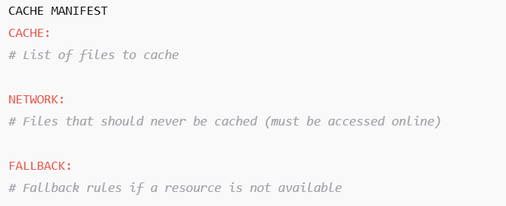
Structure of a Manifest File

Slide 146
.
CACHE MANIFEST (Header)
The first line must be CACHE MANIFEST
It tells the browser this is a manifest file.
CACHE: Section
Lists all the resources (files) that should be cached.
These will be available even when offline.
CACHE:
index.html
style.css
script.js
image1.jpg

Slide 147
."
NETWORK: Section
Files or URLs that must be accessed online only (never cached).
NETWORK:
*
means "everything else not listed should be fetched from the network”

Slide 148
FALLBACK: Section
Used when the user tries to access a file that isn't available,
the browser falls back to a specified offline file.
FALLBACK:
/ /offline.html
This means: if any file in / is not available, use offline.html instead.

Slide 149
How Browser Handles Manifest
When the browser loads the page, it reads the manifest file.
It downloads and caches all files listed in CACHE.
If the manifest changes (even a comment), the browser updates the cache.
If offline, the browser serves the cached files.

Slide 150
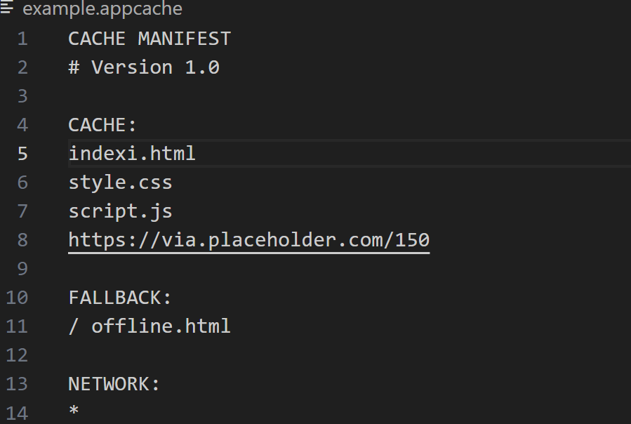
Create manifest file with .appcache extension

Slide 151
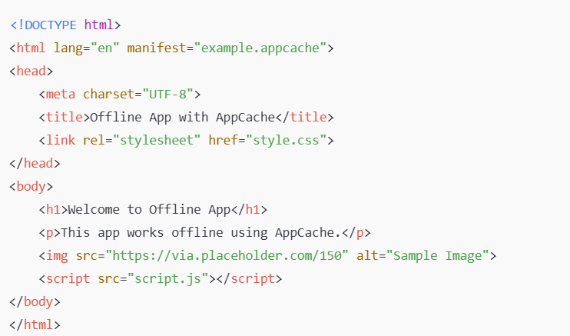
2. create index.html file

Slide 152
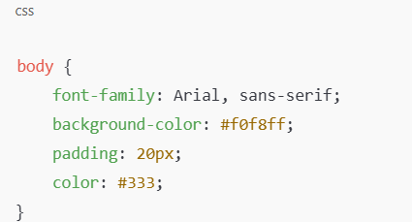
3. style.css

Slide 153
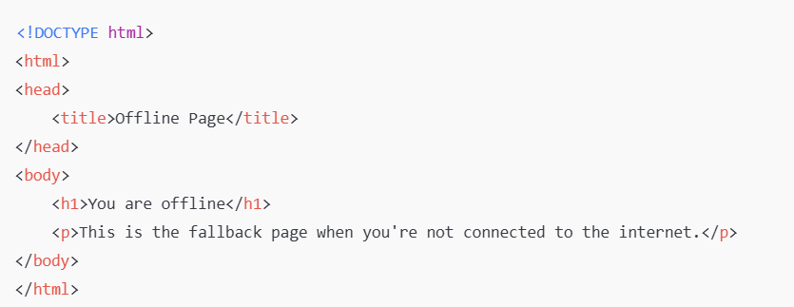
4. we can have js file
5. create an offline.html

