Slide 1
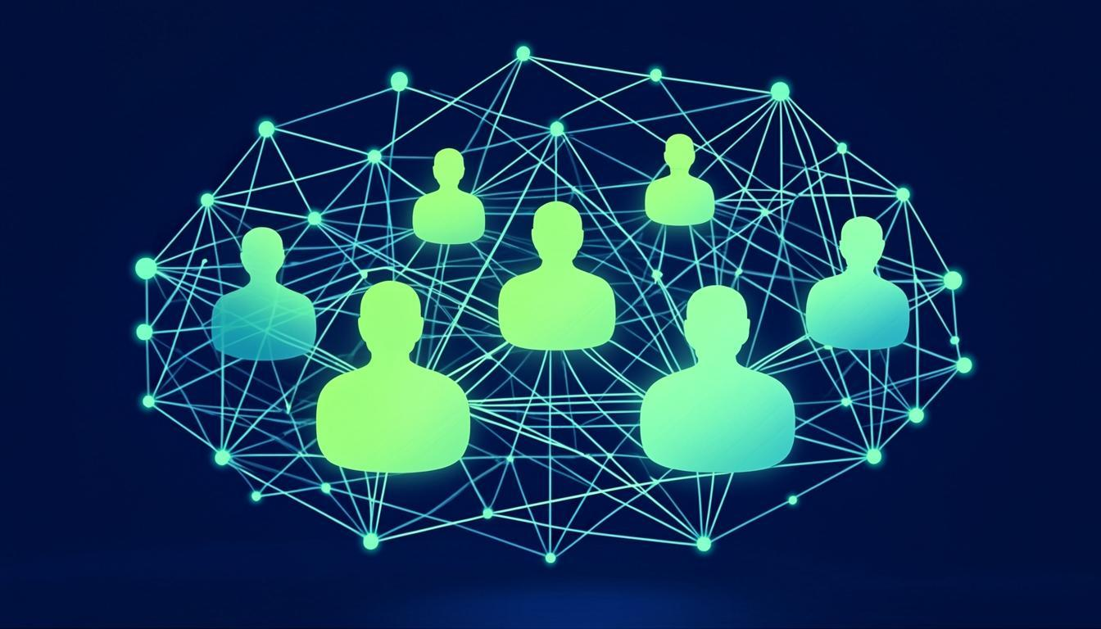
eh2r AI
AI-POWERED HRMS
Enterprise Multi-Company AI-Driven HR System
An AI Product of MARQ AI | Investor Pitch 2026

Slide 2
The HR Crisis
70%
Manual HR Processes
Organizations rely on spreadsheets for core HR
$7B
Annual Payroll Errors
Costly mistakes from fragmented HR systems
42d
Average Hiring Time
Slow recruitment drains productivity
85%
Employee Disengagement
Without modern HR tech, employees feel disconnected

Slide 3
30 Integrated Modules
One
Platform
Complete HR coverage from recruitment to exit management
AI-Powered Intelligence
Predictive analytics, automated workflows, smart decision-making
Multi-Tenant Architecture
Enterprise-grade isolation for companies of all sizes
From hire to retire, every workflow is intelligent, automated, and connected.
14 Role-Based Dashboards
Tailored views for Super Admin, HR, Managers, Employees, and more

Slide 4
30 Modules. 9 Categories. Zero Gaps.
9
60+
14
Module Categories
API Endpoints
Role-Based Dashboards
Core HR
Talent
Time & Finance
Employee Directory, Company Masters, RBAC
AI Recruitment, AI Interview, Job Portal
Attendance, Leave, Payroll, Timesheet
Performance
Portals
Operations & Analytics
Reviews, OKRs, 360 Feedback, LMS
Client, Vendor, Sub-Vendor
Helpdesk, AI Chatbot, Workflow, Audit

Slide 5
AI-First HR
3x
89%
-94%
Faster Hiring
Attrition Prediction
Payroll Errors
AI resume parsing and candidate ranking
90-day predictive workforce analytics
Z-Score anomaly detection engine
Sentiment Analysis
Bias Detection
Workforce Forecast
BERT-based feedback processing
Job description fairness scoring
ARIMA ensemble predictions

Slide 6
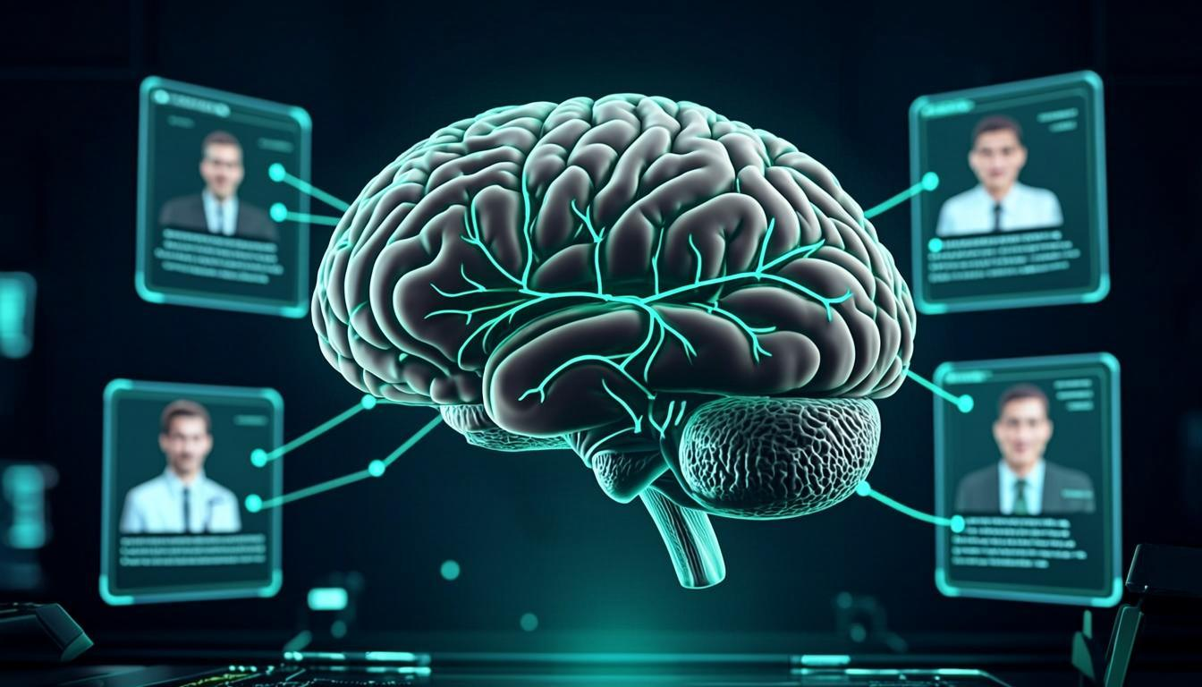
AI Interview - Revolutionize Hiring
5 Interview Modes
Text-based conversations
Voice interview with AI
Video interview analysis
MCQ assessments
Coding challenges
Reduce hiring time from weeks to days while improving candidate quality

Slide 7

Multi-Tenant Enterprise Architecture
Company Isolation
Independent branding, policies, and workflows per company
4-Tier Hierarchy
Global Parent to Branch to Department to Team
Inter-Company Transfers
Seamless employee mobility with shared services

Slide 8
Market Opportunity
$38B
12.8%
$8.5B
64%
Global HRMS Market 2028
CAGR Growth Rate
AI in HR Market 2028
Enterprises Adopting AI HR
Why Now?
The convergence of AI and HR creates a massive opportunity. Legacy HR systems are being replaced at an unprecedented rate. eh2r AI is uniquely positioned at the intersection of this transformation with 30 integrated modules and 6 AI-powered capabilities.

Slide 9
SaaS Business Model
Starter
Professional
Enterprise
Global
Up to 100 employees. Basic HRMS, Attendance, Payroll, ESS.
Up to 500 employees. + Recruitment, PMS, LMS, AI Assistant.
Up to 5,000 employees. + Multi-company, AI Workflows, White-label.
Unlimited. + Multi-country payroll, Dedicated infra, Governance.
+85%
SaaS
NDR
Gross Margins
Annual Subscriptions
High Net Dollar Retention

Slide 10
Tech Edge - Built for Scale
Frontend
AI Engine
Next.js 16 + App Router + React 19 + Tailwind CSS 4 + shadcn/ui
z-ai-web-dev-sdk + Custom ML Models + NLP Pipeline
Backend
Deployment
NextAuth.js + Prisma ORM + 60+ REST API Endpoints
Vercel Edge Network + CDN + Auto-scaling
Mobile
Database
Flutter Cross-Platform App + PWA Support
Neon PostgreSQL Serverless + Edge Deployment
14 Role-Based Access Levels | Multi-Company Isolation | 99.9% Uptime SLA

Slide 11
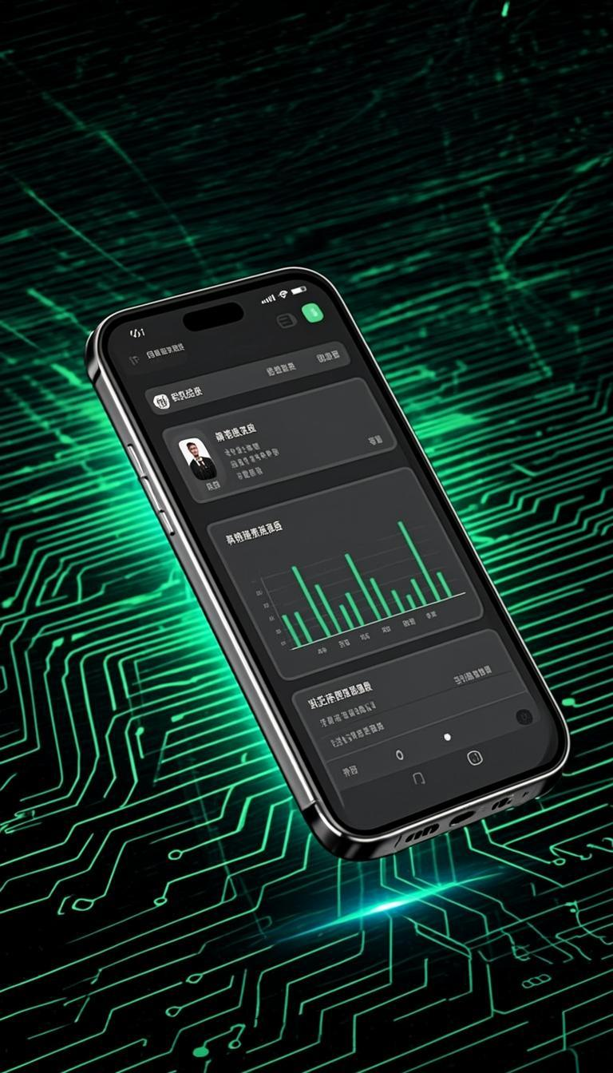
Mobile-First Experience
Flutter Cross-Platform
Native performance on iOS and Android from a single codebase
Self-Service Portal
Employees access payslips, leaves, and profile on the go
Attendance & Approvals
Geo-fenced check-in and instant leave/expense approvals
PWA + Offline Mode
Works without internet, syncs when connected

Slide 12
Product Roadmap
Q1 2026
Core Platform Launch
All 30 modules live, multi-tenant architecture, AI chatbot
Q2 2026
AI Enhancement
Advanced AI interview, predictive attrition, workflow engine
Q3 2026
Global Expansion
Multi-country payroll, compliance engines, mobile app launch
Q4 2026
Enterprise Scale
White-label solutions, API marketplace, advanced governance

Slide 13

Let's Build the Future of HR
eh2r AI is transforming how organizations manage their most valuable asset - people.
MARQ AI
admin@marqai.com | ai-hrms-rho.vercel.app | 2026

