Slide 1

#LifeKoKaroLift
Lending Club Case Study:
Analysis and Recommendation
By
Abs Varkey
Mahesh Krishna

Slide 2
Agenda
Problem Statement
Analysis Approach
Summary of Analysis
Recommendations

Slide 3
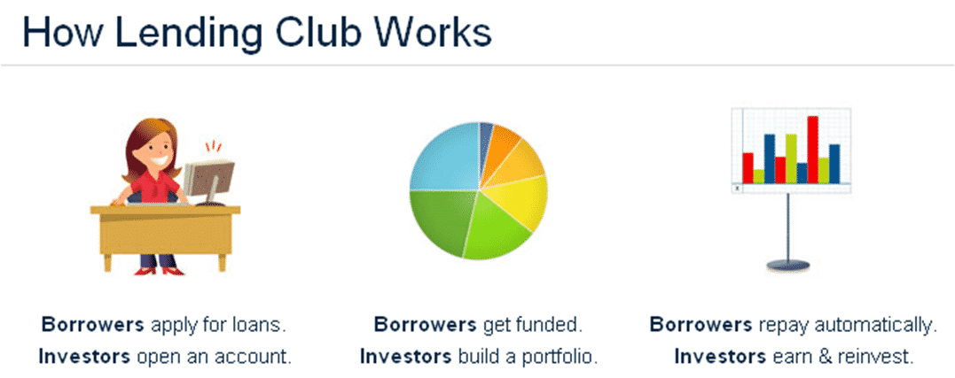
Lending Club: EDA Case Study Problem Statement
Business Objective
To identify risky loan applicants from the data set so that loans to such applicants can be reduced thereby cutting down the amount of credit loss.
Identification of such applicants is the major aim of this case study.
The analysis should also help the company understand the driving factors behind loan default
Current Situation:
When the company receives a loan application, it has to make a decision for loan approval based on the applicant’s profile. Two types of risks are associated with the bank’s decision:
If the applicant is likely to repay the loan, then not approving the loan results in a loss of business to the company
If the applicant is not likely to repay the loan, i.e. he/she is likely to default, then approving the loan may lead to a financial loss for the company

Slide 4

Analysis Approach
Data understanding
There are 39717 rows and 111 columns in the data set
Number of numerical variables are 87
Number of categorical variables are 24
Approximately 3% of records are loans that are still in progress
Approximately 14% loans have defaulted

Slide 5

Analysis Approach
Data Cleaning
Dropped all the columns from the data set where all the values are missing or NA(54 Columns)
Dropped all columns where the percentage of missing values were above 60%
Removed columns that are not part of the case study objective
Extracted the number from emp_length field and added 0 for missing fields
Stripped % symbol from int_rate and revol_util fields to retrieve the numeric value for further calculations
Checked if funded amount invested is lesser than or equal to loan amount or funded amount

Slide 6

Analysis Approach
Data Analysis
Analyzed Single columns individually (Univariate)
Analyzed 2 columns at a time and checked if there were any relation between them(Bivariate)
Checked if columns are dependent/related with each other(correlation)
Visualization graphs were plotted to enhance the understanding

Slide 7
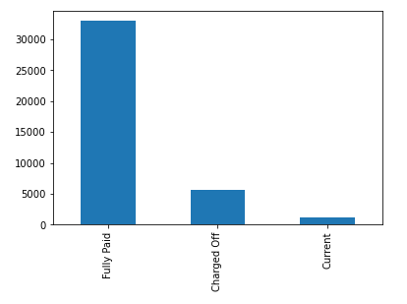
Summary Of Analysis
Univariate
Loan Status
14% of the loans are Charged Off, meanwhile 82 % loans are Fully Paid

Slide 8
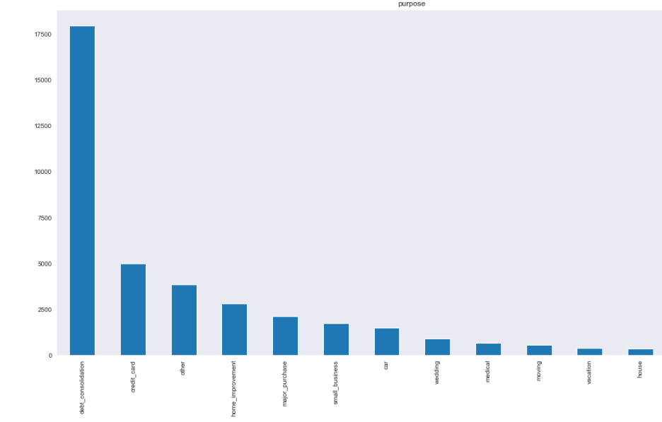
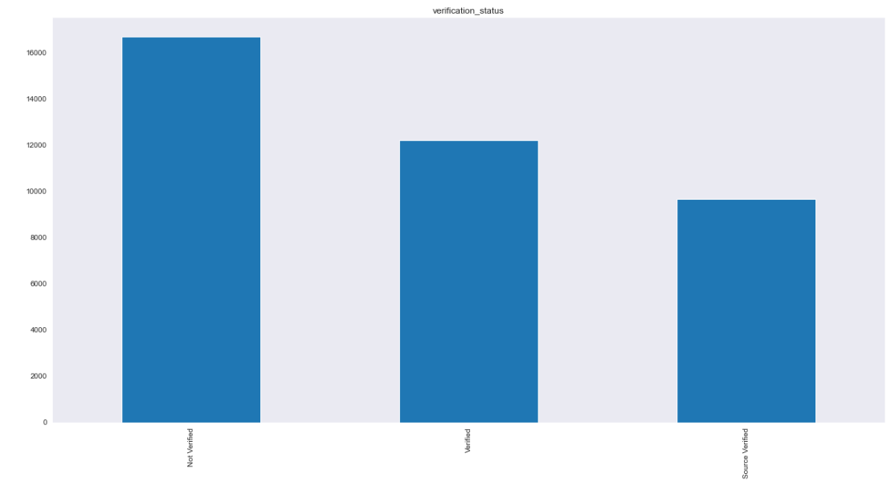
Summary Of Analysis
Univariate
Purpose of Loan
Most of the loans were taken for the purpose of debt consolidation(47%) & paying credit card bill(13%).
Verification Status
43% are Not verified
31% are Verified
25% are Source Verified

Slide 9
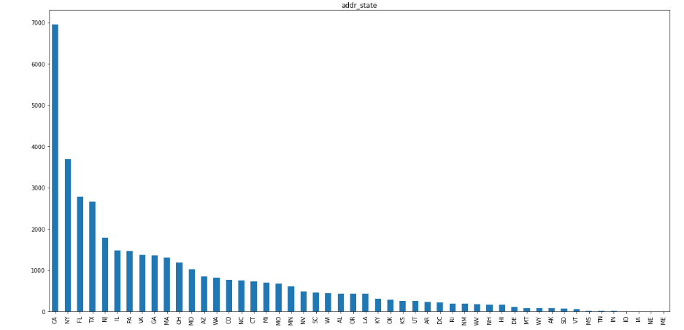
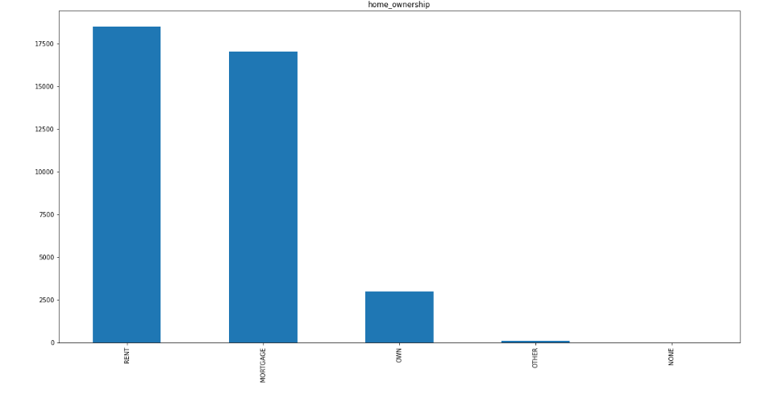
Summary Of Analysis
Univariate
State
18% loans are offered to State of CA
9% loans are offered to State of NY
7% Offered to state of FL
Home Ownership
47% are applicants who stay on rent
44% stay in Mortgage
8% are staying in their own home

Slide 10
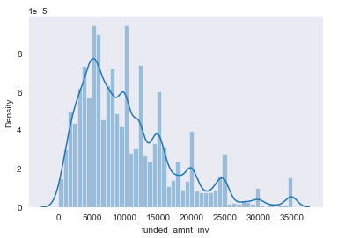
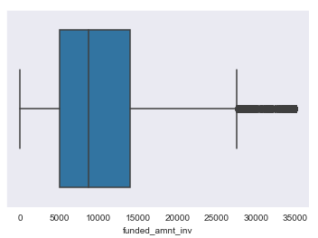
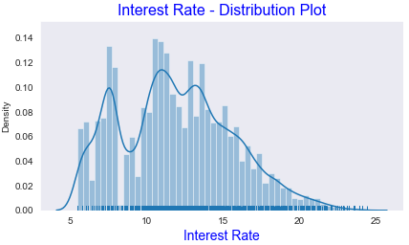
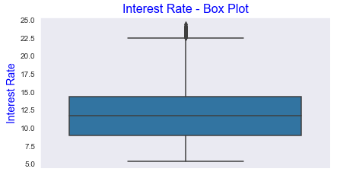
Summary Of Analysis
Univariate
Final Funded Amount
Most of the loan amounts that are approved are in the range of
5000 – 15000
Interest Rate
Interest rate at which the loan is offered falls in the range of
10% to 15 %

Slide 11
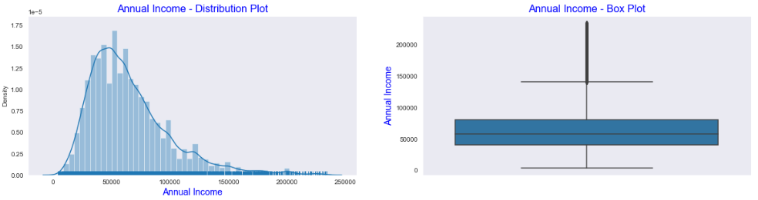
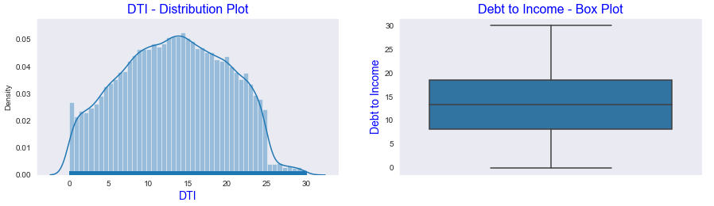
Summary Of Analysis
Univariate
Annual Income
Most of the borrower's income lies in the range of 40000 - 80000
Debt to Income
Majority of the loans have been offered to applicant with a DTI ratio between of 9 to 19.

Slide 12
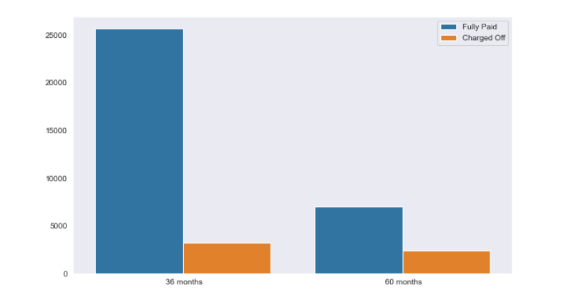
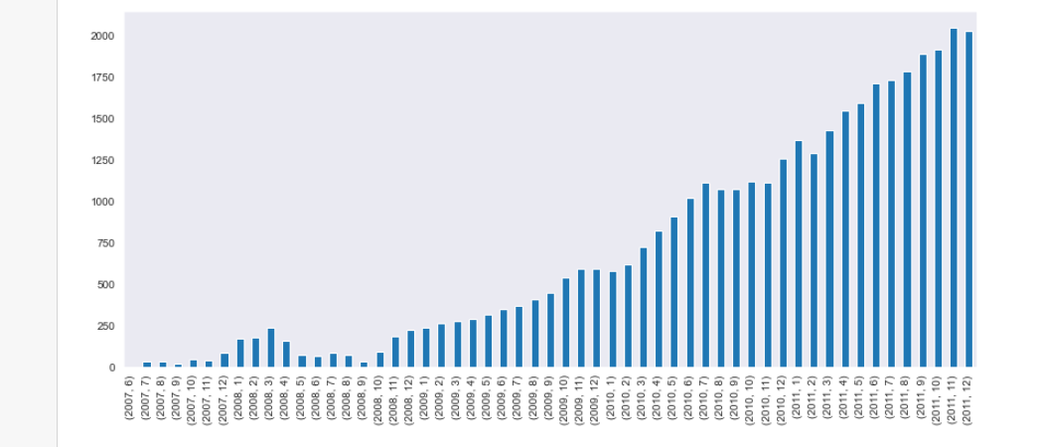
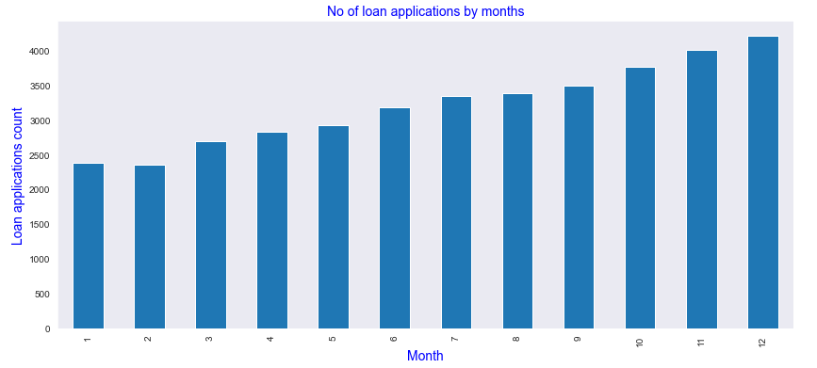
Summary Of Analysis
Univariate
Loan Paying term
75% of loans are given for 36 months
25% loans for 60 months
Loan Applications issued
There is increase in the number of loans processed every month. Lowest during recession (2008,september)
The number of loans issued is highest in December possibly attributed to the festival season and lowest in February

Slide 13
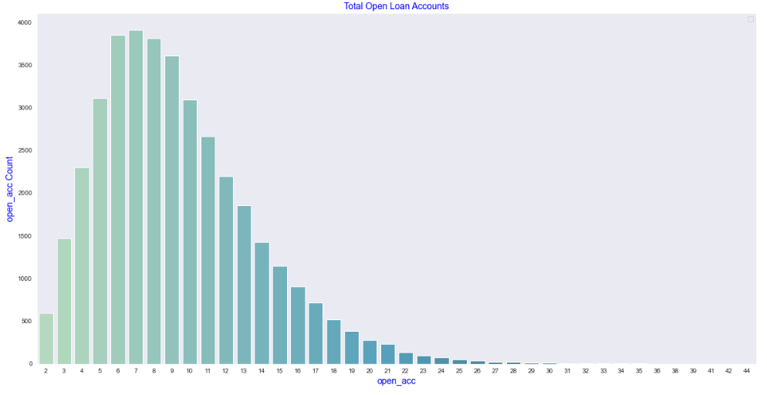
Summary Of Analysis
Univariate
Open Account
Loans were provided to applicant with already high number of existing loans There is an increasing trend of loans sanctioned upto 7 open accounts.
After 7 open accounts here is a decreasing trend in the loans sanctioned with respect to the number of open accounts.

Slide 14
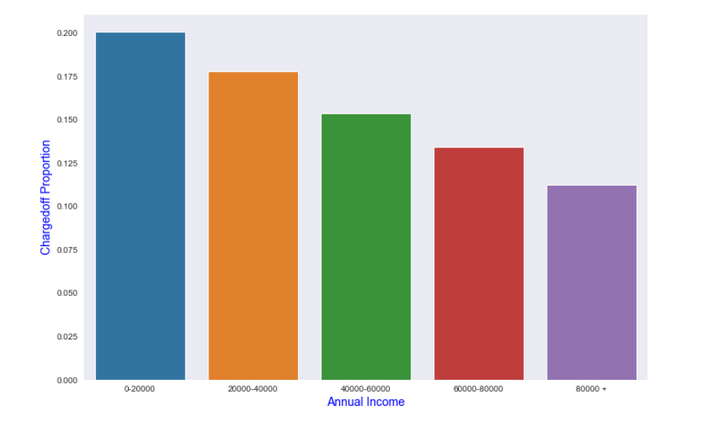
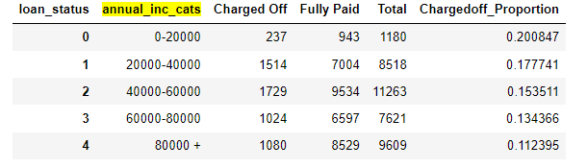
Summary Of Analysis - Bivariate
Annual Income Vs Charged Off Proportion
Charged Off percentage is less when income of the applicants are above 80000+
Charged Off percentage is highest when income of the applicants is between
0-20000

Slide 15
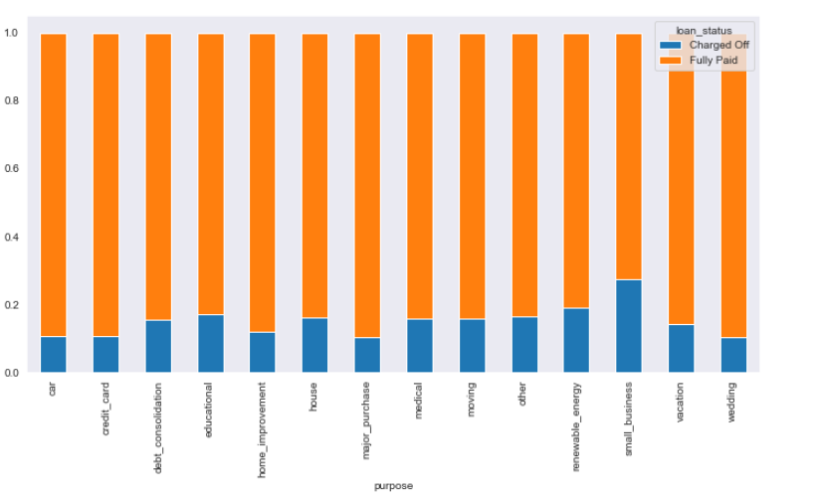
Summary Of Analysis - Bivariate
Purpose of loan Vs Charged Off Proportion
Charged Off percentage was higher when loans were offered for small business
Charged Off percentage is lowest when offered for weddings or major purchases

Slide 16
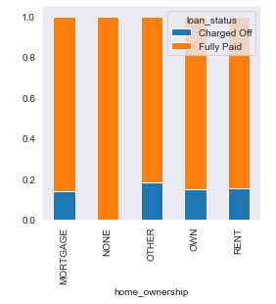
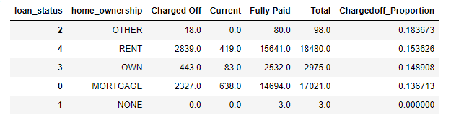
Summary Of Analysis - Bivariate
Home Ownership Vs Charged Off Proportion
Rent and others have higher Charged Off proportion
Mortgage seems to be lower than the average default rate

Slide 17
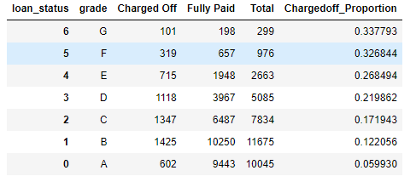
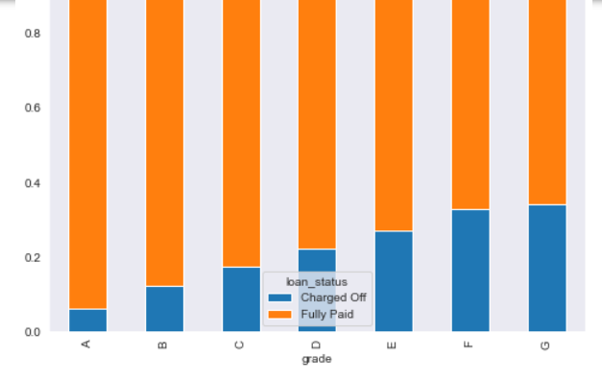
Summary Of Analysis - Bivariate
Grade(Credit risk indicator) Vs Charged Off Proportion
Grade G followed by Grade E has highest charged off percentage
Grade A has the lowest charged off percentage
Applicants with higher credit risk are most likely to default(Charged Off)

Slide 18
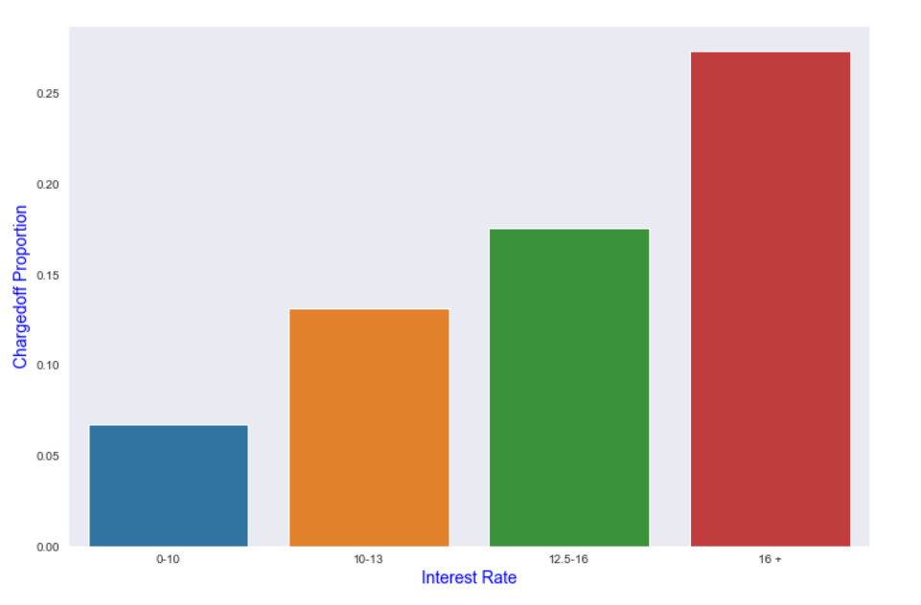
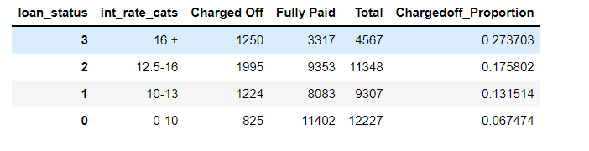
Summary Of Analysis - Bivariate
Interest Vs Charged Off Proportion
Charged off percentage is lowest when interest rate is ranging from 0-10
Charged off percentage is highest when interest rate is above 16%
Gradual increase is seen in charged off percentage when interest rate increases

Slide 19
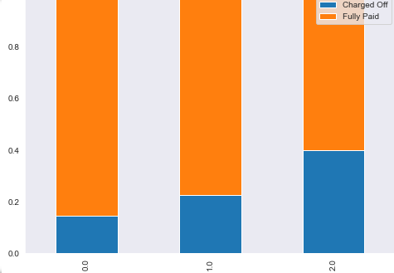
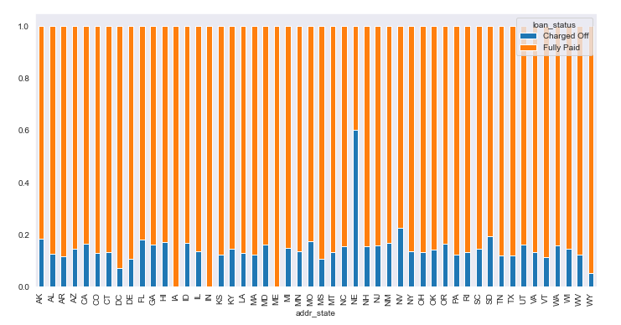
Summary Of Analysis - Bivariate
Bankruptcy record Vs Charged Off Proportion
Applicants with higher publicly recorded bankruptcy records have higher likelihood of default
Charged off percentage is highest when publicly recorded bankruptcy count is 2 and lowest when 0
State Vs Charged off Proportion
NE shows higher proportion charged offs. However, the number of applicants is only 5
Any state with less than 0.14 as charged off proportion is a less risky candidate for loan disbursal (TX=0.12 and good no of applications)

Slide 20
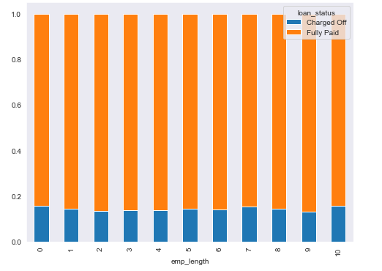
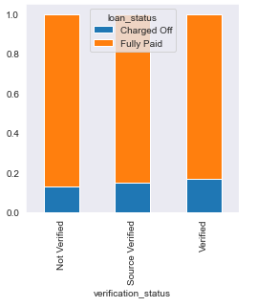
Summary Of Analysis - Bivariate
Employment Length Vs Charged Off Proportion
Employment length seems to have no impact on Charge Off proportion
Verification Status Vs Charged off Proportion
There is no clear pattern observed between verification status and charged off proportion

Slide 21
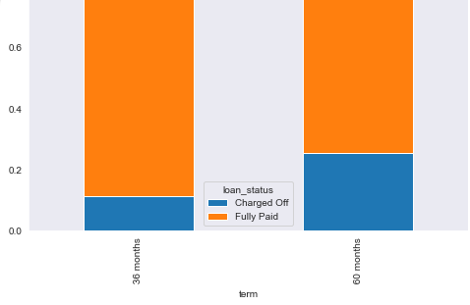
Summary Of Analysis - Bivariate
Loan Term Vs Charged Off Proportion
Loans given for a period of 60 months has higher charge off proportion when compared to loans given for 36 months

Slide 22
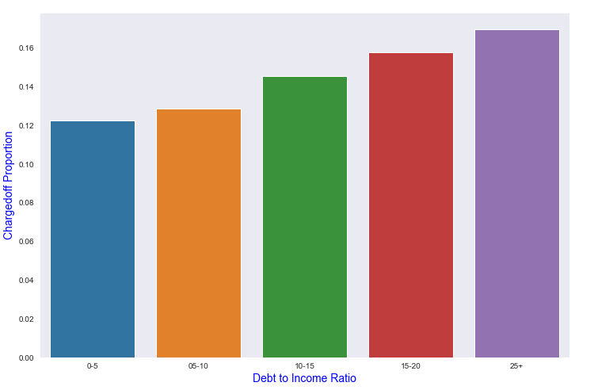
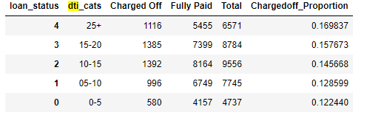
Summary Of Analysis - Bivariate
Debt to Income Vs Charged Off Proportion
Charged off percentage is highest when DTI is greater than 25
Charged off percentage is lowest when DTI is ranging between 0-5
Gradual increase is seen in charged off percentage when DTI increases

Slide 23
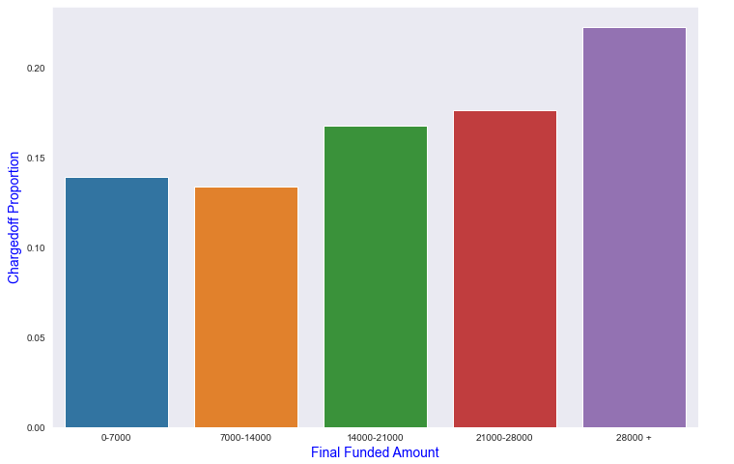
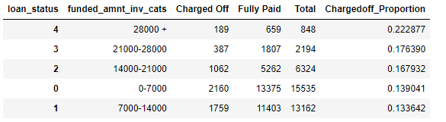
Summary Of Analysis - Bivariate
Final Funded Amount Vs Charged Off Proportion
Charged off percentage is greater when funded amount is 28000+
Charged off percentage is lowest when funded amount is ranging between 7K-14K

Slide 24

Recommendations
Continue giving loans to Grade A applicants. Avoid Grade F applicants
Loans Provided to higher income applicants are relatively safer
Reduce giving loans to applicants who borrow the money to start a small business
Avoid giving loans to those who have publicly known bankruptcy records. Higher the number greater the chance of default
The lower the loan duration, the lesser the risk

Slide 25
Recommendations
Avoid giving loans to applicants with income group 0-20000 whose loan purpose is for debt consolidation
Reduce giving loans to applicants with 20000-60000 income with debt consolidation as purpose of loan as it accounts for 50% default
Verification expenses can be avoided as they seem to make no impact on charge offs
Avoid giving loans to applicants with DTI greater than 25
Reduce giving loans greater than 28000. Success rate is highest between 7k-14k

Slide 26
#LifeKoKaroLift
Thank you!

