Slide 1
HOTEL RESERVATION SYSTEM
Submitted By:
Dharshini Govindarajan
Dipanjan Haldar
Mahesh Kumar
Sanhita Murthy

Slide 2
INDEX
Introduction
Requirement
Actors
Design
Implementation
Functionality
Future Enhancements
Conclusion

Slide 3
Introduction
Purpose is to automate the cumbersome process of making a hotel reservation as well as the process of updating the hotel database with the available rooms and facilities

Slide 4
Requirement
Hotel Reservation System (HRS) is a platform that allows users, system administrators to access the HRS to perform different functionalities.
SYSTEM ADMIN :
Allows the system administrator to add/delete a room to the available list of rooms, query information regarding the guests and keep track of the employees in the Hotel
USER :
Allows the user to search/book a room, place food order and pay the settlements for his stay

Slide 5
Actors
CUSTOMER/USER
Can search for rooms available from – to date in the HRS
Can book a room or cancel a booking
Can order food
Can make payment

Slide 6
Actors
SYSTEM ADMIN
Can add/delete a room to/from the existing room list
Check out the guests
Create menu items for the food an beverages department
Can view the list of Customers currently in house
Can view list of bookings

Slide 7
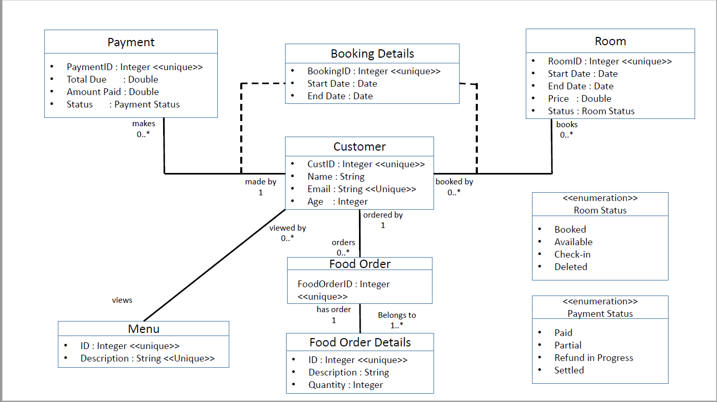
Design

Slide 8
Implementation
For the implementation of HRS following technologies are used:
Programming Language : Java
Database : MySQL
IDE : Eclipse Neon

Slide 9
DEMO

Slide 10
Future Goals
Adding functionality for customer feedback
Creating Email alerts for customers regarding offers available
Creating a web interface for the HRS

Slide 11
References
www.tutorialspoint.com
http://www.ccs.neu.edu/home/kenb/db/topics.html
http://www.ccs.neu.edu/home/kenb/
https://piazza.com/northeastern/spring2017/cs520001/resources
http://stackoverflow.com/

Slide 12
Conclusion
We have achieved our required goal set of building up a basic Hotel Reservation System. It caters to the needs of the Customers and administrators and makes the experience of booking a room or managing a hotel effortless.

Slide 13
Questions

